Slide 1
Enterprise Information Systems Technologies
Grace Mugambi
gmugambi@jkuat.ac.ke

Slide 2
Enterprise Information Systems
Executive Information System
Computer system that allows executives access to management reports
Drill-down capabilities
User-friendly
Executive Support Systems
Comprehensive executive support system
Includes communication, office automation, analysis support, business intelligence
Enterprise Information Systems
Corporate-wide system
Not restricted to executives
Business intelligence
Notes:
In information technology to drill down means to move from one place to another, information to detailed data by focusing in on something. In a GUI-environment, "drilling-down" may involve clicking on some representation in order to reveal more detail.

Slide 3
Capabilities of Enterprise Information System
Drill-down paths
Supported by star or snowflake schemas
Critical success factors
Strategic, managerial, or operational
Sources: organizational, industrial, environmental
Types of information monitored:
Key problem narratives
Highlight charts
Top level financials
Key factors
Detailed key performance indicator (KPI) responsibility reports

Slide 4
Capabilities of Enterprise Information System Contd.
Status Access
Relevance of latest data of key indicators
Analysis
Built-in analytical functions
Integration with Decision Support Systems (DSS) products
Analysis by intelligent agents
Exception reporting
Management by exception to standards
Navigation of information
Large amounts of data can be analyzed
Audio and Visual
Use of colors and sounds
Communications
E-mail, Group Support System (GSS), news groups, interface with voice mail

Slide 5
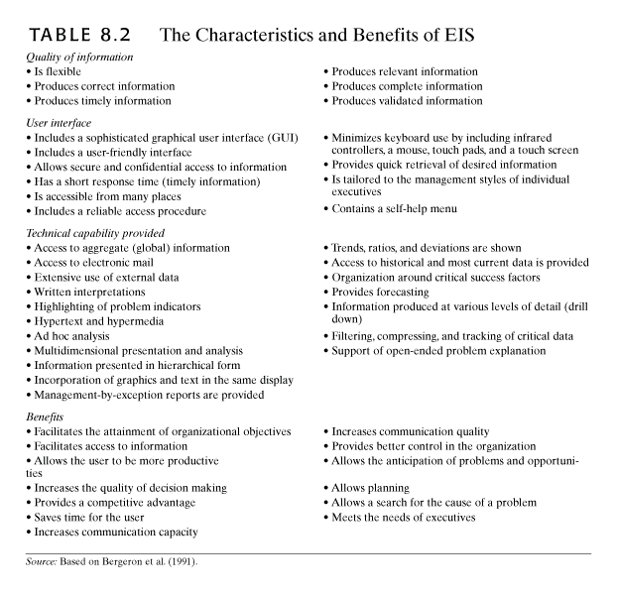

Slide 6
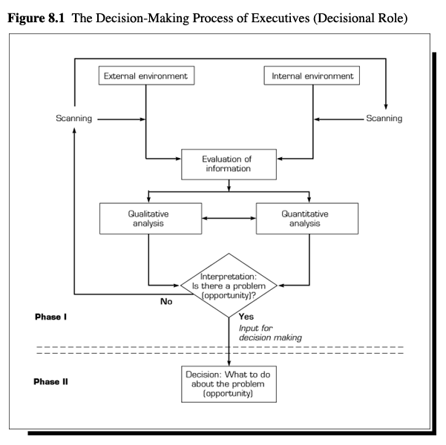
Information Flows
Internal information from functional units
External information from Internet, news media, government
Environmental scanning

Slide 7
Decision Support Questions that Enterprises need to have answered
What were the variances between the amounts budgeted and the amounts spent?
What positions are being filled by people with what types of background?
What is the average pay for people within different age brackets?
What is the average pay for people within different age brackets?

Slide 8
Comparing EIS to DSS
Executive Information Systems (EIS)
Supports upper management in discovering problems and opportunities
Repetitive analysis
High speed
GUI based
Decision Support Systems (DSS)
Analyzes specific problem or opportunity
Ad hoc analysis
Effective
May have GUI
Integration
Uses EIS output to launch DSS
Data from same places
Integrates user roles
Third party software

Slide 9
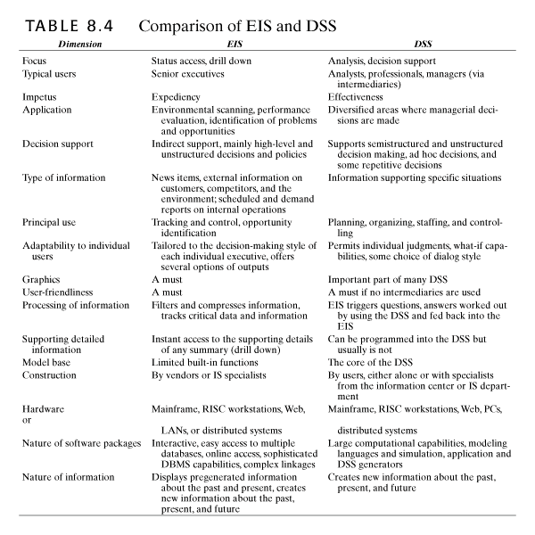

Slide 10
EIS Data Access and Use
Data usually comes from single warehouse
Advanced data visualization
Combines multidimensional analysis with OLAP
Spreadsheets and graphics
Slice and dice
Web ready

Slide 11
Comparing EIS to DSS
Executive Information Systems (EIS)
Supports upper management in discovering problems and opportunities
Repetitive analysis
High speed
GUI based
Decision Support Systems (DSS)
Analyzes specific problem or opportunity
Ad hoc analysis
Effective
May have GUI
Integration
Uses EIS output to launch DSS
Data from same places
Integrates user roles
Third party software

Slide 13
EIS Data Access and Use
Data usually comes from single warehouse
Advanced data visualization
Combines multidimensional analysis with OLAP
Spreadsheets and graphics
Slice and dice
Web ready

Slide 14
Enterprise Portals
Corporate portals
Integrate internal and external applications
Web-based interface
Effective distribution of information
Encourage collaboration
Data visualization tools
Customized
Search engines

Slide 15
Soft Information
Information for questionable sources that is used informally
Vague
Unofficial
News reports and external data sources
Predictions and speculations
Explanations and justifications
Opinions and gut feelings
Rumors and hearsay

Slide 16
Organizational Decisional Support Systems
Focused on organizational task or activity
affects several units
Cuts across hierarchy layers
Cuts across functional groups
Computer based
Communication technology
Can be integrated into a DSS or EIS

Slide 17
Product Lifecycle Management (PLM)
Integrated, information driven
Includes all aspects of product’s life
Goals
Streamline development
Increase innovation
Requires integration of independent databases
Shares information about product among different groups, both inside and outside organization

Slide 18
Product Lifecycle Management (PLM) Contd.
Tracks electronic information about life of product
Links together all required processes
Integrates nodules and tools into single application suite
Enhances communication and collaboration
Product data is central component
Repository
Specifications, requirements, design documents, manufacturing plans, and support
Available to all stakeholders at all times

Slide 19
Product Lifecycle Management (PLM) Contd.
Benefits:
Flexibility
Reduced change orders
Improved design
Reduced production times
Reduced time to market
Improved quality control
Collaboration
Centralized repository
Issues:
Support from senior management
User involvement
Training
Integration

Slide 20
Business Process Management Systems (BPM)
Integrates data, applications, and people through business process
Streamlined
Automates processes
Less administration
Graphical map of processes
Enterprise information portal into business processes
Integrates systems
Provides view of organization’s health and progress
Unifies rules, processes, methods, and workflows
Benefits
Links legacy systems to newer workflows
Issues
Forces review of processes

Slide 21
Business Activity Monitoring Systems (BAM)
Real time systems monitoring specific facility
Detects opportunities, problems, and threats
Modeling function for solutions
Collaboration
Fast response
Benefits
Recognizing and responding to events
Allows for quick resolution
Issues
Senior management support
Change in business processes
Requires identification of Critical Success Factors (CSFs) and proper analytical techniques

Slide 22
Frontline Decision Support Systems
Frontline decision-making
Automate decision processes and push them down the organization or out to partners
Empowers employees
Incorporates decision-making into daily work
Provides right questions to ask
Locates needed data
Provides metrics for use with data

Slide 23
Business Process
Business processes are simply a set of activities that transform a set of inputs into a set of outputs (goods or services) for another person or process using people and tools.

Slide 24
BPR
BPR is the redesign of business processes and the associated systems and organizational structures to achieve a dramatic improvement in business performance
Why BPR?
The business reasons:
Poor financial performance
External competition
Erosion of market share or
Emerging market opportunities.

Slide 25
BPR
It is the examination and change of five components of the business:
Strategy
Processes
Technology
Organization
Culture

Slide 26
Check out Process
Purpose of the process is to pay for and bag your groceries.
The process begins with you stepping into line, and ends with you receiving your receipt and leaving the store.
You are the customer (you have the money and you have come to buy food), and the store is the supplier.

Slide 27
Reengineering Business Processes
Business
Improvement
Business
Reengineering
Level of Change
Incremental
Radical
Process
Change
Improved New
Version of Process
Brand New
Process
Starting Point
Existing Processes
Clean Slate
Frequency of
Change
One-time or
Continuous
Periodic One-time
Change
Time Required
Short
Long
Narrow, Within
Functions
Broad, Cross-
Functional
Typical Scope
Horizon
Past and Present
Future
Participation
Bottom-up
Top-down
Path to
Execution
Cultural
Cultural Structural
Primary Enabler
Statistical Control
Information Technology
Risk
Moderate
High

Slide 28
The Virtual Company Interenterprise IS
Alliance -
Subcontractors
Boundary of a Firm
Alliance -
Major
Supplier
Customer
Response
and Order-
Fulfillment
Teams
Intranets
Extranets
Alliance -
Major
Customer
Manufacturing
Teams
Alliance -
Small
Suppliers
Alliance -
Complementary
Services
Cross-Functional
Teams
Engineering
Teams

Slide 29
Virtual Company Strategies
Share Infrastructure and Risk with Alliance Partners
Link Complementary Core Competencies
Reduce Concept-to-Cash Time Through Sharing
The time period between when a business pays cash to its suppliers for inventory and receives cash from its customers, used to determine the amount of cash needed to fund ongoing operations
Increase Facilities and Market Coverage
Gain Access to New Markets and Share Market or Customer Loyalty
Migrate from Selling Products to Selling Solutions

Slide 30
Supply Chains
Old
Supply chain
Material flow from sources to finished product and disbursement within the organization
Demand chain
Order generation, taking, and fulfillment
New
Flow of material, information, services from suppliers through manufacturer to end user
Supply chain management
Planning, organization, and coordination of supply chain activities
Increase effectiveness
Reduce risk
Decrease cycle time
Improve customer service

Slide 31
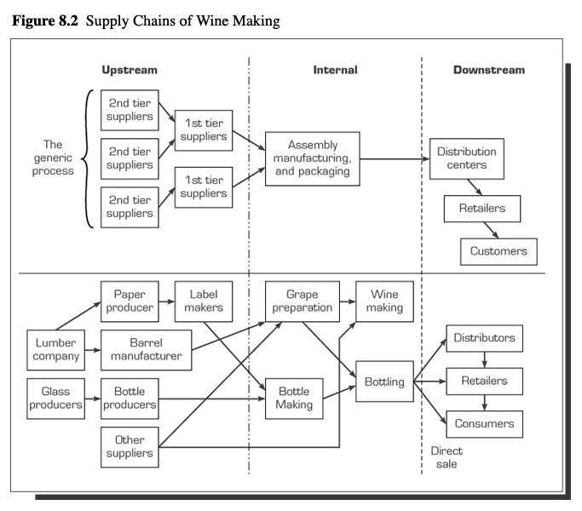
Supply Chains Contd.
Upstream = suppliers
Internal supply chain = changing inputs to outputs
Downstream = distribution

Slide 32
Value Chains (Michael Porter in his book "Competitive Advantage: Creating and Sustaining superior Performance" (1985).
A value chain is a set of activities that a firm operating in a specific industry performs in order to deliver a valuable product or service for the market/customers.
It evaluates which value each particular activity adds to the organizations products or services.
This idea was built upon the insight that an organization is more than a random compilation of machinery, equipment, people and money.
Only if these things are arranged into systems and systematic activates it will become possible to produce something for which customers are willing to pay a price.
Porter argues that the ability to perform particular activities and to manage the linkages between these activities is a source of competitive advantage.

Slide 33
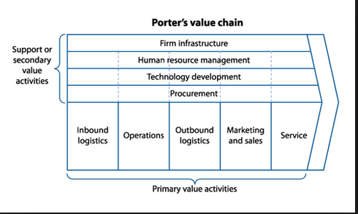
Michael Porter’s Value Chain Model (1985)
Primary activities
Inbound logistics
Operations
Outbound logistics
Marketing and sales
Customer service
Support activities
Organization’s infrastructure
Human resource management
Technology development
Procurement
Notes:
Michael Porter discussed this in his influential 1985 book "Competitive Advantage," in which he first introduced the concept of the value chain. A value chain is a set of activities that an organization carries out to create value for its customers.

Slide 34
Primary Activities
Primary activities are directly concerned with the creation or delivery of a product or service.
Inbound logistics,
Here goods are received from a company's suppliers. They are stored until they are needed on the production/assembly line. Goods are moved around the organization.
Operations,
This is where goods are manufactured or assembled. Individual operations could include room service in an hotel, packing of books/videos/games by an online retailer, or the final tune for a new car's engine.
Outbound logistics,
The goods are now finished, and they need to be sent along the supply chain to wholesalers, retailers or the final consumer.

Slide 35
Primary Activities Contd.
Primary activities
Marketing and sales,
In true customer orientated fashion, at this stage the organization prepares the offering to meet the needs of targeted customers. This area focuses strongly upon marketing communications and the promotions mix.
and service.
This includes all areas of service such as installation, after-sales service, complaints handling, training and so on.
Each of these primary activities is linked to support activities which help to improve their effectiveness or efficiency.

Slide 36
Secondary Activities
There are four main areas of support activities:
Procurement
This function is responsible for all purchasing of goods, services and materials. The aim is to secure the lowest possible price for purchases of the highest possible quality.
Technology development (including R&D),
Technology is an important source of competitive advantage. Companies need to innovate to reduce costs and to protect and sustain competitive advantage. This could include production technology, Internet marketing activities, lean manufacturing, Customer Relationship Management (CRM), and many other technological developments.

Slide 37
Secondary Activities Contd.
There are four main areas of support activities:
Human resource management, and
Employees are an expensive and vital resource. An organization would manage recruitment and selection, training and development, and rewards and remuneration.
Infrastructure (systems for planning, finance, quality, information management etc.).
This activity includes and is driven by corporate or strategic planning. It includes the Management Information System (MIS), and other mechanisms for planning and control such as the accounting department.

Slide 38
Margin
Margin’ implies that organizations realize a profit margin that depends on their ability to manage the linkages between all activities in the value chain.
Organization is able to deliver a product / service for which the customer is willing to pay more than the sum of the costs of all activities in the value chain.
The more value an organization creates, the more profitable it is likely to be. And when you provide more value to your customers, you build competitive advantage.
Value Created and Captured – Cost of Creating that Value = Margin
Understanding how your company creates value, and looking for ways to add more value, are critical elements in developing a competitive strategy

Slide 39
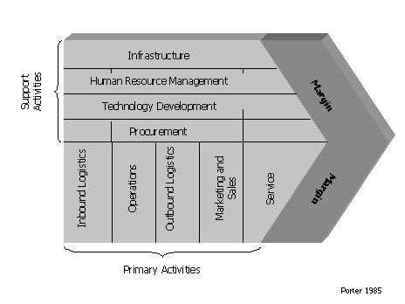
Porter’s Original Model

Slide 40
Value System
Value chain is part of larger stream called value system and includes the values chains of:
Tiers of suppliers
Value chains of distributors
Buyers
Extended supply chain
Maximize and optimize total value of chain
Value system can extend beyond the boundaries of an enterprise (M Porter)
Enterprise systems are designed to plan and integrate processes, enforce data integrity, and better manage resources.
Notes:
A firm's value chain forms a part of a larger stream of activities, which Porter calls a value system. A value system, or an industry value chain, includes the suppliers that provide the inputs necessary to the firm along with their value chains.

Slide 41
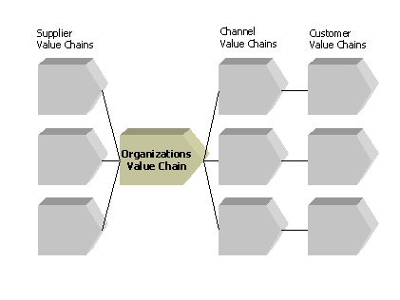
Value Chain System

Slide 42
Typical Value Chain Analysis
Analysis of own value chain – which costs are related to what activities
Analysis of Customer value chain
Identification of cost advantage
Identification of potential “value” added for the customer—lower cost/high performance-where does customer see “value”

Slide 43
Pater Keen an MIS Consultant
“….We have learned that it is NOT technology that creates a competitive edge, but the management process that exploits technology…”
Question
What does he mean?
Do you agree or disagree?
Why?

Slide 44
Case Study: IKEA https://www.ikea.com/
IKEA has quickly evolved from a local Swedish home furnishing manufacturer into the largest home furnishing company in the world; partly by convincing their customer to perform the transport and assembly processes of the furniture manufacturing value chain.
They use out-of-market supply chain strategy, for the better utilization of the product
They have executed their strategy by building a worldwide sourcing network of high quality global manufacturers to support their growth.

Slide 45
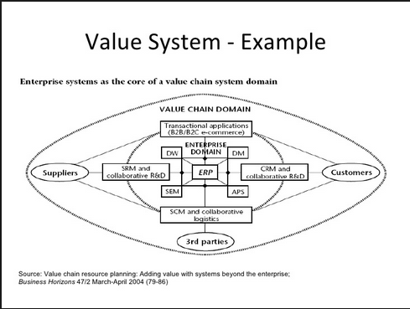
Value System Example 1

Slide 46
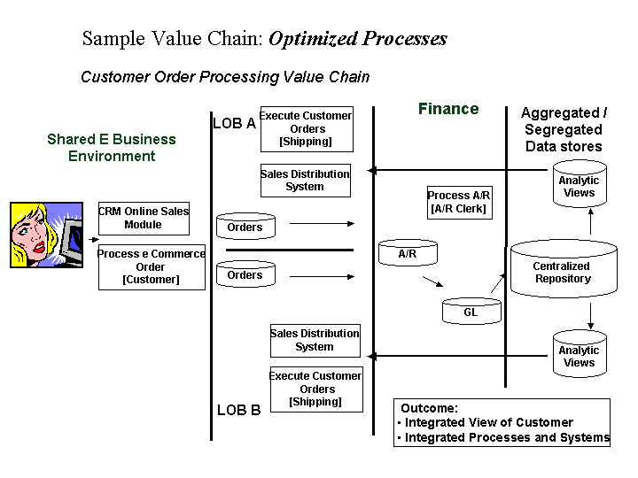
AR - Accounts Receivable, GL - General Ledger

Slide 47
Supply Chain Problems
Uncertainties
Demand forecasts
Delivery time
Quality issues
Need to coordinate activities
Other issues
Poor customer service
Obtaining real time data on chain status
Cultural problems

Slide 48
Supply Chain Problem Solutions
Solutions
Inventory management
Shipping management
Efficient purchasing
Just-In-Time (JIT)
IT sets out to cut costs by reducing the amount of goods and materials a firm holds in stock.
Customer Relationship Management (CRM)
Collaboration along chain
Strategic partnerships
Reduce number of intermediaries
Outsourcing
Notes:
Just-In-Time (JIT)
producing and delivering finished goods ‘just in time’ to be sold
partly finished goods ‘just in time’ to be assembled into finished goods
parts ‘just in time’ to go into partly finished goods
materials ‘just in time’ to be made into parts.

Slide 49
Future Developments
Hardware and software advances
Virtual reality
Three-dimensional image displays
Increased utilization of multimedia
Increased collaboration
Improved communication
Automated support
Intelligent agents

