Slide 1
KiNG COUNTY HOUSE Analysis

Slide 2
Introductions
Problem Statement : A real estate agency that helps homeowners buy and/or sell homes based on the most profitable features

Slide 3
Objectives:
Importing the required Libraries and Loading Data from the Files
Data understanding by analysing the data
Data Cleaning and Pre-processing
Data Visualisation
Modelling using linear regression
Validation of the model
Conclusions and Recommendations

Slide 4
Sources of the Datasets:
kc_house_data.csv
column_names.md

Slide 5
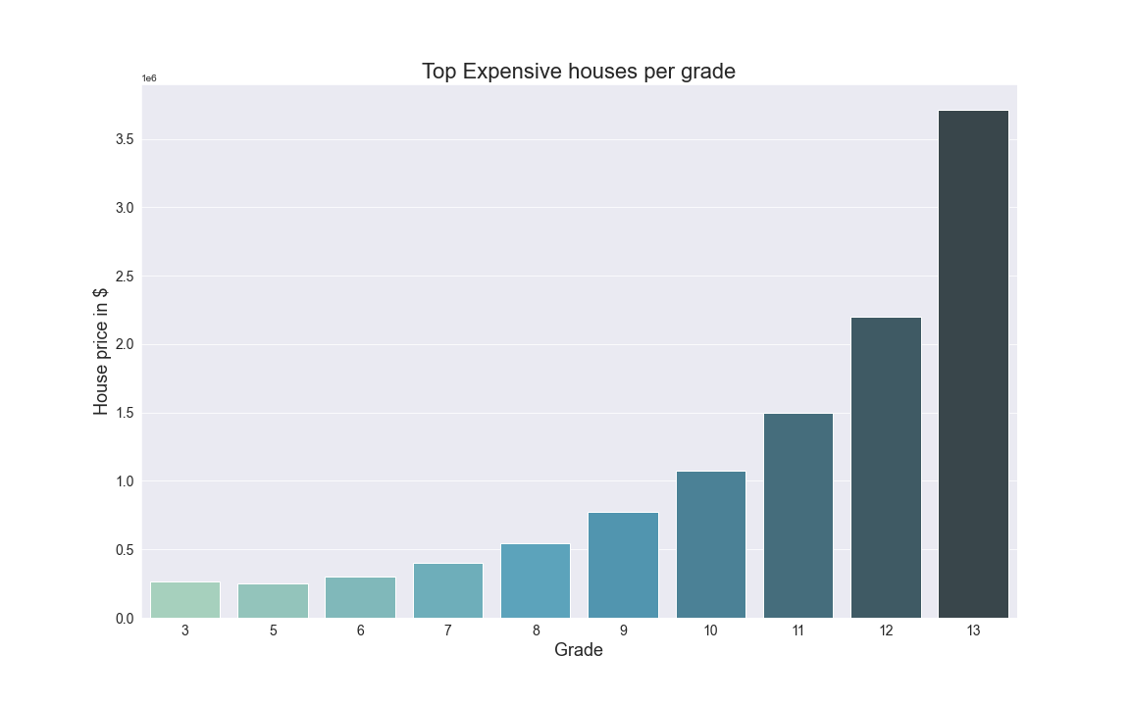
houses prices per grade

Slide 6
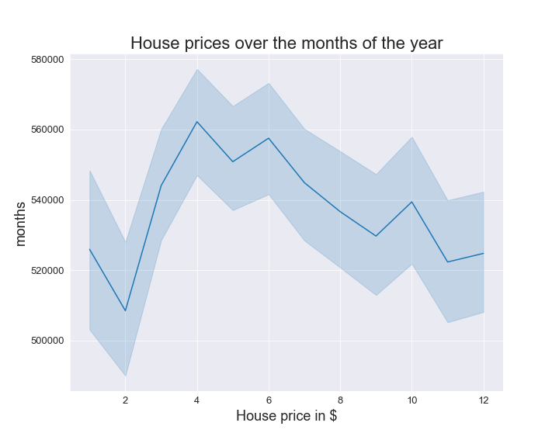
House prices over the months

Slide 7
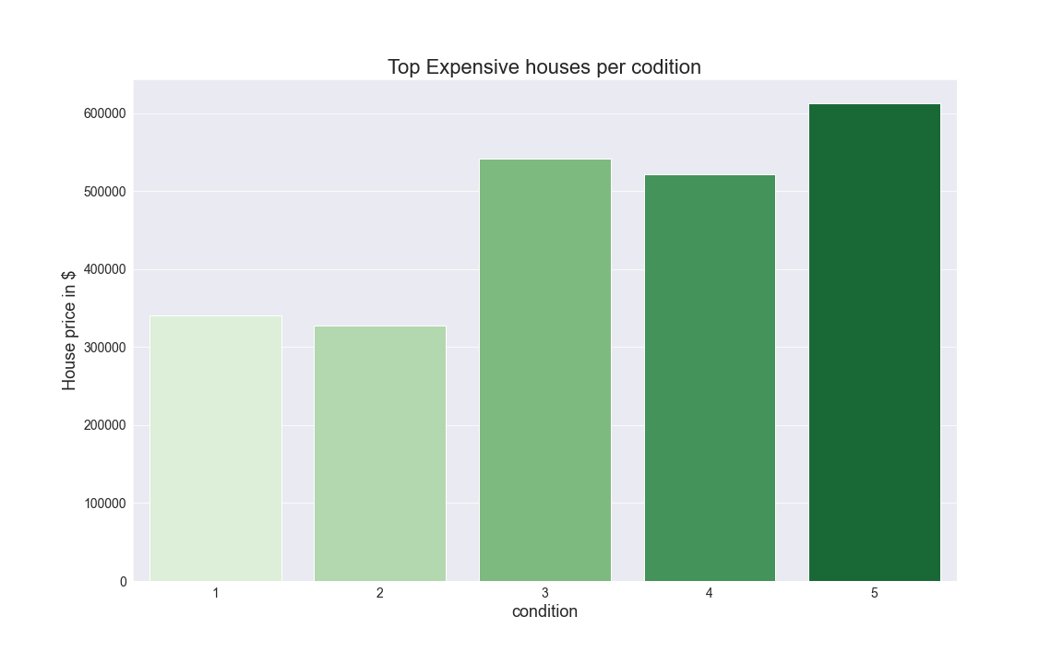
House prices Per condition

Slide 8
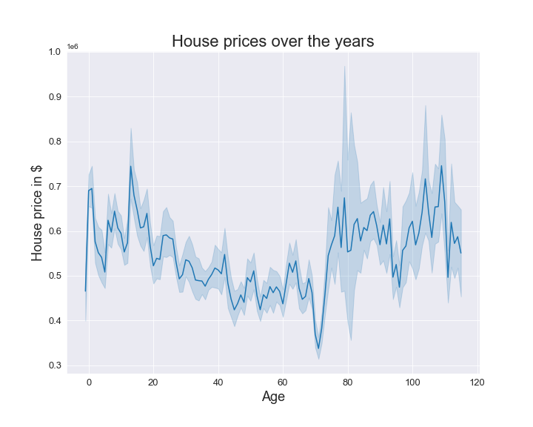
House prices over house ages

Slide 9
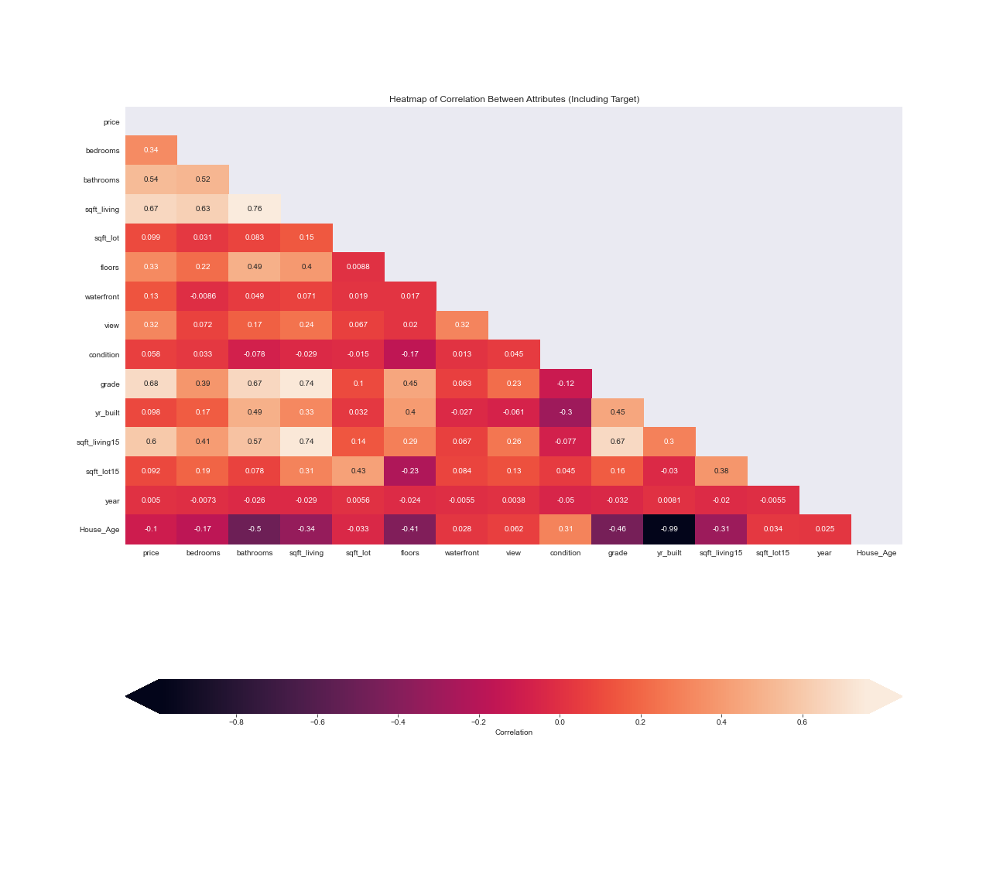
Correlation chart

Slide 10
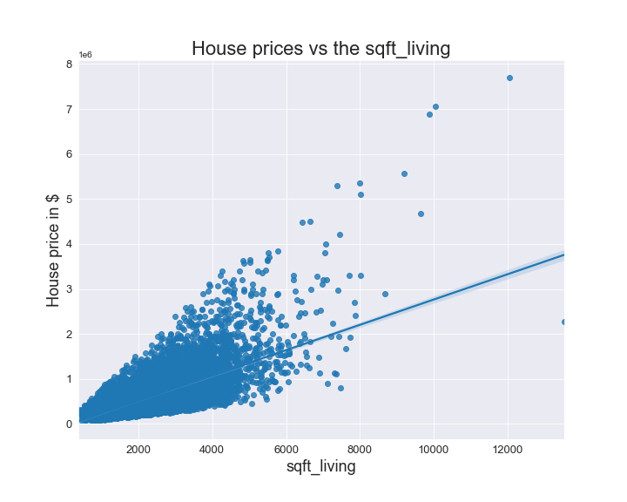
House prices vs sqft_living

Slide 11
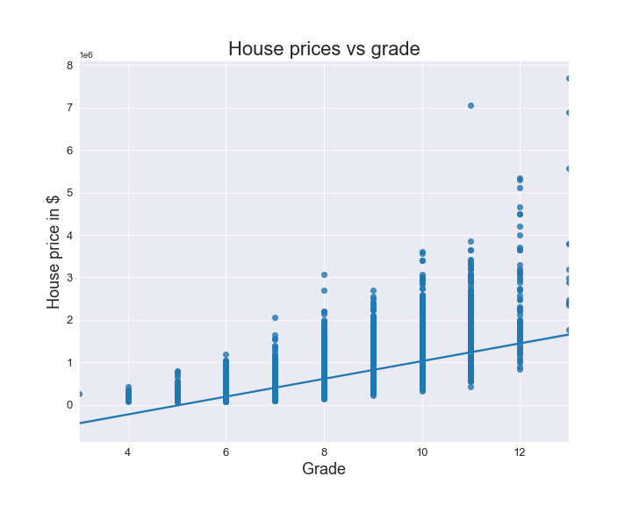
House prices vs grade

Slide 12
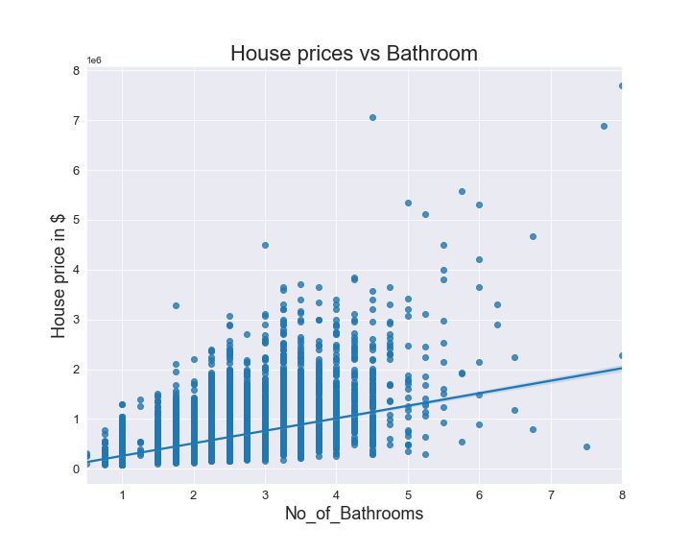
House prices vs no. of bathrooms

Slide 13
Conclusions :
The top 3 most profitable feature combination include: Sqft_living , grade and bathrooms
Sqft_living is the most correlated feature to the house prices ie more sqft_living attracts higher prices and vice versa
New houses of between 0-20 years and older houses of above 70 years fetch higher prices as compared to those between 20-70 years
Houses of higher condition fetch higher prices as compared to those of lower conditions

Slide 14
Conclusions:
5. There is a steep drop in house prices from january to february from where the prices increase upto the peak month April
6. Generally house prices have been increasing for the past two years

Slide 15
Recommendations:
We recommend that Homeowners should consider sqft_living ,grade and bathrooms when planning on selling their houses
We recommend to Homeowners that they should consider selling houses in the month of April when the prices are at the highest
We recommend to Homeowners who want to buy houses to consider buying in the month of February when the prices are at their lowest
We recommend to Homeowners to consider buying houses of ages between 20-70 years where there prices are relatively low and sell when is age is above 70 years as prices are higher
We recommend to Homeowners to consider buying houses as the trend shows that the prices have been increasing for the past two years and well it is likely it will continue

