Slide 1
Microsoft Movie Analysis

Slide 2
Introductions
Problem Statement : Microsoft sees all the big companies creating original video content and they want to get in on the fun. They have decided to create a new movie studio, but they don’t know anything about creating movies. You are charged with exploring what types of films are currently doing the best at the box office. You must then translate those findings into actionable insights that the head of Microsoft's new movie studio can use to help decide what type of films to create.

Slide 3
Objectives:
Importing the required Libraries
Loading Data from the Files
Data understanding by analysing the data
Data Cleaning and identifying as well as handling NAN values in the dataset
Data Visualisation
Conclusions and Recommendations

Slide 4
Sources of the Datasets:
imdb.title.basics
imdb.title.ratings
bom.movie_gross

Slide 5
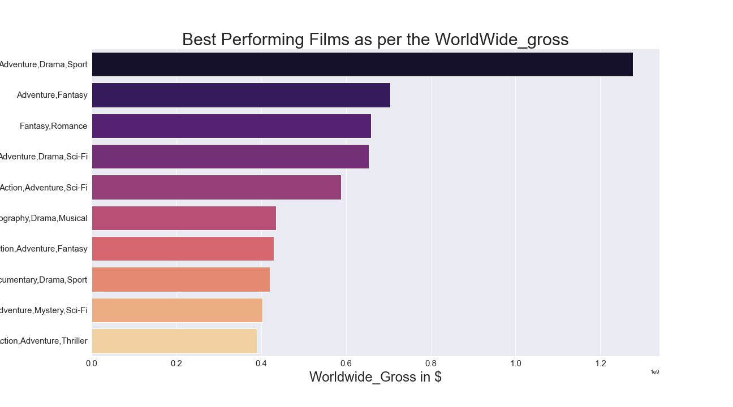
Genres Vs WorldWide gross

Slide 6
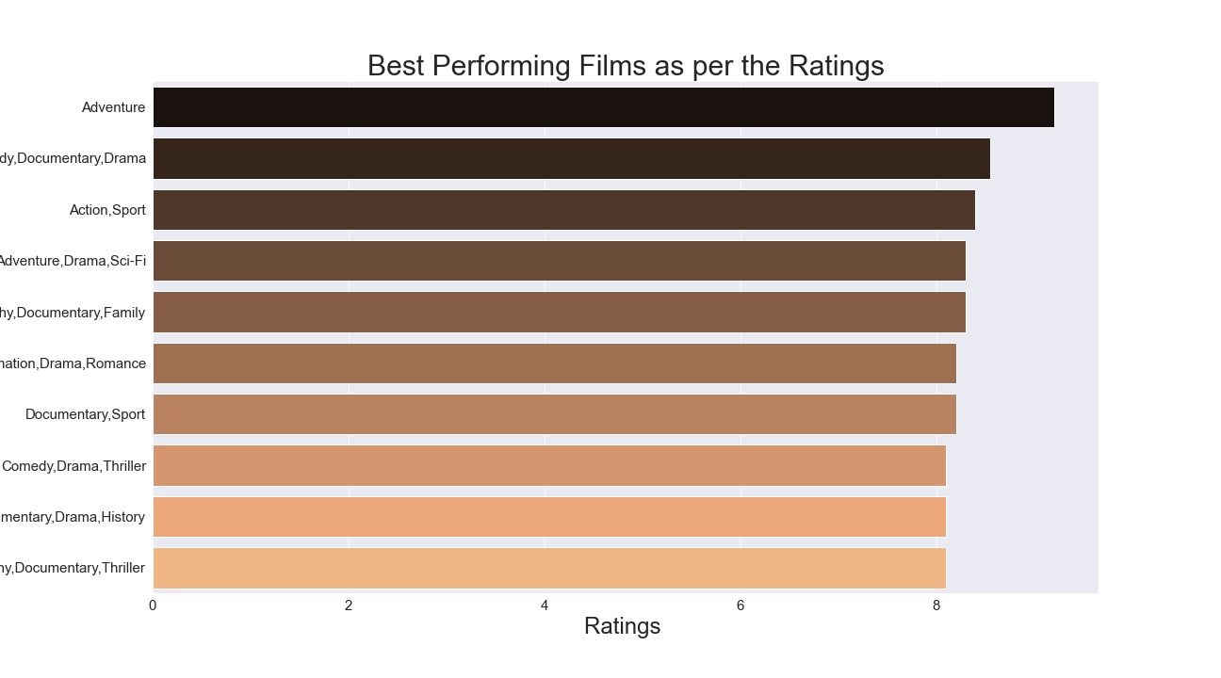
Genres Vs Ratings

Slide 7
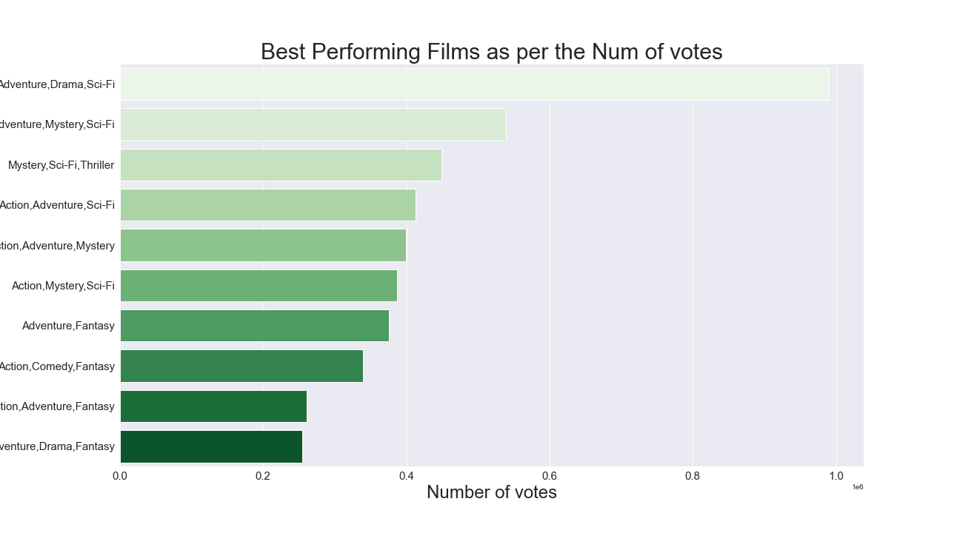
Genres Vs Number of Votes

Slide 8
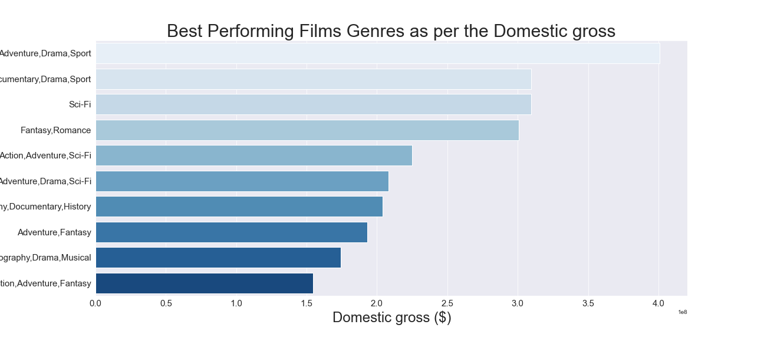
Genres Vs Domestic gross

Slide 9
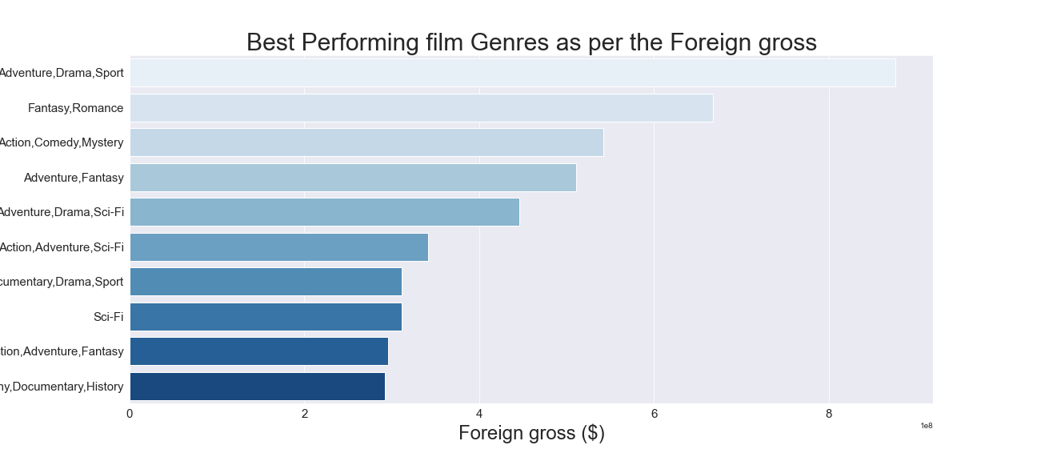
Genres Vs Foreign gross

Slide 10
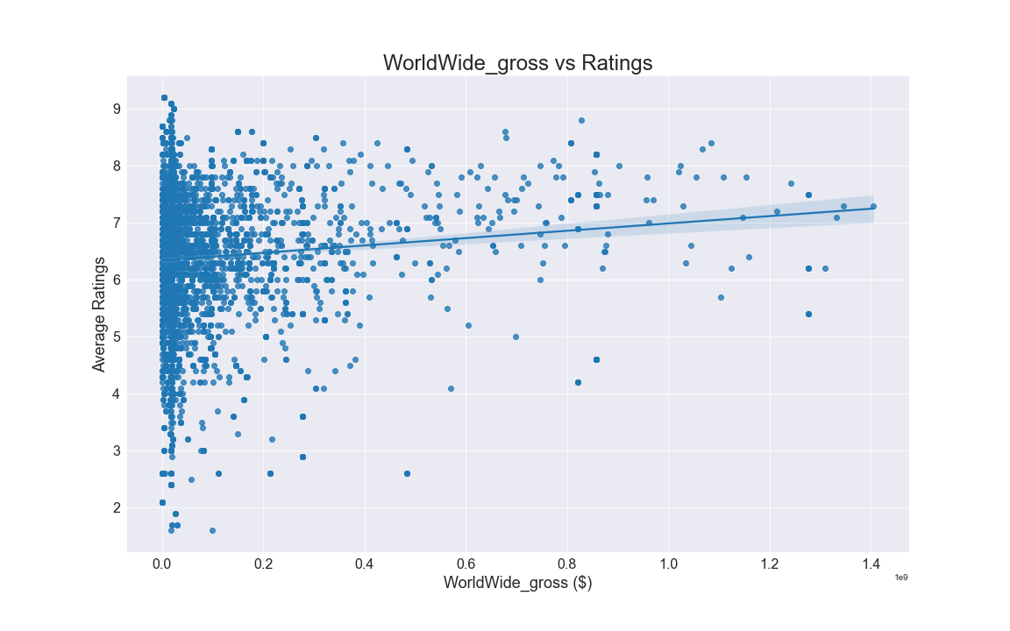
Worldwide gross Vs Ratings

Slide 11
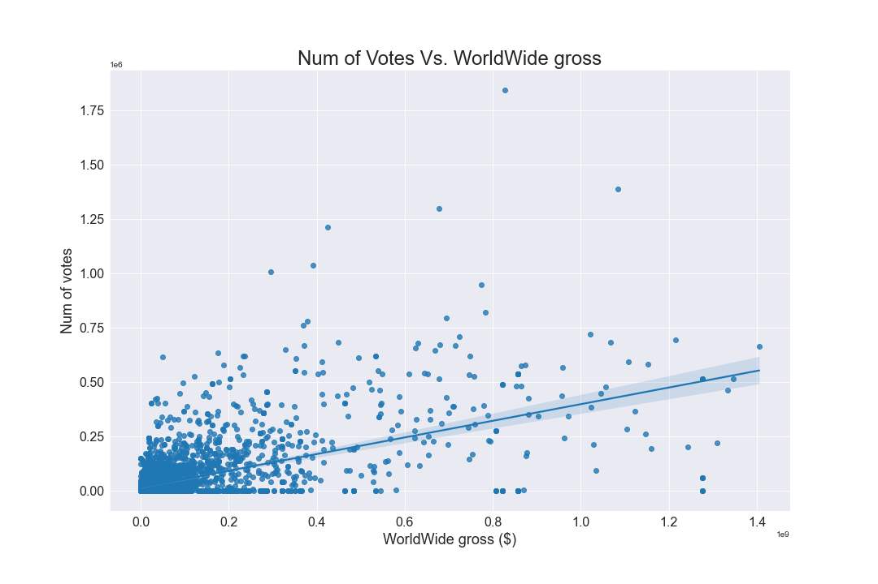
Number of Votes Vs WorldWide gross

Slide 12
Worldwide gross Vs Ratings

Slide 13
Conclusions :
The top 3 most profitable genre combination include: [Adventure,Drama,Sport], [adventure,fantasy], [Fantasy,romance]
The top 3 most rated genre combination include: [Adventure], [Comedy,Documentary,Drama], [Action,Sport]
The top 3 most voted for genre combinations include: [Adventure,Drama,Sci-Fi], [Adventure,Mystery,Sci-Fi]
The top 3 most successful genres for the domestic market include: [Adventure,Drama,Sport], [Documentary,Drama,Sport], [Sci-Fi]

Slide 14
Conclusions:
5. The top 3 most successful genres for the foreign market include: [Adventure,Drama,Sport], [Fantasy,Romance], [Action,Romance,Comedy]
6. There is a positive correlation between the number of votes for a movie and the Gross income it generates
7. There is a weak correlation between the ratings of a movie and the Gross it generates

Slide 15
Recommendations:
We recommend Microsoft to go into the following genres combinations: [Adventure,Drama,Sport], [adventure,fantasy], [Fantasy,romance] as they are the most profitable
We recommend Microsoft to go into the following genres combinations :[Adventure,Drama,Sport], [Documentary,Drama,Sport], [Sci-Fi] if their target audience is the domestic market
We recommend Microsoft to go into the following genres combinations [Adventure,Drama,Sport], [Fantasy,Romance], [Action,Romance,Comedy] if their target audience is the foreign market
We recommend Microsoft to take into consideration that high movie rating do not translate to high Gross incomes as shown by the correlation between ratings and Worldwide gross income
We recommend Microsoft to take into consideration the Number of votes for movies as they positively correlated to the Gross income

