Slide 1
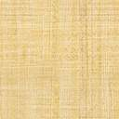

SyrialTel Company
SyrialTel Company Churn Analysis and Modelling

Slide 2
Introduction
Syrial is a telecommunication company that aims at optimizing its operation by reducing the amount of money spend on customers who don't stick to the company for long by using machine learning and finding the predictable patterns for such customers

Slide 3
Business Understanding
Our stakeholder will be the SyrialTel telecom Company. The purpose of this project is to provide the Syrial with valuable insight regarding the factors that most contribute to a customer churning , as well as use predictive model that can be used to make recommendations to the company in order to help reduce the amount of money spend wasted on customers who don't stick for long.

Slide 4
Objectives
To do analysis and find patterns between customers who churn and those who don’t.
To build a Machine Learning prediction model for classifying the churn of the Syrial Company.
To use iterative modelling to find the best model with the highest classification accuracy.

Slide 5
Data Understanding
The data for this project comes from SyrialTelecom customer churn dataset:
Data/bigml_59c28831336c6604c800002a.csv

Slide 6
Modelling
Different Modelling algorithms were used iteratively to find the best:
Logistic Regression
Decision tree
Random Forest
Gradient Boosting
Stacking

Slide 7
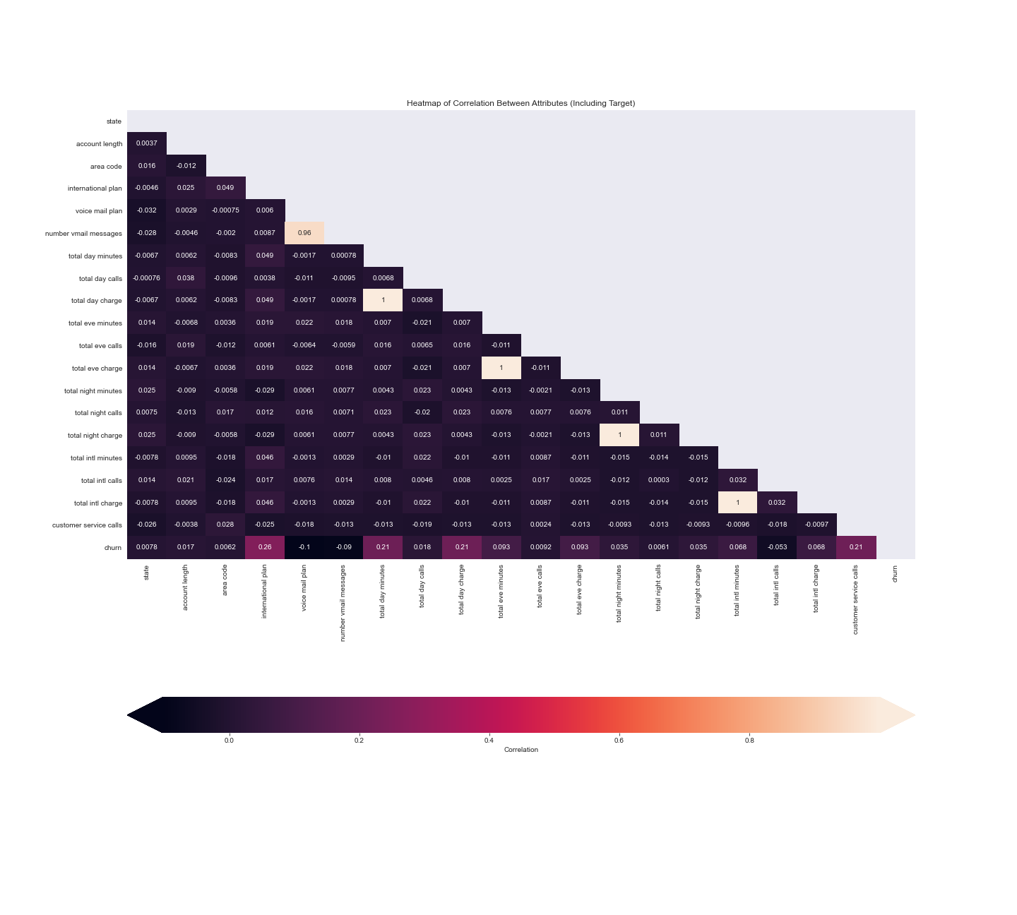
Correlation chart

Slide 8
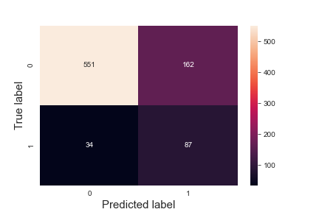
Best logistic model confusion matrix
True positive : 87
True Negative : 551
False Positive : 162
False Negative : 34

Slide 9
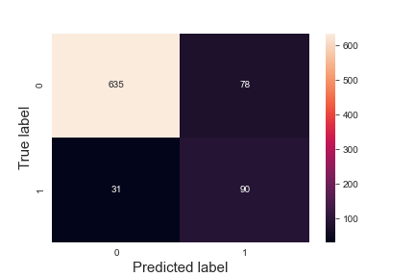
Best Decision tree model confusion matrix
True positive : 90
True Negative : 635
False Positive : 78
False Negative : 31

Slide 10
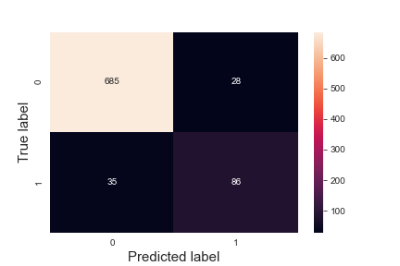
Best Random Forest model confusion matrix
True positive : 86
True Negative : 685
False Positive : 28
False Negative : 35

Slide 11

Gradient Boosting model confusion matrix
True positive : 88
True Negative : 683
False Positive : 30
False Negative : 33

Slide 12

Stacking Model confusion matrix
True positive : 86
True Negative : 682
False Positive : 31
False Negative : 35

Slide 13
Conclusion
The final model picked was the Random forest model 1 which had the highest metrics of :
Classification Accuracy : 93%
Classification recall : 73%
Classification F1 score : 74%
Classification precision : 75%
This model had a very high classification accuracy of 93% and also it had a balance in the other evaluating metrics above 70% for recall , F1 score and precision

