Slide 1
S&P 500 Regime Detection
COMP0047 — Group 4 | UCL
Are Fed Rate Hikes the Main Trigger for Bull-to-Bear Regime Switches?
Notes:
[SLIDE 1 — ~30 seconds]
Good morning/afternoon everyone. We are Group 4 from COMP0047, and today we're presenting our research on S&P 500 regime detection.
Our core question is simple but important: are Federal Reserve interest rate hikes the main trigger that switches the stock market from a bull market to a bear market? This is a widely held belief in finance, and we set out to test it using data science methods.

Slide 2
Research Question
"Are Federal Reserve interest rate hikes the
main trigger for S&P 500 Bull → Bear switches?"
Bull regime: market ≥ 20% above recent trough
Bear regime: market ≥ 20% below recent peak
Notes:
[SLIDE 2 — ~1 minute]
Let me first define what we mean by market regimes. A bull market is a sustained period where the S&P 500 has risen at least 20 percent from its most recent low point. A bear market is a sustained drop of at least 20 percent from a recent peak.
We applied this standard 20 percent threshold to 25 years of monthly S&P 500 data — from January 2000 to January 2026 — giving us 312 monthly observations. Out of these, roughly 260 are bull months and only 52 are bear months, so we have a 5-to-1 class imbalance. This is important because it means our models could achieve 80 percent accuracy just by always predicting bull — so we had to account for this bias in our methodology.

Slide 3
Data: 12 Features × 312 Months
Technical: RSI, ROC, MACD, MACDH, Volume, VIX
Macro: Real GDP, Unemployment, Inflation
Fed: Fed Funds Rate, 10Y-2Y Spread
Sources: Yahoo Finance • FRED API
Notes:
[SLIDE 3 — ~1 minute]
Our feature set spans three categories. First, technical indicators — these are market-derived signals like RSI, which measures buying versus selling pressure, Rate of Change, MACD for trend momentum, and the VIX, which is often called the "fear index."
Second, macroeconomic variables — Real GDP, unemployment, and inflation measured by the Core PCE index. These update monthly or quarterly.
Third, the Federal Reserve variables at the heart of our question — the Fed Funds Rate itself, and the 10-year minus 2-year Treasury spread, which is widely watched as a recession indicator when it inverts.
We pulled all data from Yahoo Finance and the FRED API, applied stationarity transforms, and removed redundant features to arrive at 12 clean features across 312 months.

Slide 4
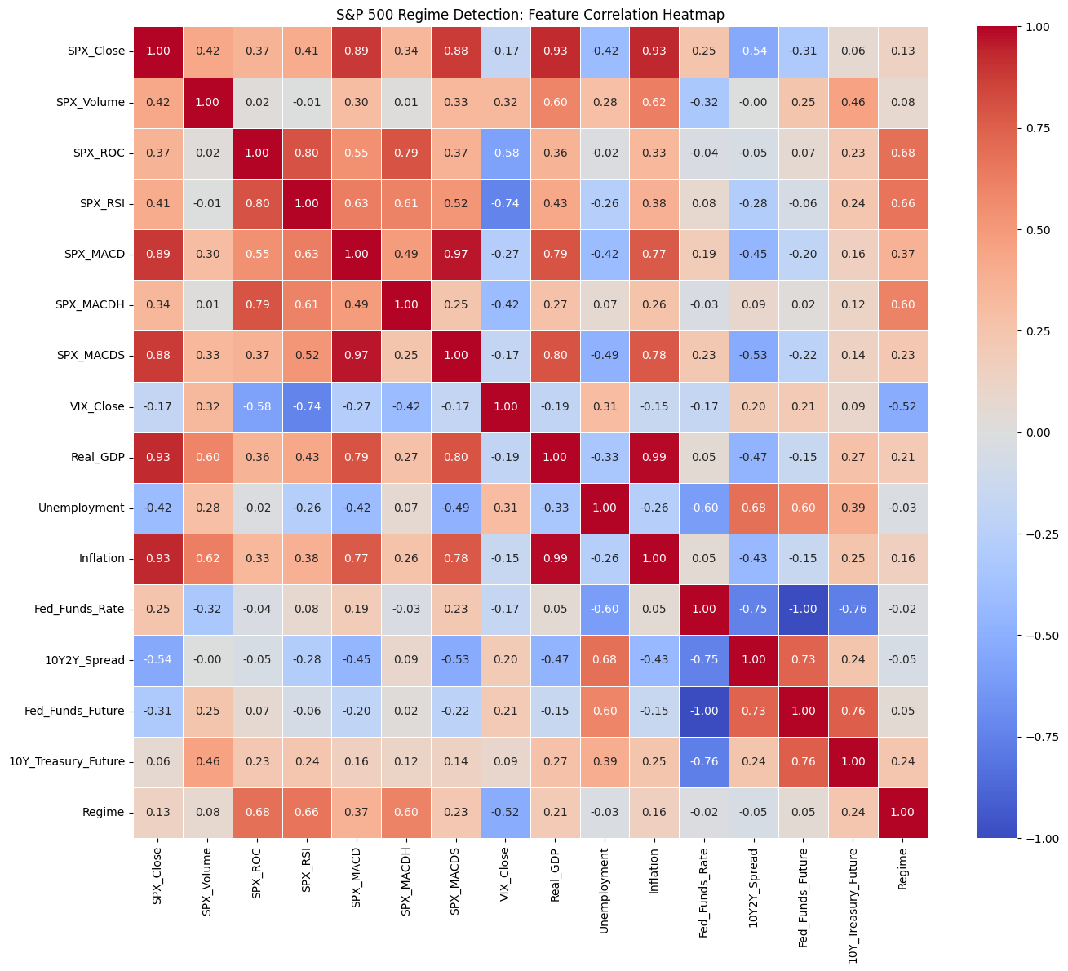
Correlation Heatmap
Technical indicators cluster together — Fed & macro variables sit apart
Notes:
[SLIDE 4 — ~1 minute]
Before modelling, we explored the data with a correlation heatmap. What immediately stands out is that the technical indicators — RSI, ROC, the MACD family — form a tight cluster of inter-correlations. They move together because they all measure different aspects of market momentum.
Now look at the Fed Funds Rate. Its correlation with the regime label is essentially zero — negative 0.02. Compare that to RSI at 0.66 or ROC at 0.68. Even at this exploratory stage, the data is already hinting that market momentum has a much stronger linear relationship with regimes than the Fed rate does.
This motivated us to use formal modelling to test whether this pattern holds up.

Slide 5
Three Classification Models
Logistic Regression — 90.5% accuracy
Random Forest — 81.0% (balanced class weights)
Gradient Boosting — 81.0%
80/20 chronological train/test split
Notes:
[SLIDE 5 — ~1 minute]
We trained three classification models. Logistic Regression is our linear baseline — it achieved 90.5 percent accuracy. Random Forest and Gradient Boosting are both non-linear, tree-based models that achieved about 81 percent each.
Why three models? Because each captures different patterns. Logistic Regression finds linear relationships. Random Forest and Gradient Boosting can detect non-linear, complex interactions between features. If the Fed Rate is truly a dominant driver, all three should rank it highly.
We used a chronological 80/20 split — training on 2000 to 2020 and testing on 2020 to 2026 — so there's no future data leakage. Random Forest also uses balanced class weights to address the 5-to-1 imbalance.

Slide 6
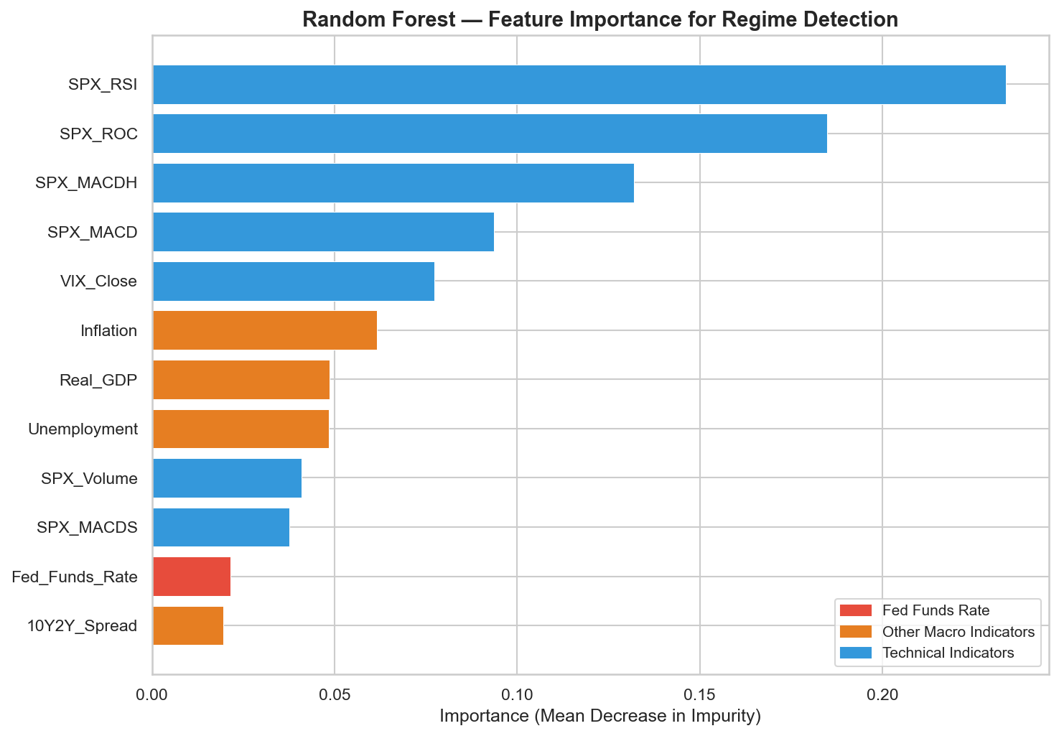
Random Forest: Feature Importance
Top 3: RSI, ROC, MACDH (momentum). Fed Rate: #11 out of 12.
Notes:
[SLIDE 6 — ~1 minute]
Here are the Random Forest feature importance rankings, measured by Mean Decrease in Impurity. Look at the top: RSI ranks first, Rate of Change second, and the MACD histogram third. These are all momentum indicators — they measure how fast and in what direction the market is moving.
Now look at where the Fed Funds Rate sits — it's 11th out of 12 features. It barely contributes to the model's ability to distinguish bull from bear months.
Even the VIX — the fear index — outranks all macroeconomic variables. This tells us that the market's own internal dynamics — its speed, its momentum, its fear level — are far more informative than what the Federal Reserve is doing with interest rates.

Slide 7
Where Does the Fed Rate Rank?
Logistic Regression: #2 / 12
Random Forest: #11 / 12
Gradient Boosting: #10 / 12
Cross-model average: #7.7 / 12
Notes:
[SLIDE 7 — ~1 minute]
Now here's something interesting. Logistic Regression actually ranks the Fed Rate at number 2 out of 12. But the non-linear models — Random Forest and Gradient Boosting — both rank it near the bottom, at 11th and 10th.
Why the disagreement? Logistic Regression is detecting a genuine linear correlation: the Fed tends to raise rates when the economy is strong, which is also when we're in a bull market. Higher rates and bull markets happen at the same time.
But that's correlation, not causation. The Fed raises rates because the economy is doing well — not the other way around. The tree-based models, which can look beyond simple linear patterns, see through this and rank it low.
The cross-model average is 7.7 out of 12 — middle of the pack, not a dominant driver.

Slide 8
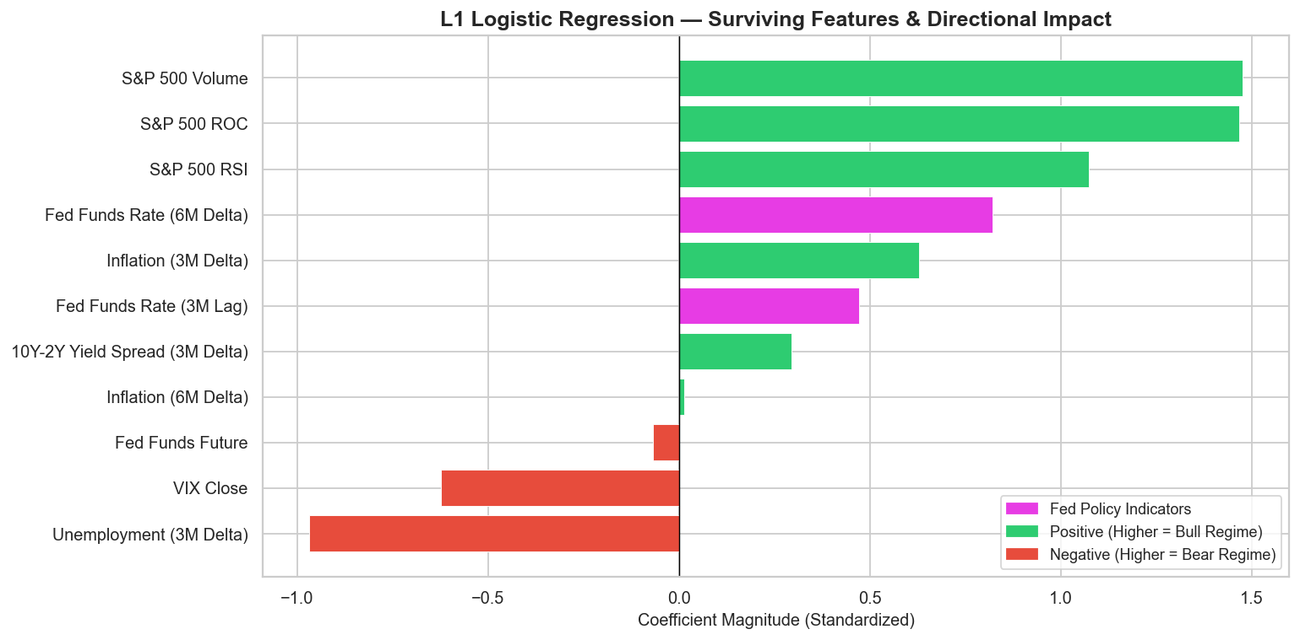
Digging Deeper: Lags & Deltas
Markets price in Fed moves early
→ Raw rate is stale by announcement
Engineered: 3M/6M lags + deltas
L1 pruning: 23 → 11 features
Fed 6M Delta: RF #3, LR #5
Fed 3M Lag: GB #3
Notes:
[SLIDE 8 — ~1.5 minutes]
At this point, we asked ourselves: could the raw Fed Rate be weak simply because markets anticipate rate changes before they're announced? By the time the Fed officially hikes, the market may have already priced it in months ago.
To test this, we engineered new features: 3-month and 6-month lags — capturing where the rate was in the past — and deltas — capturing how fast the rate was changing. This expanded our feature set to 23 variables, so we applied L1 regularisation, also known as Lasso, to prune redundant features. This brought us back down to 11.
The results were striking. Two Fed features survived the pruning. The 6-month rate of change — how fast the Fed has been hiking — jumped to rank 3 in Random Forest. The 3-month lag jumped to rank 3 in Gradient Boosting.
So the raw level doesn't tell the models much, but how fast and when the Fed moves carries real signal. It's not the rate itself — it's the momentum of rate changes.

Slide 9
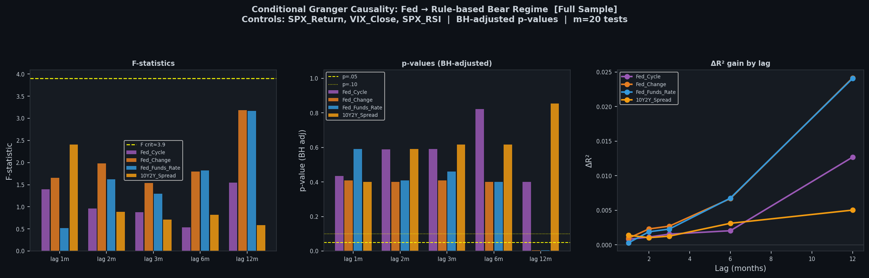
Granger Causality: Does the Fed Predict Regimes?
After controlling for market signals → Fed adds ≤ 2.5% explained variance
Notes:
[SLIDE 9 — ~1 minute]
Next we asked: does the Fed rate even Granger-cause regime changes? Granger causality tests whether adding lagged Fed variables improves our ability to predict regimes beyond what market signals like VIX and RSI already tell us.
We tested four Fed variables across five different lag lengths and applied a Benjamini-Hochberg correction for multiple testing. The result: after controlling for market signals, the Fed adds at most 2.5 percent to the explained variance. That's essentially nothing. None of the results pass the F-statistic significance threshold.
In plain English: once you already know what the market's own momentum and volatility are doing, knowing the Fed rate gives you almost no additional information about regime switches.

Slide 10
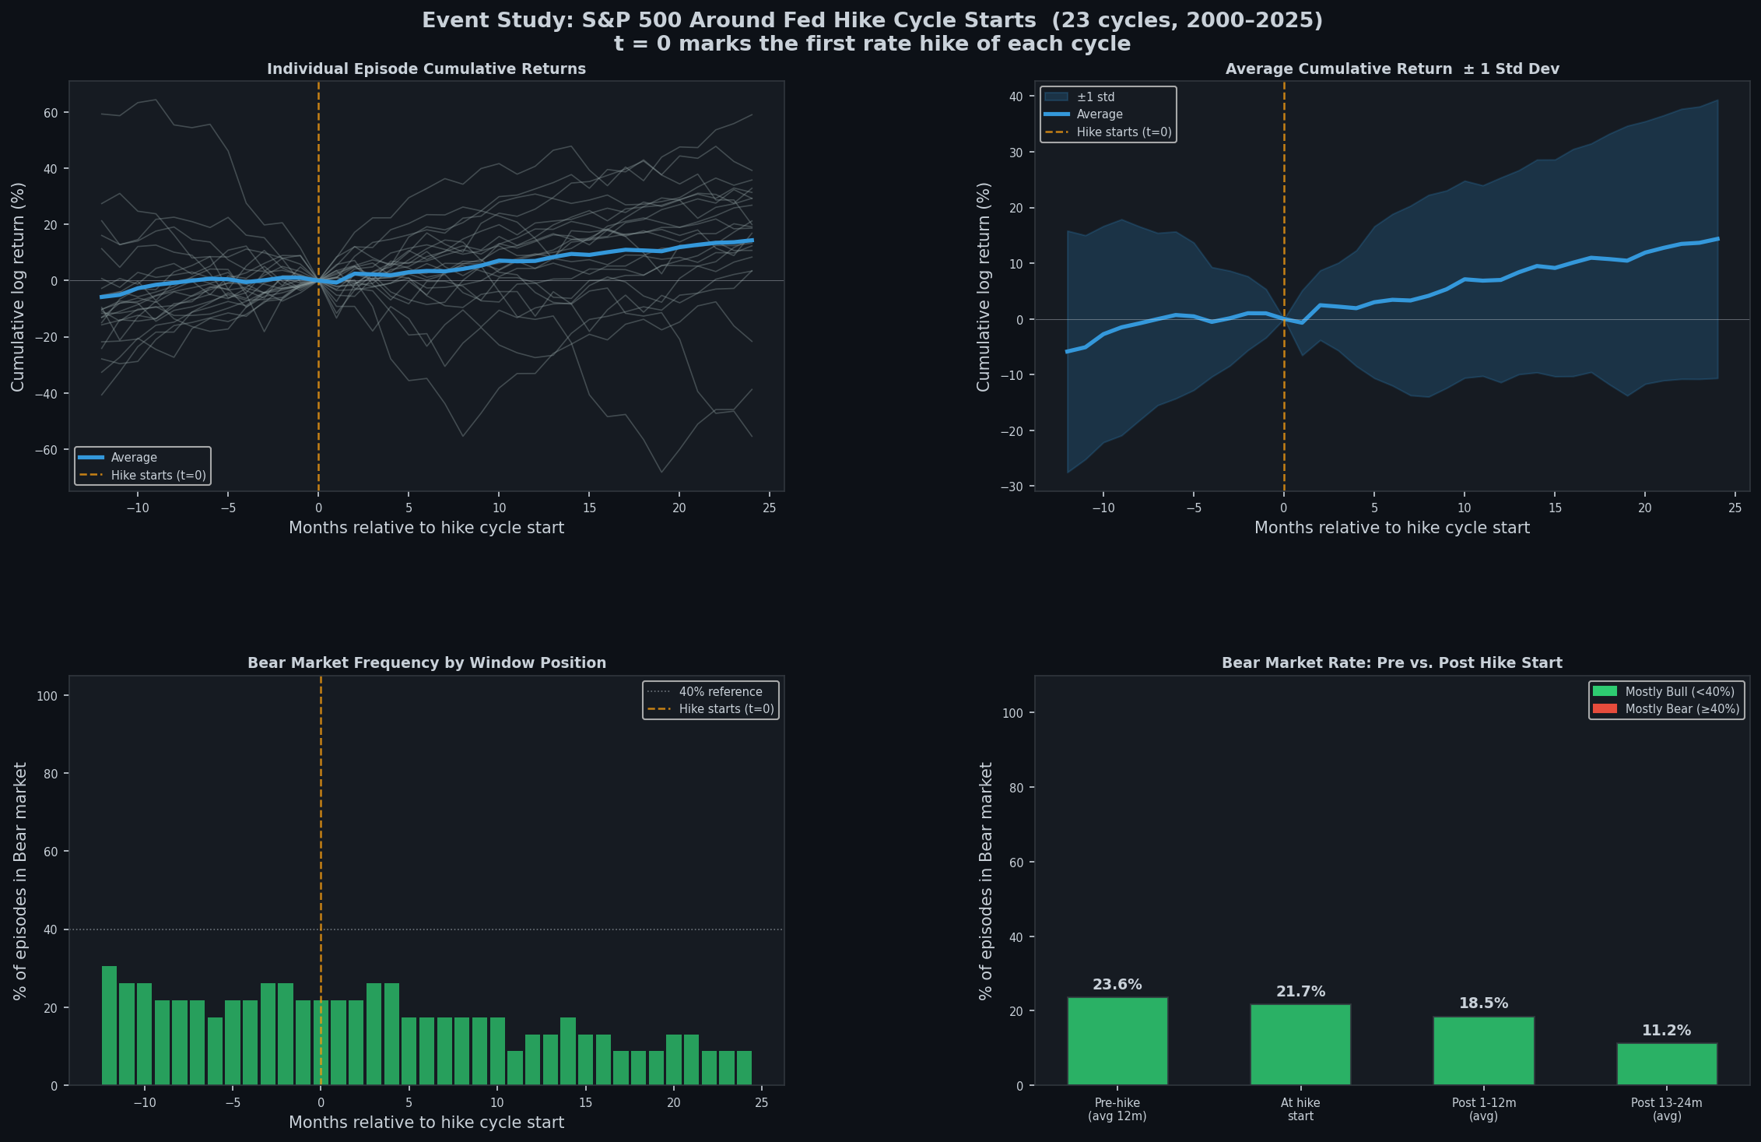
Event Study: What Happens After Rate Hike Starts?
Bear frequency falls after hikes: 23.6% → 18.5% → 11.2%. S&P 500 keeps rising.
Notes:
[SLIDE 10 — ~1.5 minutes]
This is one of our most compelling findings. We identified 23 rate hike cycle starts — defined as the first hike after at least three months of no hikes — and tracked what happened to the S&P 500 in a window from 12 months before to 24 months after.
If rate hikes trigger bear markets, we'd expect bear frequency to spike right after the first hike. But look at what actually happens — it's the opposite. Bear market frequency is 23.6 percent in the 12 months before the hike, drops to 18.5 percent in the first year after, and falls further to just 11.2 percent in the second year.
The blue average line shows that the S&P 500 continues rising after hike cycles begin. The wide shaded band shows there's huge variation — some cycles ended in crashes like 2007 and 2022, but on average, rate hikes happen during good times and the market continues to do well.
This directly contradicts the idea that rate hikes are a bear market trigger.

Slide 11
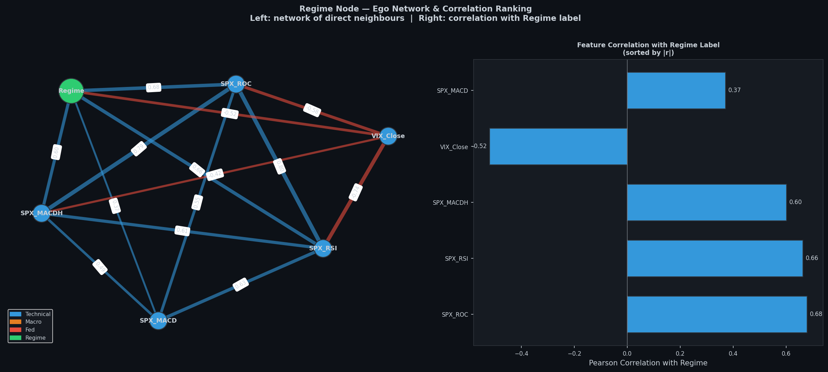
Network Analysis: Who Connects to Regime?
Avg |r| with Regime:
Technical: 0.49
Macro: 0.11
Fed: 0.02
Fed Rate = most isolated node
Only 3 edges in the graph
Notes:
[SLIDE 11 — ~1 minute]
Finally, we built a correlation network — a graph where each feature is a node, and edges connect features with correlations above 0.3.
This visualisation makes the structural story immediately clear. On the right you can see the ego network centred on the Regime node. The technical indicators — RSI, ROC, MACDH, VIX — cluster tightly around it with an average absolute correlation of 0.49. They are the regime node's immediate neighbours.
The macroeconomic variables sit further away, with an average of just 0.11. And the Fed Funds Rate? It's the most isolated node in the entire graph, with only 3 edges and a correlation of negative 0.02 with Regime. It's essentially disconnected from regime states.
This visual captures in one image what every quantitative analysis found.

Slide 12
Answer: No — The Fed Is Not the Main Trigger
Feature Importance: Fed ranks #7.7 / 12
Granger Causality: only 2.5% added variance
Event Study: bear markets fall after hikes, not rise
Network: Fed is the most isolated node from Regime
What drives regime switches:
→ Market momentum (RSI, ROC) and volatility (VIX)
Notes:
[SLIDE 12 — ~1.5 minutes]
So to answer our research question: no, Federal Reserve rate hikes are not the main trigger for bear market regimes.
All four of our analyses converge on this conclusion. Feature importance ranks the Fed at 7.7 out of 12 on average. Granger causality shows the Fed adds at most 2.5 percent beyond market signals. The event study shows bear frequency actually falls after hike cycles begin. And the network analysis shows the Fed rate is the most structurally isolated node from regime states.
What does drive regime switches? The market's own momentum — RSI and Rate of Change — and volatility, captured by the VIX. Markets predict their own turning points through deceleration and fear, not through interest rates.
However, there is an important nuance. When we properly engineered the data to capture the momentum and delayed effect of Fed rate changes — not the raw level, but how fast and when the Fed moves — those features did gain meaningful predictive power. The Fed is not irrelevant, but it's a contributing factor, not the main trigger.

Slide 13
Limitations & Future Work
5:1 class imbalance biases models toward Bull
Only 23 hike cycles — small sample for event study
Linear methods cannot detect non-linear causality
Future: HMMs, dynamic networks, transfer entropy
Notes:
[SLIDE 13 — ~30 seconds]
Quickly on limitations: the 5-to-1 class imbalance means our models are biased toward predicting bull. We only had 23 hike cycles to study, which is a small sample. And our Granger causality test is linear, so it can't detect non-linear causal mechanisms.
For future work, we'd suggest Hidden Markov Models for probabilistic regime detection, dynamic network analysis that evolves over time, and non-linear causality tests like transfer entropy.

Slide 14
Thank You
COMP0047 — Group 4 | UCL Questions?
Notes:
[SLIDE 14]
Thank you very much for listening. We're happy to take any questions.
[PREPARED Q&A NOTES]
Q: Why not use Hidden Markov Models?
A: HMMs would be a great extension — they assign probabilities to regime states rather than hard labels, which would give us smoother transitions. We consider this a key direction for future work.
Q: Could the 2022 crash be an outlier that skews results?
A: Yes — the 2022 episode (425bp hikes in 12 months) is the most aggressive hiking cycle in our dataset. It's the strongest case FOR the trigger hypothesis, but it's one event out of 23. Our analysis accounts for this by averaging across all cycles.
Q: Why does Logistic Regression rank Fed Rate #2 but tree models rank it #11?
A: LR captures a linear pattern: high rates coincide with bull markets because the Fed hikes when the economy is strong. The tree models see deeper — they can tell that this correlation doesn't actually help predict regime SWITCHES.

