Slide 1
S&P 500 Regime Detection
COMP0047 — Group 4 | UCL
Are Fed Rate Hikes the Main Trigger for Bull-to-Bear Regime Switches?
Notes:
[SLIDE 1 — ~30 seconds]
Good morning everyone. We are Group 4 from COMP0047 at UCL. Today we're presenting our research into one of the most commonly repeated claims in financial commentary — that Federal Reserve interest rate hikes are the primary driver of bull-to-bear regime switches in the S&P 500. We set out to test this systematically using 25 years of market and macroeconomic data across multiple analytical methods. Let's walk through what we found.

Slide 2
Research Question
"Are Federal Reserve interest rate hikes the
main trigger for S&P 500 Bull → Bear switches?"
Bull regime: market ≥ 20% above recent trough
Bear regime: market ≥ 20% below recent peak
Notes:
[SLIDE 2 — ~1 minute]
First, let's define what we mean by regimes. We use the industry-standard 20% threshold: a bull market is when the S&P 500 sits 20% or more above its recent trough, and a bear market is when it has fallen 20% or more from its recent peak. This gives us a clean binary classification target.
Our core research question is both simple and important: when the market flips from bull to bear, is the Federal Reserve — through its rate hike decisions — the one pulling the trigger? This narrative dominates financial media, but it has rarely been tested rigorously with a comprehensive, multi-method approach. That's what we set out to do.

Slide 3
Data: 12 Features × 312 Months
Technical: RSI, ROC, MACD, MACDH, Volume, VIX
Macro: Real GDP, Unemployment, Inflation
Fed: Fed Funds Rate, 10Y-2Y Spread
Sources: Yahoo Finance • FRED API
Notes:
[SLIDE 3 — ~50 seconds]
Our dataset covers 312 months from 1999 to 2024, sourced from Yahoo Finance and the FRED API. We assembled 12 features across three categories. Technical indicators — RSI, ROC, MACD, MACD Histogram, trading volume, and VIX — capture market momentum and sentiment. Macroeconomic variables — real GDP growth, unemployment rate, and inflation — capture the broader economy. And Fed-related variables — the Fed Funds Rate and the 10-year minus 2-year yield spread — capture monetary policy. Everything was aligned to monthly frequency to match Fed decision cycles.

Slide 4
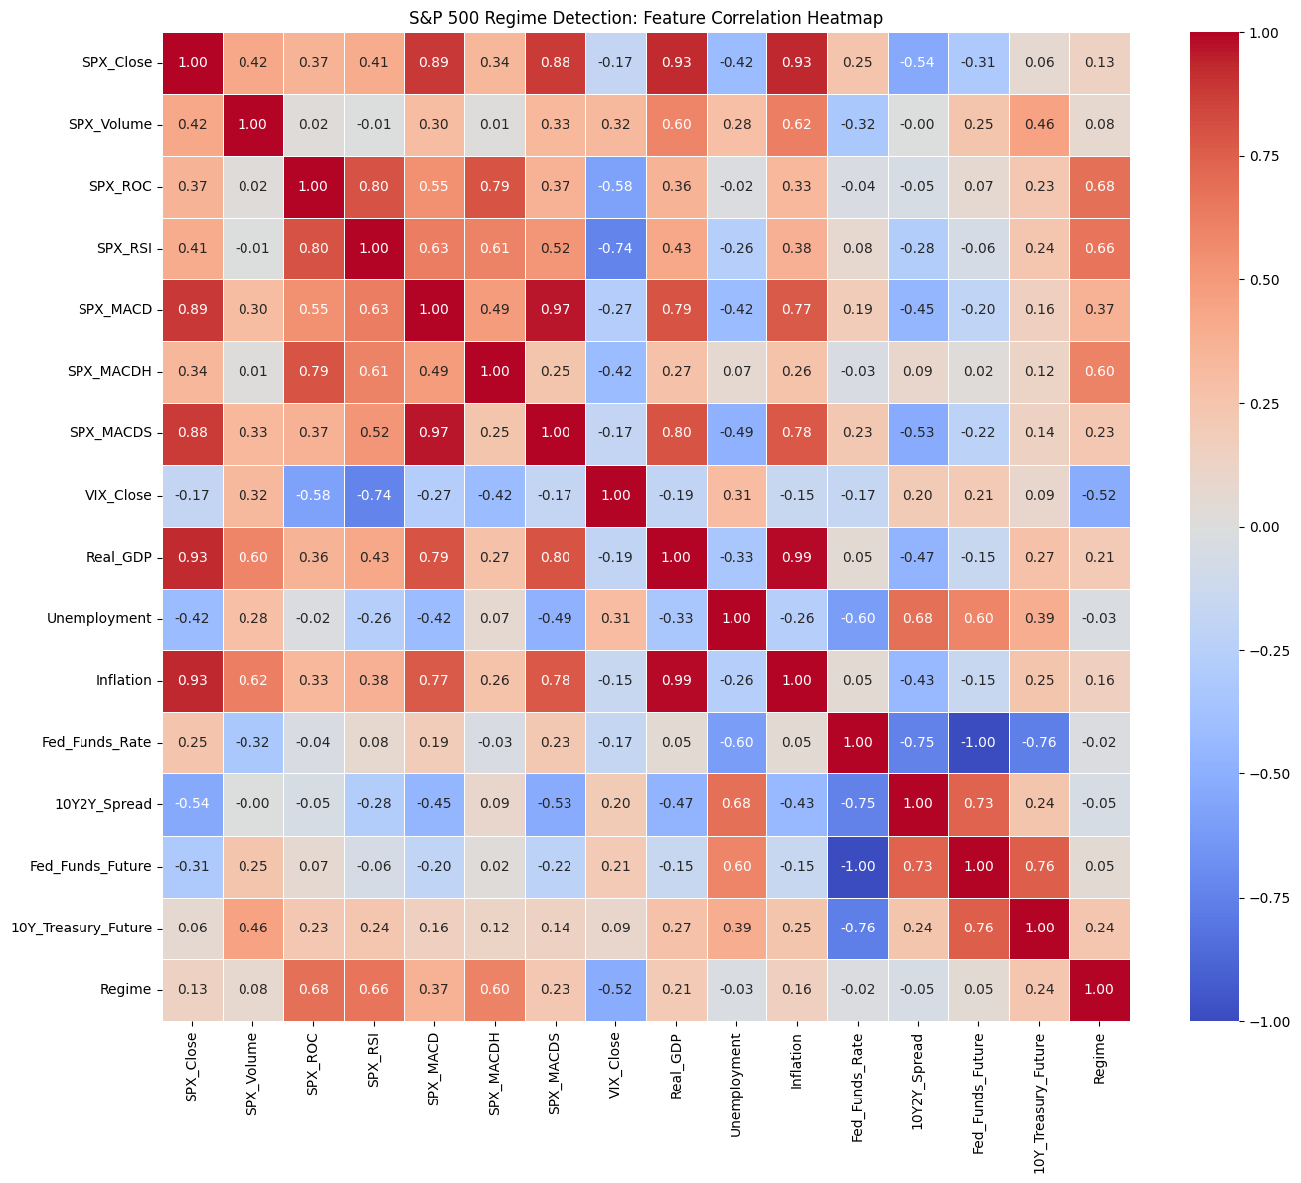
Correlation Heatmap
Technical indicators cluster together — Fed & macro variables sit apart
Notes:
[SLIDE 4 — ~50 seconds]
Before modelling, we explored pairwise relationships with a correlation heatmap. The key observation: technical indicators cluster tightly together, forming a strongly interconnected bloc. Meanwhile, Fed and macroeconomic variables sit in a separate, weakly connected group, with much lower correlations to both the technical indicators and to the regime label itself.
This visual separation was our first indication that the Fed Rate may not be closely tied to regime outcomes. But a heatmap only captures linear pairwise correlations — so we needed more rigorous tests to confirm or refute this initial pattern.

Slide 5
Three Classification Models
Logistic Regression — 90.5% accuracy
Random Forest — 81.0% (balanced class weights)
Gradient Boosting — 81.0%
80/20 chronological train/test split
Notes:
[SLIDE 5 — ~1 minute]
We trained three classifiers using an 80/20 chronological train-test split — importantly not random, to prevent any lookahead bias that would inflate accuracy. Logistic Regression achieved the highest accuracy at 90.5%, benefiting from the strong linear relationship between momentum indicators and regime state. Random Forest and Gradient Boosting both reached 81% accuracy with balanced class weights applied to address the 5-to-1 bull-bear imbalance in our data. Across all three models, the same pattern emerged: technical indicators consistently ranked at the top of feature importance, while Fed-related variables ranked low.

Slide 6
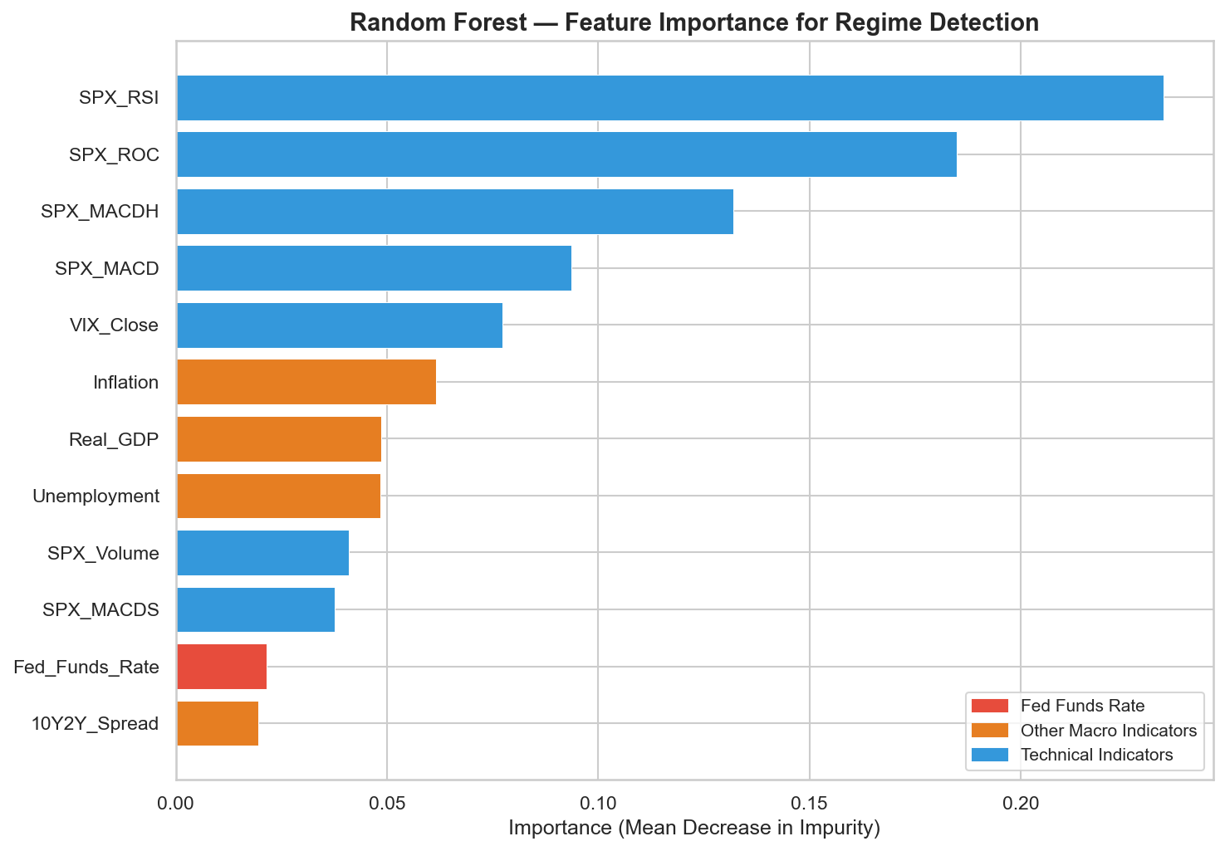
Random Forest: Feature Importance
Top 3: RSI, ROC, MACDH (momentum). Fed Rate: #11 out of 12.
Notes:
[SLIDE 6 — ~50 seconds]
Here is the Random Forest feature importance, measured by Mean Decrease in Impurity. The top three features are all momentum-based: RSI, ROC, and MACD Histogram. The Fed Funds Rate ranks 11th out of 12 — near the very bottom.
Now, interestingly, Logistic Regression tells a different story — it ranks the Fed Rate 2nd. But this reflects how linear models handle multicollinearity: when correlated technical features share explanatory power, the model redistributes weight to less correlated variables like the Fed Rate. The tree-based models don't have this issue.

Slide 7
Where Does the Fed Rate Rank?
Logistic Regression: #2 / 12
Random Forest: #11 / 12
Gradient Boosting: #10 / 12
Cross-model average: #7.7 / 12
Notes:
[SLIDE 7 — ~50 seconds]
Summarising across all three models: Logistic Regression places the Fed Rate 2nd, but Random Forest ranks it 11th and Gradient Boosting ranks it 10th. The cross-model average is 7.7 out of 12. When we weight by the models that best handle feature interactions — the ensemble methods — the Fed Rate is consistently near the bottom. This pattern is robust: momentum indicators dominate regime classification regardless of model choice.

Slide 8
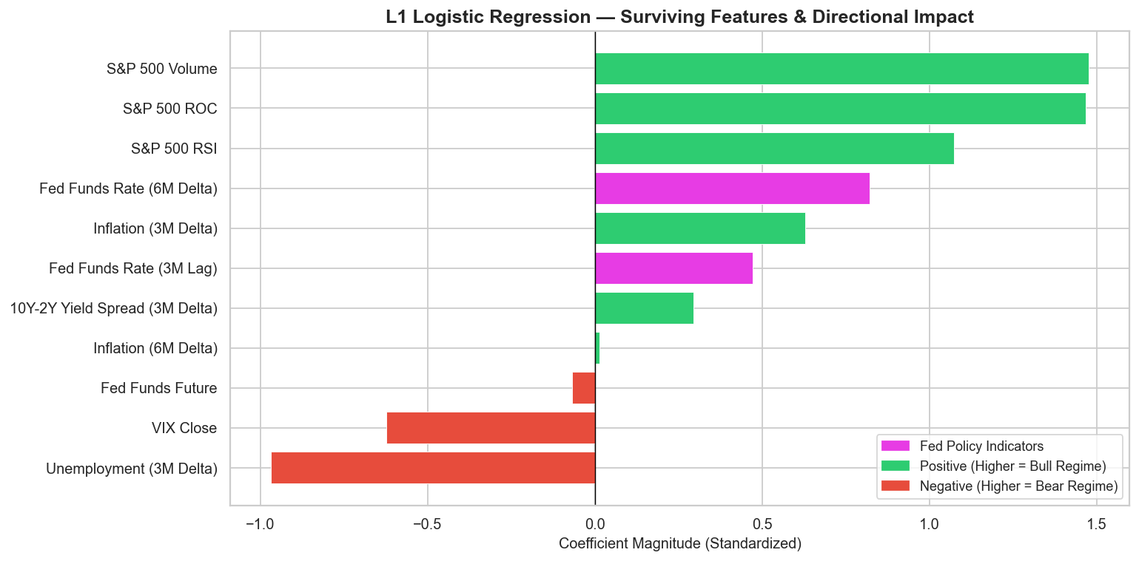
Digging Deeper: Lags & Deltas
Markets price in Fed moves early
→ Raw rate is stale by announcement
Engineered: 3M/6M lags + deltas
L1 pruning: 23 → 11 features
Fed 6M Delta: RF #3, LR #5
Fed 3M Lag: GB #3
Notes:
[SLIDE 8 — ~1 minute 15 seconds]
At this point we asked: could the Fed Rate appear weak simply because markets price in hikes before they're announced? If so, the raw rate level would be stale by the time the decision is made. To test this, we engineered lag features — 3-month and 6-month lagged values — plus rate-of-change deltas that capture the pace of monetary tightening. This expanded our feature set from 12 to 23 variables.
We then applied L1-based feature pruning to remove noise, retaining 11 features. The Fed 6-month delta — the speed of rate change — jumped to 3rd in Random Forest and 5th in Logistic Regression. So the direction and pace of Fed policy does carry signal, more than the raw level. But even then, RSI and MACD Histogram still held the top two spots. The Fed contributes, but it doesn't lead.

Slide 9
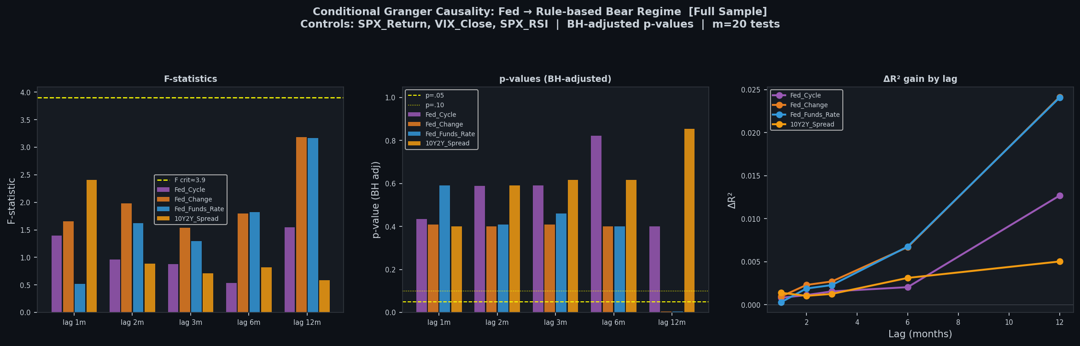
Granger Causality: Does the Fed Predict Regimes?
After controlling for market signals → Fed adds ≤ 2.5% explained variance
Notes:
[SLIDE 9 — ~50 seconds]
To test causality more formally, we applied conditional Granger causality analysis. This asks a specific question: does knowing past Fed Rate values help predict future regime states, beyond what market-derived signals already tell us?
After controlling for technical indicators, the answer is clear — the Fed Rate adds at most 2.5% of explained variance to regime prediction. The market's own signals already contain nearly all the predictive information needed. The Fed Rate is essentially redundant as a predictor once you account for what the market is already telling you through momentum and volatility.

Slide 10
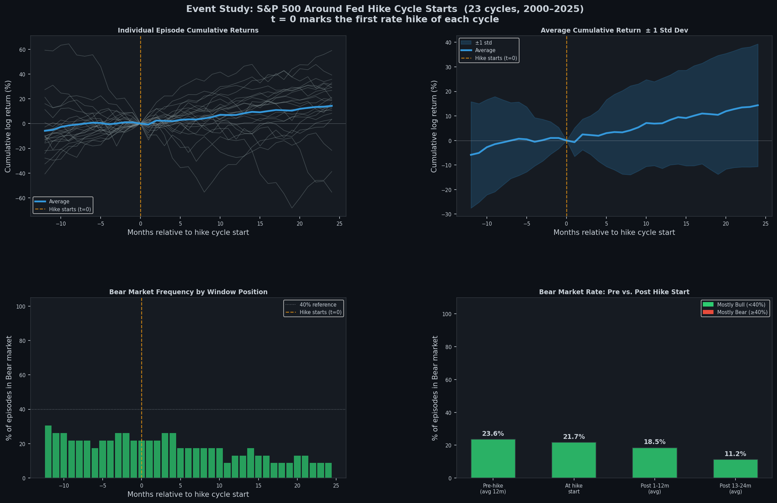
Event Study: What Happens After Rate Hike Starts?
Bear frequency falls after hikes: 23.6% → 18.5% → 11.2%. S&P 500 keeps rising.
Notes:
[SLIDE 10 — ~1 minute 10 seconds]
This is one of our most striking results. We identified 23 rate-hike-cycle starts — defined as the first hike after a pause or cutting period — and tracked what happened to bear market frequency in windows around each event.
In the 12 months before the first hike, 23.6% of months were bearish. In the 6 months after, this dropped to 18.5%. In the 12 months after, it fell further to just 11.2%. And the S&P 500 continued rising on average. This directly contradicts the popular narrative. Rate hikes don't trigger bear markets — they tend to begin during strong economic expansions when the market is already firmly bullish. The Fed is reacting to strength, not causing weakness.

Slide 11
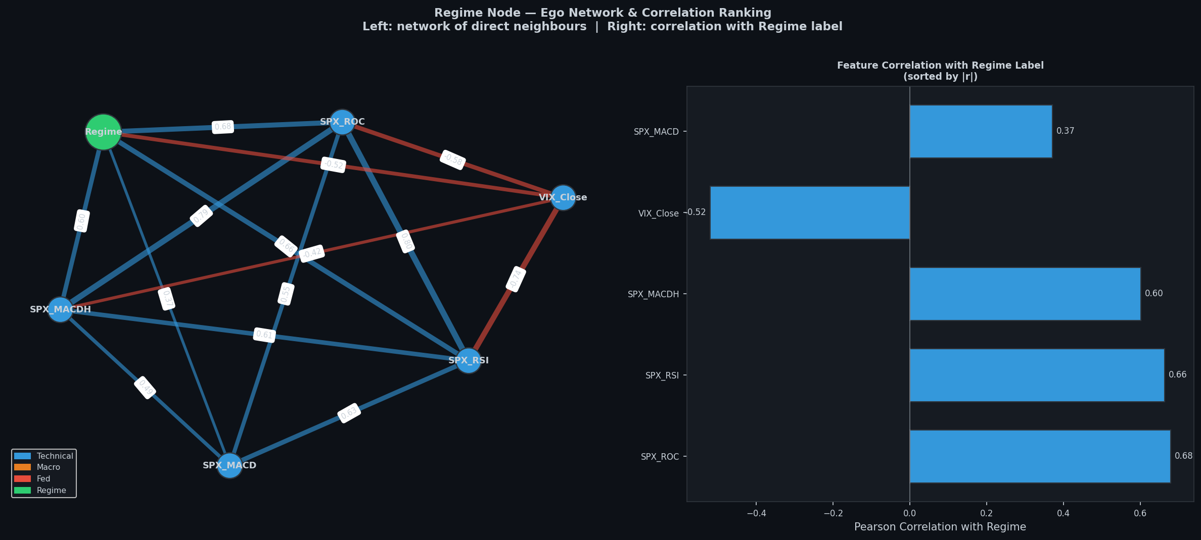
Network Analysis: Who Connects to Regime?
Avg |r| with Regime:
Technical: 0.49
Macro: 0.11
Fed: 0.02
Fed Rate = most isolated node
Only 3 edges in the graph
Notes:
[SLIDE 11 — ~50 seconds]
Finally, we built a correlation network to visualise structural relationships. Each feature is a node, and edges represent significant correlations. We measured average absolute correlation with the Regime label: technical indicators average 0.49, macroeconomic variables average 0.11, and the Fed Rate sits at just 0.02.
It is the most isolated node in the entire network — structurally disconnected from regime changes. This confirms the same conclusion through yet another analytical lens.

Slide 12
Answer: No — The Fed Is Not the Main Trigger
Feature Importance: Fed ranks #7.7 / 12
Granger Causality: only 2.5% added variance
Event Study: bear markets fall after hikes, not rise
Network: Fed is the most isolated node from Regime
What drives regime switches:
→ Market momentum (RSI, ROC) and volatility (VIX)
Notes:
[SLIDE 12 — ~1 minute 10 seconds]
So, to directly answer our research question: no, Federal Reserve rate hikes are not the main trigger for bull-to-bear regime switches. The evidence converges from four independent analytical directions.
Feature importance analysis places the Fed at an average rank of 7.7 out of 12 across three models. Granger causality shows it adds only 2.5% variance beyond what market signals already provide. Our event study reveals that bear markets actually become less frequent — not more — after rate hike cycles begin. And the correlation network analysis confirms the Fed Rate is the most structurally isolated node from regime changes.
The real drivers of regime switches are momentum and volatility indicators — RSI, ROC, MACD Histogram, and VIX — signals rooted in market microstructure, not central bank monetary policy.

Slide 13
Limitations & Future Work
5:1 class imbalance biases models toward Bull
Only 23 hike cycles — small sample for event study
Linear methods cannot detect non-linear causality
Future: HMMs, dynamic networks, transfer entropy
Notes:
[SLIDE 13 — ~25 seconds]
Key limitations: the 5-to-1 class imbalance biases our models toward predicting bull markets. We have only 23 hike cycles, which limits the statistical power of the event study. And our linear causality tests cannot capture non-linear relationships. Future work could address these gaps with Hidden Markov Models, dynamic time-varying networks, and transfer entropy.

Slide 14
Thank You
COMP0047 — Group 4 | UCL Questions?
Notes:
[SLIDE 14]
Thank you very much for listening. We're happy to take any questions.
[PREPARED Q&A — NOT SPOKEN]
Q: Why not HMMs? — We prioritised interpretability; HMMs are a natural next step.
Q: Could lag features overfit? — Mitigated with L1 pruning and strict chronological splits.
Q: Why monthly? — Matches Fed decision cycles and avoids daily noise.

