Slide 1
STATS 504 – Memo 5 Spatial Variations in Global Ocean Profiles: A Multivariate Statistical Approach using ARGO Data Oscar Shih March 30, 2026
Notes:
Hello everyone, today I’m going to present my analysis on spatiotemporal variations in global ocean profiles using ARGO data.
This project focuses on understanding large-scale patterns in ocean temperature and salinity profiles

Slide 2
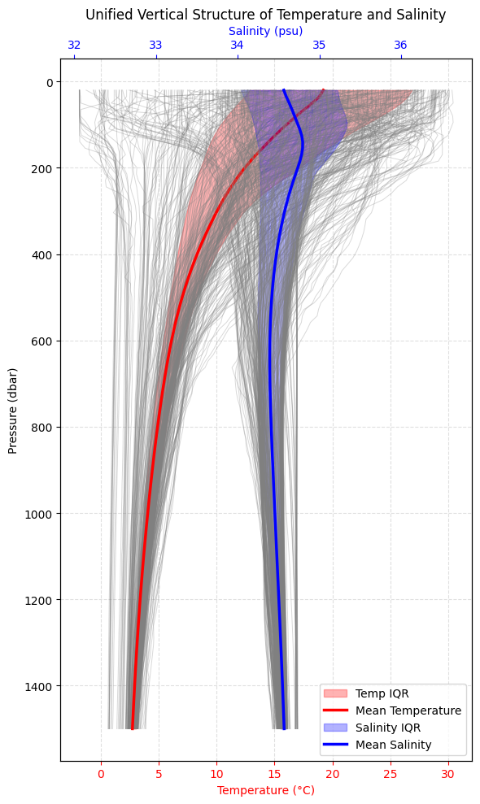
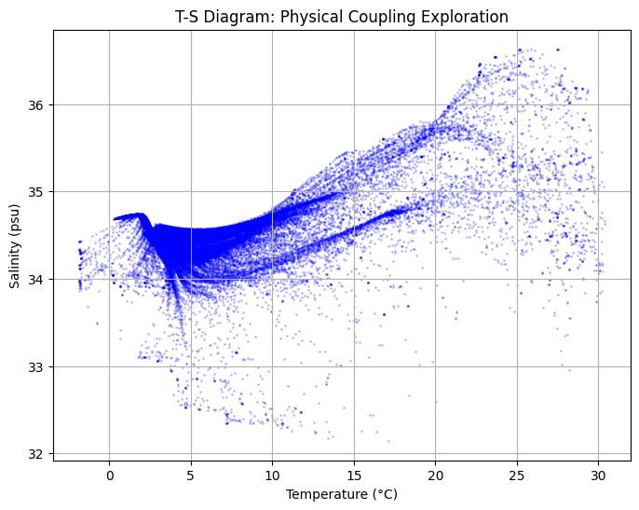
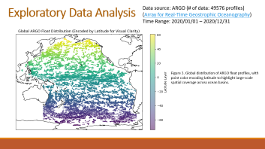
Exploratory Data Analysis
Data source: ARGO (# of data: 49576 profiles)
(Array for Real-Time Geostrophic Oceanography)
Time Range: 2020/01/01 – 2020/12/31
Figure 1. Vertical profiles of temperature and salinity, showing the mean structure and interquartile variability across pressure levels.
Ref: Geo-distribution of data
Figure 2. Temperature–salinity relationships reveal distinct water-mass structure and strong surface-to-deep stratification.
Notes:
The dataset comes from ARGO. In this analysis, I used about 49,576 profiles collected during 2020. And to begin with I looked at the structure of temperature & salinity profiles. From the first figure, we can see a clear vertical structure: temperature changes much more dramatically near the surface, and deeper water is relatively stable. Salinity also changes with depth, but its structure is more subtle and less uniform than temperature. And I also plot the temperature-salinity plot, it suggests that the ocean is not varying randomly. It actually reflects distinct water-mass structure and strong surface-to-deep stratification. I also mapped the geographic distribution of profiles. But because of the limitation of time, I will skip several parts of my analysis. But I have made those slides, so feel free to ask me any question after the presentation.

Slide 3
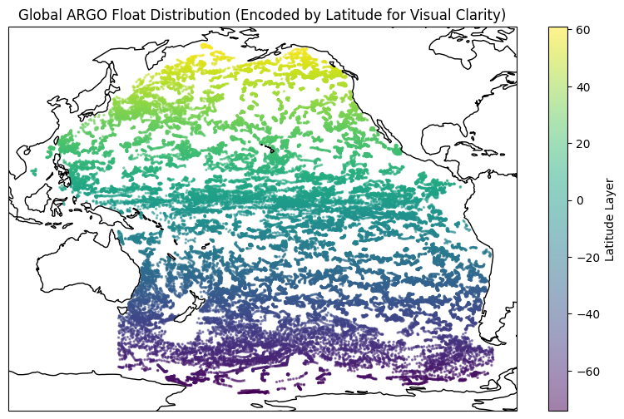
Exploratory Data Analysis
Data source: ARGO (# of data: 49576 profiles)
(Array for Real-Time Geostrophic Oceanography)
Time Range: 2020/01/01 – 2020/12/31
Figure 3. Global distribution of ARGO float profiles, with point color encoding latitude to highlight large-scale spatial coverage across ocean basins.
Notes:
Here I’m showing the spatial distribution of the ARGO profiles in my dataset. I used about 49,500 profiles from 2020, and each point marks the location of one profile. The color represents latitude, mainly to make the large-scale spatial pattern easier to see. Overall, we can see that the data cover most major ocean basins quite well, which makes this dataset suitable for analyzing broad global ocean variabilit

Slide 4









Methodologies
Principle Component Analysis (PCA)
Purpose: To achieve dimension reduction by identifying the primary modes of vertical variation. Since 100-dimensional profiles are highly redundant, PCA allows us to summarize over 90% of the data variance into a few PCs
Canonical Correlation Analysis (CCA)
Purpose: To quantify the statistical coupling between temperature and salinity profiles. CCA finds the linear combinations of T and S that are maximally correlated.
Sliced Inverse Regression (SIR)
Purpose: To identify specific ocean depths that are most sensitive to geographic location (latitude). SIR is a supervised reduction method that extracts the structural features of a profile that best predict where in the world the observation was taken.
Minimum Covariance Determinant (MCD)
Purpose: To provide a robust estimation of the ocean's "typical" state while isolating anomalies. By identifying profiles with high Mahalanobis distances, MCD allows us to detect outliers.
Support Points
Purpose: To perform data quantization. The goal is to find a small set of representative "anchor" profiles (e.g., 50 points) that accurately mimic the distribution of the entire 50,000-profile dataset.
Notes:
To study these patterns, I applied five statistical methods, each answering a different question. Including PCA, CCA, SIR, MCD, and support points. PCA is for dimension reduction, since the original profile is a 100-dimensional data, which contains many redundant information. But because this topic is relatively easy, so I will skip this part for now. But I will include the conclusion at the end.
Now, ‘m going to move on to the next methodology, Canonical Component Analysis.

Slide 5
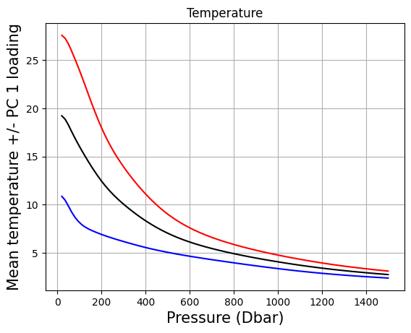
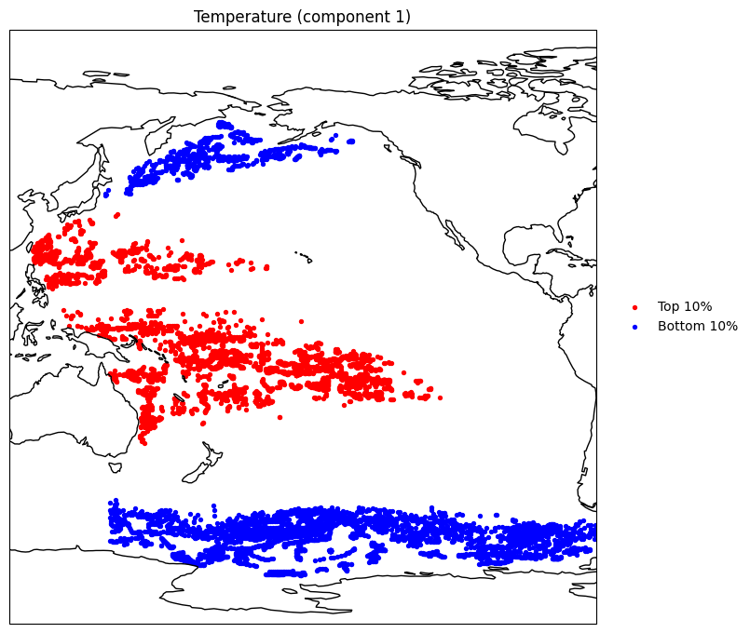
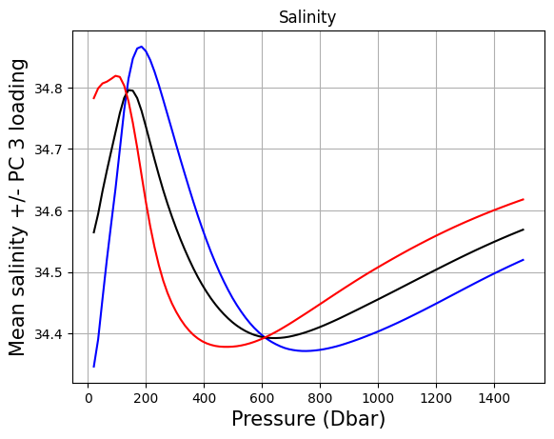
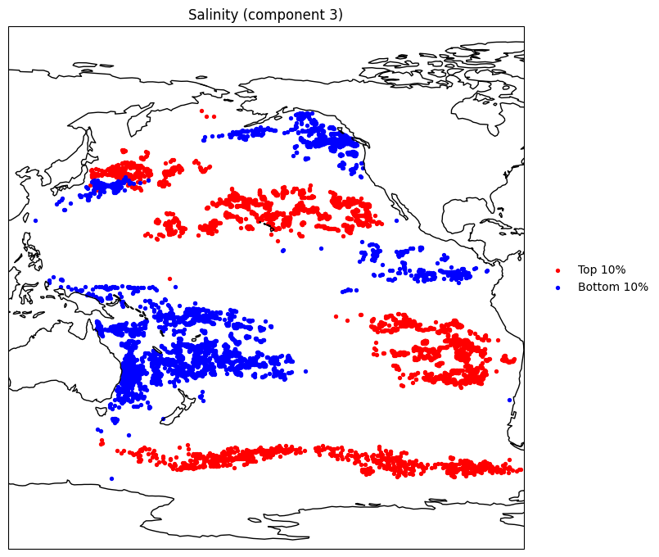
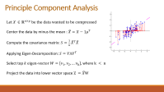
Mathematical Explanation
Principle Component Analysis
Compressing 100-dimensional T & S into a lower dimension for further analysis
We can infer some PC’s meaning by visualizing it:
Figure 4. Temperature PC1 mainly captures the overall upper-ocean temperature level. Profiles with high PC1 scores are warmer throughout the water column, especially near the surface, whereas profiles with low PC1 scores are cooler.
Figure 5. PC3 appears to represent a regional salinity-structure mode. In particular, the western tropical Pacific and maritime-continent side tend to cluster on one end of the component, while parts of the central/eastern Pacific and higher southern latitudes cluster on the other. This suggests that PC3 is associated with basin-scale regional contrasts.
Notes:
So here, we compress the data into several principle components, and use the mean to add or subtract the PCs, to visualize the potential meaning of the component. As we can see here, the first PC of temperature capture the upper-ocean temperature. And similarly, the third PC of salinity seems more complex, but mapping it on map, we can see PC3 might be the basin-scale regional features.

Slide 6
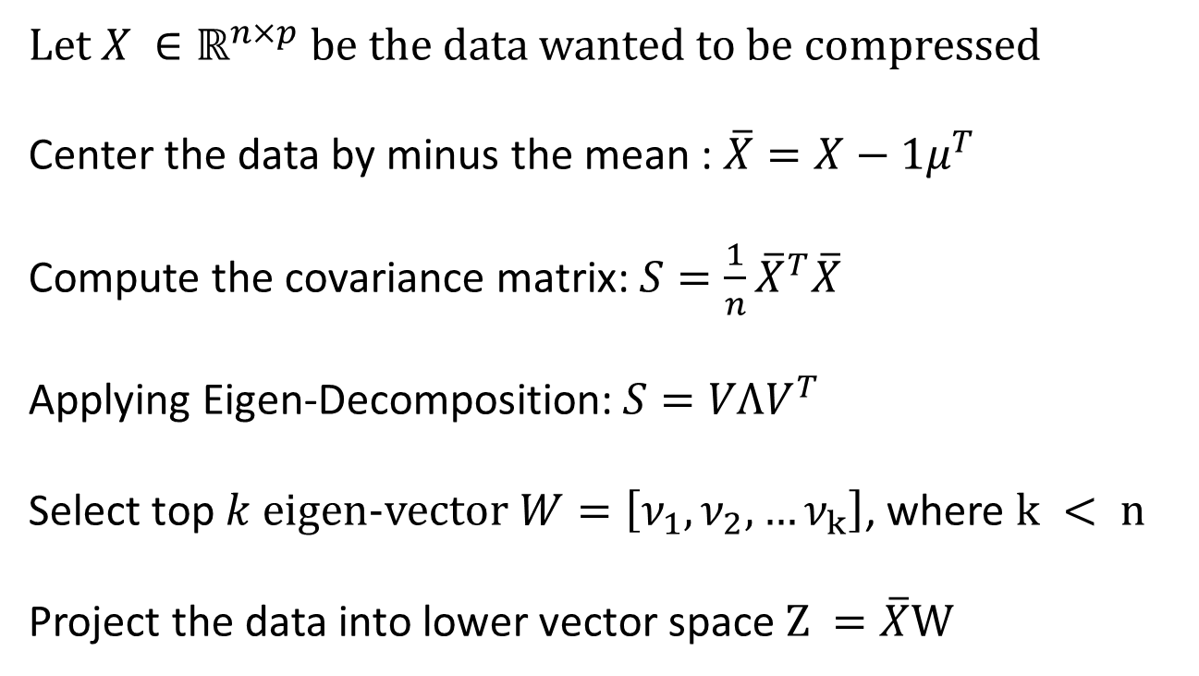
Principle Component Analysis
$Let X ∈ℝ^{n×p}$ be the data wanted to be compressed
Center the data by minus the mean : $\overline{X}=X−1μ^{T}$
Compute the covariance matrix: $S=\frac{1}{n}{\overline{X}}^{T}\overline{X}$
Applying Eigen-Decomposition:$S=VΛV^{T}$
Select top$k$ eigen-vector$W=\left[ν_{1},ν_{2},…ν_{k}\right]$, where $k < n$
Project the data into lower vector space$Z =\overline{X}W$

Slide 7
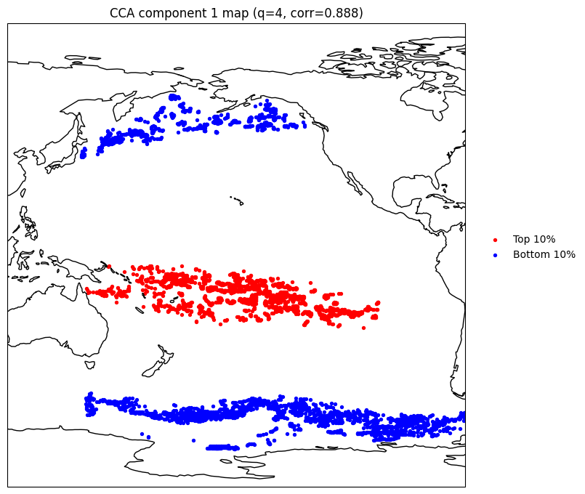
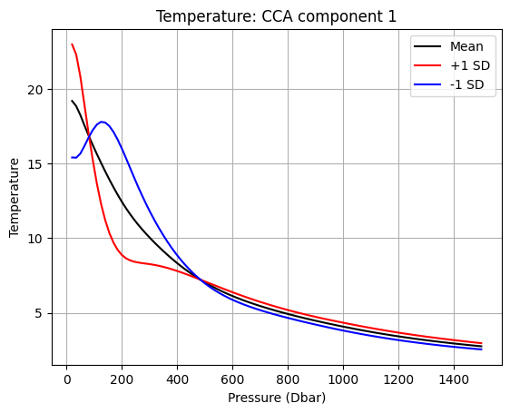
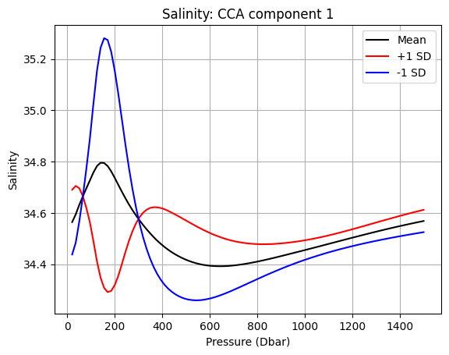


Mathematical Explanation
Canonical Correlation Analysis
CCA component captures the temperature–salinity pattern in the Pacific
Separates warm tropical/subtropical profiles from cold high-latitude profiles
Strongest temperature contrast occurs in the upper ocean
Salinity pattern reflects upper-to-intermediate stratification differences, not just overall salty vs fresh
q = 4: kept the leading profile structure while avoiding noisy higher-order PCs
Strong canonical correlation (0.888) indicates a robust large-scale coupled mode
Notes:
Unlike PCA, which looks at variation within one dataset, CCA looks for linear combinations of temperature and salinity that are maximally correlated.
The first canonical component reveals a very clear large-scale pattern in the Pacific. It separates warm tropical and subtropical profiles from cold high-latitude profiles. And as you can see in the middle plot, The temperature contrast is strongest in the upper ocean. For salinity, the pattern is more complex. It is not simply a fresh-versus-salty contrast. Instead, it reflects differences in upper-to-intermediate salinity stratification.
The first canonical correlation is 0.888, which is quite strong. This suggests that temperature and salinity are not changing independently, but are part of a coherent basin-scale ocean structure.”
(We used q = 4 PCs before CCA to retain the dominant profile structure while excluding noisier higher-order variation, giving a mode that was both strong and physically interpretable.)

Slide 8
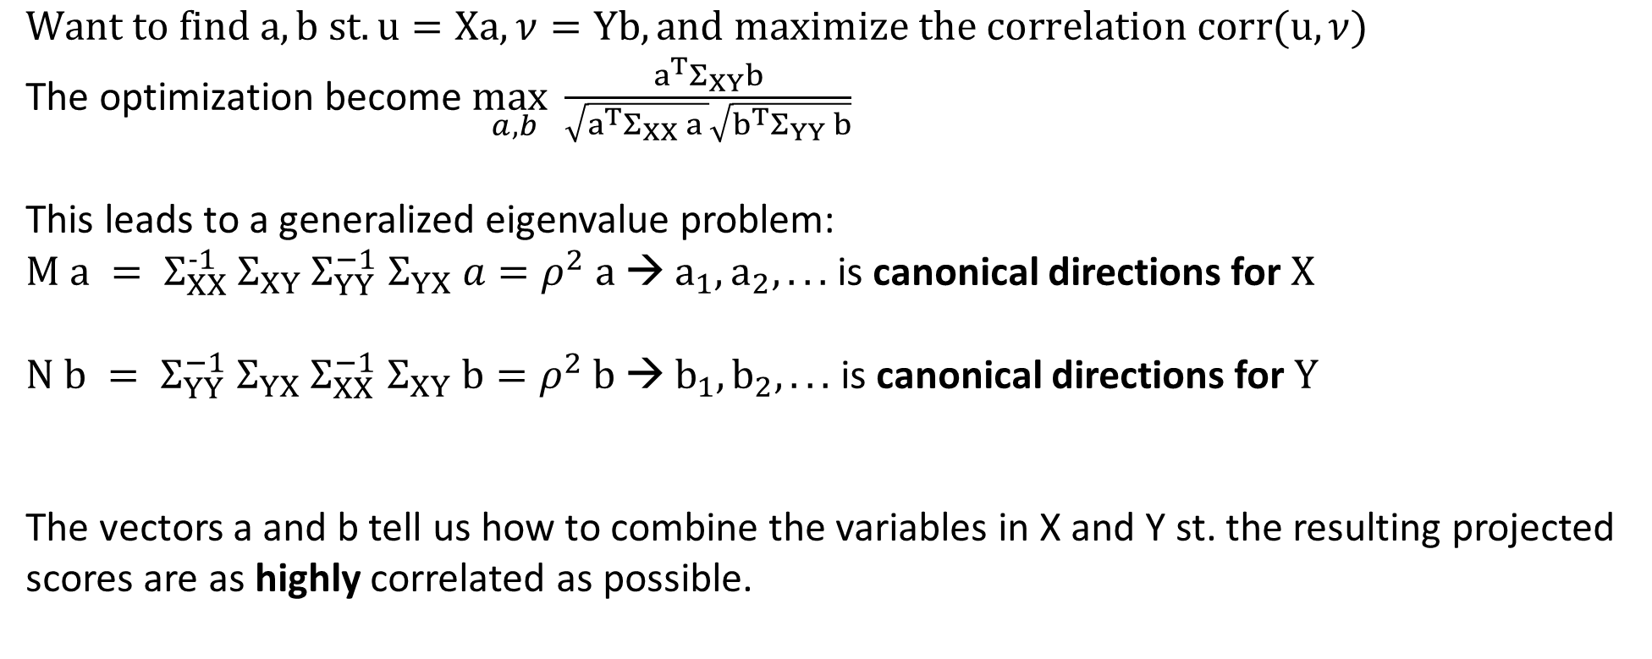
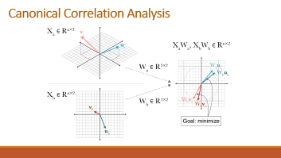
Canonical Correlation Analysis
Constraint of PCA: Maximize variance within one dataset
What if we want to know the correlation between two datasets? Canonical Correlation Analysis
$$Want to find a,b st. u=Xa, ν=Yb, and maximize the correlation corr(u,ν)$$
The optimization become $\max_{a,b}{\frac{a^{T}Σ_{XY}b}{\sqrt{a^{T}Σ_{XX} a }\sqrt{b^{T}Σ_{YY} b}}}$
This leads to a generalized eigenvalue problem:
$M a = Σ_{XX}^{−1}$ $Σ_{XY}$ $Σ_{YY}^{−1}$ $Σ_{YX} a=ρ^{2} a$ → $a_{1},a_{2}, ...$ is canonical directions for $X$
$N b = Σ_{YY}^{−1}$ $Σ_{YX}$ $Σ_{XX}^{−1}$ $Σ_{XY} b=ρ^{2} b$ → $b_{1},b_{2}, ...$ is canonical directions for $Y$
The vectors a and b tell us how to combine the variables in X and Y st. the resulting projected scores are as highly correlated as possible.

Slide 9
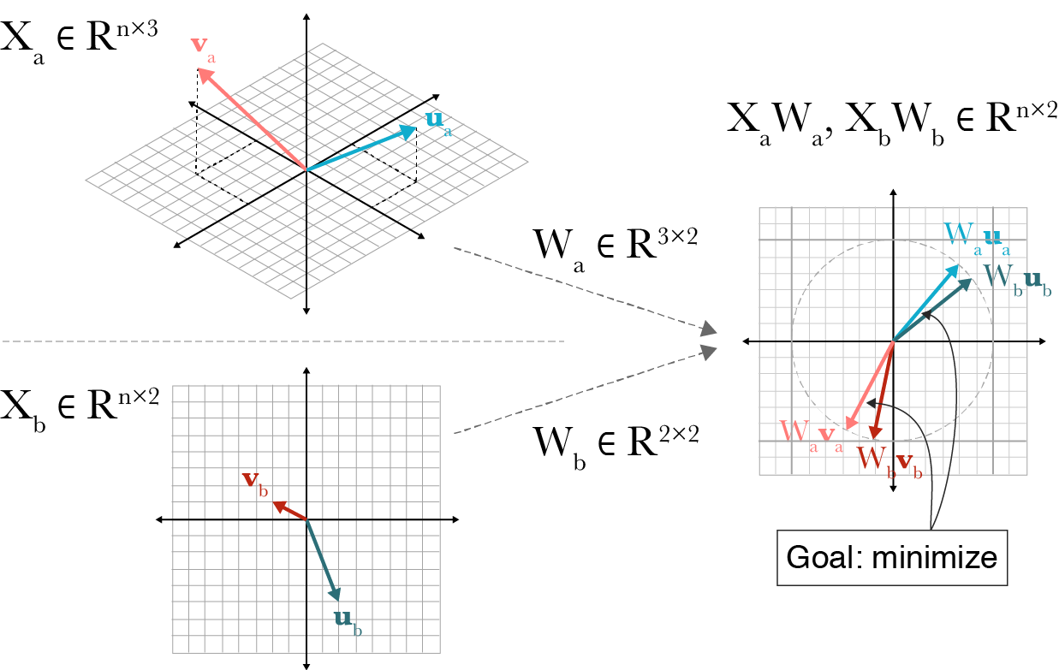
Canonical Correlation Analysis
Notes:
This slide illustrates the basic idea of Canonical Correlation Analysis, or CCA.
Here, we start with two sets of variables, Xa and Xb.
In my project, you can think of these as two multivariate profile datasets, for example temperature and salinity.
Each dataset may have many dimensions, so instead of looking at all variables directly, CCA looks for linear combinations of the variables in each set.
That is what the matrices Wa and Wb represent. They project the original data into lower-dimensional directions.
After projection, we get XaWa and XbWb, which are the canonical variables.
The goal is to find directions so that these projected variables are as strongly related as possible.
“In this slide, $X_{a}$and $X_{b}$represent two datasets measured on the same set of samples. For example, in my project, $X_{a}$can represent temperature profiles and $X_{b}$can represent salinity profiles. Each row corresponds to one ocean profile, and each column corresponds to one variable, such as measurements at different depths or reduced features extracted from the original profiles.
The arrows like $u_{a}$, $v_{a}$, $u_{b}$, and $v_{b}$represent directions in the original data spaces. These directions are not single variables. Instead, each direction represents a pattern formed by combining multiple variables together. For example, one direction in the temperature space might represent a profile pattern with a warmer surface and a rapid decline with depth. Another direction might represent an overall colder profile that changes more gradually with depth. So these directions correspond to interpretable modes of variation in the data.
The matrices $W_{a}$and $W_{b}$are the weights used to define those directions more systematically. They tell us how much each original variable contributes to a new combined feature. So in the temperature case, a column of $W_{a}$might place more weight on upper-ocean measurements and less weight on deep-ocean measurements, meaning that this canonical direction is especially sensitive to surface structure. In salinity, a column of $W_{b}$might capture a pattern such as fresher near-surface water but more stable salinity at depth.
”

Slide 10
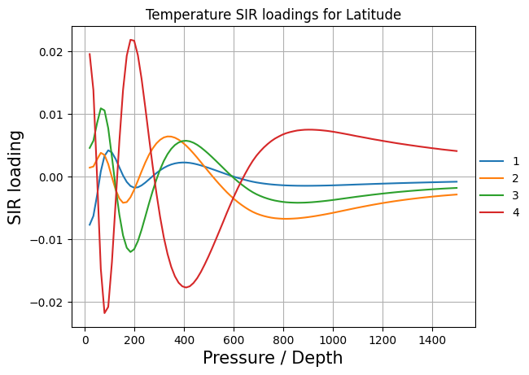
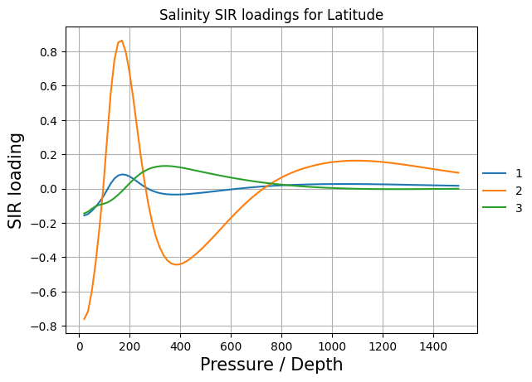
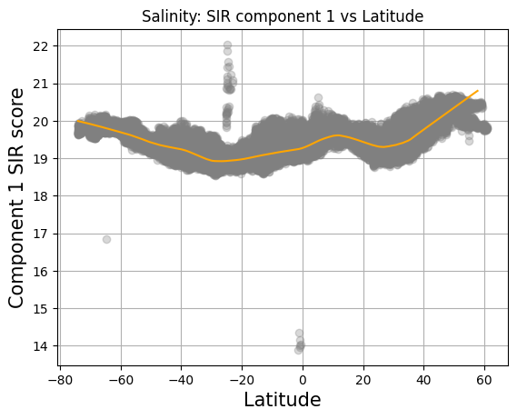

Mathematical Explanation
Sliced Inverse Regression
Temperature loadings: the strongest latitude-related signal is concentrated in the upper to mid-depth ocean
Temperature SIR scores: the first two components vary clearly and nonlinearly with latitude. This indicates that temperature profiles differ systematically across latitude bands
Salinity loadings: latitude-related structure is present, but weaker and more localized
Salinity SIR scores: variation with latitude is much flatter than for temperature
Notes:
After that, I applied Sliced Inverse Regression, or SIR, to see how well profiles can be explained by latitude. Since we want to know how location affect temperature & salinity. For temperature, the strongest latitude-related signal is concentrated In the upper to mid-depth ocean. And the first 2 SIR components change nonlinearly with latitude, showing that temperature differ systematically across latitude.
For salinity, there is also some latitude-related structure, especially in the upper and intermediate layers, but it is obviously weaker comparing to temperature.
So the main conclusion from SIR is that latitude explains temperature more strongly than salinity profiles especially in the upper ocean.

Slide 11
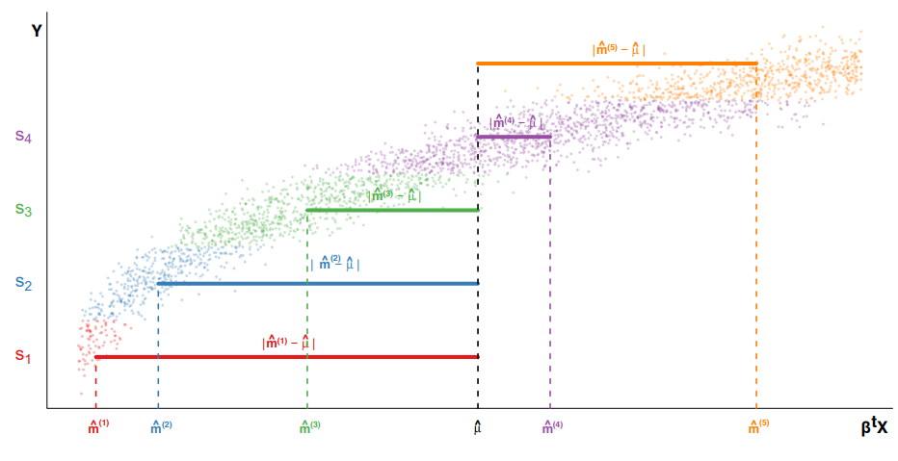
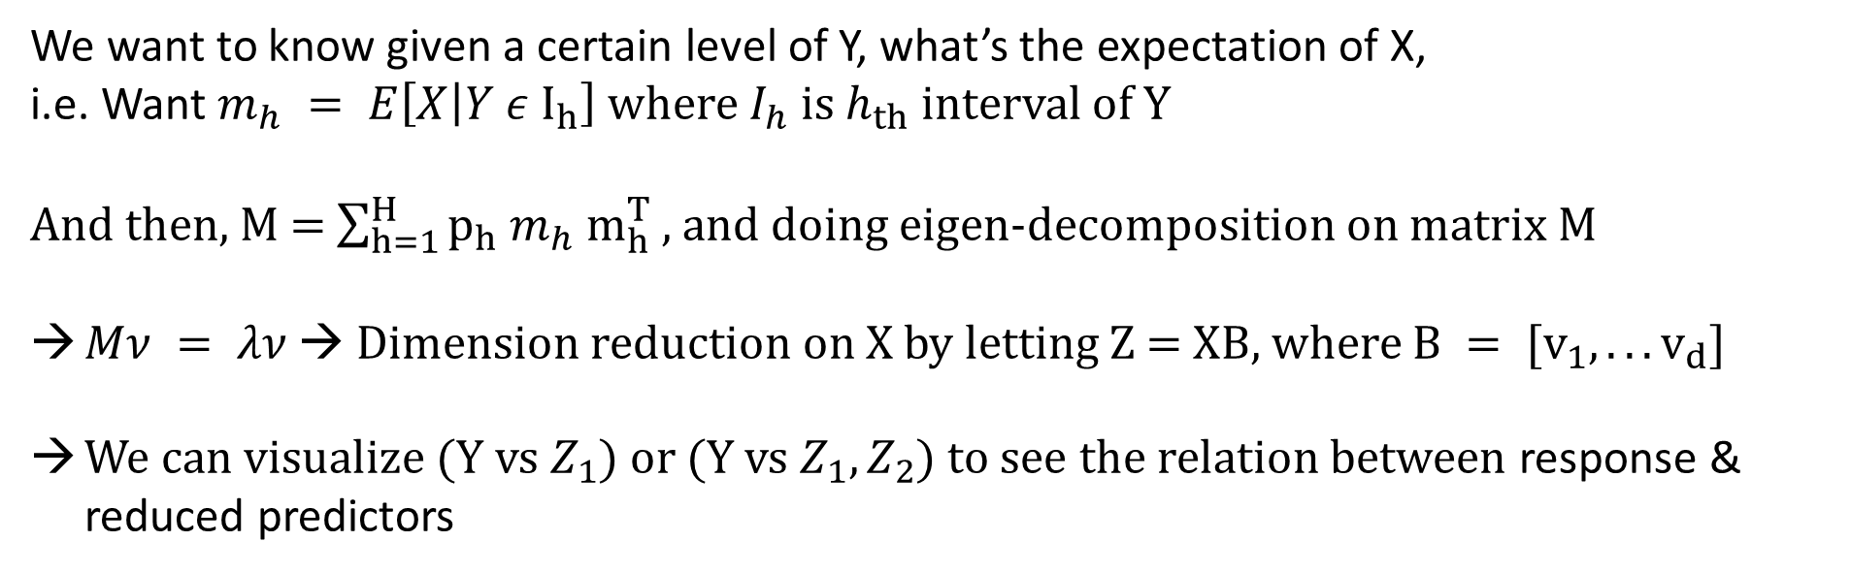
Sliced Inverse Regression
Another method to understand the relationship between X, Y & dimension reduction is Sliced Inverse Regression.
We want to know given a certain level of Y, what’s the expectation of X,
i.e. Want $m_{h} = E\left[X | Y ε I_{h}\right]$ where${ I}_{h}$ is$h_{th}$ interval of Y
And then, M = $\sum_{h=1}^{H}{p_{h}}$ $m_{h}{ m}_{h}^{T}$ , and doing eigen-decomposition on matrix M
$Mν = λν$ → Dimension reduction on X by letting Z = XB, where $B = [v_{1},...v_{d}]$
We can visualize (Y vs $Z_{1}$) or (Y vs $Z_{1},Z_{2}$) to see the relation between response & reduced predictors
Notes:
Sliced Inverse Regression, or SIR, is a supervised dimension reduction method for studying the relationship between $X$and $Y$.
The key idea is that instead of directly modeling $Y$from $X$, we first divide $Y$into several slices and look at the average value of $X$within each slice. That is what $m_{h}=E\left[X∣Y∈I_{h}\right]$means.
If these average predictor patterns change across slices, then $X$contains structure related to $Y$. We summarize these changes in the matrix $M$, and by doing eigen-decomposition, we find the main directions in $X$that are most associated with the response.
Finally, we project $X$onto those directions to get a lower-dimensional representation, $Z=XB$. So in this project, SIR helps us identify the main temperature or salinity profile patterns that are related to latitude.

Slide 12
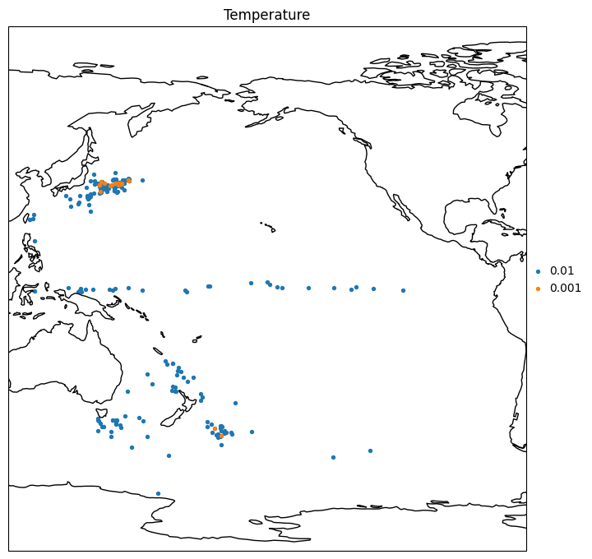
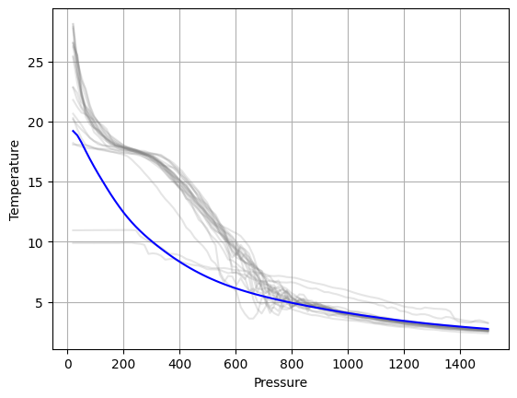
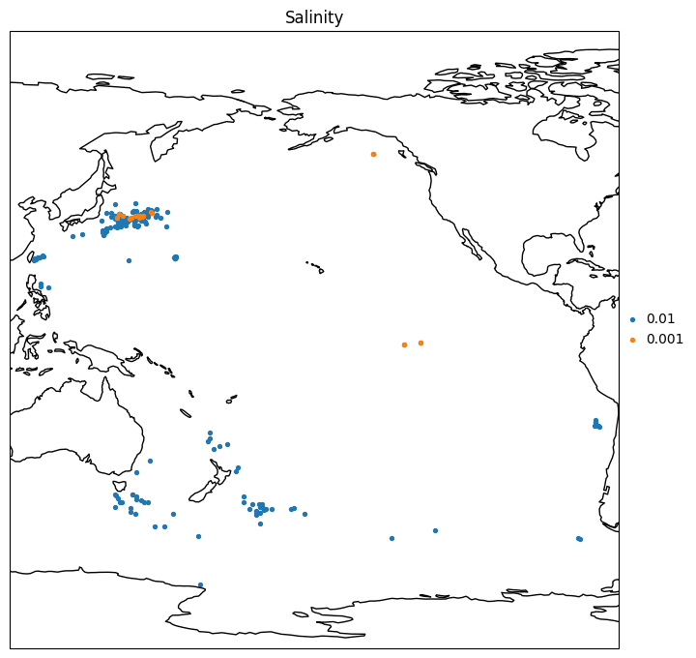
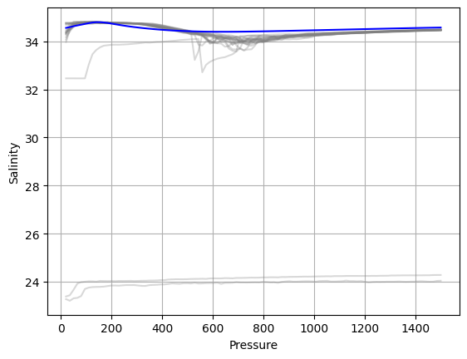


Mathematical Explanation
Minimum Covariance Determinant
Treat each temperature or salinity profile as a high-dimensional vector over pressure levels.
Use MCD to estimate a robust mean and covariance from the most compact subset of profiles.
Compute Mahalanobis depth to identify profiles far from the robust data center.
Outlying profiles are geographically clustered rather than randomly scattered.
Salinity outliers are especially pronounced, with several profiles showing extremely low values.
Notes:
And then the next topic is Minimum Covariance Determinant to identify unusual profiles. The key reason for using MCD is because the ordinary covariance-based distance measures can be distorted by outliers. MCD provides a more robust estimate of the data center and covariance by focusing on the most compact subset. Using the Mahalanobis distance, I found that outlying profiles are not randomly scattered. Instead, they tend to be geographically clusterd, which suggest that they mat reflect meaningful regional anomalies rather than just noise.

Slide 13
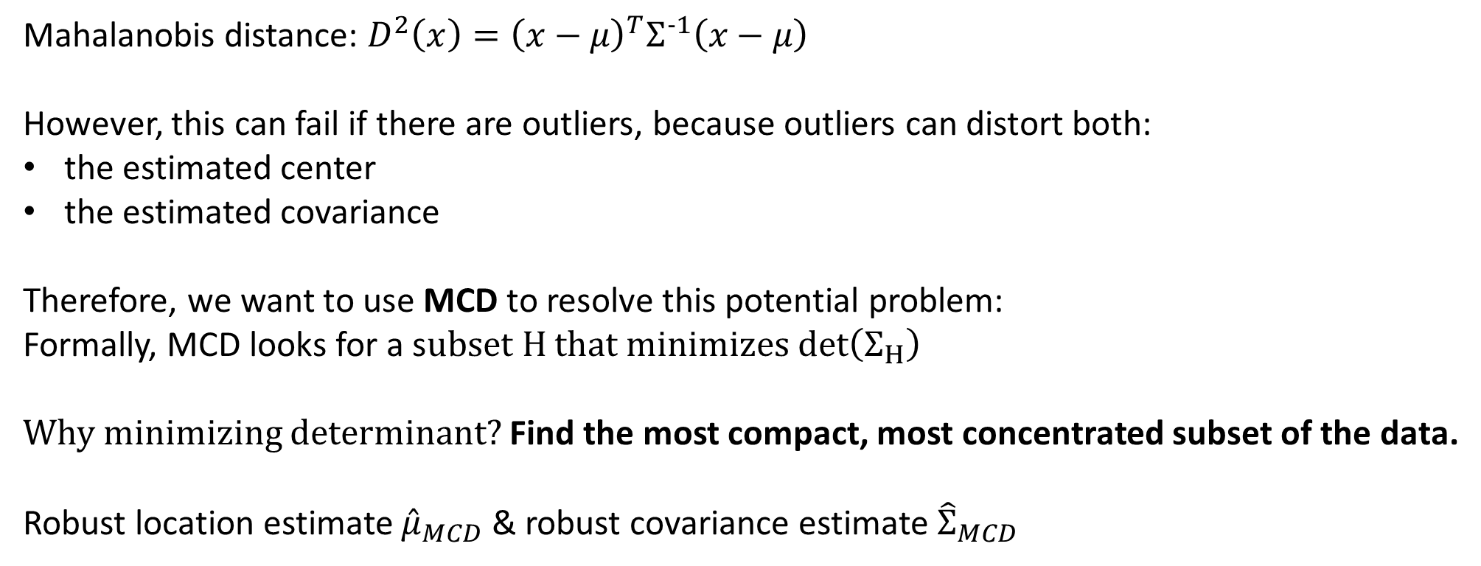
Minimum Covariance Determinant
Why not use Euclidean distance as the distance metric? It treats all variables equally and ignores covariance structure.
Therefore, we introduce Mahalanobis distance:
Mahalanobis distance: $D^{2}\left(x\right)={\left(x−μ\right)}^{T}Σ^{−1}\left(x−μ\right)$
However, this can fail if there are outliers, because outliers can distort both:
the estimated center
the estimated covariance
Therefore, we want to use MCD to resolve this potential problem:
Formally, MCD looks for a subset $H$ that minimizes$det⁡\left(Σ_{H}\right)$
Why minimizing determinant? Find the most compact, most concentrated subset of the data.
Robust location estimate ${\hat{μ}}_{MCD}$ ​& robust covariance estimate ${\hat{Σ}}_{MCD}$
Notes:
Minimum Covariance Determinant, or MCD, which is a robust method for outlier detection.
A simple Euclidean distance is not ideal because it treats all variables equally and ignores the covariance structure. Mahalanobis distance improves on this by measuring distance relative to the data center and covariance.
However, there is still a problem: if the dataset contains outliers, those outliers can distort both the estimated mean and the covariance matrix. As a result, the Mahalanobis distance itself may become unreliable.
MCD solves this by searching for the most compact subset of the data, meaning the subset with the smallest covariance determinant. The idea is that this subset is less affected by outliers and better represents the main body of the data.
Using this subset, we obtain a robust estimate of the center and covariance, and then compute a more reliable Mahalanobis distance for detecting unusual profiles

Slide 14
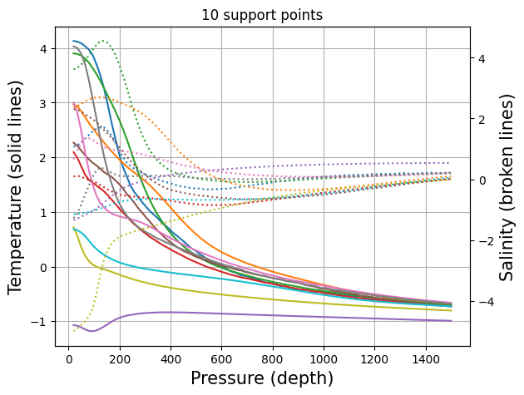
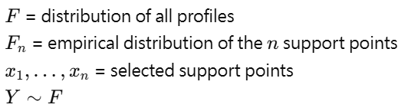
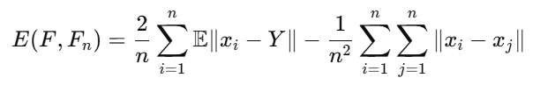
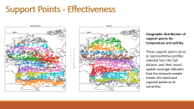
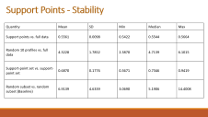
Representative support points
Stability of Supports Points
Support Points
Support points aim to represent the overall distribution of profiles using only a small number of representative points, rather than discovering latent clusters. Each original profile is later assigned to its nearest support point only for visualization.
The method minimizes the energy distance between the full data distribution and the empirical distribution formed by the selected support points.
Figure 6. Ten support points summarizing temperature and salinity profiles across depth.
This objective balances two goals: keep the support points close to the data distribution, keep them spread out to avoid redundancy.
Notes:
Finally, I used support points to summarize the full dataset with a small representative subset.
The idea here is not clustering in the usual sense, but selecting a small number of points that preserve the distribution of the full data.
The support-point profiles cover a broad range of temperature and salinity structures, and their geographic distribution also suggests that they retain the dominant regional patterns.
To evaluate stability of this methods, I compared support points with random subsets. The results show that support points are much closer to the full data distribution than randomly selected profiles.

Slide 15
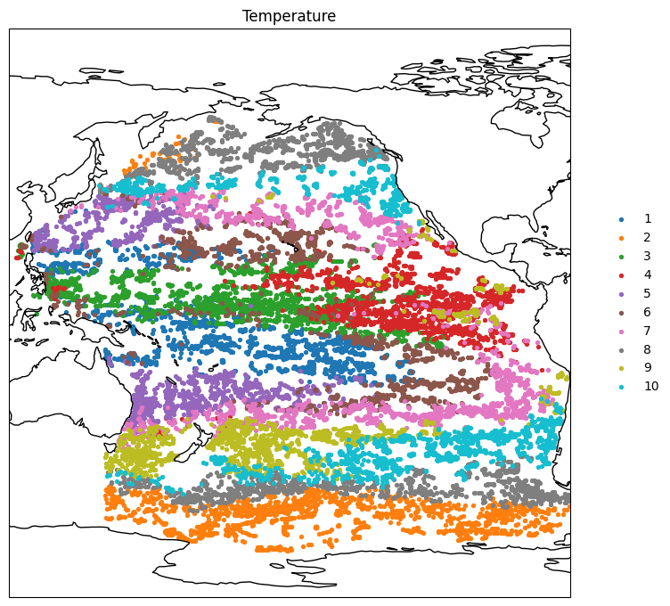
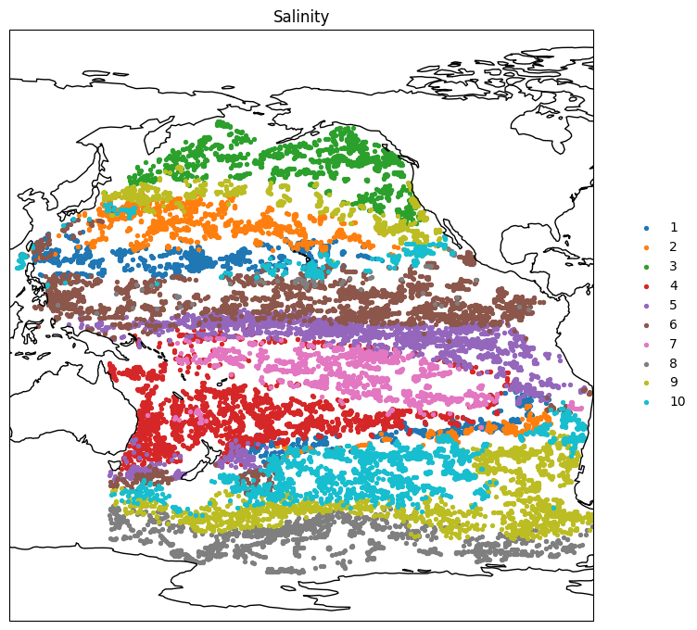
Support Points - Effectiveness
Geographic distribution of support points for temperature and salinity.
These support points serve as representative profiles selected from the full dataset, and their broad spatial coverage indicates that the reduced sample retains the dominant regional patterns of variability.
Notes:
Here I’m showing where the support points are located for temperature and salinity. Although this is only a reduced subset of the full dataset, the points still cover the major ocean regions quite broadly. That’s important because it means the reduced sample is not losing the main spatial patterns in the original data. In other words, the support points still capture the large-scale variability of the full dataset, but in a much more compact way. “I first computed 10 support points as representative prototype profiles for the full dataset. Then, for each observed profile, I calculated its distance to all 10 support points and assigned it to the nearest one. So the classification is based on profile similarity, not just geographic location.”

Slide 16
Support Points - Stability
Quantity | Mean | SD | Min | Median | Max
Support points vs. full data | 0.5561 | 0.0098 | 0.5422 | 0.5544 | 0.5664
Random 10 profiles vs. full data | 4.3228 | 1.7852 | 2.3870 | 4.7139 | 6.1015
Support-point set vs. support-point set | 0.6870 | 0.1776 | 0.3671 | 0.7346 | 0.9419
Random subset vs. random subset (Baseline) | 6.9139 | 4.6339 | 3.0690 | 5.1906 | 14.4008
Notes:
This table shows why support points are more effective than just randomly picking a few profiles.
First, support points stay much closer to the full dataset, with a mean distance of about 0.56, while random 10-profile subsets are much farther away, with a mean above 4.3.
Second, support points are also much more stable, because their variability is much smaller across repeated runs.
Even when comparing one support-point set to another, the distances remain relatively small, while random subsets vary a lot more.
So the main takeaway is that support points give a much more reliable and representative summary of the full dataset than random sampling.

Slide 17
Findings & Discussion
The dominant temperature contrast in the Pacific is a surface-intensified warm–cold gradient, separating tropical/subtropical waters from high-latitude waters.
Salinity variability is driven less by an overall fresh–salty shift and more by differences in upper-to-intermediate vertical stratification.
Temperature and salinity are strongly coupled at basin scale, indicating a coherent large-scale ocean structure rather than independent variation.
Latitude explains temperature profiles more strongly than salinity profiles, especially in the upper and middle ocean.
Extreme profiles are geographically clustered, suggesting meaningful regional anomalies rather than random noise; salinity outliers are especially pronounced.
Notes:
To summarize the main findings:
First, the dominant temperature variation in the Pacific is a surface-intensified warm–cold gradient, separating tropical and subtropical waters from high-latitude waters.
Second, salinity variability is driven less by a simple fresh-versus-salty contrast, and more by differences in vertical stratification.
Third, temperature and salinity are strongly coupled at basin scale, which indicates a coherent large-scale ocean structure.
Fourth, latitude has a stronger effect on temperature than on salinity, especially in the upper and middle ocean.
And finally, extreme profiles are geographically clustered, suggesting that these outliers may represent real regional anomalies rather than random measurement noise.

Slide 18
Thank you

