Slide 1
1-15 | 2-15 | 3-15 | 4-15 | 5-15 | 6-15 | 7-15 | 8-15 | 9-15 | 10-15 | 11-15
1-14 | 2-14 | 3-14 | 4-14 | 5-14 | 6-14 | 7-14 | 8-14 | 9-14 | 10-14 | 11-14
6-13 | 7-13 | 8-13
server
1-12 | 2-12 | 3-12 | 4-12 | 5-12 | 6-12 | 7-12 | 8-12 | 9-12 | 10-12 | 11-12
1-11 | 2-11 | 3-11 | 4-11 | 5-11 | 6-11 | 7-11 | 8-11 | 9-11 | 10-11 | 11-11
1-10 |  |  |  |  | 6-10 |  |  |  |  | 11-10
1-9 |  |  |  |  | 6-9 |  |  |  |  | 11-9
1-8 |  |  |  |  | 6-8 |  |  |  |  | 11-8
1-7 |  |  |  |  | 6-7 |  |  |  |  | 11-7
1-6 |  |  |  |  | 6-6 |  |  |  |  | 11-6
1-5 |  |  |  |  | 6-5 |  |  |  |  | 11-5
1-4 |  |  |  |  | 6-4 |  |  |  |  | 11-4
1-3 |  |  |  |  | 6-3 |  |  |  |  | 11-3
1-2 |  |  |  |  | 6-2 |  |  |  |  | 11-2
1-1 | 2-1 | 3-1 | 4-1 | 5-1 | 6-1 | 7-1 | 8-1 | 9-1 | 10-1 | 11-1
7.2m
1.5m
6.6m
3.9m

Slide 2
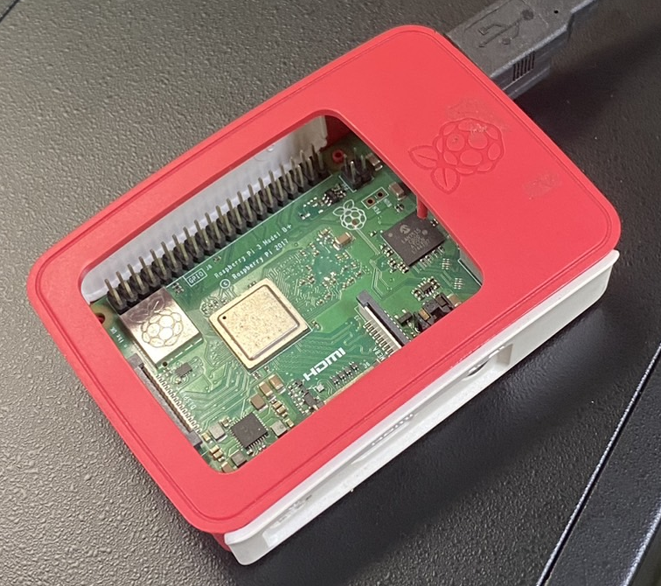
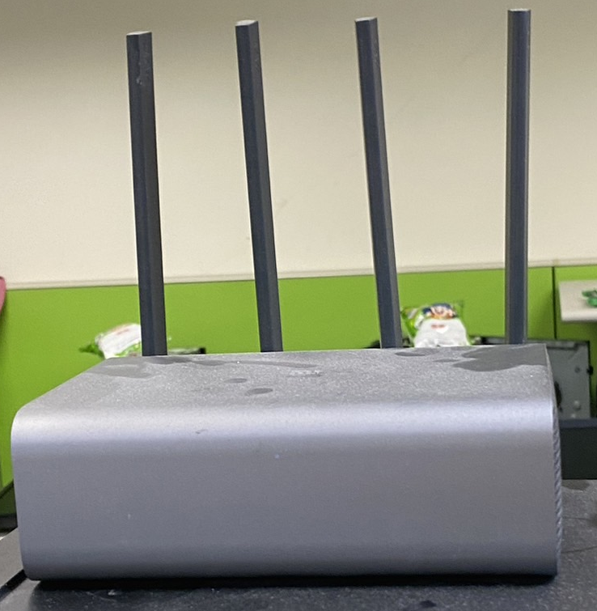
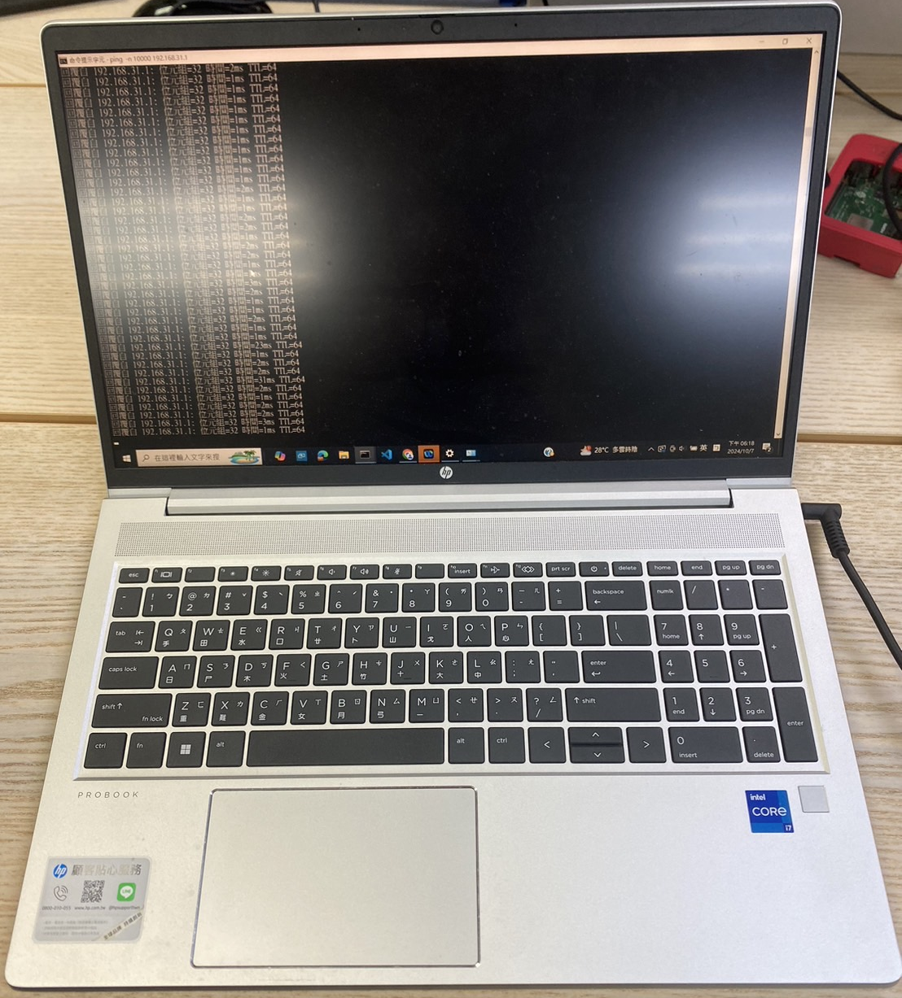
p
2.8m
p
p
p
p
p

Slide 3

11 | 12 | 13 | 14 | 15 | 16 | 17 | 18 | 19 | 20 | 21
10 |  |  |  |  | 49 |  |  |  |  | 22
9 |  |  |  |  | 48 |  |  |  |  | 23
8 |  |  |  |  | 47 |  |  |  |  | 24
7 |  |  |  |  | 46 |  |  |  |  | 25
6 |  |  |  |  | 45 |  |  |  |  | 26
5 |  |  |  |  | 44 |  |  |  |  | 27
4 |  |  |  |  | 43 |  |  |  |  | 28
3 |  |  |  |  | 42 |  |  |  |  | 29
2 |  |  |  |  | 41 |  |  |  |  | 30
1 | 40 | 39 | 38 | 37 | 36 | 35 | 34 | 33 | 32 | 31
Wi-Fi AP + CSI Extractor
seat partition
seating area
electrical appliance area

Slide 4
1
Wi-Fi AP
seat partition
reference point
1

Slide 5
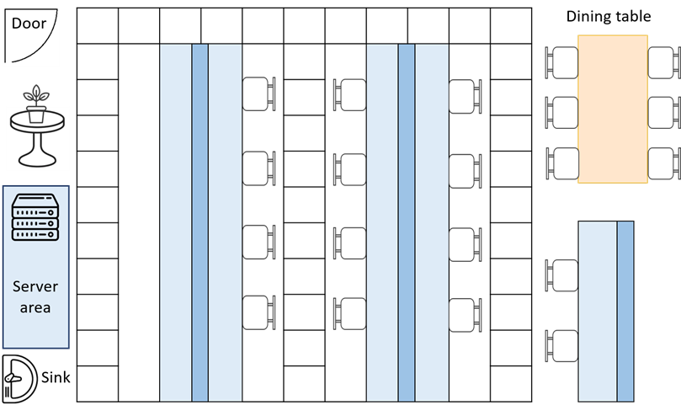
Door
1-11 | 2-11 | 3-11 | 4-11 | 5-11 | 6-11 | 7-11 | 8-11 | 9-11 | 10-11 | 11-11
1-10 |  |  |  |  | 6-10 |  |  |  |  | 11-10
1-9 |  |  |  |  | 6-9 |  |  |  |  | 11-9
1-8 |  |  |  |  | 6-8 |  |  |  |  | 11-8
1-7 |  |  |  |  | 6-7 |  |  |  |  | 11-7
1-6 |  |  |  |  | 6-6 |  |  |  |  | 11-6
1-5 |  |  |  |  | 6-5 |  |  |  |  | 11-5
1-4 |  |  |  |  | 6-4 |  |  |  |  | 11-4
1-3 |  |  |  |  | 6-3 |  |  |  |  | 11-3
1-2 |  |  |  |  | 6-2 |  |  |  |  | 11-2
1-1 | 2-1 | 3-1 | 4-1 | 5-1 | 6-1 | 7-1 | 8-1 | 9-1 | 10-1 | 11-1
Dining table
4
1
1
Wi-Fi AP
seat partition
reference point
Metal Cabinet
7.2m
1
Server
area
3
2
Sink
3-1 | 4-1
8-1 | 9-1
1.5m
6.6m
3.9m

Slide 6
All RP 之於 AP 1 的 LOS/NLOS 關係
Door
1-11 | 2-11 | 3-11 | 4-11 | 5-11 | 6-11 | 7-11 | 8-11 | 9-11 | 10-11 | 11-11
1-10 |  |  |  |  | 6-10 |  |  |  |  | 11-10
1-9 |  |  |  |  | 6-9 |  |  |  |  | 11-9
1-8 |  |  |  |  | 6-8 |  |  |  |  | 11-8
1-7 |  |  |  |  | 6-7 |  |  |  |  | 11-7
1-6 |  |  |  |  | 6-6 |  |  |  |  | 11-6
1-5 |  |  |  |  | 6-5 |  |  |  |  | 11-5
1-4 |  |  |  |  | 6-4 |  |  |  |  | 11-4
1-3 |  |  |  |  | 6-3 |  |  |  |  | 11-3
1-2 |  |  |  |  | 6-2 |  |  |  |  | 11-2
1-1 | 2-1 | 3-1 | 4-1 | 5-1 | 6-1 | 7-1 | 8-1 | 9-1 | 10-1 | 11-1
Dining table
1
1
Wi-Fi AP
seat partition
LOS reference point
Metal Cabinet
7.2m
1
1
NLOS reference point
Server
area
Sink
3-1 | 4-1
8-1 | 9-1
1.5m
6.6m
3.9m

Slide 7
All RP 之於 AP 2 的 LOS/NLOS 關係
Door
1-11 | 2-11 | 3-11 | 4-11 | 5-11 | 6-11 | 7-11 | 8-11 | 9-11 | 10-11 | 11-11
1-10 |  |  |  |  | 6-10 |  |  |  |  | 11-10
1-9 |  |  |  |  | 6-9 |  |  |  |  | 11-9
1-8 |  |  |  |  | 6-8 |  |  |  |  | 11-8
1-7 |  |  |  |  | 6-7 |  |  |  |  | 11-7
1-6 |  |  |  |  | 6-6 |  |  |  |  | 11-6
1-5 |  |  |  |  | 6-5 |  |  |  |  | 11-5
1-4 |  |  |  |  | 6-4 |  |  |  |  | 11-4
1-3 |  |  |  |  | 6-3 |  |  |  |  | 11-3
1-2 |  |  |  |  | 6-2 |  |  |  |  | 11-2
1-1 | 2-1 | 3-1 | 4-1 | 5-1 | 6-1 | 7-1 | 8-1 | 9-1 | 10-1 | 11-1
Dining table
2
Wi-Fi AP
seat partition
LOS reference point
Metal Cabinet
7.2m
1
1
NLOS reference point
Server
area
2
Sink
3-1 | 4-1
8-1 | 9-1
1.5m
6.6m
3.9m

Slide 8
All RP 之於 AP 3 的 LOS/NLOS 關係
Door
1-11 | 2-11 | 3-11 | 4-11 | 5-11 | 6-11 | 7-11 | 8-11 | 9-11 | 10-11 | 11-11
1-10 |  |  |  |  | 6-10 |  |  |  |  | 11-10
1-9 |  |  |  |  | 6-9 |  |  |  |  | 11-9
1-8 |  |  |  |  | 6-8 |  |  |  |  | 11-8
1-7 |  |  |  |  | 6-7 |  |  |  |  | 11-7
1-6 |  |  |  |  | 6-6 |  |  |  |  | 11-6
1-5 |  |  |  |  | 6-5 |  |  |  |  | 11-5
1-4 |  |  |  |  | 6-4 |  |  |  |  | 11-4
1-3 |  |  |  |  | 6-3 |  |  |  |  | 11-3
1-2 |  |  |  |  | 6-2 |  |  |  |  | 11-2
1-1 | 2-1 | 3-1 | 4-1 | 5-1 | 6-1 | 7-1 | 8-1 | 9-1 | 10-1 | 11-1
Dining table
3
Wi-Fi AP
seat partition
LOS reference point
Metal Cabinet
7.2m
1
1
NLOS reference point
Server
area
3
Sink
3-1 | 4-1
8-1 | 9-1
1.5m
6.6m
3.9m

Slide 9
All RP 之於 AP 4 的 LOS/NLOS 關係
Door
1-11 | 2-11 | 3-11 | 4-11 | 5-11 | 6-11 | 7-11 | 8-11 | 9-11 | 10-11 | 11-11
1-10 |  |  |  |  | 6-10 |  |  |  |  | 11-10
1-9 |  |  |  |  | 6-9 |  |  |  |  | 11-9
1-8 |  |  |  |  | 6-8 |  |  |  |  | 11-8
1-7 |  |  |  |  | 6-7 |  |  |  |  | 11-7
1-6 |  |  |  |  | 6-6 |  |  |  |  | 11-6
1-5 |  |  |  |  | 6-5 |  |  |  |  | 11-5
1-4 |  |  |  |  | 6-4 |  |  |  |  | 11-4
1-3 |  |  |  |  | 6-3 |  |  |  |  | 11-3
1-2 |  |  |  |  | 6-2 |  |  |  |  | 11-2
1-1 | 2-1 | 3-1 | 4-1 | 5-1 | 6-1 | 7-1 | 8-1 | 9-1 | 10-1 | 11-1
Dining table
4
4
Wi-Fi AP
seat partition
LOS reference point
Metal Cabinet
7.2m
1
1
NLOS reference point
Server
area
Sink
3-1 | 4-1
8-1 | 9-1
1.5m
6.6m
3.9m

Slide 11
Indoor LOS/NLOS Distribution Analysis for Wi-Fi AP2 and AP4
Door
1-11 | 2-11 | 3-11 | 4-11 | 5-11 | 6-11 | 7-11 | 8-11 | 9-11 | 10-11 | 11-11
1-10 |  |  |  |  | 6-10 |  |  |  |  | 11-10
1-9 |  |  |  |  | 6-9 |  |  |  |  | 11-9
1-8 |  |  |  |  | 6-8 |  |  |  |  | 11-8
1-7 |  |  |  |  | 6-7 |  |  |  |  | 11-7
1-6 |  |  |  |  | 6-6 |  |  |  |  | 11-6
1-5 |  |  |  |  | 6-5 |  |  |  |  | 11-5
1-4 |  |  |  |  | 6-4 |  |  |  |  | 11-4
1-3 |  |  |  |  | 6-3 |  |  |  |  | 11-3
1-2 |  |  |  |  | 6-2 |  |  |  |  | 11-2
1-1 | 2-1 | 3-1 | 4-1 | 5-1 | 6-1 | 7-1 | 8-1 | 9-1 | 10-1 | 11-1
Dining table
4
2
Wi-Fi AP
Wi-Fi AP
seat partition
LOS reference point
4
Metal Cabinet
7.2m
1
1
NLOS reference point
Server
area
2
Sink
3-1 | 4-1
8-1 | 9-1
1.5m
6.6m
3.9m

Slide 12
Indoor LOS/NLOS Distribution Analysis for Wi-Fi AP1 and AP3
Door
1-11 | 2-11 | 3-11 | 4-11 | 5-11 | 6-11 | 7-11 | 8-11 | 9-11 | 10-11 | 11-11
1-10 |  |  |  |  | 6-10 |  |  |  |  | 11-10
1-9 |  |  |  |  | 6-9 |  |  |  |  | 11-9
1-8 |  |  |  |  | 6-8 |  |  |  |  | 11-8
1-7 |  |  |  |  | 6-7 |  |  |  |  | 11-7
1-6 |  |  |  |  | 6-6 |  |  |  |  | 11-6
1-5 |  |  |  |  | 6-5 |  |  |  |  | 11-5
1-4 |  |  |  |  | 6-4 |  |  |  |  | 11-4
1-3 |  |  |  |  | 6-3 |  |  |  |  | 11-3
1-2 |  |  |  |  | 6-2 |  |  |  |  | 11-2
1-1 | 2-1 | 3-1 | 4-1 | 5-1 | 6-1 | 7-1 | 8-1 | 9-1 | 10-1 | 11-1
Dining table
1
1
Wi-Fi AP
Wi-Fi AP
seat partition
LOS reference point
3
Metal Cabinet
7.2m
1
1
NLOS reference point
Server
area
3
Sink
3-1 | 4-1
8-1 | 9-1
1.5m
6.6m
3.9m

