Slide 1
Team 2
Adrian Cano
Daniel Uribe
Oscar Alcantara
Oscar Alvarez

Slide 2
JavaScript 2 + React
Scope & this
ECMAScript 6
Webpack
Styles
Hooks
Portals
React Router
Unit Testing

Slide 3
Introduction
The main idea of this project was to create an application from a restaurant to order food with the knowledge acquired from each class session from the React and the knowledge from the previous module of JavaScript.

Slide 4
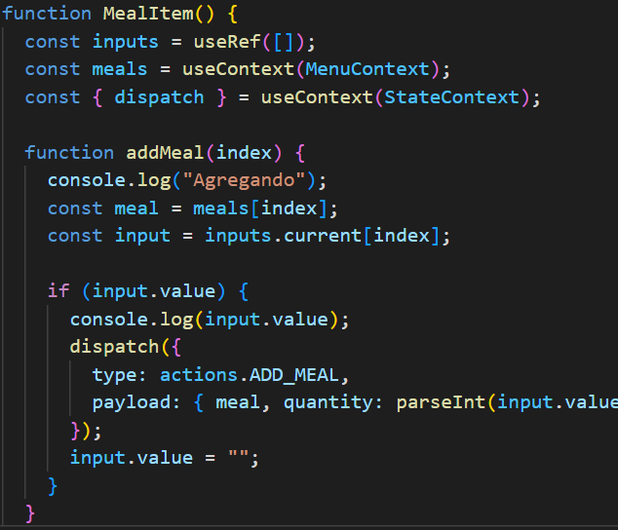
Scope
THIS

Slide 5

ECMASCRIPT
Is a JavaScript standard and ES6 was the second major revision on 2015
Arrows =>
Template Strings ``
Destructuring {data}
Spread Operator
Let & Const > Var (nobody wants it)
Default parameter
Rest parameter …

Slide 6
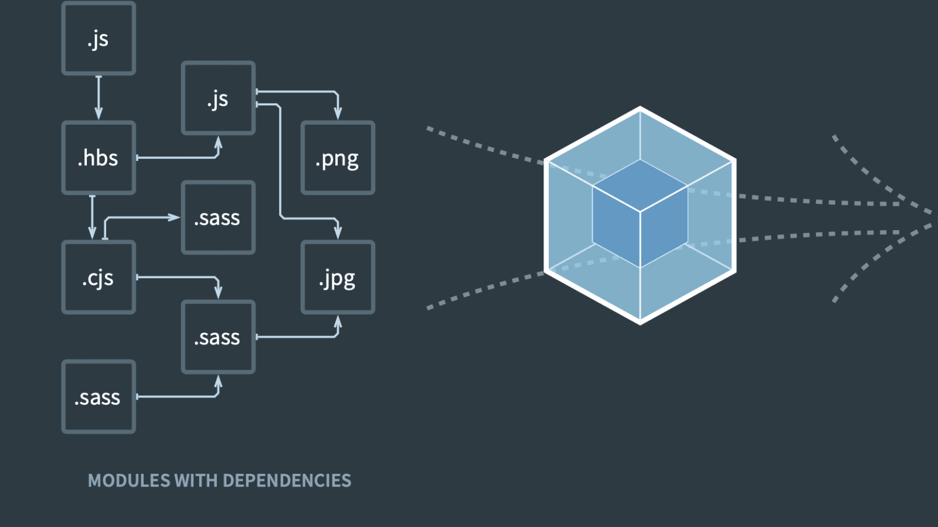
Webpack goes through your application from a root entry point, builds a dependency graph comprising of dependencies that act directly or indirectly on the root file and produces optimized bundles of the combined modules.
WEBPACK

Slide 7

Styles
We also used styled components.

Slide 8
Hooks

Slide 9
PORTALS

Slide 10
REACT ROUTER

Slide 11
UNIT TESTING

Slide 12
OUR REACT MEALS PROJECT

Slide 13




Thank you

