Slide 1



BUKYIA_ResAnalysis
View in Power BI
Last data refresh:
4/28/2023 2:48:40 AM UTC
Downloaded at:
4/28/2023 3:58:29 PM UTC

Slide 2
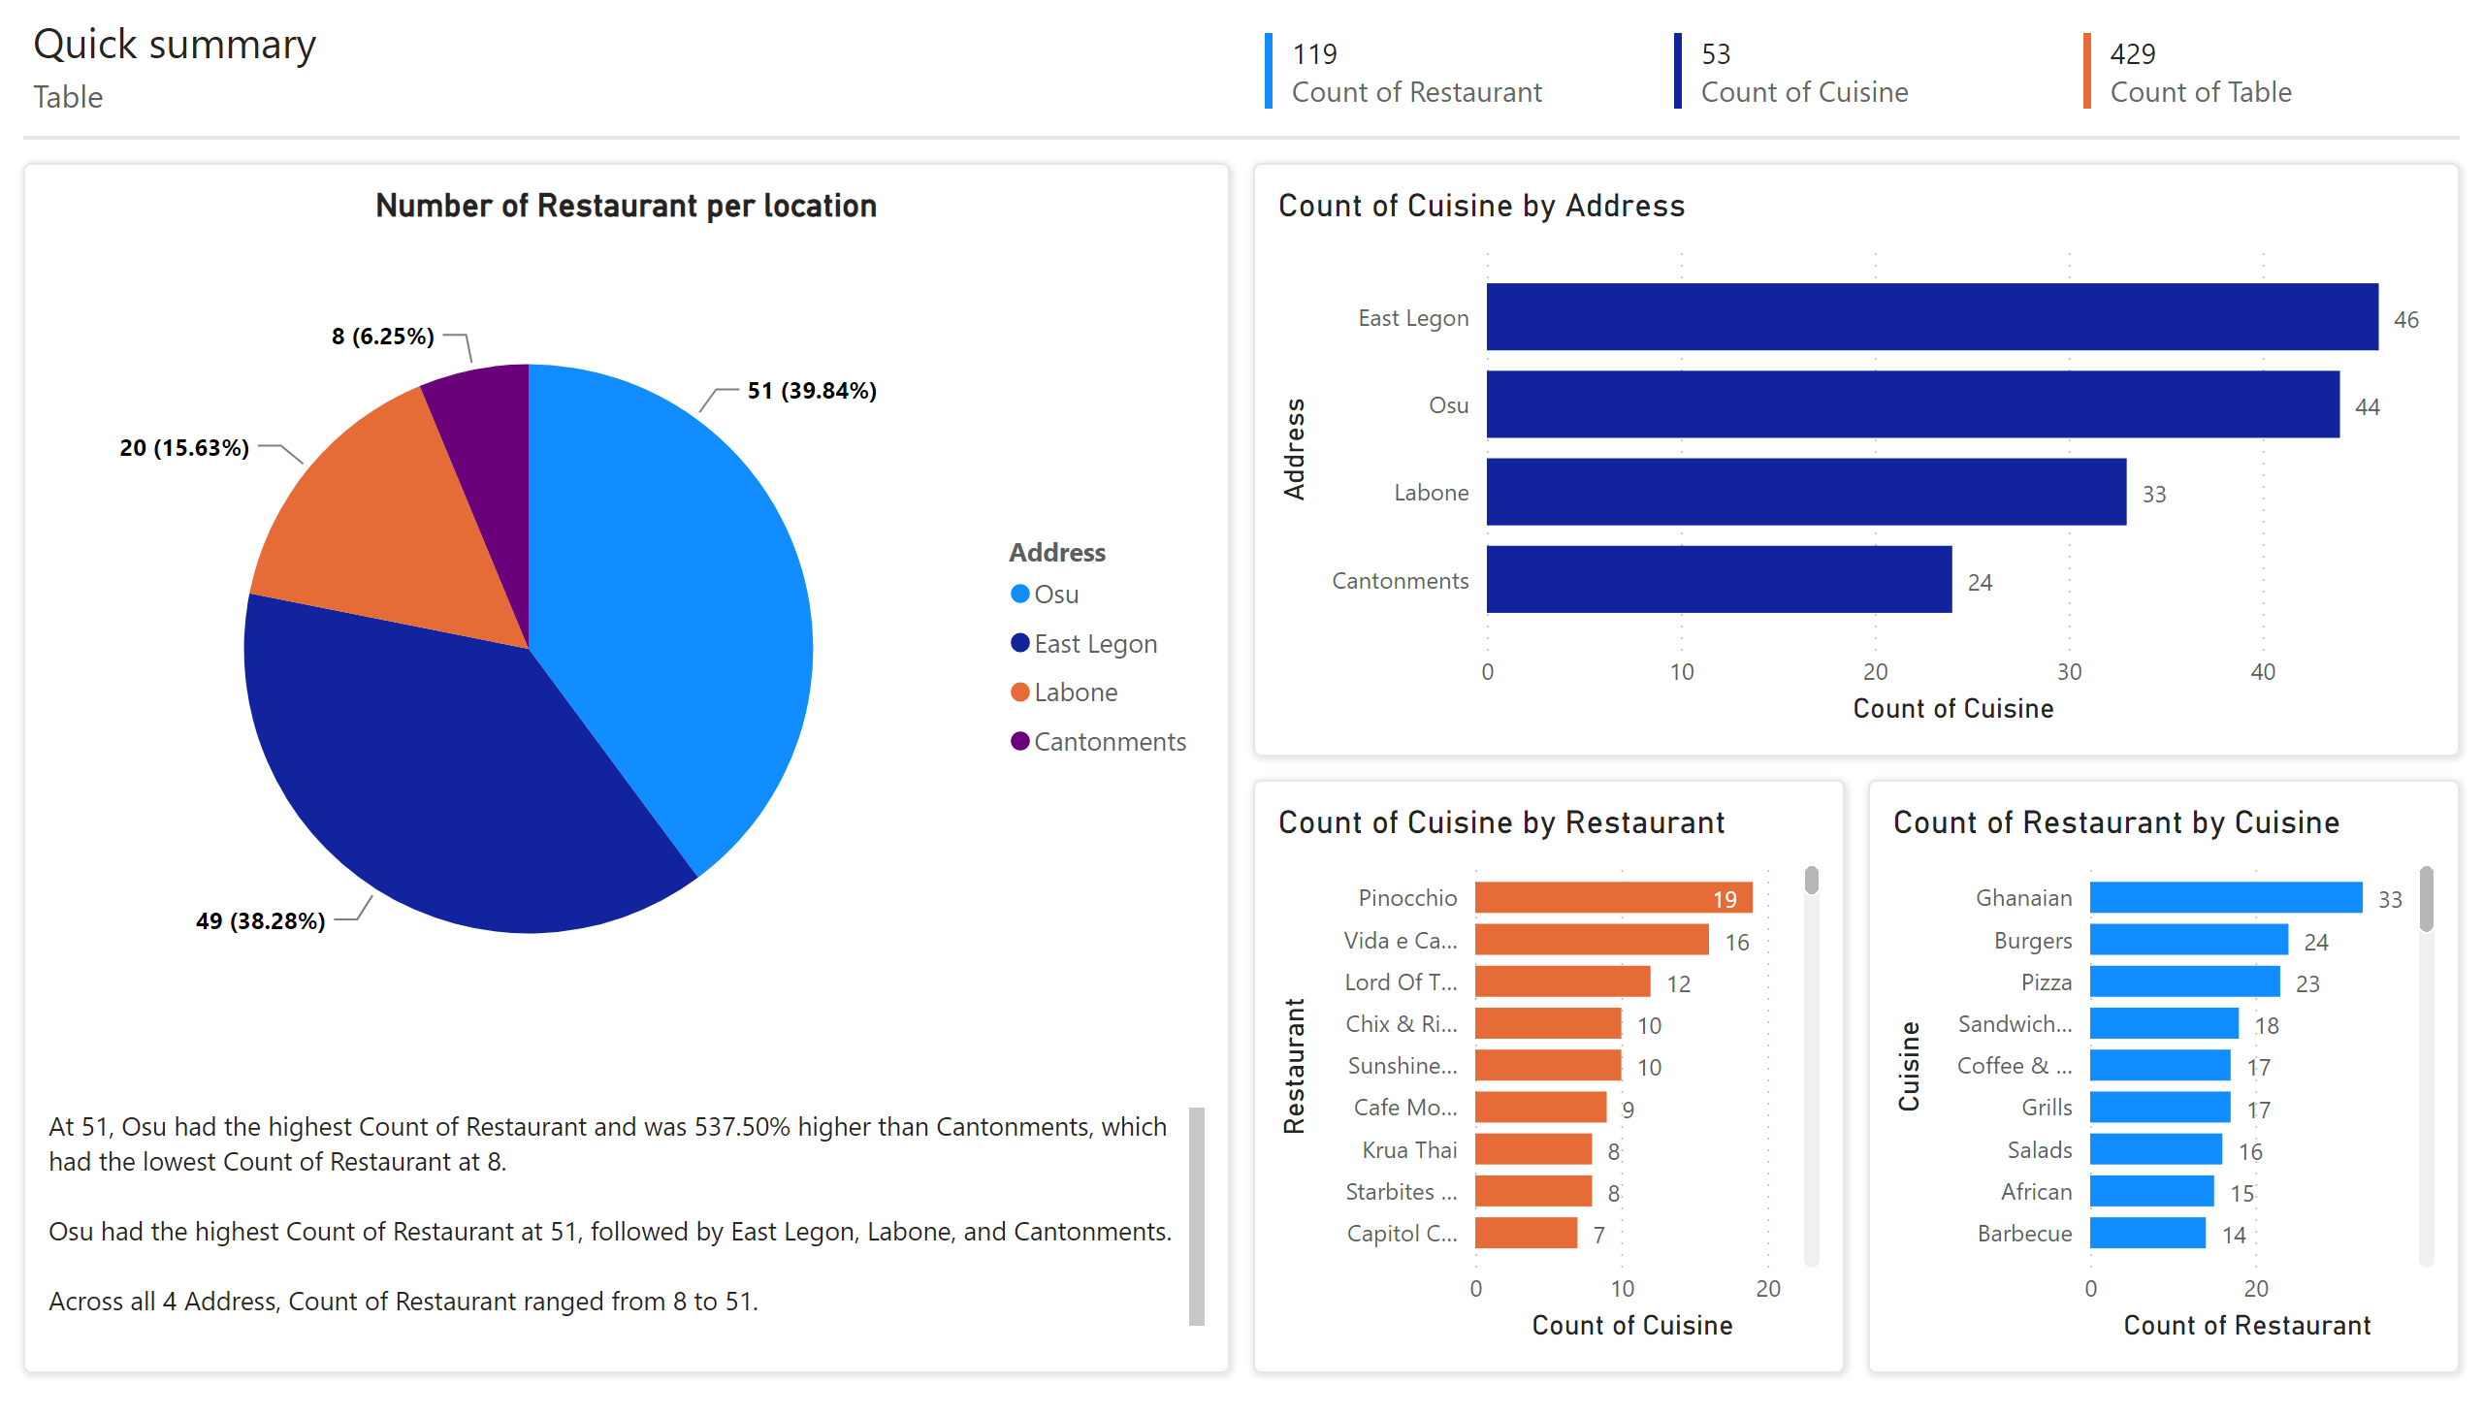
Page 1
Notes:
Number of Restaurant per location
No alt text provided
clusteredBarChart
No alt text provided
clusteredBarChart
No alt text provided
clusteredBarChart
No alt text provided
shape
No alt text provided
textbox
No alt text provided
shape
No alt text provided
shape
No alt text provided
shape
No alt text provided
textbox
No alt text provided
textbox
No alt text provided
multiRowCard
No alt text provided
multiRowCard
No alt text provided
multiRowCard
No alt text provided
shape
No alt text provided

Slide 3
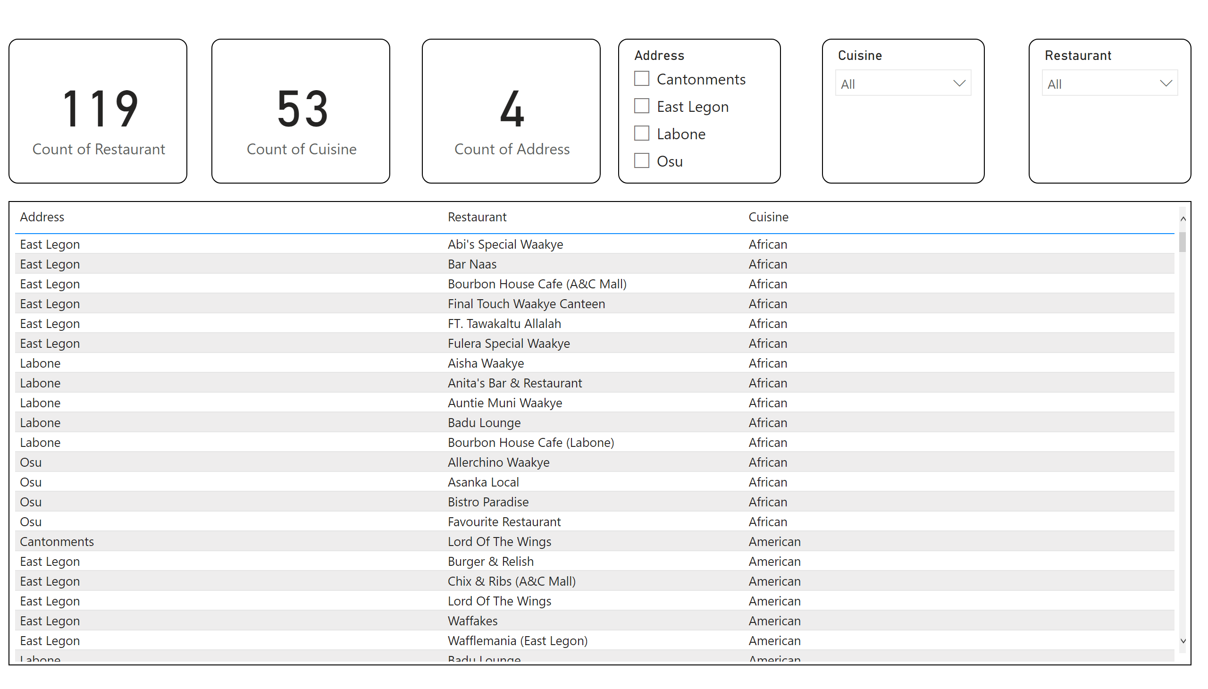
Page 2
Notes:
card
No alt text provided
card
No alt text provided
card
No alt text provided
slicer
No alt text provided
slicer
No alt text provided
slicer
No alt text provided
tableEx
No alt text provided

