Slide 1

Investigation of the mechanism of formation of nitro-substituted nicotine analog via the (3 + 2) Cycloaddition reaction of (E)-substituted nitroethene derivatives and C, N-Disubstituted pyridinyl nitrones: A Density Functional Theory study
Presented by: Oscar Appiah
Supervisors: Evans Adei, Ph.D.
Richard Tia, Ph.D.

Slide 2
Outline
Introduction and literature review
Aims and objectives
Justification
Methodology
Scheme
Results and discussion
Conclusion

Slide 3
Introduction and literature review
Nicotine analog is one of the five-membered ring compound prepared from
(3 + 2) Cycloaddition reaction.
Nicotine is a major alkaloid found in tobacco plants [1]. Due to its biological activity, a lot of researchers have developed interest in it [2].
Sun, B., Tian, Y.X., Zhang, F., Chen, Q., Zhang, Y., Luo, Y., Wang, X.R., Lin, F.C., Yang, J. and Tang, H.R., 2018. Variations of alkaloid accumulation and gene transcription in Nicotiana tabacum. Biomolecules, 8(4), p.114.
Powledge, T.M., 2004. Nicotine as therapy. PLoS Biol, 2(11), p.e404.

Slide 4
Introduction and literature review
(3 + 2) Cycloaddition reaction is a useful method for the synthesis of five-membered heterocycles[1,2].
It involves the reaction between a dipolarophile and a 1,3 dipole. This reaction was initially suggested by Smith in 1938, but was generalized by Huisgen in 1960's for worldwide application[3,4]. This reaction is the most efficient method for the preparation of five-membered heterocycles.
Huisgen, R., 2000. Adventures with heterocycles. Chemical and pharmaceutical bulletin, 48(6), pp.757-765.
Padwa, A. and Pearson, W.H. eds., 2003. Synthetic applications of 1, 3-dipolar cycloaddition chemistry toward heterocycles and natural products (Vol. 59). John Wiley & Sons.
Smith, L.I., 1938. Aliphatic Diazo Compounds, Nitrones, and Structurally Analogous Compounds. Systems Capable of Undergoing 1, 3-Additions. Chemical Reviews, 23(2), pp.193-285.
Huisgen, R., 1963. 1, 3‐dipolar cycloadditions. Past and future. Angewandte Chemie International Edition in English, 2(10), pp.565-598.

Slide 5
Introduction and literature review
Singh et al in 2005 reported the development of an efficient route to novel nicotine analog by reacting α-(3-Pyridyl)-N-phenylnitrone with several dipolarophiles.
Scheme 1
Singh, G., Ishar, M.P.S., Girdhar, N.K. and Singh, L., 2005. Investigations on regio‐and stereoselectivities in cycloadditions involving α‐(3‐pyridyl)‐N‐phenylnitrone: Development of an efficient route to novel nicotine analogs. Journal of heterocyclic chemistry, 42(6), pp.1047-1054.

Slide 6
Reaction Time and Yields (%) of the products (5-7)
Serial No. | X | Reaction time (h) | Yield (%) of various products 5:6:7
1 | OEt | 30 | 5a(90) | 6a(traces) | 7a(--)
2 | OisoButyl | 12 | 5b(90) | 6b(traces) | 7b(--)
3 | Ph | 24 | 5c(90) | 6c(<5) | 7c(--)
4 | 4-Pyridyl | 24 | 5d(87) | 6d(--) | 7d(--)
5 | CH(OMe)₂ | 24 | 5e(75) | 6e(--) | 7e(--)
6 | CN | 18 | 5f(40) | 6f(30) | 7f(20)
7 | COMe | 10 | 5g(10) | 6g(¬10) | 7g(70)
8 | CO₂Me | 15 | 5h(15) | 6h(15) | 7h(60)

Slide 7
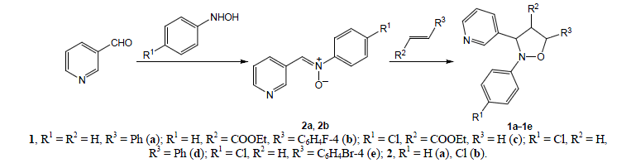
Introduction and literature review
Kuzenkov et al in 2018 synthesized substituted 3-(1,2-oxazolidin-3-yl)pyridines by reacting N-(pyridin-3-ylmethylidene)-N-phenylaminoxide with ethyl acrylate, styrene and their derivatives.
Kuzenkov, A.V., Zakharychev, V.V. and Volkova, A.N., 2018. Synthesis and Fungicidal Activity of Substituted 3-(1, 2-Oxazolidin-3-yl) pyridines. Russian Journal of Organic Chemistry, 54(5), pp.763-765.

Slide 8
Introduction and literature review
Fryźlewicz et al also reported on the reaction between (E)-3,3,3-Trichloro-1-nitroprop-1-ene and N-aryl(pyridin-3-yl) nitrones.
Fryźlewicz, A., Łapczuk-Krygier, A., Kula, K., Demchuk, O.M., Dresler, E. and Jasiński, R., 2020. Regio-and stereoselective synthesis of nitrofunctionalized 1, 2-oxazolidine analogs of nicotine. Chemistry of Heterocyclic Compounds, pp.1-3.

Slide 9
Aims and Objectives
From the papers reviewed, a novel reaction route for synthesizing a nicotine analog has been developed by singh et al in 2005.
This reaction route which possesses a high degree of regio- and stereo-selectivity has been used been worked on by other researchers such as Kuzenkov et al and Fryźlewicz et al.
But through all their research, an explanation on the selectivity observed in the reaction has not been explored.
My objective is to apply computational chemistry tools to explore the selectivity observed and also provide a mechanistic insight into the effects of substituents on the reaction.

Slide 10
Aims and objectives
To ascertain what is controlling the regio- and stereoselectivity.
The mechanistic effect of a wide range of substituents on both reactants with different electronic and steric effects.
To investigate the effect of solvent on the rate and selectivities of the reaction.

Slide 11
Justification
This will help rationalize this unique reactivity pattern seen with the reaction of (E)-nitro-substituted alkene with nitrones for the formation of nicotine analogs.
The study will provide a justification to the experimental result that was obtained.

Slide 12
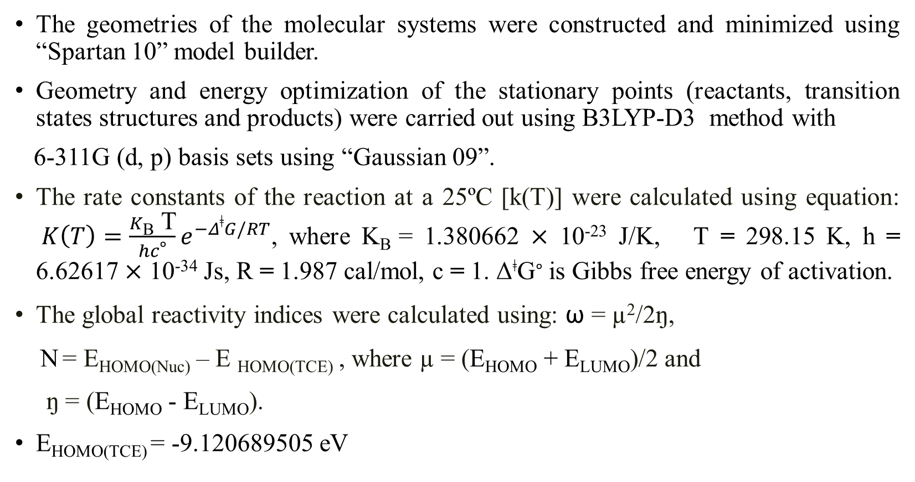
Methodology
The geometries of the molecular systems were constructed and minimized using “Spartan 10” model builder.
Geometry and energy optimization of the stationary points (reactants, transition states structures and products) were carried out using B3LYP-D3 method with
6-311G (d, p) basis sets using “Gaussian 09”.
The rate constants of the reaction at a 25ºC [k(T)] were calculated using equation: $K\left(T\right)=\frac{K\text{B} \text{T}}{hc\text{∘}}e^{−Δ\text{ǂ}G/RT}$, where K_{B} = 1.380662 × 10⁻²³ J/K, T = 298.15 K, h = 6.62617 × 10⁻³⁴ Js, R = 1.987 cal/mol, c = 1. Δ^{ǂ}G∘ is Gibbs free energy of activation.
The global reactivity indices were calculated using: ω = µ²/2ŋ,
N = E_{HOMO(Nuc)} – E _{HOMO(TCE)} , where µ = (E_{HOMO} + E_{LUMO})/2 and
ŋ = (E_{HOMO} - E_{LUMO}).
E_{HOMO(TCE)} = -9.120689505 eV

Slide 13
Scheme 3: Proposed scheme for the reaction of (E)-substituted nitroethene derivative (A1) with C, N-disubstituted pyridinyl nitrone (A2)

Slide 14
RESULTS AND DISCUSSION

Slide 15
Figure 1: Gibbs free energy profile for the reaction of (E)-substituted-nitroethene with C, N-Disubstituted pyridinyl nitrone in both gas phase and solvent phase (benzene).

Slide 16
Table 1: Rate constants of the reaction (E)-substituted-nitroethene with N-Phenyl-C-pyridinyl-nitrone for the formation of the various cycloadducts computed in both gas phase and solvent phase (benzene) at room temperature. R1 = CCl3, R2 = Phenyl and R3 = H
Products | Rate constants[k(T)]/s⁻¹ Gas phase | Rate constants[k(T)]/s⁻¹ Solvent phase (benzene)
P1A | 3.07 x 10⁹ | 7.43 x 10⁸
P2A | 3.87 x 10¹² | 1.81 x 10¹²
P1B | 2.21 x 10¹⁰ | 4.23 x 10⁹
P2B | - | 5.85 x 10⁶

Slide 17
Solvent effect
Table 2: Activation energies and reaction energies of the various elementary steps in the reaction between (E)-substituted-nitroethene derivatives with N-substituted-C-pyridinyl-nitrones in different solvents.
R1 = CCl₃ , R2 = Phenyl and R3 = H
Solvent | TS1A | TS1B | TS2A | TS2B | P1A | P1B | P2A | P2B
Benzene | 5.4 | 4.3 | 0.7 | 8.2 | -23.1 | -25.8 | -21.4 | -20.9
Toluene | 5.4 | 4.4 | 0.8 | 8.3 | -23.0 | -25.7 | -21.3 | -20.8
Nitromethane | 6.0 | 5.1 | 0.9 | 9.4 | -21.1 | -24.3 | -19.9 | -19.3

Slide 18
Table 3: Activation energies and reaction energies of the various elementary steps in the reaction between (E)-substituted-nitroethene derivatives with C, N-disubstituted pyridinyl nitrone at different level of theories. R1 = CCl₃ , R2 = Phenyl and R3 = H Basis sets : 6-311G (d, p)
Level of theory | TS1A | TS2A | TS1B | TS2B | P1A | P2A | P1B | P2B
B3LYP | 18.6 | 14.2 | - | 22.5 | -11.4 | -9.8 | -13.1 | -6.7
B3LYP-D3 | 5.4 | 0.7 | 4.3 | 8.2 | -23.1 | -21.4 | -25.8 | -20.9
M06 | -5.7 | -5.8 | 5.6 | 9.9 | -29.3 | -27.5 | -32.7 | -21.0
M06-2X | 3.5 | -2.5 | 2.9 | 5.7 | -35.4 | -34.7 | -38.3 | -33.4

Slide 19
Table 4: Activation energies and reaction energies (in kcal/mol) of the various elementary steps in the reaction of (E)-substituted- nitroethene derivatives and N-Phenyl-C-pyridinyl Nitrones.
R1 | TS1A | TS2A | TS1B | TS2B | P1A | P2A | P1B | P2B
H | 6.3 | 4.1 | 7.5 | 8.3 | -19.2 | -17.5 | -22.4 | -21.8
EDG
Methyl | 8.4 | 4.4 | 11.4 | 12.8 | -17.7 | -17.6 | -19.9 | -17.8
NH₂ | 12.9 | 9.9 | 21.1 | 20.3 | -9.8 | -10.3 | -9.1 | -2.5
EWG
CN | 5.1 | 4.3 | 4.7 | 5.6 | -17.0 | -14.1 | -20.8 | -19.3
Br | 6.2 | 3.8 | 7.2 | 9.0 | -24.6 | -23.8 | -23.1 | -22.1
BG
Phenyl | 8.4 | 6.9 | 15.8 | 11.0 | -16.8 | -14.7 | -17.8 | -15.3

Slide 20
Table 5: Activation energies and reaction energies (in kcal/mol) of the various elementary steps in the reaction of (E)-substituted nitroethene (R1 = CCl₃) with C, N-disubstituted pyridinyl nitrones derivatives.
R2 | R3 | TS1A | TS2A | TS1B | TS2B | P1A | P2A | P1B | P2B
Methyl | H | 6.4 | 3.3 | 10.0 | 11.4 | -21.1 | -19.6 | -23.5 | -18.4
NH₂ | H | 5.7 | 3.0 | 12.6 | 10.5 | -22.6 | -20.8 | -25.1 | -21.6
OH | H | 11.6 | 7.7 | 13.1 | 13.7 | -15.6 | -14.3 | -18.2 | -13.8
CN | H | 4.0 | 1.9 | 7.0 | 6.9 | -29.6 | - | -31.8 | -27.5
Br | H | 14.2 | 12.2 | 15.2 | 17.6 | -13.5 | -12.1 | -15.2 | -14.0
4-Me-Ph | H | 6.5 | 1.9 | - | 9.4 | -21.7 | -19.8 | -24.2 | -18.8
4-F-Ph | H | 5.6 | 0.9 | 4.7 | 8.5 | -21.6 | -19.7 | -24.2 | -18.8
4-Br-Ph | H | 5.6 | 0.9 | 4.6 | 8.4 | -23.5 | -21.6 | -26.1 | -21.0
4-Cl-Ph | H | 5.6 | 0.9 | 4.6 | 8.5 | -21.7 | -19.9 | -24.3 | -19.3
Ph | Methyl | 3.8 | -0.4 | 5.4 | 7.4 | -24.7 | -23.0 | -22.9 | -16.6
Ph | OH | - | -7.1 | -2.4 | -1.3 | -26.3 | - | -25.6 | -20.0
Ph | CN | 12.8 | 6.8 | 12.5 | 15.3 | -16.1 | -15.2 | -16.5 | -9.7
Ph | Br | 8.1 | 3.1 | 7.8 | 11.3 | -31.4 | -30.9 | -26.8 | -30.6
Ph | Phenyl | 7.6 | -8.8 | 0.8 | 1.2 | -24.8 | -24.3 | -20.4 | -17.7

Slide 21
Fig 2: Graphical illustration of the highest occupied molecular orbital (HOMO) – lowest unoccupied molecular orbital (LUMO) interaction between (E)-substituted-nitroethene (A1) and N-phenyl-C-pyridinyl-Nitrone (A2) . R1 = CCl₃ , R2 = Phenyl and R3 = H

Slide 22
Table 6: Global reactivity indices for (E)-substituted-nitroethene, A1 (alkene). HOMO, LUMO energies, electronic chemical potential (μ), chemical hardness (η), global electrophilicity (ω) and global nucleophilicity (N). All in eV.
R1 | HOMO | LUMO | µ | ƞ | ω | N
CCl₃ | -8.70 | -1.85 | -5.27 | 6.84 | 2.03 | 0.43
H | -8.36 | -2.80 | -5.58 | 5.56 | 2.80 | 0.76
Methyl | -8.17 | -2.57 | -5.37 | 5.60 | 2.57 | 0.95
NH₂ | -6.74 | -1.91 | -4.33 | 4.83 | 1.94 | 2.38
CN | -8.90 | -3.74 | -6.32 | 5.16 | 3.87 | 0.22
Br | -8.09 | -3.01 | -5.55 | 5.08 | 3.03 | 0.03
Phenyl | -7.09 | -2.89 | -4.99 | 4.20 | 2.96 | 2.03

Slide 23
Table 7: Global reactivity indices for N-Substituted-C-pyridinyl-nitrones, A2 (three-atom components). HOMO, LUMO energies, electronic chemical potential (μ), chemical hardness (η), global electrophilicity (ω) and global nucleophilicity (N). All in eV.
R2 | R3 | HOMO | LUMO | µ | ƞ | ω | N
Methyl | H | -6.09 | -1.85 | -3.97 | 4.24 | 1.86 | 3.03
NH₂ | H | -6.25 | -1.93 | -4.09 | 4.32 | 1.94 | 2.87
OH | H | -6.34 | -1.89 | -4.12 | 4.45 | 1.91 | 2.78
CN | H | -6.81 | -3.04 | -4.93 | 3.77 | 3.22 | 2.31
Br | H | -6.21 | -2.16 | -4.19 | 4.05 | 2.17 | 2.91
Phenyl | H | -6.06 | -2.30 | -4.18 | 3.76 | 2.33 | 3.06
4-Me-Ph | H | -6.02 | -2.12 | -4.07 | 3.90 | 2.12 | 3.10
4-Cl-Ph | H | -6.16 | -2.44 | -4.30 | 3.72 | 2.49 | 2.96
4-F-Ph | H | -6.11 | -2.35 | -4.23 | 3.76 | 2.38 | 3.01
4-Br-Ph | H | -6.15 | -2.45 | -4.30 | 3.70 | 2.50 | 2.97
Ph | Me | -5.98 | -1.86 | -3.92 | 4.12 | 1.86 | 3.14
Ph | OH | -5.85 | -2.03 | -3.94 | 3.82 | 2.03 | 3.27
Ph | CN | -6.64 | -2.81 | -4.73 | 3.83 | 2.92 | 2.48
Ph | Br | -6.21 | -2.16 | -4.19 | 4.05 | 2.17 | 2.91
Ph | Ph | -6.00 | -2.21 | -4.11 | 3.79 | 2.23 | 3.12

Slide 24
Conclusion
The 32CA reaction between (E)-substituted-nitroethene derivatives (A1, R1= CCl3) and C, N-disubstituted-pyridinyl nitrone derivatives (A2, R2= Phenyl and R3 = H) is fully regio- and stereoselective towards the formation of the exo 4-nitro substituted nicotine analog product (P2A).This reaction is kinetically controlled.
Solvent show no significant effect on the energetic pattern.
Electron-donating and withdrawing groups on both A1 and A2 increase the activation energies of the reaction relative to the parent reaction but reaction trend remains the same.
EDGs substitution on the alkene is fully regioselective to path A whiles EWGs substitution is partially regioselective to both path A and B.
The reactions are kinetically controlled due to the thermodynamic stability of all the considered isomeric products in all reactions studied.

Slide 25
THANK YOU

