Slide 1

A computational study of the oxidation mechanisms of naphthalene by hydroxyl radicals: the H abstraction pathway
PRESENTATION BY: APPIAH OSCAR

Slide 2
Outline
Introduction and literature review
Computational techniques
Results and Discussion
Findings
Contributions.

Slide 3
Introduction and Literature Review
Polycyclic aromatic hydrocarbons (PAHs) are constantly encountered environmental pollutants. They are potentially carcinogenic, genotoxic or mutagenic.
They are released into the atmosphere by incomplete combustion of fossil fuels and biomass from agricultural processes. Vehicles contributes to these PAHs in urban areas.
The tropospheric removal of PAHs involves wet and dry deposition, and oxidation reactions with hydroxyl, nitrate and ozone radicals.
Among the different oxidants, reaction with hydroxyl radical is usually the most important reaction
Naphthalene is an example of polycyclic aromatic hydrocarbons. It is the most volatile and abundant PAHs in the atmosphere.
Because of the harmful effect of these PAHs, a lot of research are being performed on them to help reduce their effect in the environment.
Baek, S.O., Field, R.A., Goldstone, M.E., Kirk, P.W., Lester, J.N. and Perry, R., 1991. A review of atmospheric polycyclic aromatic hydrocarbons: sources, fate and behavior. Water, air, and soil pollution, 60(3), pp.279-300.

Slide 4
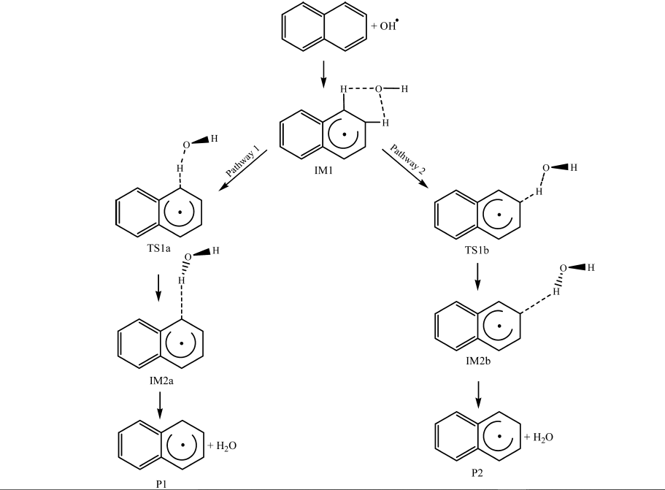
Shiroudi et al, in 2014 decided to research on the mechanism of the oxidation of naphthalene using hydroxyl radicals.
Scheme 1: Oxidation reaction of naphthalene with –OH radical
Shiroudi, S. Y.; Raghunath, P.; Wu, J. S.; Lin, M. C. Ab Initio Chemical Kinetic Study for Reactions of H Atoms with SiH4 and Si2H6: Comparison of Theory and Experiment. J. Phys. Chem. A 2014, 114, 633−639.

Slide 5
Why did they study this work ?
Shiroudi et al, in 2014 performed a research on the computational study of the oxidation mechanism of naphthalene by hydroxyl radicals.
A mechanistic study to explain whatever is occurring in this reaction has not been well established.
So they set out to provide a comprehensive and quantitative theoretical insights into this reaction.

Slide 6
Lorenz et al, in 1983 experimented on the reaction of –OH radicals with Naphthalene at temperatures lower than 410 K and at temperatures ranging from 636 to 873 K, by means of laser flash photolysis using laser-induced fluorescence.
They found that the reaction proceeded by ;
addition of the –OH radical to the any of the hydrogens on the naphthalene.
Followed by the abstraction of the hydrogen.
Lorenz, K.; Zellner, R. Kinetics of the Reactions of OH-Radicals with Benzene, Benzene-d6 and Naphthalene. Ber. Bunsen-Ges. Phys. Chem. 1983, 87, 629−636.

Slide 7
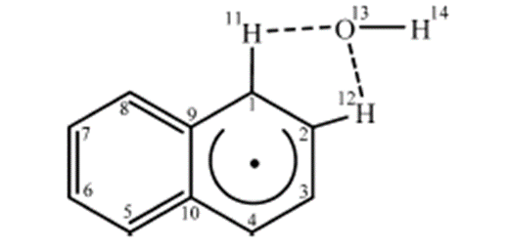
Qu et al, in 2006 used BB1K/6-311+G(3df,2p) level to study the latter reaction in Lorenz’s work.
They were able to propose a reaction pathway, where the hydrogen abstraction could take place at either C-1 or C-2.
Qu, X.; Zhang, Q.; Wang, W. Mechanism for OH-Initiated Photooxidation of Naphthalene in the Presence of O2 and NOx: A DFT Study. Chem. Phys. Lett. 2006, 429, 77−85.

Slide 8
Computational techniques used and why?
All their calculations were performed using Gaussian 09 software.
Reaction mechanisms was studied theoretically using Density Functional Theory in conjunction with B3LYP/aug-cc-pVTZ and B3LYP/6-311G(2d,P) functionals.
When applied to aromatic systems, the B3LYP approach is known to deliver geometrical parameters (bond lengths and bond angles) of quality results.
A weakness of the B3LYP approach is that it neglects dispersion forces, which may have some influence on torsional characteristics.

Slide 9
Results and discussion

Slide 10
FINDINGS
They observed that the reaction steps involved in the removal of hydrogen atoms by OH radicals satisfy Hammond’s principle.
The energy profiles for removal of hydrogen atoms at the C1 and C2 positions are very similar, with differences in activation energies and reaction energies that do not exceed ∼0.3 kcal /mol. Therefore, these reaction processes do not appear to exhibit a particularly pronounced site-selectivity: only a slight preference for a reaction at site C1 and formation thereby of 1-naphthyl can be reported from the computed branching ratios.

Slide 11
CONTRIBUTIONS TO THIS FIELD
A detailed mechanism as to why the OH radical is preferred to the other oxidants(ozone and nitrate radicals), is not yet known.
Study on the effect of substituents on the reaction.

Slide 12
THANK YOU

