Slide 1
Embracing changes, the Agile way
Oscar Centeno
2021

Slide 2

Find the Example Excel file at
https://github.com/oscarcenteno/adaptive-planning

Slide 3
Embracing changes, the Agile way
www.agilemanifesto.org
Agile principle
Welcome changing requirements, even late in development. Agile processes harness change for the customer's competitive advantage.
Agile manifesto
We value Responding to change over following a RIGID plan
Notes:
We value Responding to change over following a RIGID plan
In this session we will go through a Study case of a project that illustrates how to embrace changes in real life.

Slide 4
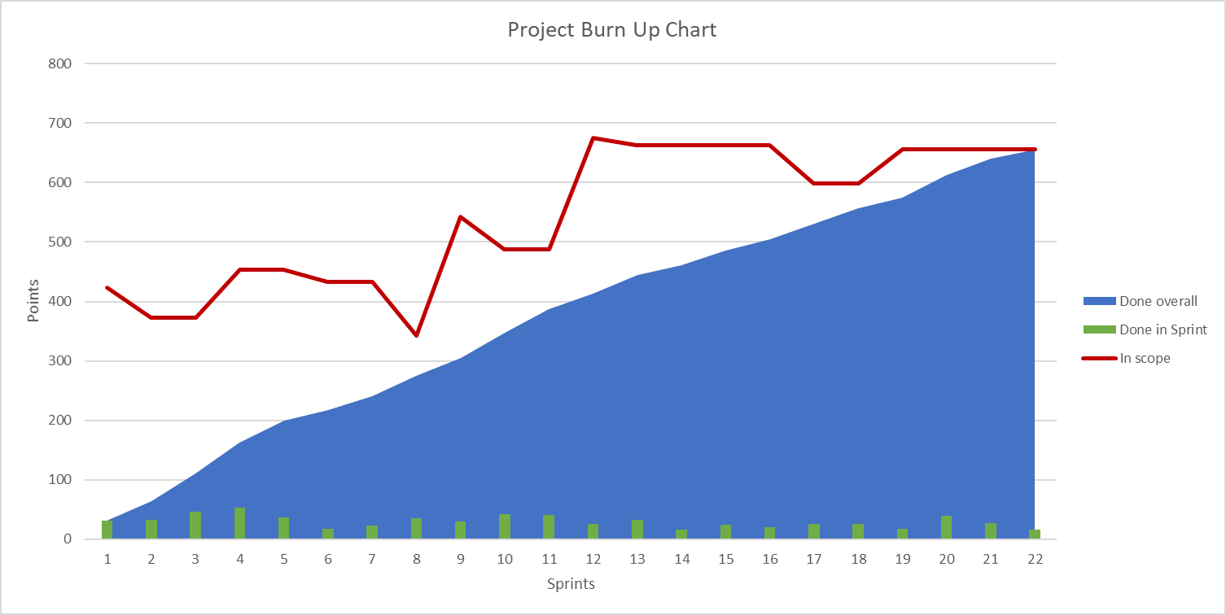

An agile plan tells the story of the project
Initially estimated in 13 Sprints
Ended up taking 22 Sprints in duration.
Would you consider it to be a good or a bad project?
What would you like to know about this project?
Burn Up Chart
Notes:
+ We’ll use a burn up chart to track scope changes, team delivery and use that information for constantly adjust our assumptions and estimates.
What can we say about this project?
What happened to the scope?
Still, we need to know the reasons for those changes. Were they requested by the client?
Did we negotiate according to the team’s delivery pace?
How did we track the amount of people involved in the effort?
How did we calculate the expected dates for the delivery?

Slide 5
Embracing changes, the Agile way
What are the benefits for clients on
having such a plan?
Practices required
Estimation: Relative sizing of Story Points
Backlog management
Requirements management
Transparency
Flexibility to change the course of the project
Early decision making (ROI)
Scope-Resources-Timeline negotiation
Notes:
What are the benefits for clients on having such a plan?
+ early deviations allow for scope negotiation
+ transparency
What practices and tools do we need to put in place for managing such projects?
+ relative estimation
+ backlog management
+ requirements management
+ adaptive planning

Slide 6
What changes should our Plan track?
Scope changes
Team velocity
Team capacity
Future Team capacity
...after each Sprint is done.

Slide 7
Start with a Backlog
One, estimated, prioritized.
Items closer to be developed should have less uncertainty…
To comment: What estimation techniques do we use in our current projects?
Initial scope
Sample Backlog
Notes:
Show sample Backlog in Excel

Slide 8
Scope Changes
What changed? When? How much?
New requirements
Requirements that go out of scope
Re-estimation of requirements
Scope changes
Notes:
The project is left in the dark, if changes are not estimated.

Slide 9
Team Velocity
The team’s delivery pace
Points done per Sprint
To comment: Have you faced issues tracking velocity for your teams?
Velocity

Slide 10
Team Velocity
Sprint | Day 1 | Done in Sprint | Historic avg. velocity
1 | 1-Jun | 31 | 31
2 | 15-Jun | 33 | 32
3 | 29-Jun | 46 | 36
4 | 13-Jul | 53 | 40
5 | 27-Jul | 36 | 39
6 | 10-Aug | 18 | 36
7 | 24-Aug | 23 | 34
8 | 7-Sep | 35 | 34
9 | 21-Sep | 30 | 33
10 | 5-Oct | 42 | 34
11 | 19-Oct | 40 | 35
12 | 2-Nov | 26 | 34
13 | 16-Nov | 32 | 34
14 | 30-Nov | 16 | 32
15 | 14-Dec | 24 | 32
16 | 28-Dec | 20 | 31
17 | 11-Jan | 26 | 31
18 | 25-Jan | 26 | 30
19 | 8-Feb | 17 | 30
20 | 22-Feb | 39 | 30
21 | 8-Mar | 27 | 30
22 | 22-Mar | 16 | 29
How many points can the Team deliver per Sprint?
Calculate historic velocity as an Average of previous points per Sprint
Velocity, Sprints

Slide 11
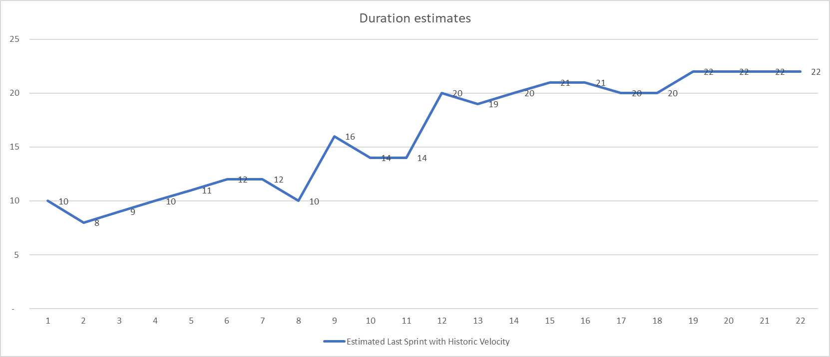
Duration Estimates
Every Sprint, we could estimate duration assuming a team will have same delivery pace in the future
Remaining sprints = remaining scope / team velocity
Estimated Last Sprint = Current Sprint + Remaining sprints
Estimated Last Sprint:
9 + CEILING(238/38)
9 + 7
16

Slide 12
Team Capacity
It’s not only about the Points, but also People.
Take Days-off into consideration (i.e., known holidays and vacations)
Team capacity for a Sprint = # Team members * % available time
"On Sprint 1, the team finished 31 points with 7 t.members at 100%"
Let’s visualize Team Capacity with historic data…
Team Capacity

Slide 13
Velocity is relative to Capacity
We could determine the delivery pace of the team based on Historic Data...
“After 2 Sprints, the team finished avg. 52 pts, with 7 t.members available 100% of their time.”
Conclusion:
Remaining sprints =
remaining scope / team velocity assuming same team capacity
= 309 / 52
= 6 Sprints
Will the project be done after Sprint 8?
Notes:
Maybe, maybe not.
We are doing the best with current information.
What else can we consider for our estimation?

Slide 14
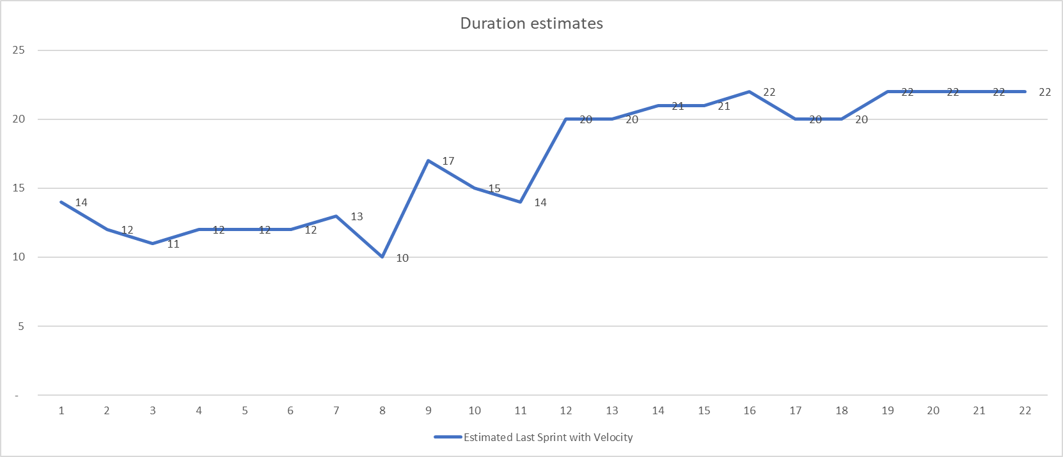
Adaptive Planning
Frequently, adapt the time estimates according to current info:
Remaining scope
Team delivery pace (velocity/capacity)
NEXT: Estimate using both Past and Future

Slide 15
Future Capacity
What do we know about the People that will do the work in the Future sprints?.
Let's say today we are on Sprint 2; we could gather planned vacations for next 6 months (12 Sprints).
Future capacity may be:
6 t.members,
84% available time.
Tip: if no data,
assume 80%

Slide 16
Everything together: Adaptive Estimates
Project the expected velocity based on Future Capacity:
For example, after Sprint 2
If team delivers 52 pts. avg. with 7 members, 100% time (6 Remaining Sprints).
Then will deliver 37 pts. avg. with 4.8 members, 85% time (9 Remaining Sprints).
For example, after Sprint 10
If team delivers 38 pts. avg. with 6.7 members, 87% available time.
Then will deliver 27 pts. avg. with 4.8 members, 85% available time.
Note! This does not mean team is less productive, but they have less team members.
Go to the “Duration estimates”

Slide 17
What changes should our Plan track?
Scope changes
Team velocity
Team capacity
Future Team capacity
...after each Sprint is done.

Slide 18
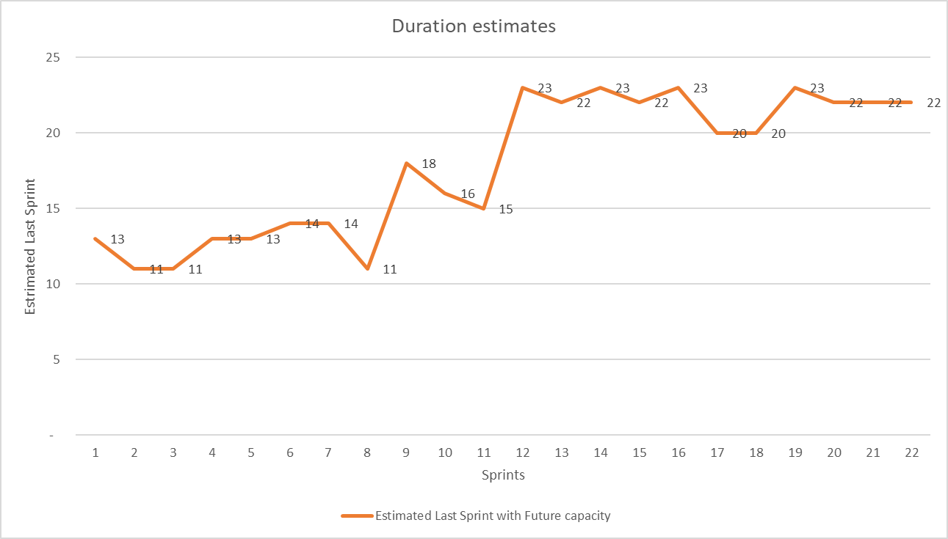
An agile plan tells the story of the project
Study Case:
Initially estimated in 13 Sprints
Ended up taking 22 Sprints in duration.
Bad Project?
Scope changed
Team productivity changed
Team composition changed
Good Project?
We embraced changes with a plan that allowed
early and frequent transparency on estimates.
Burn Up Chart
Notes:
+ We’ll use a burn up chart to track scope changes, team delivery and use that information for constantly adjust our assumptions and estimates.
What can we say about this project?
Duration was 22 sprints…
What happened to the scope?
Still, we need to know the reasons for those changes. Were they requested by the client?
Did we negotiate according to the team’s delivery pace?
How did we track the amount of people involved in the effort?
How did we calculate the expected dates for the delivery?

Slide 19
Embracing changes, the Agile way
Oscar Centeno
2021

