Slide 1
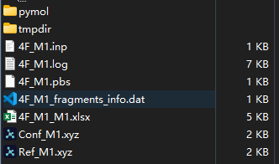
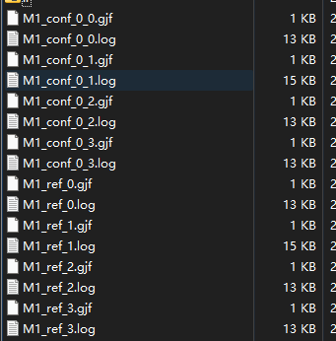
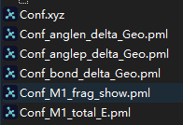
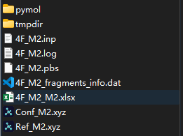
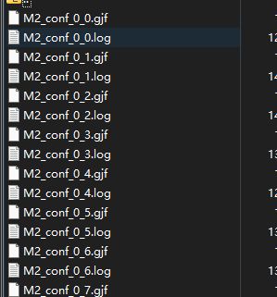
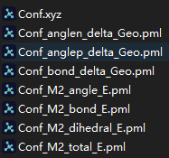
tmpdir: computation input and output files
log file
Fragments info
Result data
Sub-system strucutres
pymol: for generate the maps by Pymol
Angle difference negative
Angle difference positive
Bond difference
Fragmentation scheme
Distortion map
tmpdir: computation input and output files
log file
Fragments info
Result data
Sub-system strucutres
pymol: for generate the maps by Pymol
Angle difference negative
Angle difference positive
Bond difference
Distortion map from Angle
Bond
Dihedral
total

Slide 2
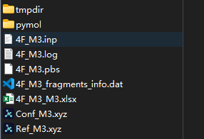
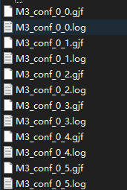
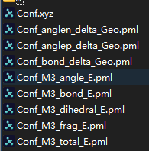
tmpdir: computation input and output files
log file
Fragments info
Result data
Sub-system strucutres
pymol: for generate the maps by Pymol
Angle difference negative
Angle difference positive
Bond difference
Distortion map from Angle
Bond
Dihedral
fragments
total

