Slide 1
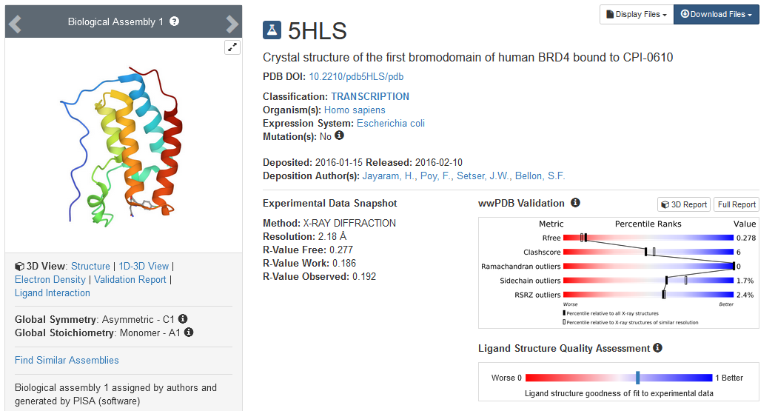
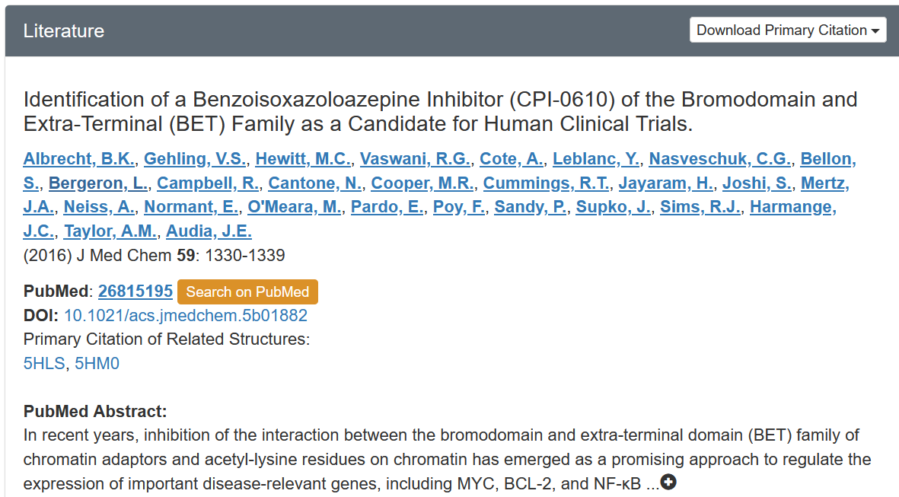
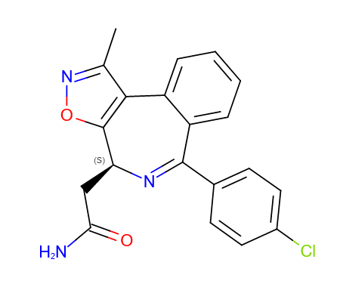
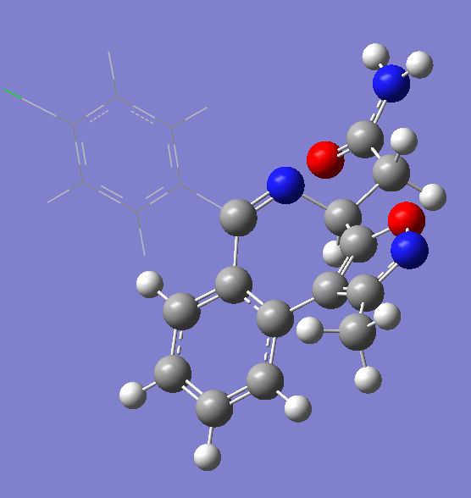
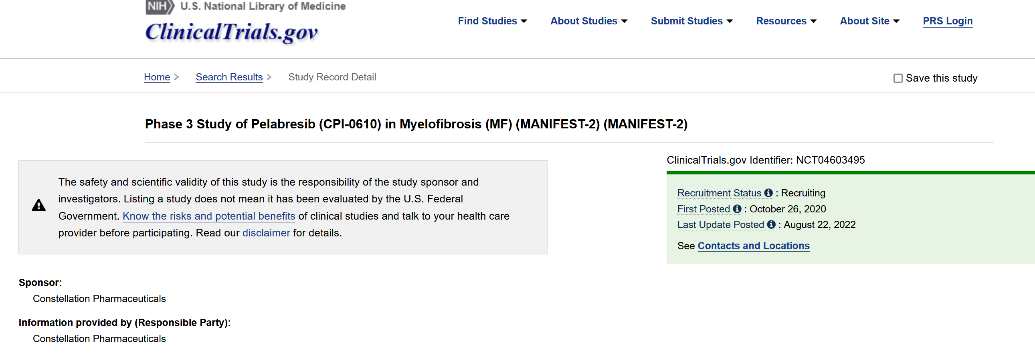
Notes:
单配体

Slide 2
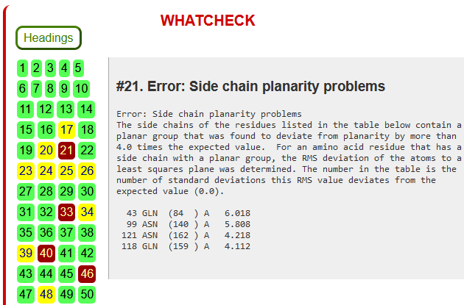
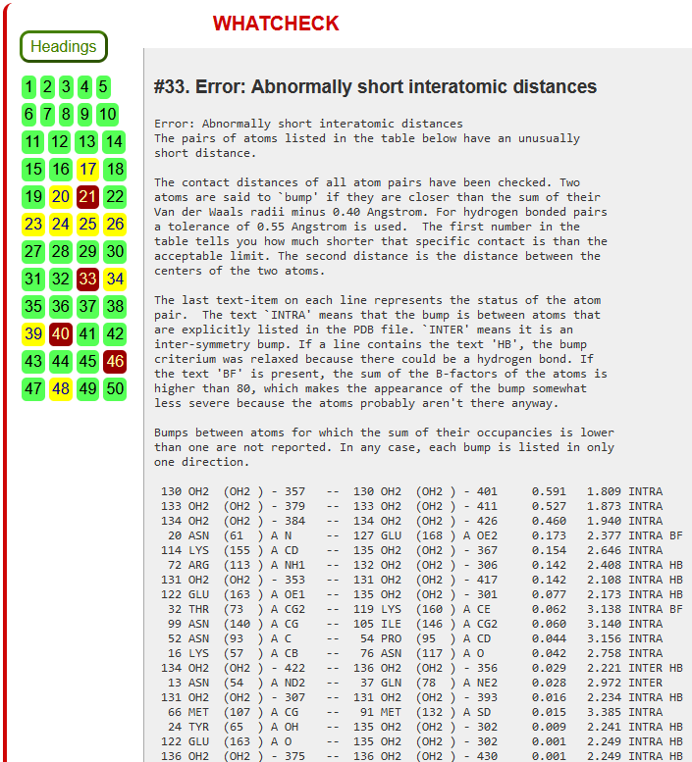
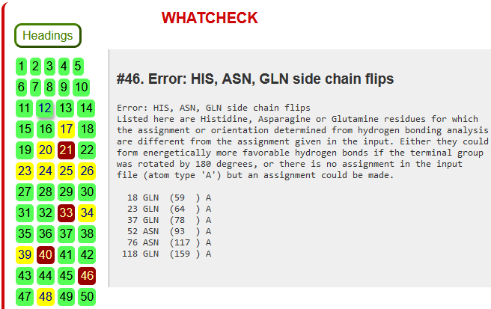
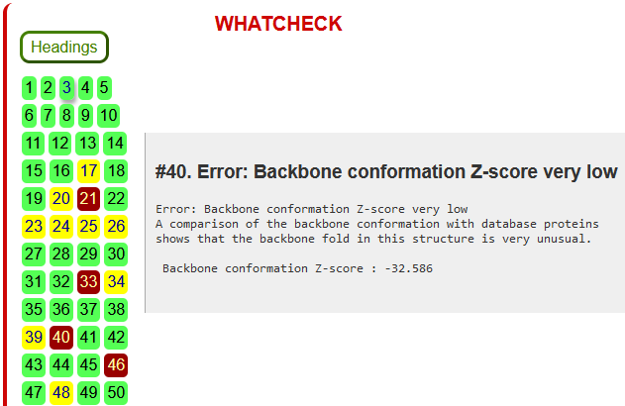
Conformers：
THR103

Slide 3
Residues flipped:
GLN59, GLN64, ASN93, ASN117
Protonation states :
HIE77
pH=7.8
Medium
TRP81, PRO82, PHE83, VAL87, LEU92, LEU94, TYR139, ASN140, ILE146, MET149, WAT323, WAT337, WAT347, WAT365, WAT395, WAT410
wa=1.7995
 | High | Medium | Opt R1
ONIOM2 | 42 |  | 42
ONIOM3 | 42 |  | 42

