Slide 1
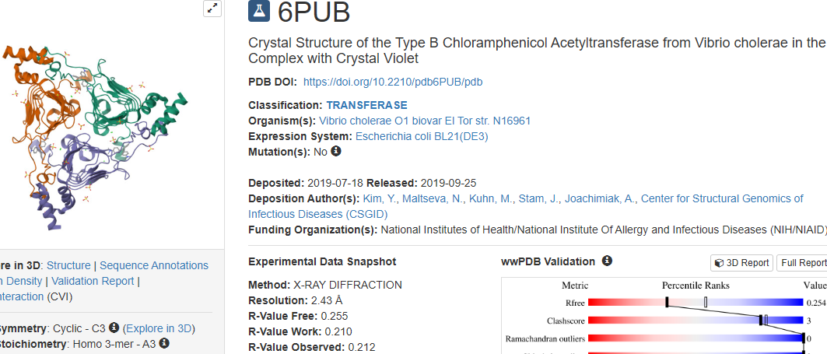
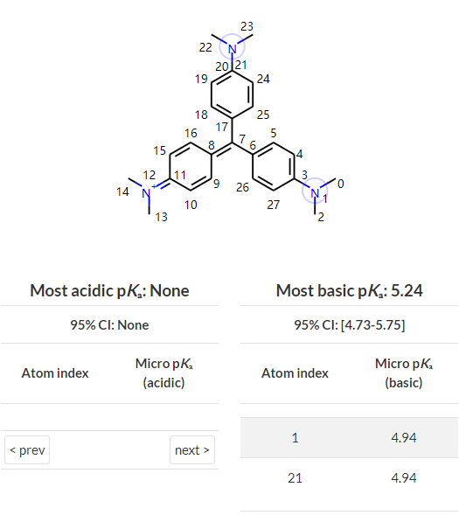
1
PDB ID | Resolution | Ligands& | ChemID | pH | Charged | DrugBank ID
6pub |  |  | CVI | 6.5 | 1

Slide 2
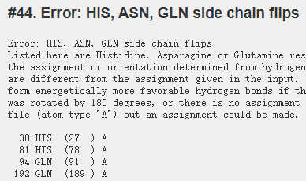
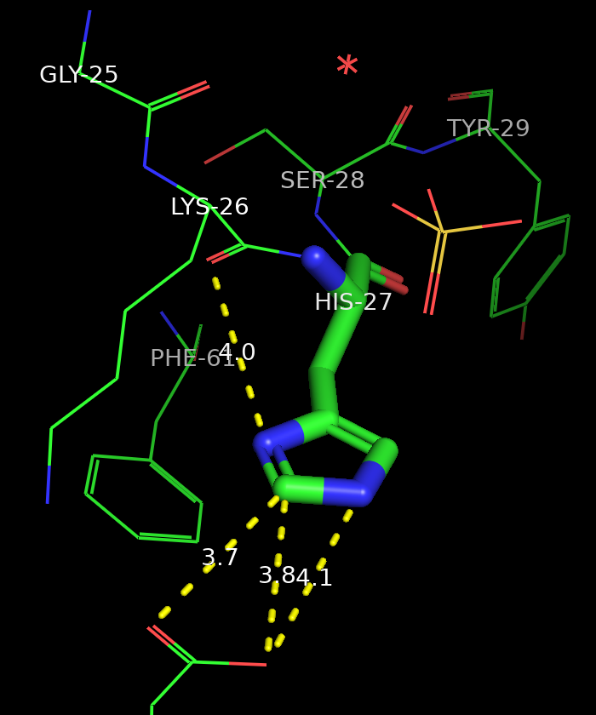
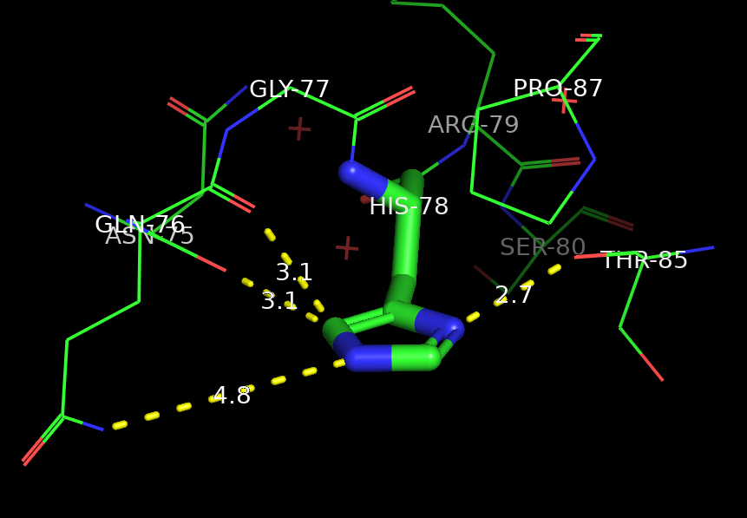
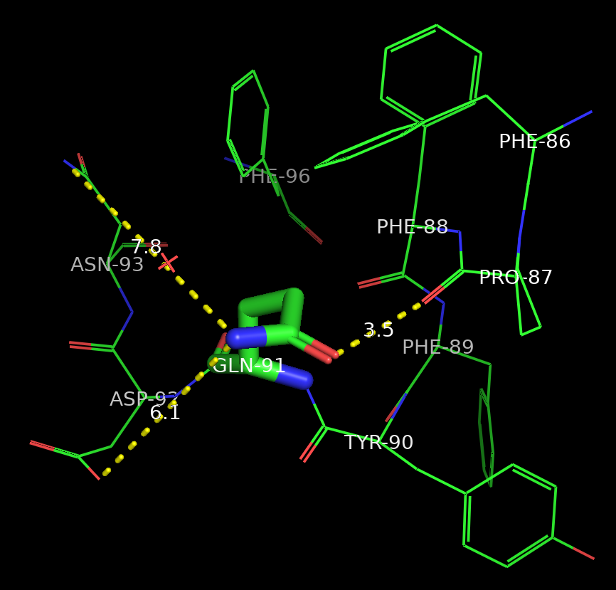
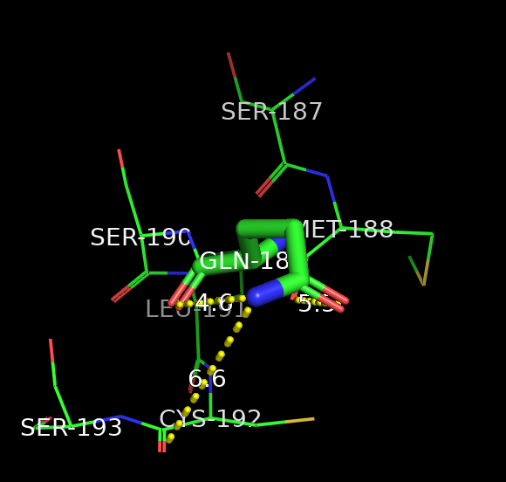

Slide 3
Fliped:
HIS27， GLN91
Protonation states(pH=6.5):
HID27, HID35, HIP37, HID47, HIP78, HID113, HID131, HIP158
wa = 1.3931

