Slide 1
Best location to open a new italian restaurant in san francisco

Slide 2
Predicting a location
Opening up a high-end eatery in the City of San Francisco is no easy feat and not for the faint of heart. In this day and economic atmosphere, it is extremely difficult to put together restaurant deals that make sense financially.
It has driven people out of the business and left some of us veterans working harder than ever before to improve food, service and overall value to keep up with the burgeoning competition.
The problem: Restaurants nearby, Italian restaurants, crime zones.

Slide 3
Data acquisition and cleaning
Google Maps reverse geocoding.
Foursquare API.
Crime rate in San Francisco data set.
This data give us the necesary information to choose a location and discard others.

Slide 4
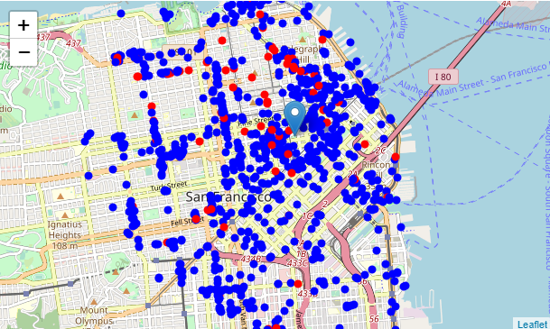
All restaurant nearby our objetive, Union Square

Slide 5
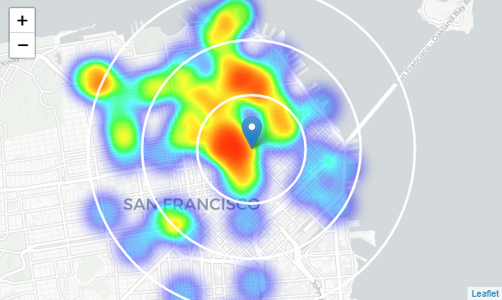
Density of only Italian restaurants
We have pockets at San Francisco south.

Slide 6
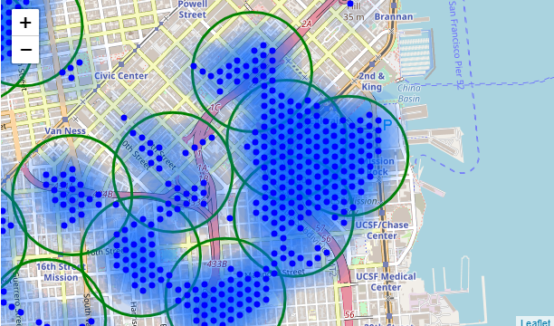
K-Mean clusteing
Selection of the center of potential candidates areas.

Slide 7
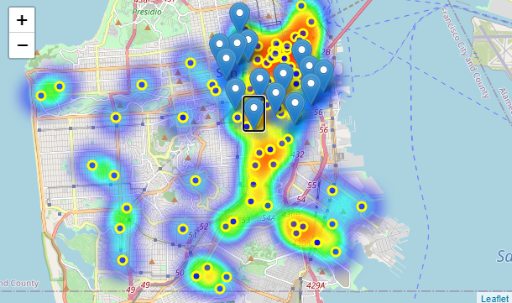
Crime zones
Some of our potencial cnadidates areas are in o really close to high crime zones rate.

Slide 8
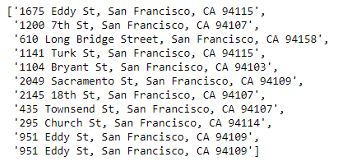
Conclusion potential addresses with low number of nearby restaurants in low crime rate zone

