Slide 1
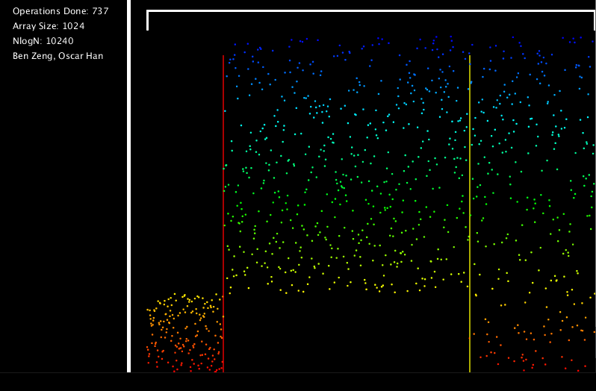
Quick Sort
Ben Zeng, Oscar Han

Slide 2
Introduction
Welcome to our presentation!
Our chosen sort: Quicksort (Iterative Version)
What our program implements:
An accurate visualization of what Quicksort does when sorting an array of integers
A method which performs one “step” of iterative Quicksort each time it is called. By repeatedly calling this method, the array will gradually get sorted.

Slide 3


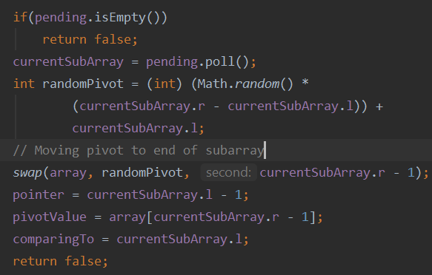
Implementation:
nextMove()
Initialization: Create a list that stores the start and end values of all subarrays that will be partitioned- initially entire array. Create a global variable that stores what subarray is currently being partitioned - initially null.
After initialization, continuously perform the following:
IF THE CURRENT SUBARRAY IS NULL:
If the list is not empty, take one of these subarrays and call it the “current subarray”. Otherwise, the method is done sorting.
Assigning the subarray:
Randomly select an element as a pivot. Move to end of subarray.
Initialize two pointers: loop index (comparing To), and the last index that is before the loop index and smaller than the pivot (pointer).

Slide 4
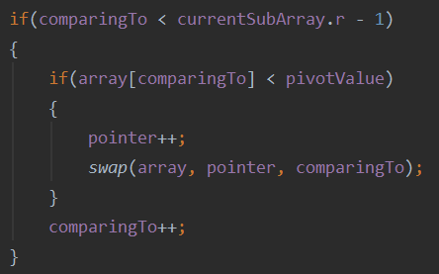
Implementation:
nextMove()
IF THE CURRENT SUBARRAY IS NOT NULL:
The current subarray is being partitioned!
Essentially, traverse the array with the loop index, that will continuously be incremented while it is still inside of the current subarray.
Before incrementing the loop index, if the current element is smaller than the pivot, shift the pointer to the right and then swap the value of the element with the value at the pointer. Otherwise, pass. This essentially moves the small element all the way to the left, ensuring all the elements before the first pointer (pointer) are smaller than the pivot.

Slide 5
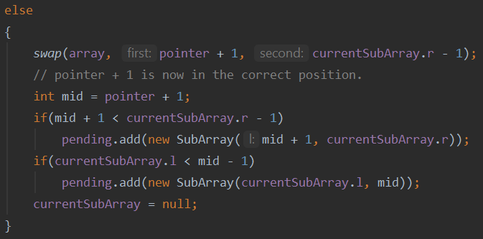
Implementation:
nextMove()
IF THE CURRENT SUBARRAY IS NOT NULL:
If we have hit the end of the array with loop index:
1. Swap the element at the end of the subarray (pivot) with the element at pointer + 1 → chosen pivot is now in its correct position. All the elements to the left are smaller than it; all the elements to the right are bigger than it.
2. Push the left and right subarrays back into the list if its size is greater than 1.
3. Set the current subarray back to null. The next time the nextMove() method is called, a new subarray will begin to be partitioned.

Slide 6
ANALYSIS:
How does iterative quicksort actually work?
In terms of the partitioning process, iterative quicksort and recursive quicksort are identical. The only major difference is that instead of using recursion to sort the left and right half after partitioning, the iterative version stores pends these subarrays in a Queue.

Slide 7
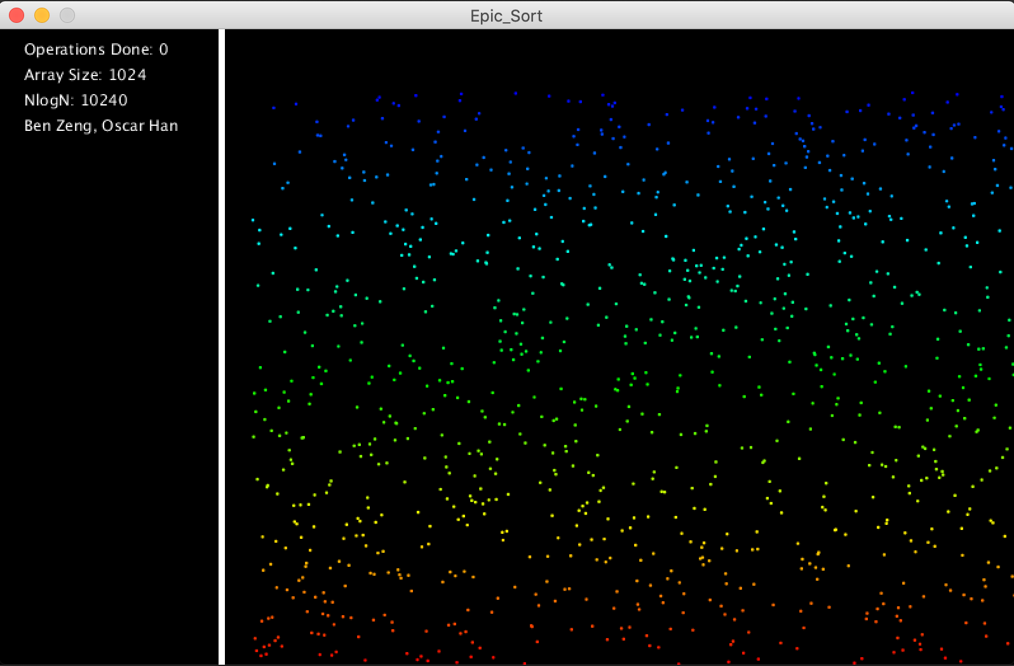
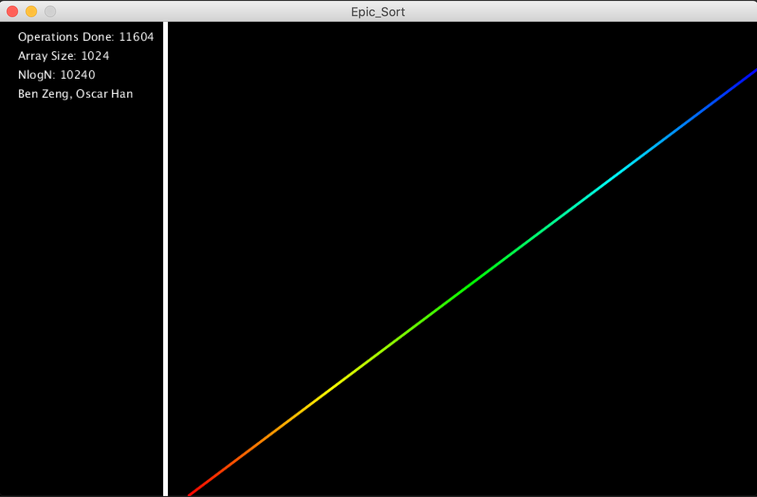
Demonstration
Graphics

Slide 8
FULL TIME COMPLEXITY ANALYSIS:
At every step of partitioning process, the loop variable, which is initialized at the start of the subarray, is incremented until it hits the end of the subarray.
This means that there will be at most N steps in this process, where N is the number of elements in the subarray. Since each individual operation at each step has a time complexity of O(1), the time complexity of partitioning is O(N).
Since every element that is added to the Queue of pending subarrays gets partitioned, the number of operations required for Quicksort in total is proportional to the sum of the sizes of each subarray that gets added into the Queue.

Slide 9
FULL TIME COMPLEXITY ANALYSIS:
Now, what does this mean for the time complexity for quicksort?
BEST CASE- when the pivot perfectly splits each subarray in ½:
O(N) + 2 * O(N/2) + 4 * O(N/4) + 8 * O(N / 8)... + N * O(1)
= O(NlogN) (Base 2)
AVERAGE CASE- when the pivot splits the subarray such that one side is ¾ while the other is ¼:
O(N) + O(N/4) + O(3N/4) + O(N/16) + 2 * O(3N/16) + O(9N/16)....
= O(NlogN) (Base 4/3)

Slide 10
FULL TIME COMPLEXITY ANALYSIS:
Now, what does this mean for the time complexity for quicksort?
WORST CASE-when the subarrays get split into a subarray of length 1 and a subarray with length N - 1:
O(N) + O(1) + O(N - 1) + O(1) + O(N - 2) + O(1) + O(N - 3).... + O(1) + O(N - (N - 1))
= O(N^2)
HOWEVER, this case is extremely unlikely, as if you are picking random pivots each time, this scenario only happens if you pick the smallest or greatest element EVERY time you are doing a partition.
Because of this, Quicksort is still one of the most efficient sorting algorithms, even though it technically has a worst case of O(N^2).

