Slide 1
An Intelligent Index Tracking System
Fung Wai Yin Pun Cheuk Kwan
Yung Chun To Samuel

Slide 2
Problem Description

Slide 3
Remind
High Cost For Fund Manager
Difficult For Beginners To Learn Investment

Slide 4
Project Objectives
The proposed objectives are:
Collect data from the stock markets
Data Analysis to help investors
Design and develop an integrated platform for investors
Evaluate new application against current method

Slide 5
Methodology

Slide 6
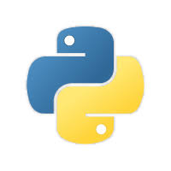

Base Technologies
Programming language : Server : Python Python perform well in Complex operation
Client : PHP PHP can support many platform and well in data reading

Slide 7
Overall Design
Client Side:
php to handle the data from website
MYSQL to store data
Server Side:
Python to collect and calculate the data
Generate the chart for user

Slide 8
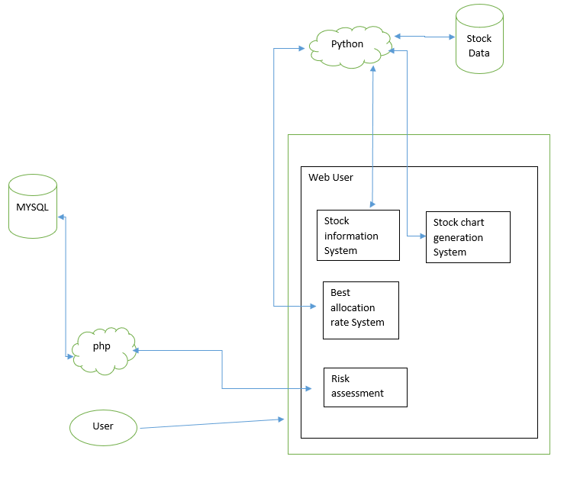
Overall Design
Existing Technologies:
-php
-MYSQL
-Python

Slide 9
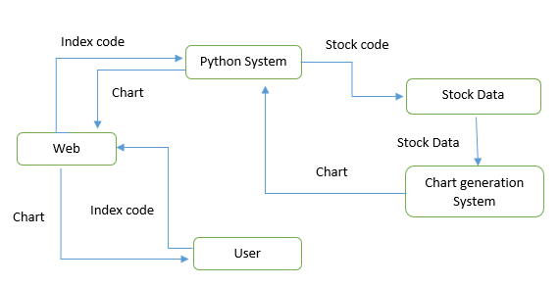
Important part
Chart Generation

Slide 10
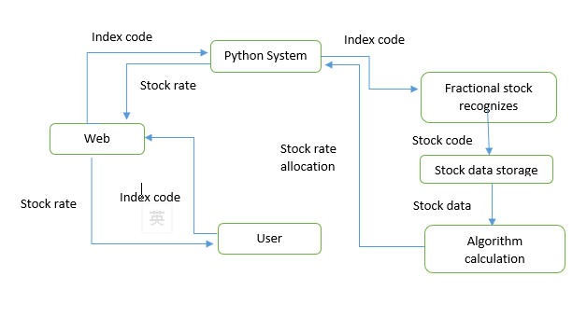
Important part
Stock rate allocation

Slide 11
Evaluation Plan

Slide 12
Evaluating the accuracy
Compare the new index which calculate with new algorithm with real-time index on internet. Check the result is it in expectation.

Slide 13
End of presentation

