Slide 1
Final Year Project
Elderly Mobile Life Assistant for Family Members with Extra Peace of Mind
Team Member
Leung Kwan Ho 12123629
Au Chi Chung 12017765
Lie Tze Wah 12123709
Group Name: Whale Did You Go? Supervisor: Kelvin Lee

Slide 2
Project Description
1
Project objectives of the application

Slide 3
Project Objectives
Low Priority
In-app notification
Elderly daily life management
Safety of elderly
Focus on families with elderly
Simple interface
High Priority

Slide 4
Methodologies
2
Current system design

Slide 5
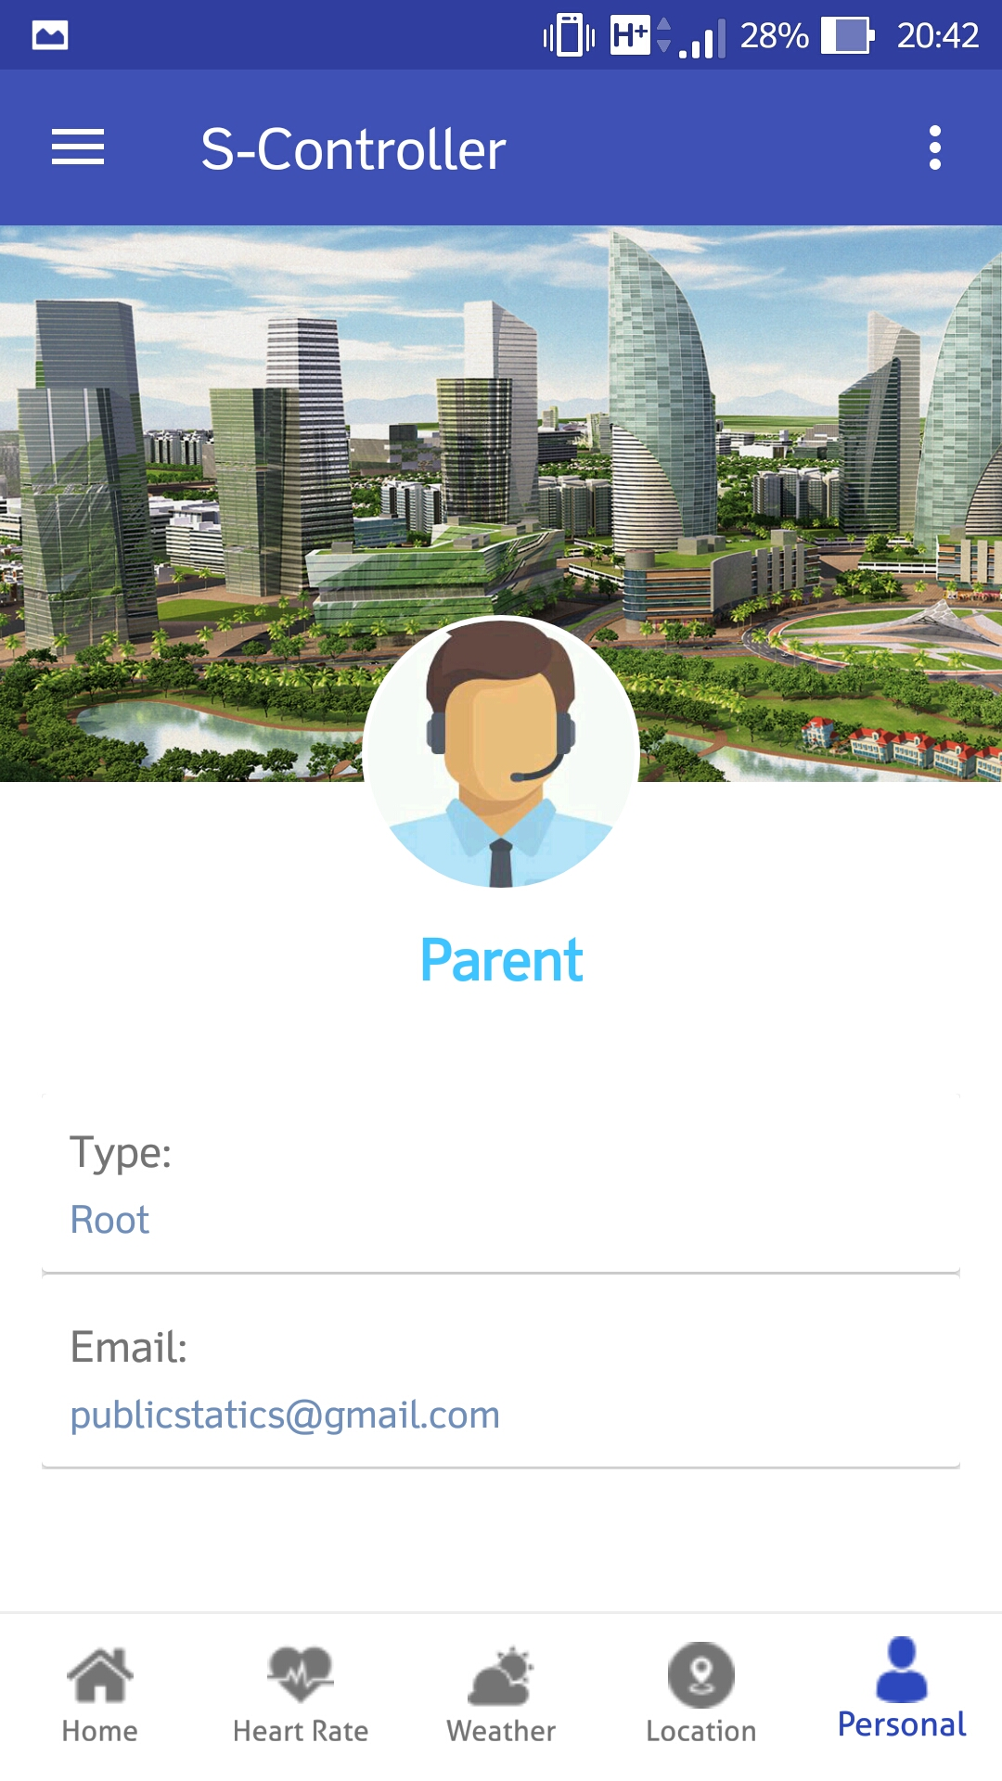
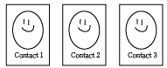
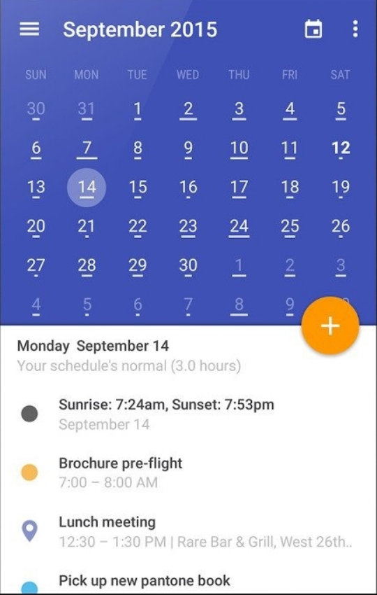
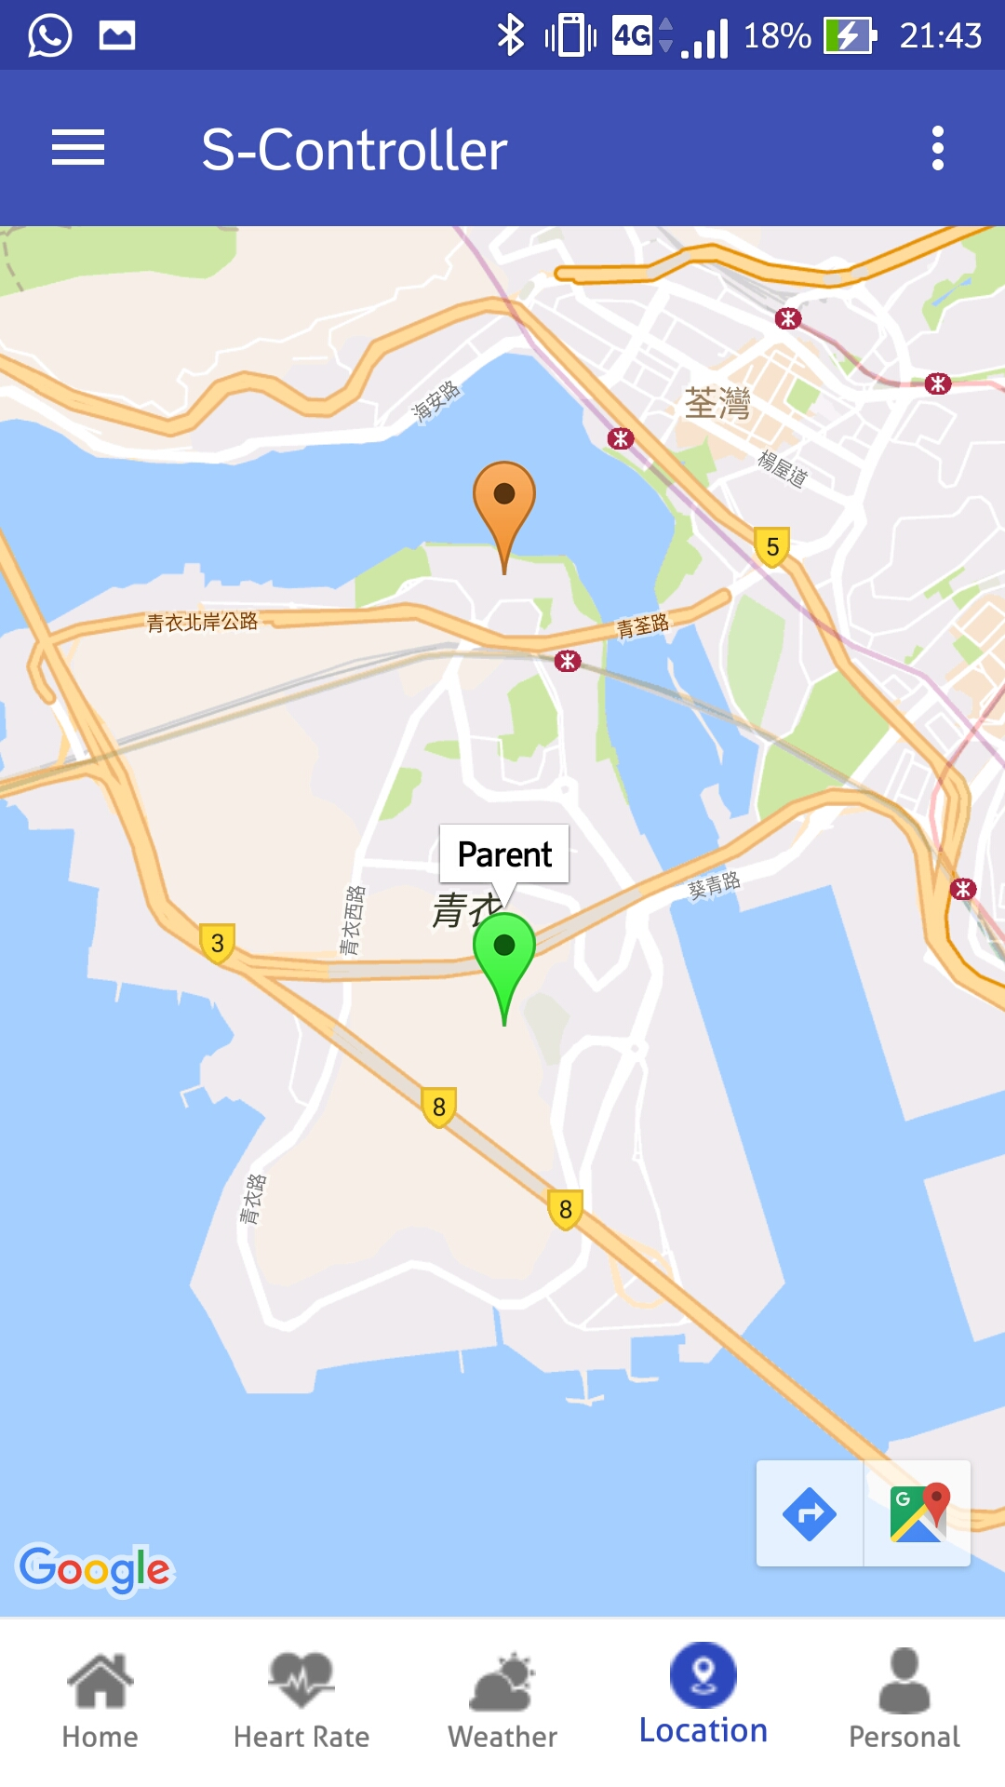

Overall Design
Single-touch dialing
Place your screenshot here
Instant messages
Voice-based control
Calendar
GPS-Monitoring
Fall-detection

Slide 6
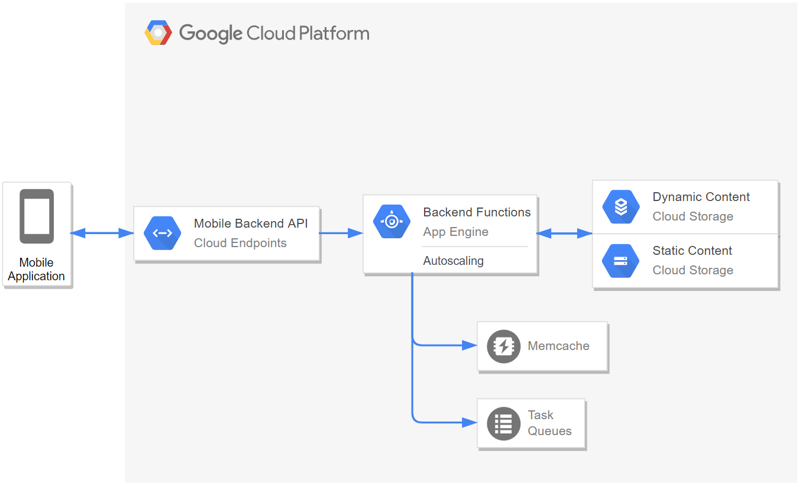
Overall Design

Slide 7
Technical Gap
Equipment Restriction
Network Restriction
User’s mobile device may not connect with the internet
Data Storage Restriction
it needs a stable environment for the large data storage

Slide 8
Evaluation Plan
3
Objectives achievement of development

Slide 9
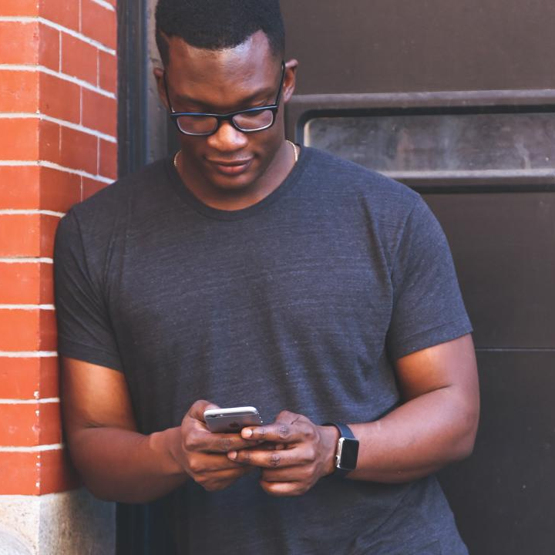


Evaluation Plan
Evaluating the effectiveness
Random sampling and control group: Set up experiment with same factors to compare two group of users
👪👪
Group A
👪👪
Group B

Slide 10
End of the Presentation
Ending
Any questions?

