Slide 1
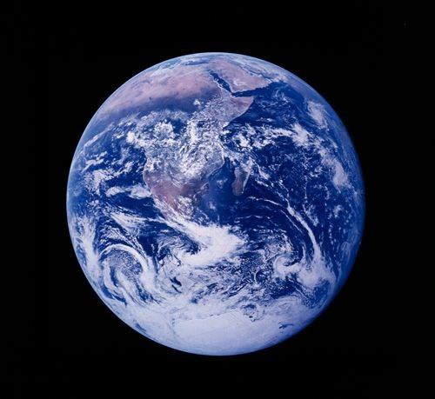
MDE Overview
Air Quality Planning Program
June 2, 2010

Slide 2

Overview
Regional Greenhouse Gas Initiative (RGGI)
Greenhouse Gas Emissions Reduction Act of 2009 (GGRA)
Other Agencies
Federal Impacts
Notes:
Great opportunity for creative interaction between existing and developing trading programs.

Slide 3

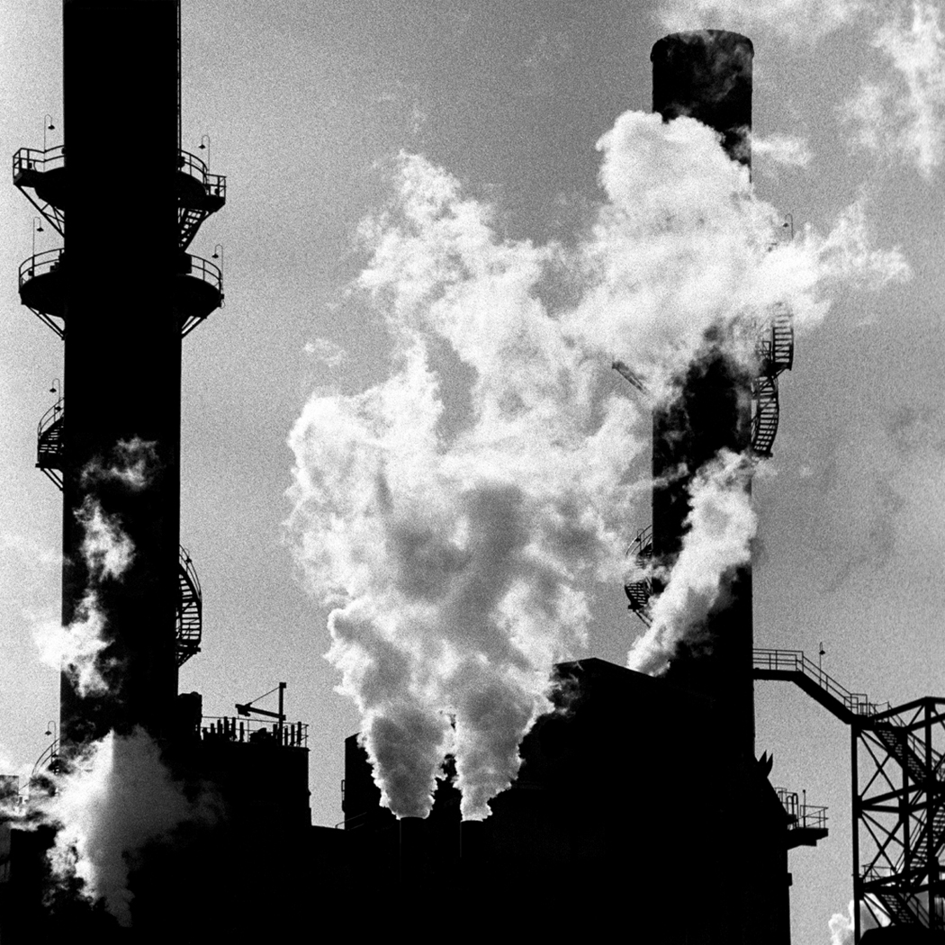
RGGI Offset Options
Landfill Methane Capture and Destruction
Reduction in Emissions of Sulfur Hexafluoride (SF₆)
Sequestration of Carbon due to Afforestation
Reduction or Avoidance of CO₂ Emissions from Natural Gas, Oil, or Propane End-Use Combustion due to End-Use Energy Efficiency
Avoided Methane Emissions from Agricultural Manure Management Operations
Notes:
Cap-and-trade: first in country, demonstration program
10 states: DE, MD and on up, excluding PA
Only CO2, not other ghg’s
LGR electric generators (oil, natural gas, coal)
States auction allowances in quarterly auctions
Have 3 years to acquire allowances = to emissions
1 allowance is equal to 1 ton of CO2
Sources can use ~ 3% of offset allowances for compliance demonstration
RGGI offsets very strict, wanted reductions from the sources and not from offsets
No projects foreseen in Maryland
(160 pages of regulations)

Slide 4
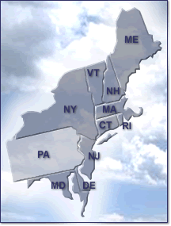
RGGI Offset Status
ICF International developed technical guidance for each offset option
  Cooperative review of all documents
Two applications received to date
  Massachusetts
    Building Energy
  New York
    SF₆

Slide 5

Greenhouse Gas Emissions Reduction Act of 2009
Establish and implement a plan to reduce greenhouse gas emissions in Maryland by 25% below 2006 levels by 2020
Notes:
2007 Executive Order for MCCC
2008 CAP – 42 policies
ES, AFWG, RCI, TLU, CC
Stakeholder developed policies
2009 GGRA – Not cap-and-trade, no cap at all
Using CAP to achieve 25% by 2020 goal
B & 1 – June 2011
2006 baseline
Normal sector based inventory
DNR - forest sequestration rates in baseline and forecast
(Summary of 1000 pages)

Slide 6


GGRA
“Provide for the use of offset credits generated by alternative compliance mechanisms executed within the State, including carbon sequestration projects to achieve compliance with greenhouse gas emissions reductions required by the subtitle.”
“Alternative compliance mechanism”
Notes:
No CAP limit of emissions for Maryland for purposes of GGRA
MDE required to promulgate regulations for “alternative compliance mechanism”.
MDE is hoping to capture GHG sinks
Reductions obtained through other programs
Avoidance, sequestration
Being developed in other agencies (DNR, PSC, MDA, DGS)
Opportunity for emitting sources and others to invest in Maryland-specific projects

Slide 7

Other Agencies
Department of Agriculture (MDA)
Public Service Commission (PSC)
Department of Natural Resources (DNR)
Notes:
MDA
CIER, working with MDA and WRI, evaluate economics for adding a carbon component to nutrient trading program
PSC
Consumer Protection Program (2009)
Ratepayer “choice”
DNR
Understood that DNR is evaluating ecosystem markets opportunities

Slide 8

Federal Impacts
Federal program may preempt any Maryland or RGGI GHG carbon market
Waxman-Markey Bill – USDA overseeing offsets (2009)
Kerry-Boxer Bill has President overseeing offsets (2009)
  Bill did not pass Senate
Kerry-Lieberman (2010)
Notes:
Greatly appreciate all of the hard work of agencies such as MDA.
MDE is watching the developing federal picture, as is other agencies. Now is the time to shape policy.

