Slide 1
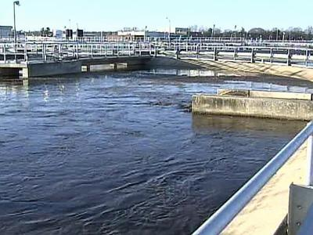
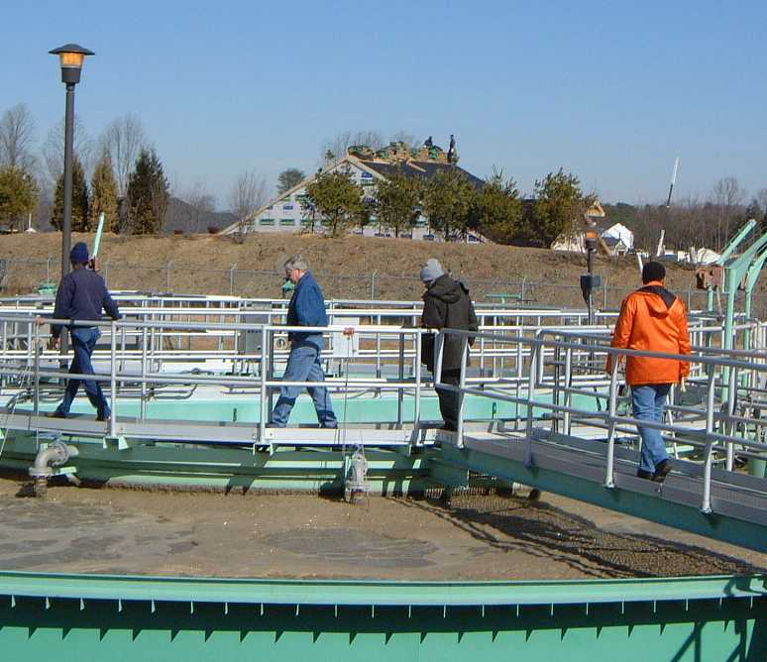
Maryland’s Nutrient Trading Program
Phase I- Trading between point sources and trading involving connecting on-site septic systems
Hood College- 5/25/10
College of Southern Maryland- 6/2/10
Chesapeake College- 6/3/10
Steve Luckman –
Municipal NPDES Permits Division
sluckman@mde.state.md.us,
(410)537-3672
Notes:
Frequently, presenters must deliver material of a technical nature to an audience unfamiliar with the topic or vocabulary. The material may be complex or heavy with detail. To present technical material effectively, use the following guidelines from Dale Carnegie Training®.
Consider the amount of time available and prepare to organize your material. Narrow your topic. Divide your presentation into clear segments. Follow a logical progression. Maintain your focus throughout. Close the presentation with a summary, repetition of the key steps, or a logical conclusion.
Keep your audience in mind at all times. For example, be sure data is clear and information is relevant. Keep the level of detail and vocabulary appropriate for the audience. Use visuals to support key points or steps. Keep alert to the needs of your listeners, and you will have a more receptive audience.

Slide 2
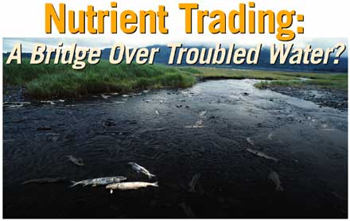
Maryland Policy for Nutrient Cap Management and Trading in Maryland’s Chesapeake Bay Watershed was finalized on April 17, 2008, and is available on MDE’s website.
This part is Phase I only- point source to point source trading, and connecting on-site disposal systems.
Phase II non-point source to point source trading.
Notes:
In your opening, establish the relevancy of the topic to the audience. Give a brief preview of the presentation and establish value for the listeners. Take into account your audience’s interest and expertise in the topic when choosing your vocabulary, examples, and illustrations. Focus on the importance of the topic to your audience, and you will have more attentive listeners.

Slide 3

Purpose of the Policy
To offset new or increased discharges and still maintain water quality.
To establish economic incentives for reductions from all sources within a watershed.
To achieve greater economic benefits than through existing regulatory programs.

Slide 4
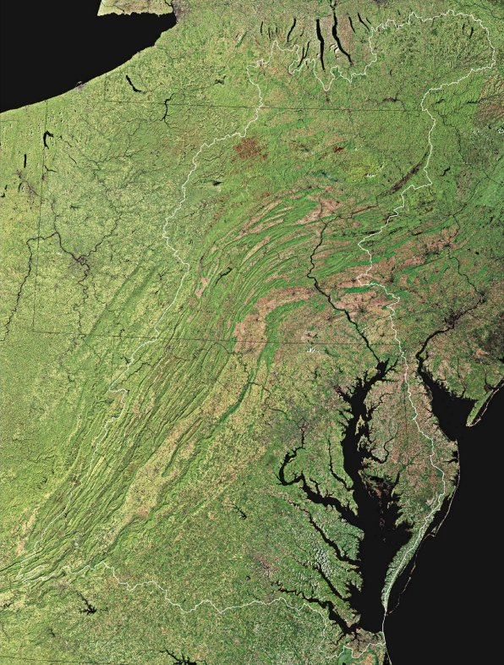
Background
The Chesapeake Bay Signatories agreed to reduce total nitrogen (TN) to 175 Mlbs/year and total phosphorus (TP) to 12.9 Mlbs/year. This has been revised to 200 Mlbs/year TN and 15 Mlbs/year using more recent water quality data and computer modeling; there may be a further revision later in June.
Maryland’s share was 37.25 Mlbs/year TN and 2.92 Mlbs/year TP. This has been revised to 41.04 Mlbs/year TN and 3.04 Mlbs/year TP. The point source portion is 29% for TN and 25% for TP.
The point source part of the Tributary Strategy requires ENR technology for all significant (0.5 MGD or larger) WWTPs.
Smaller WWTPs have nutrient caps based on 18 mg/l TN, 3.0 mg/l TP, and the lower of 2003 design flow or 2020 projected flows.
A nutrient trading policy was first presented to stakeholders in April 2006, and, after meetings with several stakeholders groups, and is available on the MDE website.

Slide 5

Key Principles
All new and expanded point source nutrient loads must be fully offset. {When a significant land use change occurs, associated increases in nonpoint source loading must also be offset if the point source acquires offsets from a nonpoint source}
Consistency with the County Water and Sewer Plan
Trading will not be available in lieu of required ENR upgrades.
Point source trades will be implemented through NPDES permits.
Compliance with TMDLs and water quality standards
Protecting local water quality
Fully offset
Water and Sewer Plan
ENR Upgrade
NPDES Permit
Local Water Quality

Slide 6
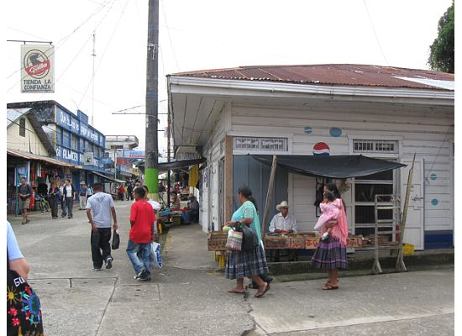
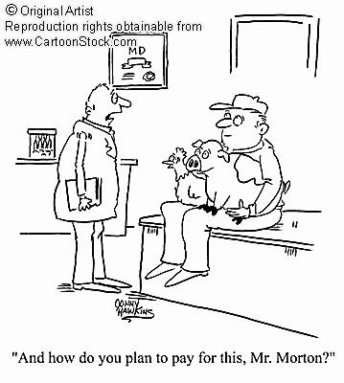

Fundamentals of Point Source to Point source Trading
There will be a 5% retirement ratio applied to each point source to point source trade.
The cost of credits is determined by the market.
Credits secured for a new or expanding facility must be for at least 10 years, with a plan for at least 10 additional years. This means that there will be no short-term trading to achieve yearly compliance with discharge permit limits.

Slide 7
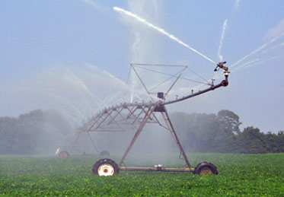
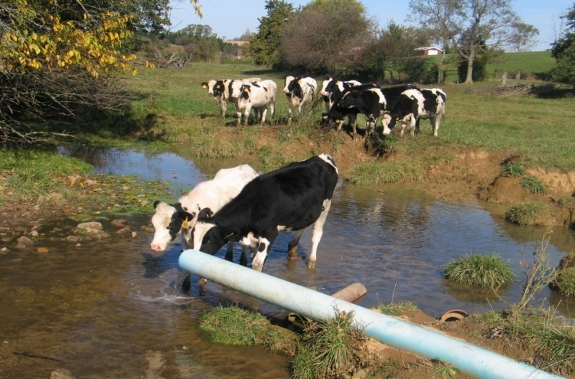
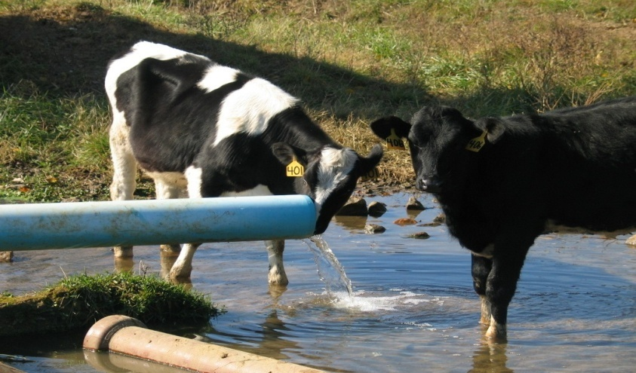
Credit Generation Options
Upgrading an existing minor WWTP to BNR or ENR
Connecting an existing WWTP to an ENR facility
Connecting existing on-site septic systems
Land application of wastewater
Innovative/alternative methods

Slide 8

DILEMMA
There are many potential buyers for nutrient credits, but there are very few potential sellers.
Psst - you got any excess nitrogen credits I can buy?
Never! I may have 91,367 pounds, but they’re all mine- every last one of them !!

Slide 9
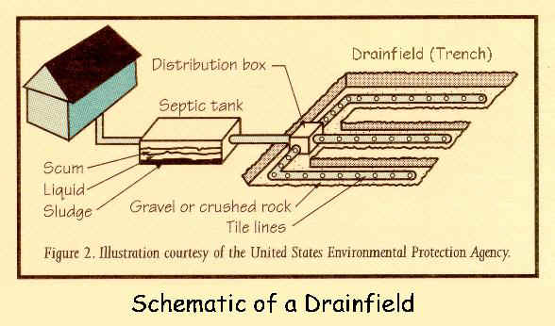
Credits for Retiring Existing on-site Septic Systems
Please note that the septic systems do not have to be “failing” to obtain credits !
Nitrogen credits may be given to an ENR WWTP based on the proximity of the septic systems to be connected to surface waters-
  In critical areas, 12.2 lbs/year TN per system
  Within 1000’ of any perennial surface water, 7.5 lbs/year TN
  All others, 4.6 lbs/year TN
  Note that it is assumed that the average residential septic system delivers no TP. Therefore, no TP credits are generated by connecting a septic system.

Slide 10
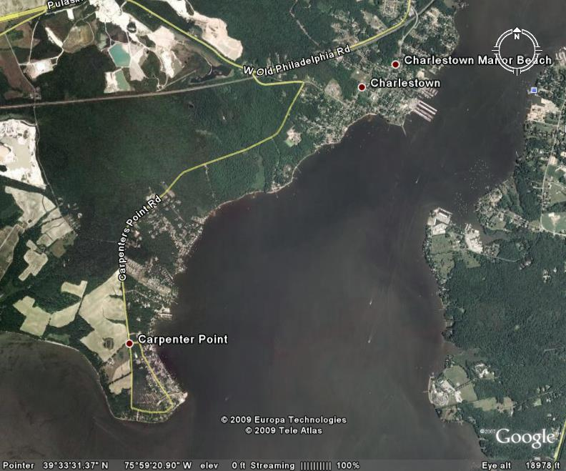
Nutrient Trading in Maryland So Far
Connecting an existing small WWTP (Dreams Landing Condominiums) to the Annapolis WWTP. The Dreams Landing WWTP had TN and TP allocations of only 490 and 82 lbs/year. 95% of this allocation has been transferred to the Annapolis WWTP.
In Carpenter Point, 194 homes in the critical area, 20 homes within 1000’ of a perennial stream, and 34 other homes previously on septics have been connected to the Northeast WWTP. An additional 2,674 lbs/year total nitrogen credits will be added to the Chesapeake Bay Cap allocation for this WWTP. (They are planning to connect more septics along with the Town of Port Deposit to obtain more nutrient credits).
The 0.6 MGD Marlboro Meadows WWTP in Prince Georges County will be connecting into the Western Branch WWTP collection system next year. At that time, 95%of the nutrient allocations previously given to Marlboro Meadows will be added to the Western Branch allocation.
Northeast River WWTP
Carpenter Point

