Slide 1
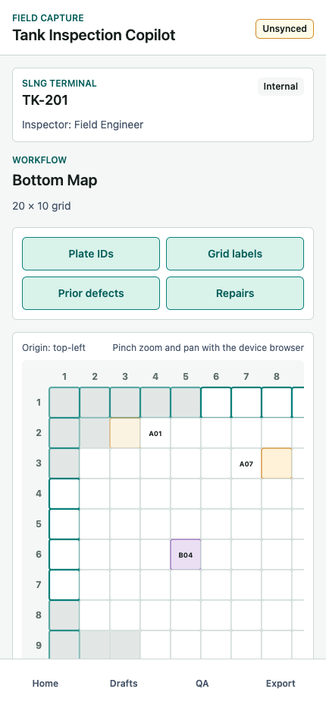
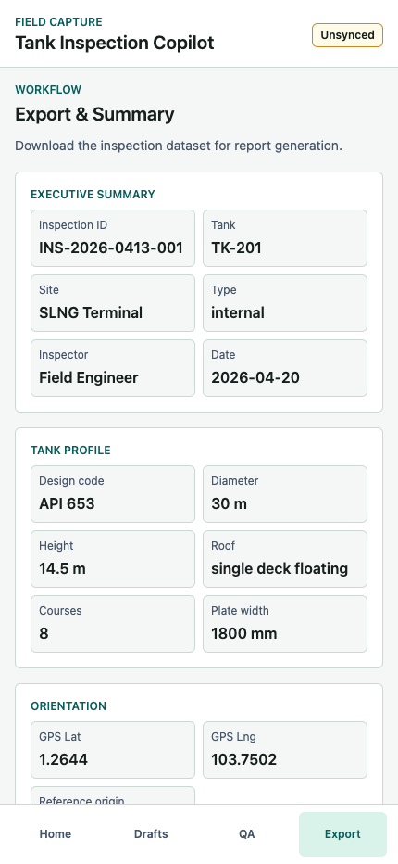
Tank Inspection Copilot
Latest screen-by-screen customer validation deck
31 current mobile screens covering setup, tank profile, orientation, MFL import, surface geometry, defect capture, QA validation, export, and submission.
Prepared for customer validation - April 20, 2026
Workflow: setup -> tank definition -> surface geometry -> location -> defect capture -> review -> export

Slide 2
Validation Coverage
Screens included in this latest pass
Start and resume
Tank definition
Surface selection
2 screens
2 screens
1 screen
Bottom inspection
Location capture
Defect capture
1 screen
5 screens
5 screens
Review
Surface geometry
Submit
3 screens
9 screens
3 screens
How to use this deck
Each screen slide includes the current screenshot, the customer-facing purpose, and validation questions.
Use the right-side validation points as the meeting checklist for feature sign-off.
The screenshots were captured from the current React app on localhost at mobile viewport 430 x 932.

Slide 3
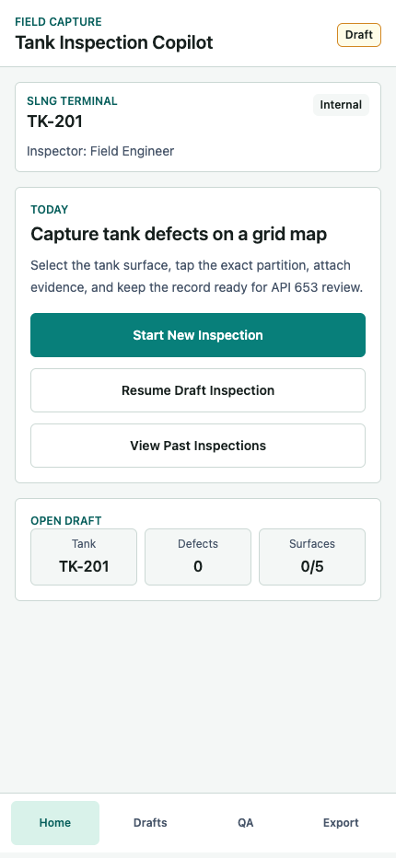
Start and resume
Screen 01 - Home
Entry point for field inspection work
Lets an inspector start a new tank inspection, resume the current draft, or review prior work while keeping the active tank context visible.
Customer validation points
1. Confirm the active draft summary uses customer-recognisable site, tank, inspection type, and inspector fields.
2. Validate that Start New Inspection and Resume Draft Inspection are the right primary actions for field users.
3. Confirm the sync badge language - Draft, Unsynced, Synced - is understandable to non-technical inspectors.
Tank Inspection Copilot - Latest Screen Review
3 / 33

Slide 4
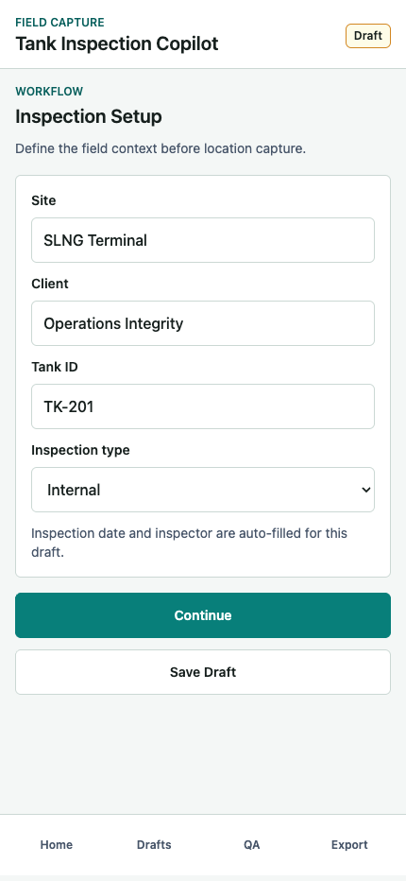
Start and resume
Screen 02 - Inspection Setup
Define the inspection context before capture begins
Captures site, client, tank ID, and inspection type so every defect record is tied to the correct asset and inspection session.
Customer validation points
1. Validate required setup fields: Site, Tank ID, and Inspection Type.
2. Confirm the pre-filled TK-201 demo values are credible for customer walkthroughs.
3. Confirm Save Draft behavior is clear for interrupted field work.
Tank Inspection Copilot - Latest Screen Review
4 / 33

Slide 5
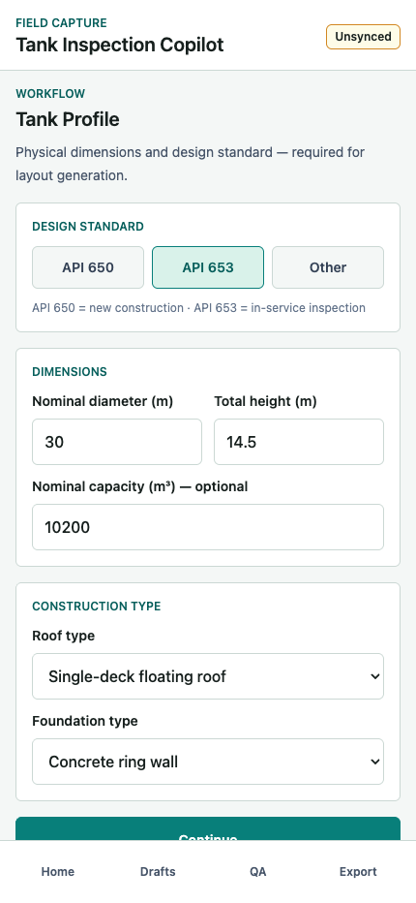
Tank definition
Screen 03 - Tank Profile
Capture tank dimensions and construction standard
Collects physical tank data required to generate repeatable floor, shell, roof, annular, and nozzle location maps.
Customer validation points
1. Confirm the design code choices reflect customer language: API 650, API 653, or Other.
2. Validate diameter, height, capacity, roof type, and foundation type as the right minimum profile fields.
3. Confirm these fields are sufficient for downstream layout drawing and defect overlay generation.
Tank Inspection Copilot - Latest Screen Review
5 / 33

Slide 6
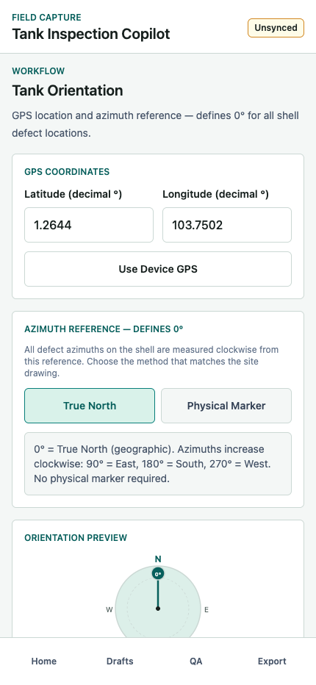
Tank definition
Screen 04 - Tank Orientation
Set GPS position and azimuth reference
Defines how shell and top-view defect positions map to real-world orientation using True North or a physical reference marker.
Customer validation points
1. Confirm True North versus Physical Marker matches customer field practice.
2. Validate whether GPS should be optional, required, or manually entered when device GPS is unavailable.
3. Confirm the compass preview is enough to explain 0 degree orientation during customer review.
Tank Inspection Copilot - Latest Screen Review
6 / 33

Slide 7
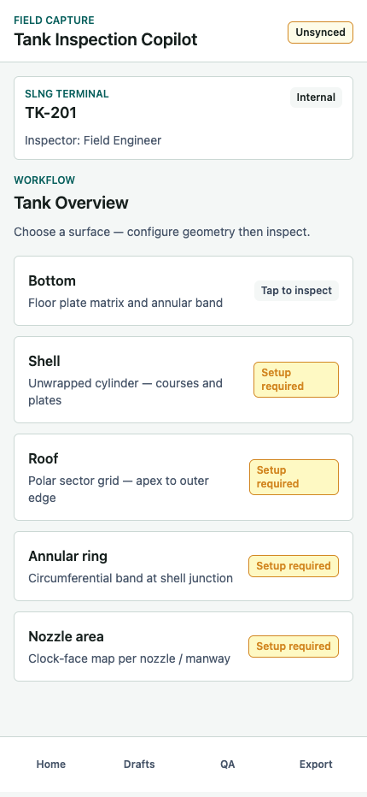
Surface selection
Screen 05 - Tank Overview
Choose the tank surface to inspect next
Shows all inspectable surfaces and whether each surface is ready, requires setup, has defects, or is complete.
Customer validation points
1. Validate the surface list: Bottom, Shell, Roof, Annular ring, and Nozzle area.
2. Confirm setup-required badges make sense before shell, roof, annular, and nozzle inspection begins.
3. Confirm Bottom should route to MFL import before manual defect capture.
Tank Inspection Copilot - Latest Screen Review
7 / 33

Slide 8
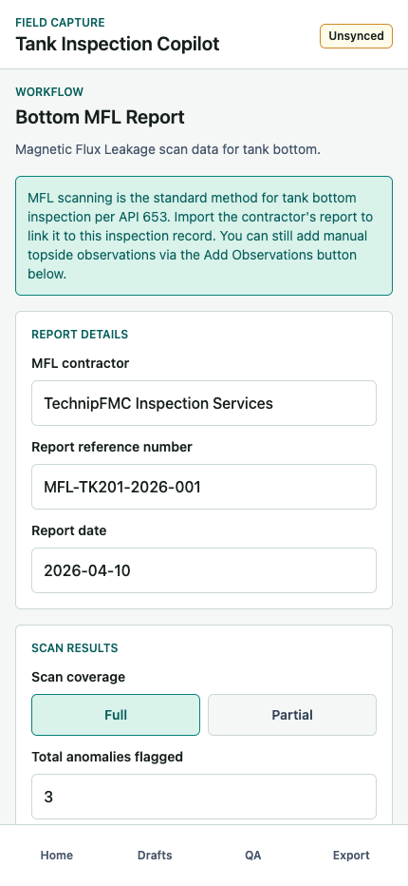
Bottom inspection
Screen 06 - Bottom MFL Report
Import contractor MFL results for tank bottom
Records the Magnetic Flux Leakage report for the bottom surface, including contractor, report reference, date, coverage, anomaly count, severity, and notes.
Customer validation points
1. Validate MFL as the default bottom inspection path for customer operations.
2. Confirm severity labels: Clean, Minor findings, Significant findings, Critical findings.
3. Confirm Add Manual Observations is the right secondary action when MFL does not capture all observations.
Tank Inspection Copilot - Latest Screen Review
8 / 33

Slide 9
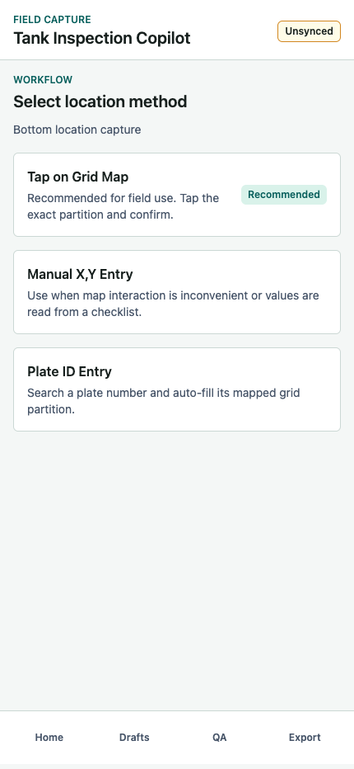
Location capture
Screen 07 - Location Mode
Select the most practical way to locate a defect
Offers three capture methods: tap the surface map, type X/Y coordinates, or search a plate ID from the drawing.
Customer validation points
1. Confirm Tap on Grid Map should remain the recommended mode.
2. Validate Manual X,Y Entry for checklist-driven inspections.
3. Validate Plate ID Entry for inspectors working from tank drawings.
Tank Inspection Copilot - Latest Screen Review
9 / 33

Slide 10
Location capture
Screen 08 - Bottom Grid Map
Pick a valid bottom plate partition on the map
Renders the bottom surface as a grid with disabled outside cells, annular edge highlighting, plate IDs, prior defects, repairs, and a selected location summary.
Customer validation points
1. Confirm the grid abstraction is understandable for bottom plate inspection.
2. Validate the overlay controls: Plate IDs, Grid labels, Prior defects, and Repairs.
3. Confirm the selected X/Y, Grid ID, and Plate ID summary provides enough audit detail.
Tank Inspection Copilot - Latest Screen Review
10 / 33

Slide 11
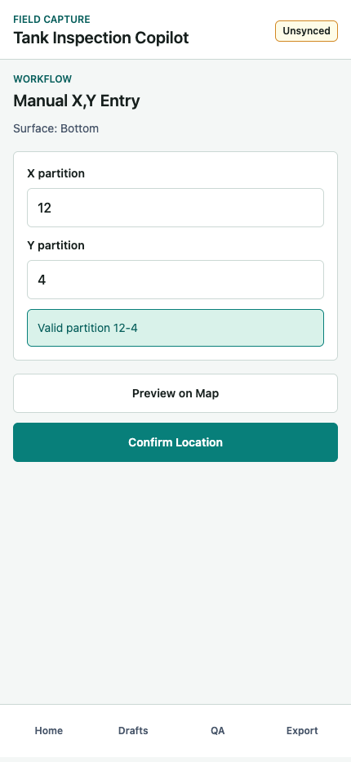
Location capture
Screen 09 - Manual X,Y Entry
Type coordinates when map tapping is impractical
Accepts integer X and Y partitions and validates them against the active surface grid and inspectable footprint.
Customer validation points
1. Confirm integer X/Y input is enough for field checklist workflows.
2. Validate the valid/invalid partition message wording.
3. Confirm Preview on Map and Confirm Location are the right next actions.
Tank Inspection Copilot - Latest Screen Review
11 / 33

Slide 12
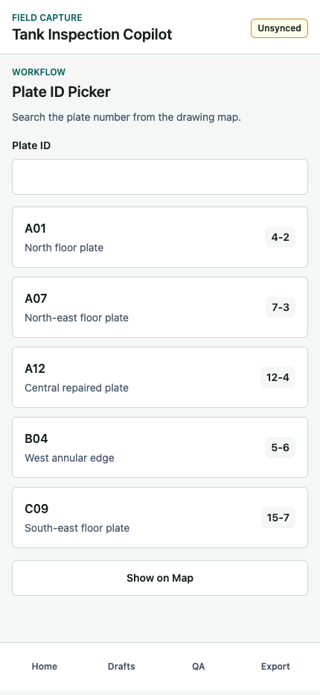
Location capture
Screen 10 - Plate ID Picker
Search a drawing plate ID to resolve coordinates
Lets the inspector choose a known plate number and automatically maps it to X/Y grid coordinates.
Customer validation points
1. Confirm plate search matches customer drawing conventions.
2. Validate which plate metadata should appear in each result: ID, subzone, and grid coordinate.
3. Confirm Show on Map is useful before locking the location.
Tank Inspection Copilot - Latest Screen Review
12 / 33

Slide 13
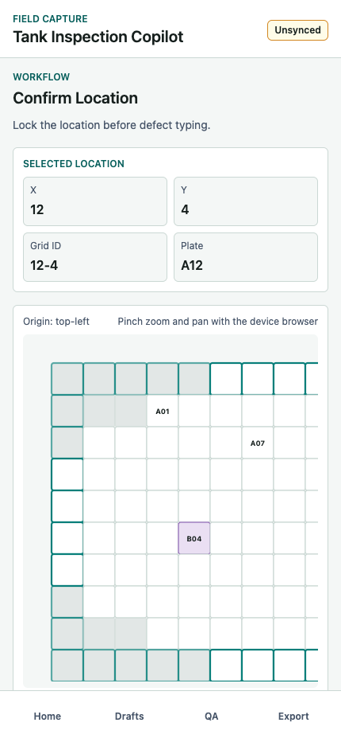
Location capture
Screen 11 - Confirm Location
Lock the selected surface position before defect typing
Shows a final location summary and preview map so spatial data is confirmed before the inspector records defect details.
Customer validation points
1. Confirm location cannot advance without a valid selected position.
2. Validate whether the mini map is enough to catch an incorrect plate or grid cell.
3. Confirm Edit Location should return to the original location method.
Tank Inspection Copilot - Latest Screen Review
13 / 33

Slide 14
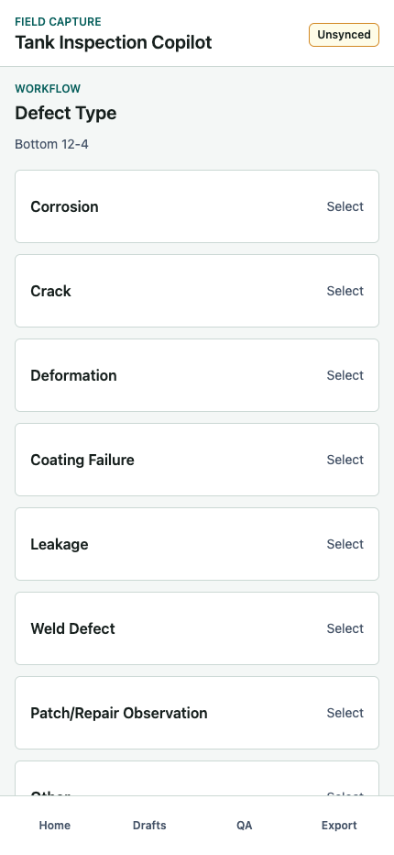
Defect capture
Screen 12 - Defect Type
Classify the defect at the locked location
Starts the defect record by selecting the primary defect type linked to the confirmed surface and grid ID.
Customer validation points
1. Validate the eight defect types against customer taxonomy.
2. Confirm one-tap selection is acceptable or whether a confirmation step is needed.
3. Confirm the location in the subtitle is visible enough as context.
Tank Inspection Copilot - Latest Screen Review
14 / 33

Slide 15
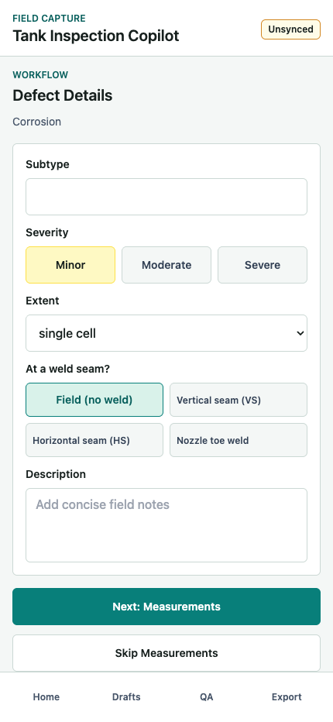
Defect capture
Screen 13 - Defect Details
Capture severity, extent, subtype, weld context, and notes
Collects qualitative defect details before numeric measurements and evidence are added.
Customer validation points
1. Confirm severity choices: Minor, Moderate, Severe.
2. Validate weld seam options for shell, bottom, roof, annular, and nozzle contexts.
3. Confirm required fields before moving to measurements.
Tank Inspection Copilot - Latest Screen Review
15 / 33

Slide 16
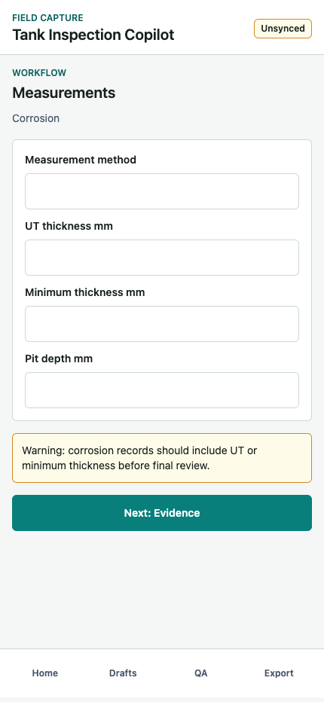
Defect capture
Screen 14 - Measurements
Record numeric readings based on defect type
Provides dynamic measurement fields for UT thickness, minimum thickness, pit depth, crack sizing, or deformation.
Customer validation points
1. Confirm the measurement method field is needed for audit traceability.
2. Validate corrosion measurement fields: UT thickness, minimum thickness, and pit depth.
3. Confirm non-blocking warnings are acceptable before final QA review.
Tank Inspection Copilot - Latest Screen Review
16 / 33

Slide 17
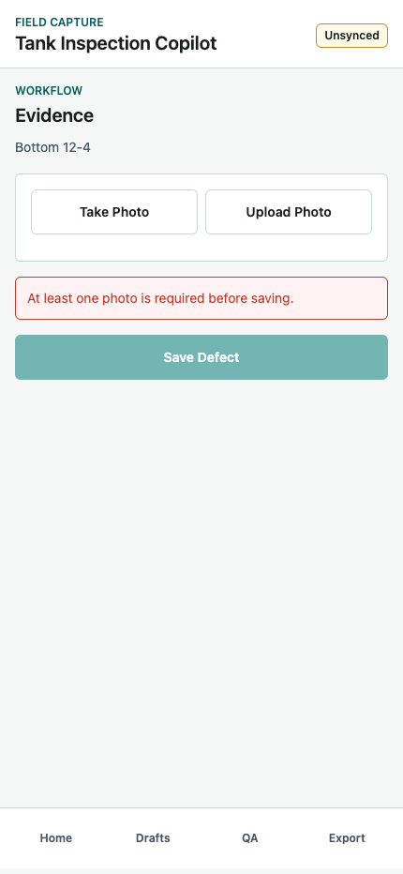
Defect capture
Screen 15 - Evidence Required
Block save until photo evidence is attached
Requires at least one photo before the defect record can be saved locally.
Customer validation points
1. Confirm photo evidence should be mandatory for all saved defects.
2. Validate Take Photo versus Upload Photo as the right field actions.
3. Confirm the disabled Save Defect state is obvious enough.
Tank Inspection Copilot - Latest Screen Review
17 / 33

Slide 18
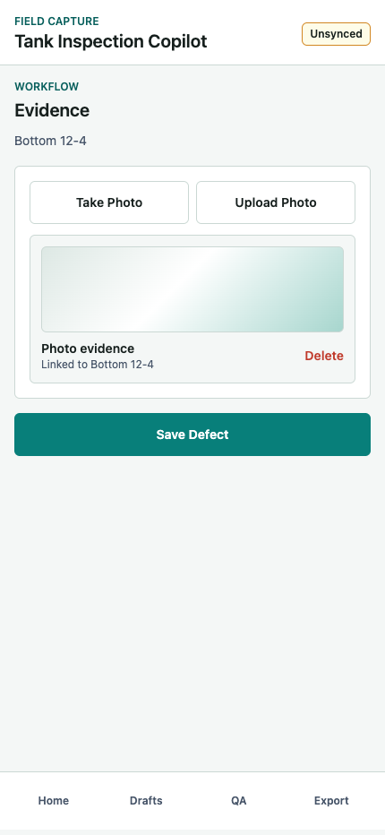
Defect capture
Screen 16 - Evidence With Photo
Link each photo to the surface and grid coordinate
Shows attached evidence cards with photo preview, surface link, coordinate link, and delete control.
Customer validation points
1. Confirm linked location metadata is sufficient for customer reporting.
2. Validate whether multiple photos per defect are needed.
3. Confirm Delete is enough for replacing incorrect or blurred evidence.
Tank Inspection Copilot - Latest Screen Review
18 / 33

Slide 19
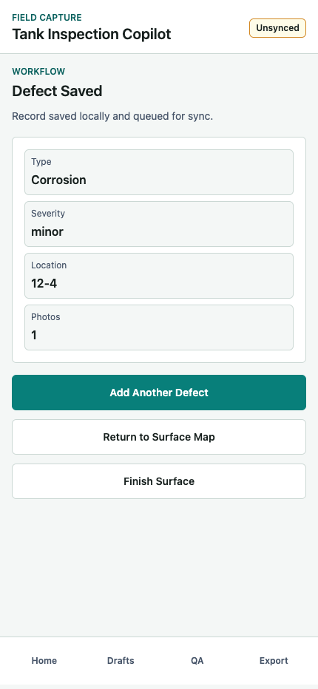
Review
Screen 17 - Defect Saved
Confirm the local defect record was saved
Summarizes the saved defect and lets the inspector add another defect, return to the surface map, or finish the surface.
Customer validation points
1. Confirm the saved summary has the right fields: type, severity, location, and photo count.
2. Validate Add Another Defect behavior for repeated observations at the same area.
3. Confirm Finish Surface is the right path into QA review.
Tank Inspection Copilot - Latest Screen Review
19 / 33

Slide 20
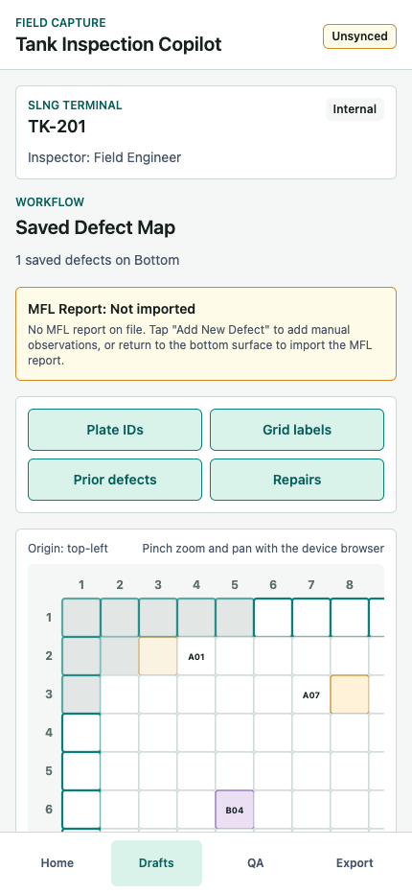
Review
Screen 18 - Saved Defect Map
Review spatial defect markers for the active surface
Displays all saved defects on the surface map alongside overlays and MFL status where applicable.
Customer validation points
1. Confirm saved defect markers are visible enough on the grid.
2. Validate whether MFL-not-imported warnings should appear on the bottom surface map.
3. Confirm Add New Defect and Finish Surface are the right review actions.
Tank Inspection Copilot - Latest Screen Review
20 / 33

Slide 21
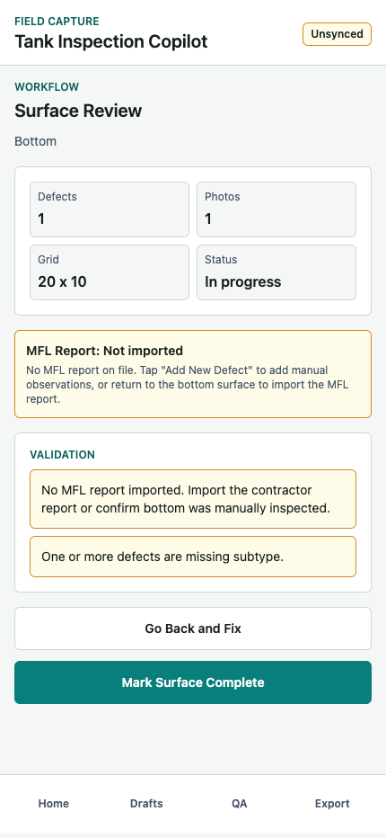
Review
Screen 19 - Surface Review
Run per-surface QA before marking complete
Shows surface metrics, warnings, MFL status, and completion actions before the surface is marked complete.
Customer validation points
1. Confirm warning language for missing MFL, missing photos, missing subtype, and empty surfaces.
2. Validate whether Mark Surface Complete should be allowed with non-blocking warnings.
3. Confirm the metrics panel is enough for customer QA review.
Tank Inspection Copilot - Latest Screen Review
21 / 33

Slide 22
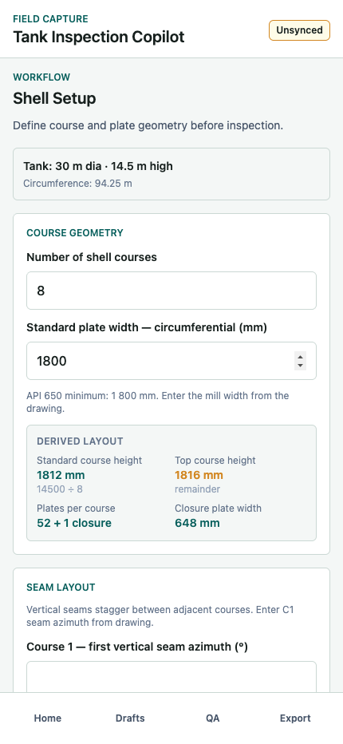
Surface geometry
Screen 20 - Shell Setup
Define shell course and plate geometry
Calculates shell layout from tank diameter, height, course count, plate width, and seam offset rules.
Customer validation points
1. Confirm shell course count and plate width are the right minimum drawing inputs.
2. Validate seam offset rules: half plate, third plate, or custom.
3. Confirm derived layout values are meaningful to inspectors and engineers.
Tank Inspection Copilot - Latest Screen Review
22 / 33

Slide 23
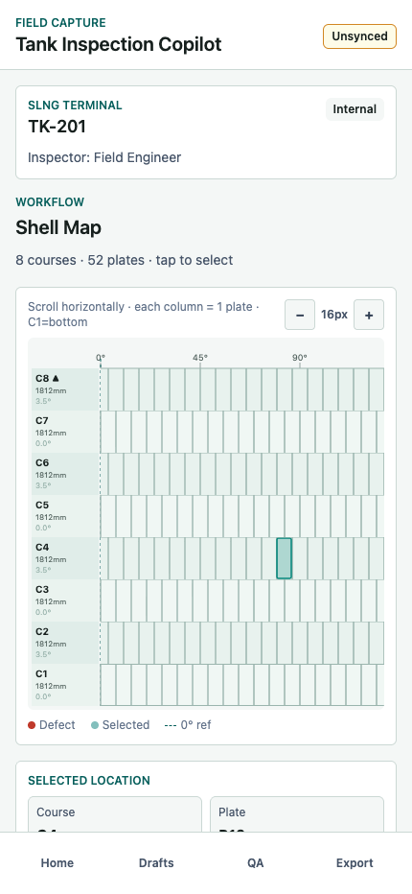
Surface geometry
Screen 21 - Shell Map
Inspect shell using an unwrapped course-by-plate map
Renders the shell as an unwrapped cylinder with course rows, plate columns, seam origins, azimuth ticks, and defect markers.
Customer validation points
1. Confirm unwrapped shell representation is acceptable for customer field users.
2. Validate course and plate terminology: C1, C2, P1, P2.
3. Confirm azimuth and elevation summaries are sufficient for report handoff.
Tank Inspection Copilot - Latest Screen Review
23 / 33

Slide 24
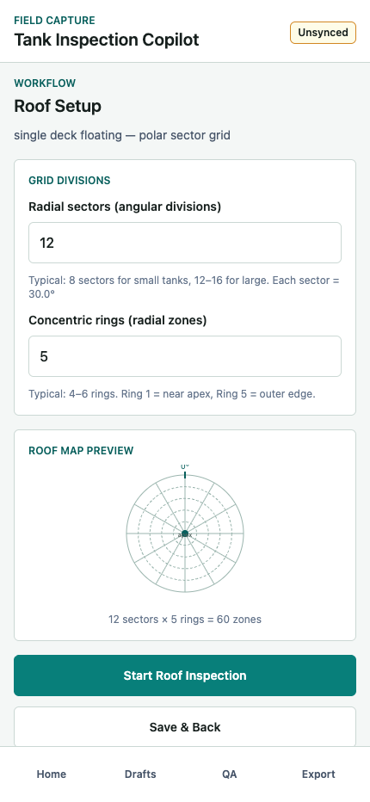
Surface geometry
Screen 22 - Roof Setup
Configure roof sectors and radial rings
Defines a polar roof grid using angular sectors and concentric radial rings.
Customer validation points
1. Confirm typical sector and ring counts for customer tank roofs.
2. Validate floating roof handling and whether apex height should be hidden or optional.
3. Confirm the preview communicates the roof map convention.
Tank Inspection Copilot - Latest Screen Review
24 / 33

Slide 25
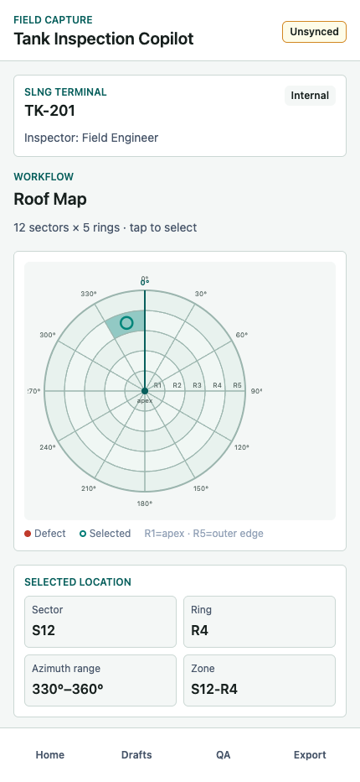
Surface geometry
Screen 23 - Roof Map
Locate roof observations by sector and ring
Provides a polar roof map with selected sector, ring, azimuth range, and zone summary.
Customer validation points
1. Confirm sector/ring location language matches how customers inspect roofs.
2. Validate 0 degree reference placement against the orientation screen.
3. Confirm selected roof zone is obvious on touch devices.
Tank Inspection Copilot - Latest Screen Review
25 / 33

Slide 26
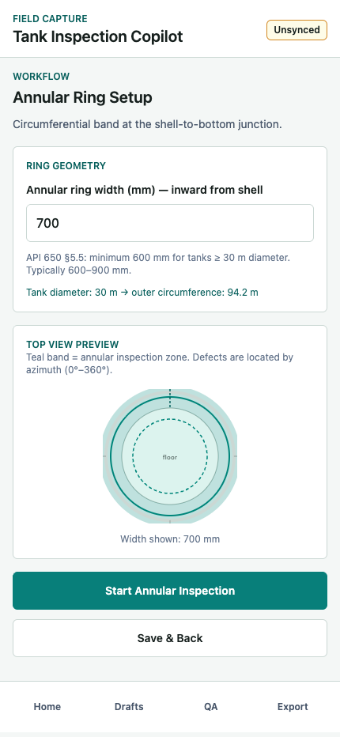
Surface geometry
Screen 24 - Annular Ring Setup
Define annular inspection band width
Captures annular ring width and previews the band around the floor-to-shell junction.
Customer validation points
1. Confirm default annular width and API 650 guidance text with customers.
2. Validate whether width should be imported from drawings instead of entered manually.
3. Confirm this setup should route directly to the annular map.
Tank Inspection Copilot - Latest Screen Review
26 / 33

Slide 27
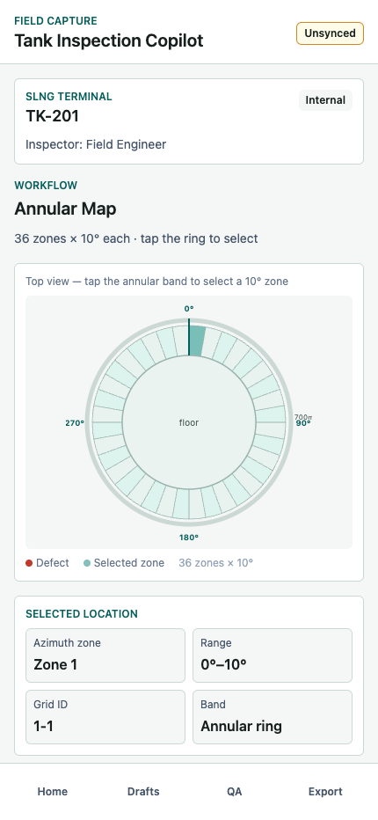
Surface geometry
Screen 25 - Annular Map
Inspect annular defects by azimuth zone
Shows the annular band as 36 ten-degree zones around the tank floor edge.
Customer validation points
1. Confirm 10 degree annular zones are the right resolution for customer use.
2. Validate whether customers need plate IDs in addition to azimuth zones.
3. Confirm zone selection and range labels are easy to explain.
Tank Inspection Copilot - Latest Screen Review
27 / 33

Slide 28
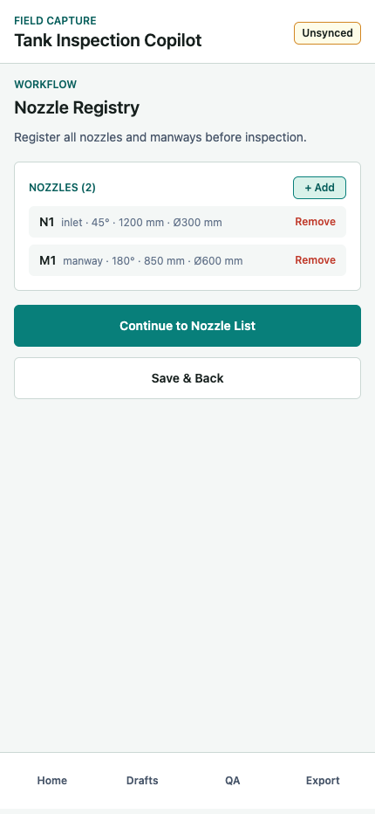
Surface geometry
Screen 26 - Nozzle Registry
Register nozzles and manways before inspection
Stores nozzle ID, type, azimuth, elevation, diameter, and optional description to support nozzle-specific defect maps.
Customer validation points
1. Confirm the nozzle registry fields match customer asset drawings.
2. Validate whether nozzle data should be manually entered or imported.
3. Confirm add/remove behavior is sufficient for the prototype.
Tank Inspection Copilot - Latest Screen Review
28 / 33

Slide 29
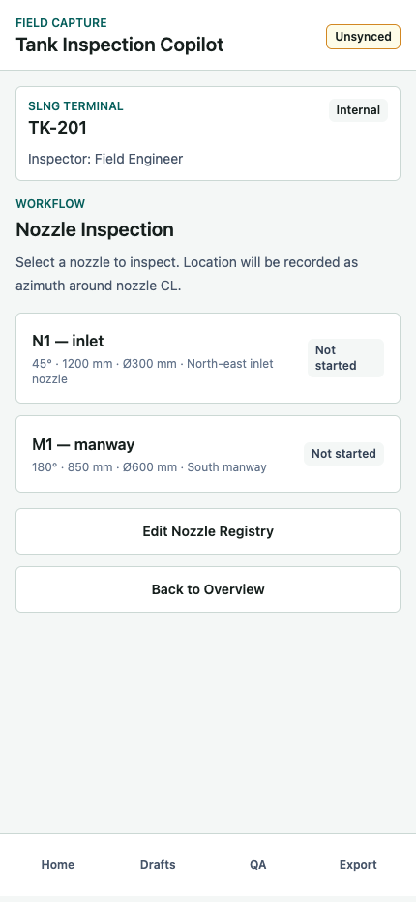
Surface geometry
Screen 27 - Nozzle Inspection List
Choose a nozzle or manway to inspect
Lists registered nozzles with azimuth, elevation, diameter, and per-nozzle defect count.
Customer validation points
1. Confirm registered nozzle metadata is enough to identify the correct feature in the field.
2. Validate defect count badges for completed or in-progress nozzle inspection.
3. Confirm Edit Nozzle Registry remains accessible during inspection.
Tank Inspection Copilot - Latest Screen Review
29 / 33

Slide 30
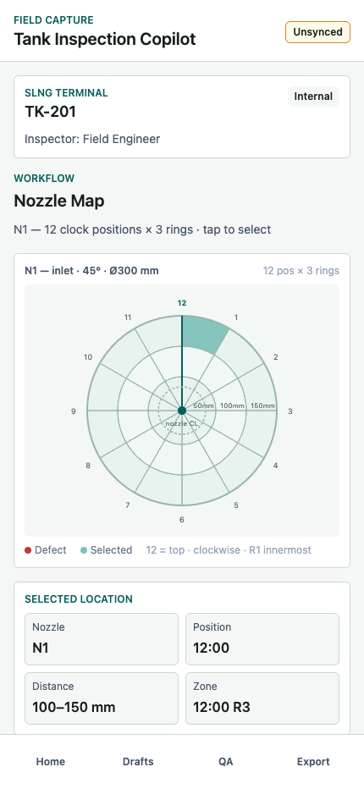
Surface geometry
Screen 28 - Nozzle Clock Map
Locate nozzle defects by clock position and radial distance
Maps defects around a selected nozzle using 12 clock positions and 3 radial distance rings from the nozzle centerline.
Customer validation points
1. Confirm clock-position language is familiar to inspectors.
2. Validate 50 mm, 100 mm, and 150 mm rings for nozzle weld inspection.
3. Confirm the selected zone summary should include nozzle ID, position, and distance.
Tank Inspection Copilot - Latest Screen Review
30 / 33

Slide 31
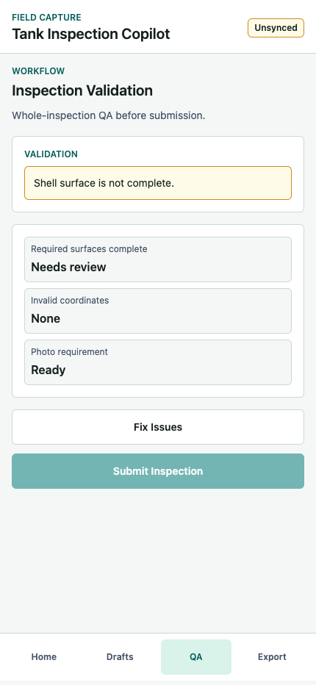
Submit
Screen 29 - Inspection Validation
Run whole-inspection QA before export
Checks required surfaces, photo evidence, and location validity before submission.
Customer validation points
1. Confirm Bottom and Shell are the required surfaces for the current inspection type.
2. Validate warning language when required surfaces are incomplete.
3. Confirm disabled Submit Inspection behavior when blocking warnings exist.
Tank Inspection Copilot - Latest Screen Review
31 / 33

Slide 32
Submit
Screen 30 - Export & Summary
Review summary metrics and download report-ready data
Shows the inspection summary, tank profile, orientation, findings, MFL status, and export actions for JSON and CSV.
Customer validation points
1. Confirm JSON package and defect CSV are the right export formats for the next reporting step.
2. Validate executive summary fields for customer reporting.
3. Confirm Confirm & Submit Inspection should live on this screen after QA passes.
Tank Inspection Copilot - Latest Screen Review
32 / 33

Slide 33
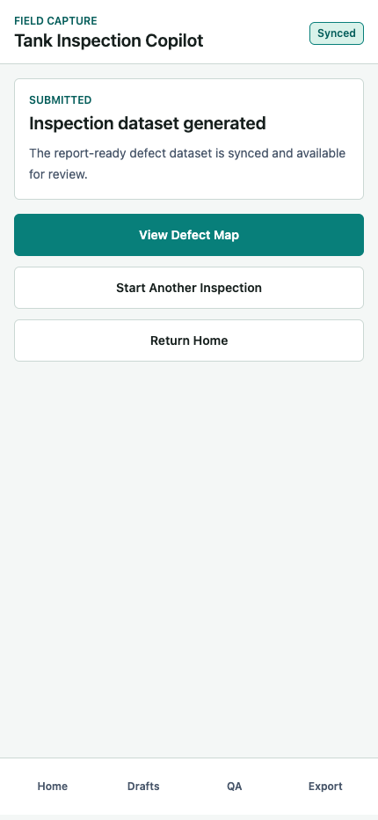
Submit
Screen 31 - Submission Success
Confirm the inspection dataset has been generated
Closes the workflow and gives the inspector options to review the defect map, start another inspection, or return home.
Customer validation points
1. Confirm success wording reflects the real integration state for the prototype.
2. Validate next actions after submission.
3. Confirm sync status changes to Synced after final submission.
Tank Inspection Copilot - Latest Screen Review
33 / 33

