Slide 1
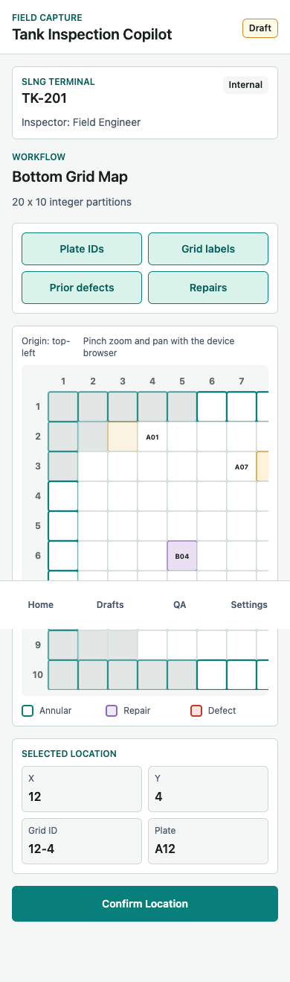
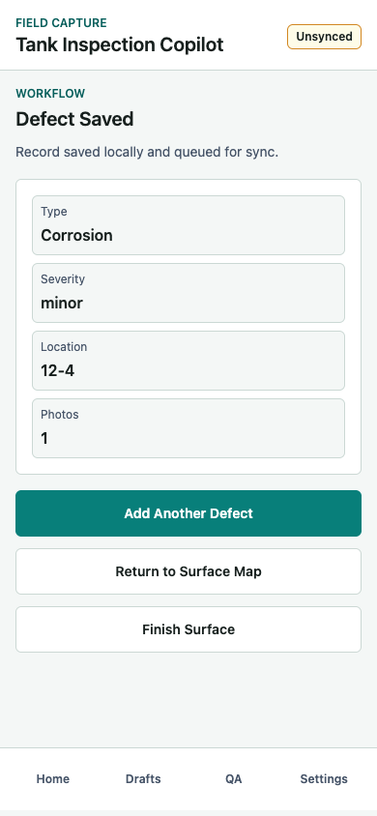
Tank Inspection Copilot
Mobile app UI product report
16:9 presentation deck generated from the Word report and mobile UI screenshots.
Core idea
Flatten each tank surface into a 2D matrix.
Record every defect by surface, X, Y, optional plate ID, severity, and photo evidence.
Audience
Field engineers capturing API 653-style tank inspection records in unreliable connectivity conditions.

Slide 2
Executive Summary
What the prototype is designed to prove
Problem
Solution
MVP focus
Inspection defects need repeatable, report-ready spatial locations.
Paper notes and photos are hard to reconcile later.
A guided mobile workflow captures tank, surface, X/Y grid location, defect details, and required evidence.
Location capture first.
Defect inventory and evidence linkage before CAD export or automatic detection.
Designed for field use
Report-ready output
- Offline draft persistence
- Large touch targets
- Minimal typing
- Clear validation before submit
- Surface, X, Y, grid ID
- Optional plate ID
- Defect type and severity
- Measurements and evidence metadata
Tank Inspection Copilot
2

Slide 3
At-a-Glance Workflow
From inspection setup to report-ready defect dataset
Start
Location
Defect
Review
Submit
Home, setup, tank overview
Open or create draft and select surface.
Mode, grid, manual, plate, confirm
Capture surface, X, Y, grid ID, plate ID.
Type, details, measurements, evidence
Record defect facts and proof.
Saved, map, surface review
Inspect spatial records and warnings.
Validation, success
Block invalid submission and close workflow.
>
>
>
>
Workflow states: Home - Setup - Overview - Location Mode - Map / Manual / Plate - Confirm - Type - Details - Measurements - Evidence - Saved - Surface Map - Surface Review - Validation - Success
Tank Inspection Copilot
3

Slide 4
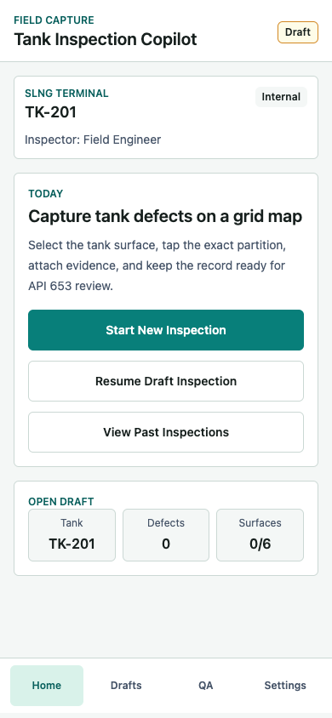
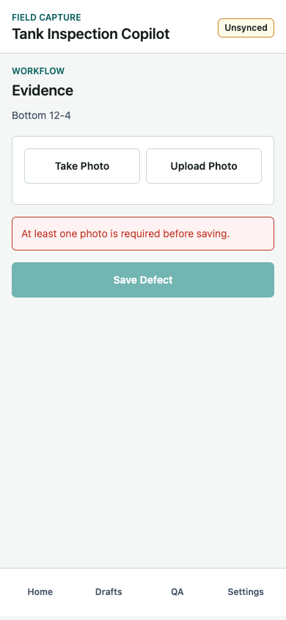
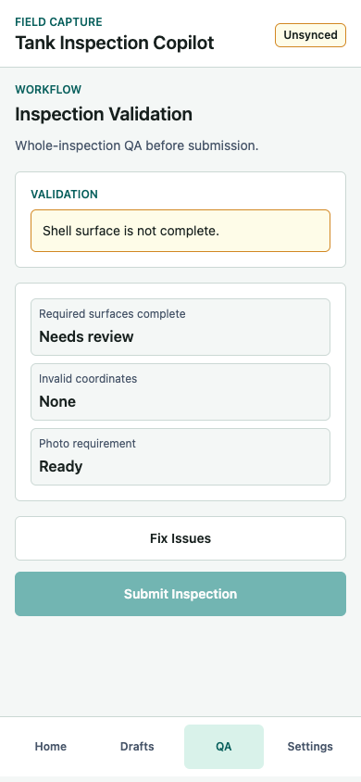
Mobile UX Principles
The design is intentionally practical rather than fancy
Mobile only
Offline first
Grid location
QA
Single-column flow.
Large primary buttons.
Short screen tasks.
Local draft save.
Unsynced badge.
Resume after restart.
Tap X/Y cell.
Validate footprint.
Show origin and plate ID.
Photo required.
Missing data warnings.
Blocked submit.
Tank Inspection Copilot
4

Slide 5
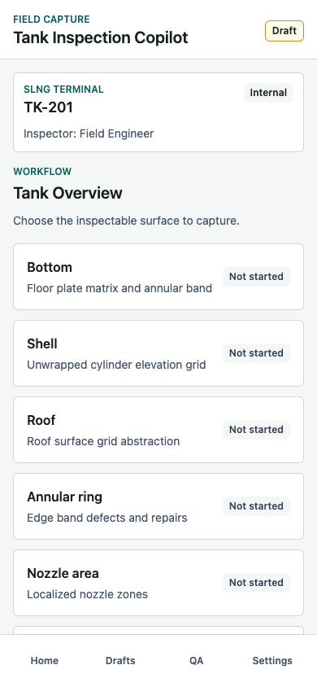
Start Screens: 01-03
Home, setup context, and surface selection
01 Home
Start new inspection, resume draft, view past inspections, show sync status and draft metrics.
02 Inspection Setup
Capture site, client, tank ID, inspection type; continue only after required fields are present.
03 Tank Overview
Choose bottom, shell, roof, annular, nozzle, or weld zone; show complete/not started/defect count.
Tank Inspection Copilot
5

Slide 6
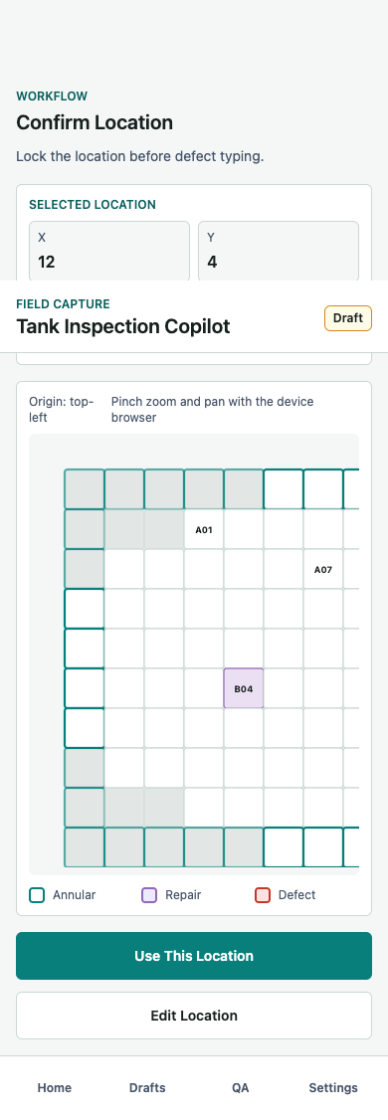
Location Screens: 04-06
Primary spatial capture and confirmation
04 Location Mode
Choose tap-on-grid, manual X/Y entry, or plate ID entry. Tap-on-grid is the recommended path.
05A Grid Map Picker
SVG grid, disabled outside-tank cells, origin label, annular band, layer toggles, selected X/Y summary.
06 Confirm Location
Lock surface, X, Y, grid ID, and plate ID before defect typing. Edit returns to the selected location mode.
Tank Inspection Copilot
6

Slide 7
Fallback Location Modes
Manual entry and plate ID support field realities
05B Manual X,Y Entry
05C Plate ID Picker
- Input X and Y integer partitions.
- Live validation checks bounds and tank footprint.
- Preview on map for visual confirmation.
- Creates same GridLocation as tap mode.
- Search known plate IDs from the drawing map.
- Plate cards show plate ID, subzone, and mapped X/Y.
- Selection auto-fills plateId and grid coordinates.
- Show on Map supports visual confirmation.
MVP location object
{ surface: "bottom", x: 12, y: 4, gridId: "12-4", plateId: "A12", locationMode: "tap_map", isAnnular: false }
Tank Inspection Copilot
7

Slide 8
Grid Map Behavior
The highest-value interaction in the product
Selectable cells
Useful overlays
- Rectangular grid abstraction.
- Bottom and roof use circular validity mask.
- Shell uses full unwrapped rectangle.
- Invalid cells are disabled.
- Plate IDs.
- Grid labels.
- Prior defects.
- Repair overlay.
- Annular band border.
On tap
Coordinate convention
- Selected cell highlights strongly.
- Footer updates X, Y, grid ID, plate ID.
- Confirm enables only for valid cells.
- Bottom/roof origin: top-left.
- Shell origin: lower-left.
- MVP uses integer partitions only.
Tank Inspection Copilot
8

Slide 9
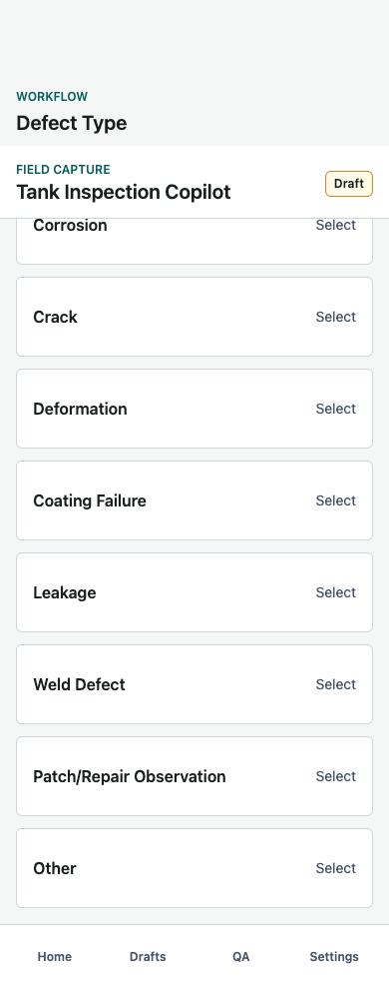
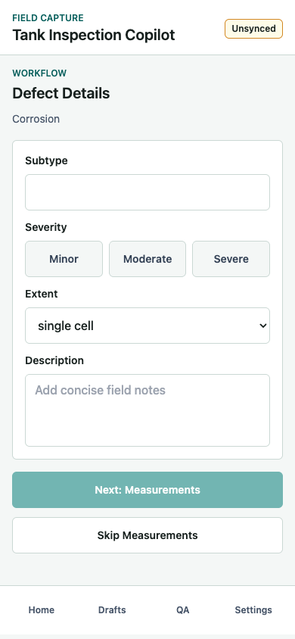
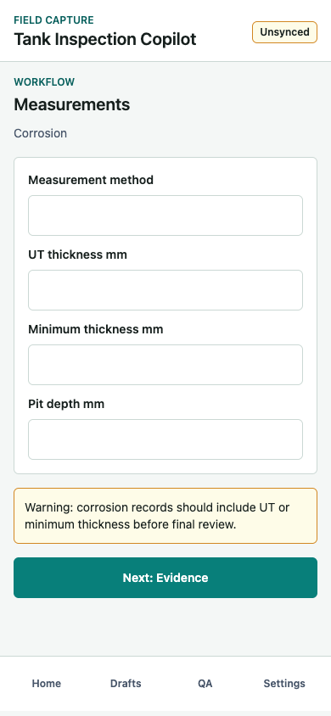
Defect Capture: 07-09
Select type, add details, capture measurements
07 Defect Type
Large type buttons tied to confirmed location.
08 Details
Subtype, severity, extent, and description. Severity is required before measurements.
09 Measurements
Dynamic fields for corrosion, crack, or deformation. Missing key values produce warnings.
Tank Inspection Copilot
9

Slide 10
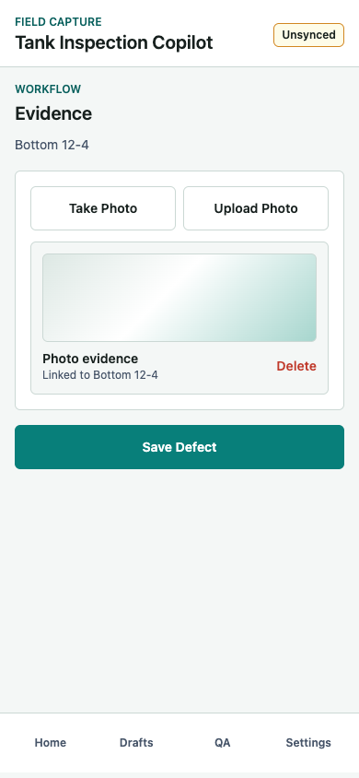
Evidence Capture: 10
Required photo proof before saving a defect
Before photo
Save Defect is blocked and the user sees a clear validation message.
After photo
Evidence card is linked to the selected surface and X/Y location. Delete remains available before save.
Production note
The data model supports photo, video, and audio. The MVP UI implements photo first.
Tank Inspection Copilot
10

Slide 11
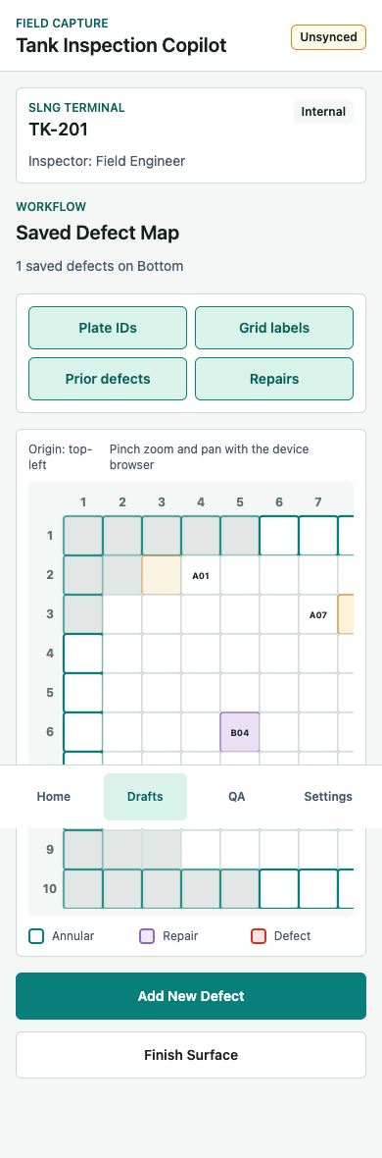
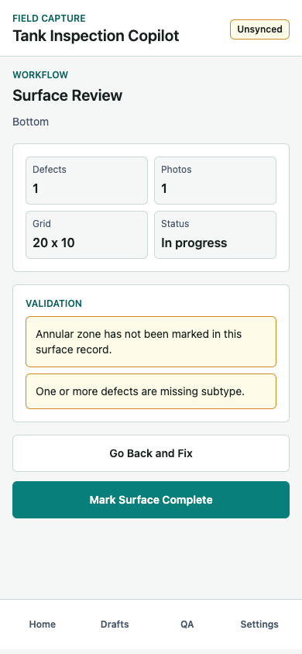
Review Screens: 11-13
Local save, spatial review, and surface QA
11 Defect Saved
Shows type, severity, location, photo count, and next field action.
12 Surface Map
Saved defects render as map markers. Engineer can add another defect or finish the surface.
13 Surface Review
Summarizes defects/photos/grid and surfaces warnings such as missing subtype or annular review.
Tank Inspection Copilot
11

Slide 12
Inspection Validation: 14-15
Submission is blocked until required QA passes
14 Validation
Submit blocking
- Required surface completion.
- Photo requirement.
- Invalid coordinate checks.
- Fix Issues route.
Submit Inspection is disabled while blocking warnings exist.
15 Success
Next actions
When valid, sync status changes to synced and the workflow closes with a report-ready dataset.
View Defect Map, Start Another Inspection, or Return Home.
Tank Inspection Copilot
12

Slide 13
Data Model
Report-ready records, not just screenshots
InspectionSession
SurfaceInspection
site, client, tankId, type, inspector, surfaces, syncStatus
surface, gridCols, gridRows, completed, defects
GridLocation
DefectRecord
surface, x, y, gridId, plateId, locationMode, isAnnular
location, type, subtype, severity, extent, description, measurements, evidence
EvidenceItem
uri, timestamp, optional GPS, linked surface, linked X/Y
Tank Inspection Copilot
13

Slide 14
Validation Logic
What prevents poor field data
Record-level checks
Review and submission checks
- Location requires surface, X, and Y.
- Selected cell must be inside valid surface footprint.
- Defect type and severity are required.
- At least one photo is required before save.
- Manual X/Y must be integer and inside bounds.
- Corrosion without UT/min thickness produces warning.
- Crack without size produces warning.
- Deformation without dimension produces warning.
- Required surfaces must be complete.
- Submit blocks invalid coordinates or missing photos.
Tank Inspection Copilot
14

Slide 15
Screen Inventory Appendix: 01-05C
Every screen in the workflow is accounted for
01 Home
05A Grid Map
Start/resume draft, show sync status and field context.
Tap valid grid cell, view overlays, confirm X/Y summary.
02 Inspection Setup
05B Manual X/Y
Capture site, client, tank ID, inspection type, date, inspector.
Validate typed integer coordinates against bounds and footprint.
03 Tank Overview
05C Plate ID
Choose bottom, shell, roof, annular, nozzle, or weld surface.
Search mapped plate ID and auto-fill X/Y.
04 Location Mode
Choose tap map, manual X/Y, or plate ID mode.
Tank Inspection Copilot
15

Slide 16
Screen Inventory Appendix: 06-10
Confirmed location through evidence capture
06 Confirm Location
09 Measurements
Lock surface, X, Y, grid ID, and optional plate before typing.
Capture UT, pit depth, crack size, or deformation dimension.
07 Defect Type
10 Evidence
Select corrosion, crack, deformation, leakage, weld defect, repair, or other.
Attach required photo, show linked metadata, enable save.
08 Defect Details
Capture subtype, severity, extent, and description.
Tank Inspection Copilot
16

Slide 17
Screen Inventory Appendix: 11-15
Review, validation, and closing workflow
11 Defect Saved
14 Inspection Validation
Summarize local record and choose next field action.
Block submission for incomplete surfaces, no photo, invalid location.
12 Surface Map
15 Submission Success
Review saved markers, overlays, legend, and add more defects.
Confirm report-ready dataset and offer next actions.
13 Surface Review
Show surface metrics and warnings before completion.
Tank Inspection Copilot
17

Slide 18
Recommended Next Steps
Implementation decisions to lock before production mobile work
Product decisions
Technical work
- Freeze grid calibration rules by tank and surface.
- Define plate ID to X/Y mapping source from TK 201 drawings.
- Decide which surfaces are required for each inspection type.
- Define how annular review is represented when no defect is found.
- Replace mock photos with native camera and offline file storage.
- Add durable sync queue with retry state.
- Add multi-cell region selection.
- Import prior repairs and historical defects as overlays.
- Move persistence from localStorage to mobile-grade storage.
Tank Inspection Copilot
18

