Slide 1
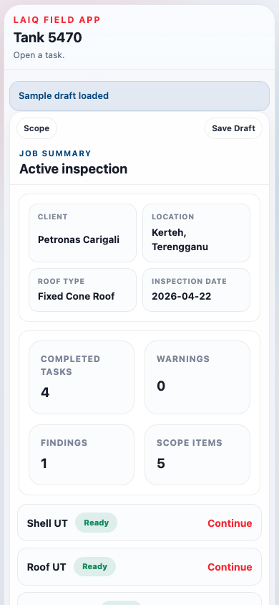

TANK INSPECTION
COPILOT
Field Capture · Structured Data · Report Generated
LAIQ Mission — 3U: Upskill People · Uplift the Standard · Uptime
Confidential · April 2026

Slide 2
THE PROBLEM
Inspectors leave site with notes — not a report.
4–8 hrs
1–3 days
0
3 PDFs
re-keying field notes into every report
to write the report after leaving site
structured records linking findings to UT rows
shell + nozzle + MFL — never unified
Root cause
▸ Paper & clipboard
re-keying adds errors and delay
▸ Findings de-coupled
lost between field capture and final report
▸ Vague locations
prose descriptions cannot be trended across cycles
▸ Incompatible formats
every contractor submits a different template
▸ MFL in a silo
floor data never linked to shell or roof findings
▸ Report writing backlog
inspector bandwidth consumed by admin, not field work
Field capture and report generation are two completely separate workflows — that is the gap.

Slide 3
HOW IT WORKS
Data-First Reporting Architecture
Structured field capture driving automated, evidence-linked report generation
1. Field Data Capture
2. Structured Data Model
3. Generated Report
Guided on-site capture via mobile app
Every reading stored against its exact context
Automated output — no re-keying
✓ Tank & surface setup
✓ Asset hierarchy: Tank → Surface → Plate
✓ Shell / roof UT thickness tables
✓ Shell / roof / nozzle UT readings
✓ Location: strake, bearing, X/Y, grid ID
✓ Nozzle UT tables (clock positions)
→
→
✓ In-context finding capture
✓ Findings: type, severity, description
✓ Findings register + linked photos
✓ Precise plate location (tap-on-canvas)
✓ Evidence: photo linked to UT row
✓ Shell plate layout map
✓ Photo evidence — required before save
✓ Validation: API 650/653 consistency checks
✓ JSON + CSV export for CMMS / digital twin
The inspector never writes a report from scratch. They capture structured data in the field — the report generates itself.
LAIQ 3U Mission: Upskill People · Uplift the Standard · Uptime

Slide 4
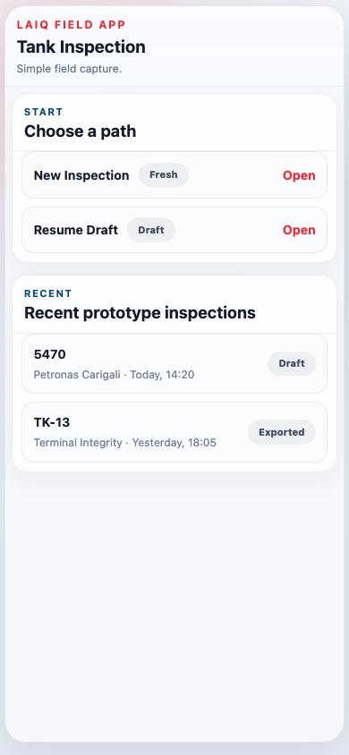
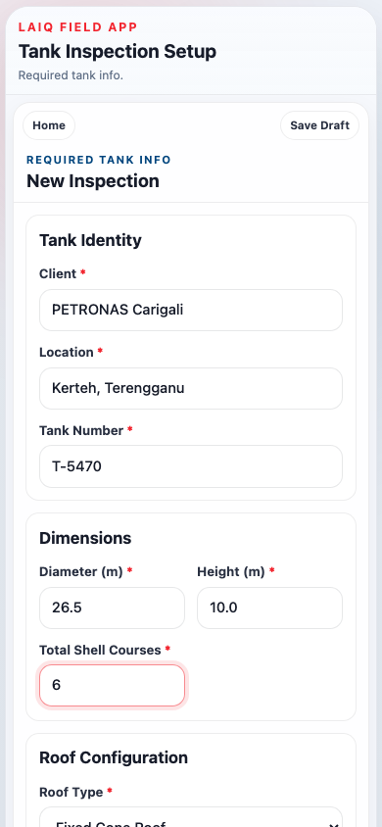
FIELD CAPTURE · STEP 1
Guided Task-Driven Workflow
The inspector configures the tank once, selects in-scope tasks, then works through a live Task Board.
Configure once tank geometry drives all report header fields
Scope selection defines which UT tables appear in the report
Live Task Board shows completion — nothing is missed
Draft save / resume works across sessions, no data lost

Slide 5
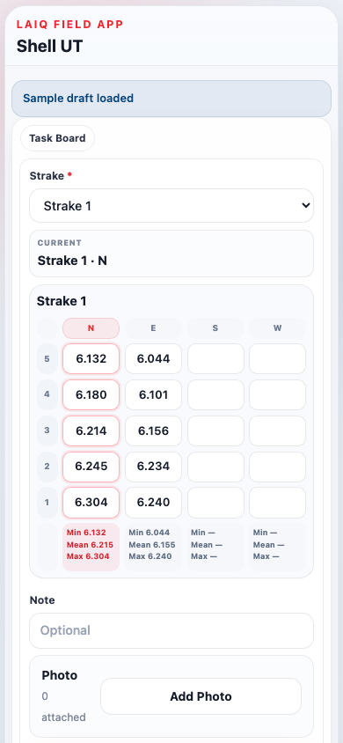
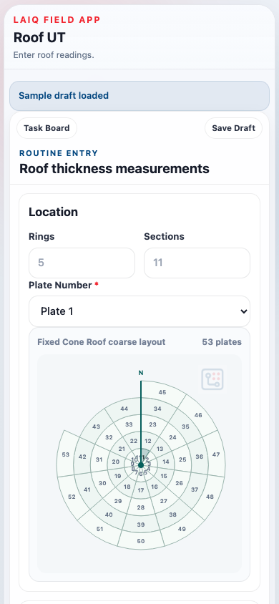
FIELD CAPTURE · STEP 2
Structured UT Data Capture
Every UT reading tagged to its exact surface, course, and position — feeds report tables directly.
Surface
Entry method
Report section
Shell UT
Strake × N/E/S/W × 5 readings
Shell Plate Thickness Table
Roof UT
Plate × A–E readings
Roof Plate Thickness Table
Shell Nozzles
12 / 3 / 6 / 9 o'clock + pad
Shell Nozzle Thickness Table
Roof Nozzles
N / E / S / W + pad
Roof Nozzle Thickness Table
Bottom MFL
Import contractor report
MFL section (attachment)

Slide 6
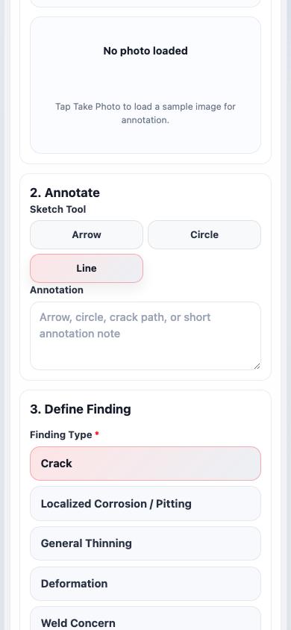
FIELD CAPTURE · STEP 3
In-Context Finding Capture
Tap 'Add Finding Here' mid-task — strake, bearing & UT context pre-filled automatically.
1
Photo
Take photo → auto-linked to active UT row
2
Annotate
Draw arrow, circle, or text on photo
3
Type & severity
Crack / Corrosion / Deformation / etc.
4
Location
Strake + bearing auto-filled from context
5
Measurements
Pit depth, crack length, or custom field
6
Report entry
Finding + photo + location → report ready

Slide 7
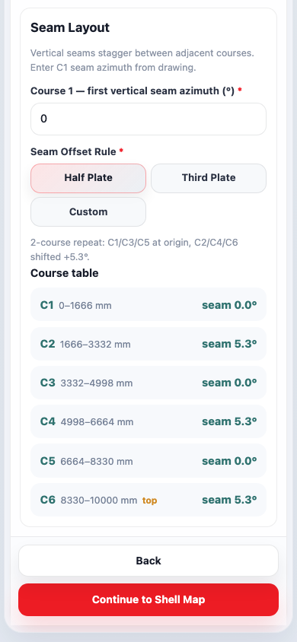
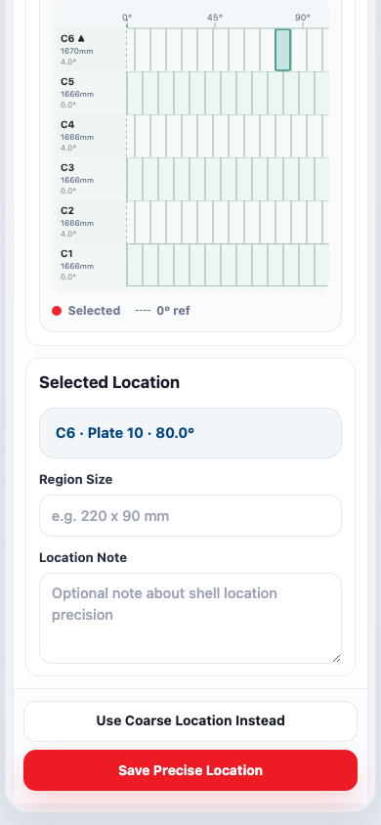
FIELD CAPTURE · STEP 4
Precise Shell Location Mapping
Tap-on-canvas unwrapped shell map → repeatable plate coordinate stored in report.
Plate geometry configured once per inspection
Tap-to-mark SVG unwrapped shell canvas
Manual fallback X/Y or plate/seam reference also supported
Coordinate → Shell Plate Layout section in report
Why this matters
Most reports record location as prose: "near the third strake, north side." That cannot be mapped, trended, or returned to. A precise coordinate can.

Slide 8
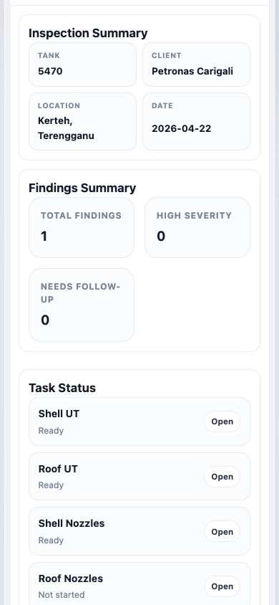
FIELD CAPTURE · STEP 5
Pre-Export Review — Completeness Check
Gaps surfaced on-site while the inspector can still fix them — not discovered during report writing.
Pass
All shell readings complete
Pass
All in-scope nozzles measured
Warning
2 findings missing photo evidence
Warning
Roof UT: 3 plates not yet entered
Pass
MFL report attached
Info
Precise location pending for 1 finding
Fix on site = no surprises during report generation.

Slide 9
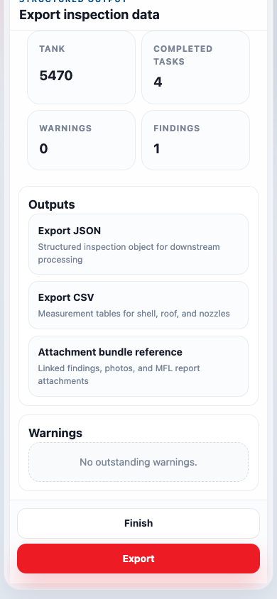
REPORT OUTPUT
Structured Export — Report Ready
Every field captures maps directly to a report section. No re-keying. No reconstruction from memory.
Report Section
Source in App
Format
Tank / Client Header
Inspection Setup fields
JSON
Shell Plate Thickness Table
Shell UT (strake × bearing)
CSV + JSON
Roof Plate Thickness Table
Roof UT (plate × A–E)
CSV + JSON
Shell Nozzle UT Table
Shell nozzle (12/3/6/9)
CSV + JSON
Roof Nozzle UT Table
Roof nozzle (N/E/S/W)
CSV + JSON
Findings Register
Type, severity, location, photo
JSON
Shell Plate Layout
Precise shell coordinates
JSON
MFL Section
Contractor, reference, coverage
JSON + attachment

Slide 10
MARKET CONTEXT
Why Now — and Who Buys
API 653 scrutiny tightening
Inspection workforce attrition
▸ Regulators want structured finding evidence
▸ Experienced inspectors are retiring
▸ Traceability across cycles — PDFs not sufficient
▸ Guided tools encode good practice into the workflow
CMMS & digital twin demand
Mobile hardware is ready
▸ Asset platforms need structured inspection data
▸ Rugged tablets / IP67 phones are now field standard
▸ Most data still arrives as PDFs — that gap is the opportunity
▸ Only barrier left: a workflow that matched the field
Who buys
▸ Independent inspection companies
Reduce report turnaround · Differentiate on data quality
▸ Oil & gas operators
Standardise across sites · Enable trend analysis
▸ Inspection consultancies
Replace bespoke Excel templates with a supported product
▸ Certification bodies
Audit-ready traceability · Structured finding evidence

Slide 11
LET'S TALK
Four questions to start the conversation
Q1
How many hours does your team spend writing the report after leaving site?
Every hour saved on report writing is an hour back in the field or billable on the next job.
Q2
Can you tell me exactly where that corrosion indication was in your 2021 inspection?
Precise, repeatable coordinates make cross-cycle trending possible. Prose descriptions don't.
Q3
How many Excel templates do your inspection contractors submit — and how long to normalise them?
One structured export format from every inspection = no normalisation before analysis.
Q4
When your best inspector retires, where does their inspection knowledge live?
A guided workflow encodes good practice into the tool — not just the person holding the clipboard.
LAIQ · Upskill People · Uplift the Standard · Uptime · Tank Inspection Copilot

