Slide 1
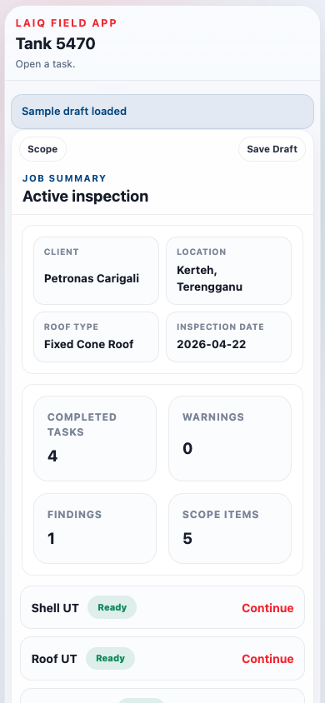

TANK INSPECTION
COPILOT
From field inspection workflow to structured inspection package
Capture readings, findings, photos, location, and MFL context in one guided flow — then leave site with a report-ready output package.
Commercial deck V2 · April 2026

Slide 2
CURRENT STATE
Current inspection workflow
The problem is not inspection effort alone. It is the broken handoff between field capture and final reporting.
1
Field inspection
2
Separate records
3
Back-office re-keying
4
Rebuild context
5
Merge MFL separately
6
Final QA and report
UT readings, notes, photos
→
Notebook, phone photos, Excel sheets
→
Transfer readings into report tables
→
Match photos, findings, and locations
→
Contractor PDF handled outside workflow
→
Gaps discovered after leaving site
Where the workflow breaks
Duplicate entry
The same reading is captured in the field, then typed again in the report.
Broken links
Findings, photos, and UT rows are not connected at the moment they are observed.
Weak location traceability
Prose descriptions are hard to trend across inspection cycles.
Fragmented outputs
Shell, nozzles, and MFL often end up as separate deliverables.
Today, the inspection and the report are still two different workflows.

Slide 3
PROPOSED WORKFLOW
One guided flow from inspection to output
Tank Inspection Copilot turns field capture, findings, MFL reference, review, and export into one connected process.
1
2
3
Capture findings in context
4
Link location and evidence
5
6
Export structured package
Configure tank
Run tasks
Review on site
Asset, geometry, roof type, reference
→
Shell UT, roof UT, nozzles, MFL
→
Photo, note, severity, location
→
Coarse by default, precise when needed
→
Warnings surfaced before leaving
→
Tables, findings, map, JSON, CSV
Single capture path
Evidence linked at source
Standard output structure
No separate note-to-report reconstruction
Finding and photo stay tied to the active task
Same delivery package across inspection jobs
Commercial message: the customer is not buying another inspection form. They are buying a cleaner workflow and a better inspection package at the end.

Slide 4
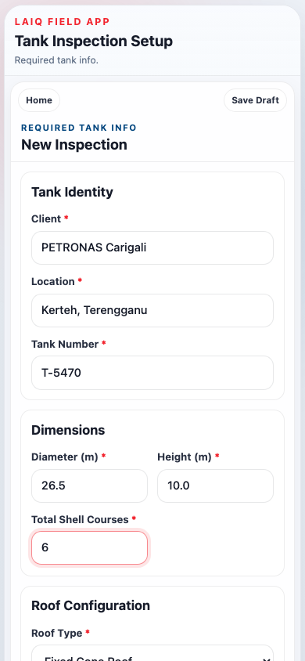
FIELD CAPTURE · STEP 1
Guided task-driven workflow
The inspector configures the tank once, selects the inspection scope, and then works from a live task board.
Configure once tank geometry and reference drive later tasks
Scope selection only in-scope tasks appear in the workflow
Task board progress, warnings, and counts stay visible
Draft save / resume supports real field interruptions

Slide 5
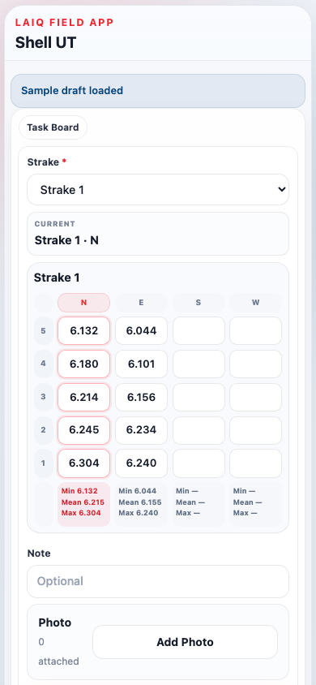
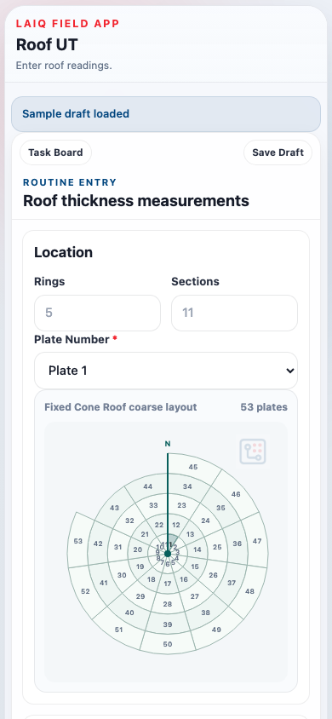
FIELD CAPTURE · STEP 2
Structured UT data capture
Each task captures readings in the same structure the report needs later.
Surface
Entry method
Output section
Shell UT
Strake × N/E/S/W × 5 readings
Shell thickness table
Roof UT
Plate × A–E readings
Roof thickness table
Shell Nozzles
12 / 3 / 6 / 9 + pad
Shell nozzle table
Roof Nozzles
N / E / S / W + pad
Roof nozzle table
Bottom MFL
Import report metadata
MFL section

Slide 6
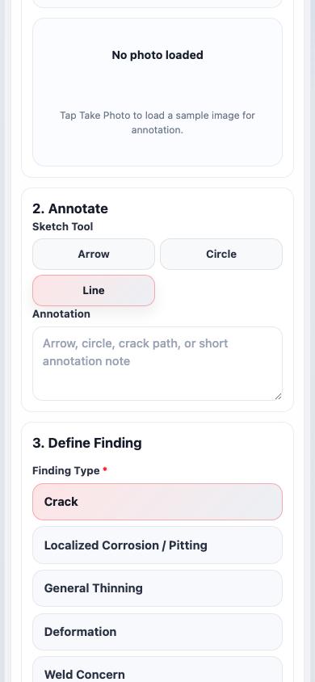
FIELD CAPTURE · STEP 3
In-context finding capture
When something is found during a task, the inspector documents it there and then — not later from memory.
1 Photo
Take photo while still on the active task
2 Annotate
Circle, arrow, or label the visible issue
3 Type + severity
Crack, corrosion, deformation, weld concern
4 Location
Task context already pre-filled
5 Measurements
Add pit depth, crack length, or notes
6 Save
Return to UT task with no duplicate entry

Slide 7
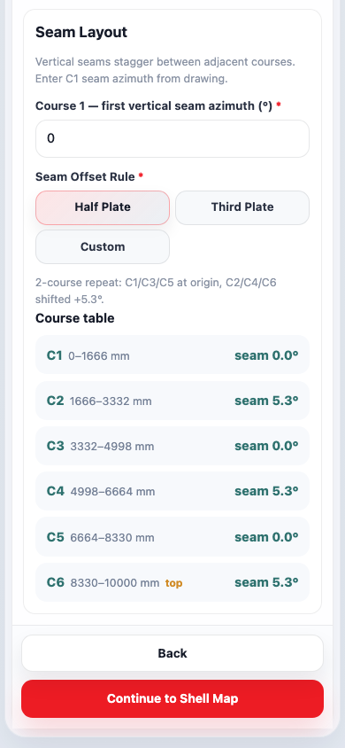
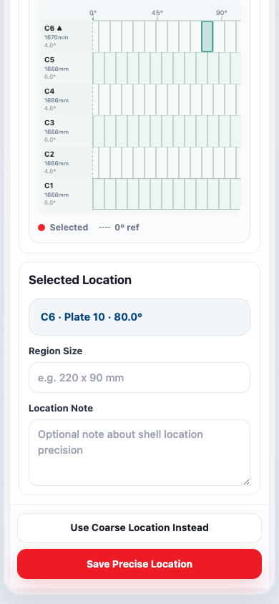
FIELD CAPTURE · STEP 4
Location intelligence by surface
The app does not force one location method for every surface. It uses the right level of mapping for the job.
Shell
Coarse UT by strake + direction. Precise shell mapping available when needed.
Roof
Coarse roof layout by ring and section. Plate-based entry for routine UT.
Shell nozzles
Course + degree on an unwrapped shell surface before readings.
Roof nozzles
Roof map registration before N/E/S/W or pad measurements.

Slide 8
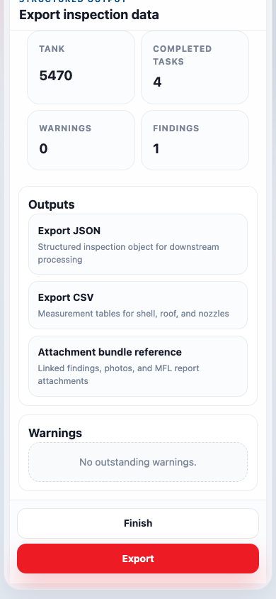
OUTPUT VALUE
What the customer gets at the end
The value is not just the capture flow. The value is the inspection package that is ready for review, handover, and downstream use.
UT tables
Findings register
Shell, roof, and nozzle readings already structured for reporting
Finding type, severity, measurement, and linked photo
Location record
MFL section
Coarse or precise shell location saved with the finding
Contractor reference and attachment context included
Structured export
JSON + CSV for analytics, CMMS, or digital twin ingestion
Commercial message: the output package is already organised for handover. The inspector leaves site with structured inspection data, not disconnected notes and photos.

Slide 9
BUYER VALUE
Why it matters commercially
Less admin load
Better traceability
Reduce re-keying and post-site report reconstruction
Tie findings, photos, and location to the original task record
Cleaner contractor handover
Better readiness for analytics
Standard structure instead of multiple templates
Structured data suitable for trend analysis and asset systems
Positioning statement
Tank Inspection Copilot is not just a mobile form. It is a structured inspection workflow that improves how inspection data is captured, checked, handed over, and reused.

Slide 10
MARKET CONTEXT
Why now — and who buys
API 653 and audit pressure
Inspection workforce change
▸ More demand for clearer finding evidence
▸ Good practice needs to be encoded in tools
▸ Better traceability across inspection cycles
▸ Less dependence on inspector memory and personal templates
Digital asset initiatives
Mobile field readiness
▸ Operators want structured inspection data
▸ Rugged tablets and phones are already standard
▸ PDF-only workflows slow analysis and reuse
▸ The missing layer is the workflow itself
Primary buyers
▸ Inspection companies
Faster delivery and stronger data quality positioning
▸ Asset owners / operators
Standard output across tanks and contractors
▸ Inspection consultancies
Move away from bespoke Excel reporting packs

Slide 11
NEXT STEP
Recommended pilot
Pilot scope
1 tank type or 1 contractor workflow
Users
2–4 inspectors plus 1 report reviewer
Pilot goal
Verify capture flow, output usability, and data completeness
Success criteria
Less manual rework, clearer linked evidence, usable structured export
Suggested close
Run a controlled pilot on one inspection workflow, prove the output package is useful, then expand surface coverage and reporting depth from there.
Tank Inspection Copilot turns inspection work into structured inspection data that is easier to check, easier to hand over, and easier to reuse.

