Slide 1

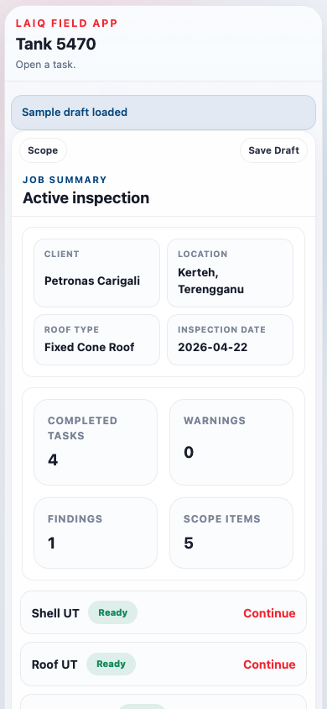
Capture readings, findings, photos, and location in one guided field flow.
TANK INSPECTION
COPILOT
Leave site with a report-ready output package.
Field inspection → Structured data → Report package
LAIQ 3U MISSION
Upskill People · Uplift the Standard · Uptime
Commercial Deck V3 · April 2026

Slide 2
THE PROBLEM
Today's inspection workflow has a broken handoff
Field data and the report are generated in two separate, disconnected workflows.
1
Field inspection
2
Separate records
3
Back-office re-keying
4
Rebuild context
5
Merge MFL separately
6
Final report & QA
›
›
›
›
›
UT readings, notes, photos
Notebook + phone photos + Excel
Transfer into report tables
Match photos, findings, locations
Contractor PDF handled outside
Gaps found after leaving site
Where the workflow breaks
Duplicate entry
Same reading captured in the field, then typed again in the report.
Broken evidence links
Findings, photos, and UT rows are not connected when observed.
Weak location traceability
Prose descriptions cannot be trended or returned to next cycle.
Fragmented deliverables
Shell, nozzles, and MFL often end up as separate, unlinked outputs.
Field capture and report generation are still two separate workflows — that gap is the commercial opportunity.
Current State · S2

Slide 3
ARCHITECTURE
Data-first reporting: from tank surfaces to structured output
One guided field workflow captures every surface. A canonical inspection record drives automated report assembly.
Roof
1 Field Capture
2 Inspection Record
3 Report Package
Roof UT plates (A–E readings)
Guided on-site workflow
Canonical structured data
Automated output assembly
Shell
• Tank & surface configuration
• Asset hierarchy: Tank→Surface→Plate
• Shell / roof UT tables (auto-filled)
Strake × N/E/S/W × 5 UT readings
• UT rows: shell, roof, nozzle
• Location: strake, bearing, X/Y
• Findings register + linked photos
Shell
›
Nozzle positions N/E/S/W clock
• In-context finding capture
• Findings: type, severity, evidence
• Shell plate layout map
Nozzles
• Photo evidence linked at source
• MFL source metadata & attachment
• MFL section with reference
12/3/6/9 clock + pad readings
›
›
• Coarse or precise location
• Completeness & API 653 checks
• JSON + CSV export for CMMS
Annular
Bottom / MFL
Base ring zone MFL reference
Import MFL metadata and attachment ref
LAIQ 3U · Upskill People · Uplift the Standard · Uptime
Architecture · S3

Slide 4
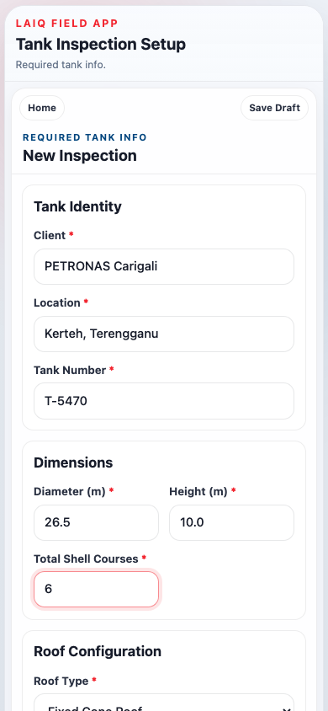
FIELD CAPTURE · STEP 1
Guided task-driven workflow
Configure the tank once. Select in-scope surfaces. Work from a live Task Board that tracks completion.
Configure once tank geometry and references drive all later tasks
Scope selection only surfaces in scope appear in the workflow
Live Task Board progress, warnings, and completion counts at a glance
Draft save/resume supports real-world field interruptions
No second entry.
Everything captured in the Task Board flows directly into the report output — no manual transfer required.
Field Capture Step 1 · S4

Slide 5
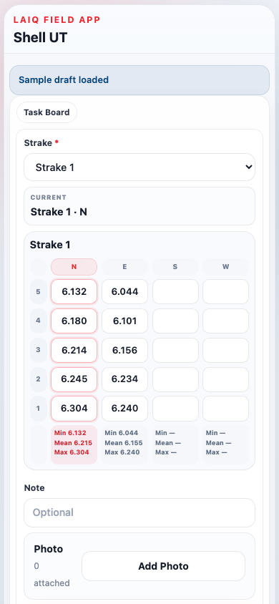
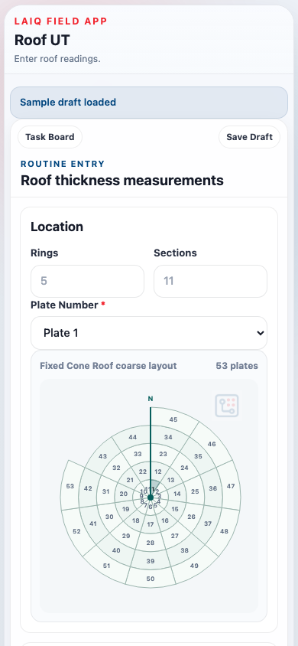
FIELD CAPTURE · STEP 2
Structured UT data capture
Each surface task captures readings in exactly the structure the report needs. Nothing is re-entered.
Surface
Entry method
Output section
Shell UT
Strake × N/E/S/W × 5 pts
Shell thickness table
Roof UT
Plate × A–E readings
Roof thickness table
Shell Nozzles
12/3/6/9 o'clock + pad
Shell nozzle table
Roof Nozzles
N/E/S/W + pad
Roof nozzle table
Bottom MFL
Import report metadata
MFL section
Why it matters
UT readings arrive in the report already mapped to the right table section. The inspector does not rebuild the structure from handwritten notes.
Field Capture Step 2 · S5

Slide 6
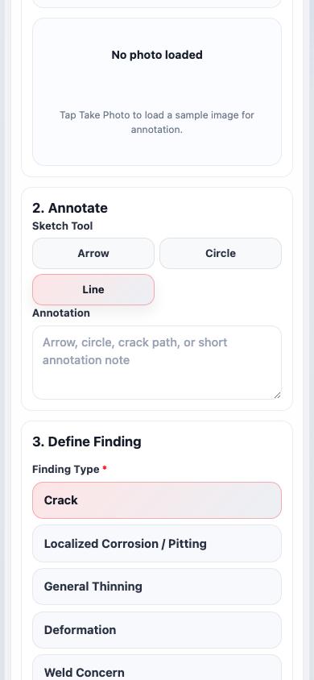
FIELD CAPTURE · STEP 3
In-context finding capture
When something is found during a UT task, the inspector documents it there and then — not later from memory.
1 Photo
Take photo — auto-linked to the active UT task row
2 Annotate
Circle, arrow, or label the visible anomaly
3 Type + severity
Crack, corrosion, deformation, or weld concern
4 Location
Strake, bearing, and UT context already pre-filled
5 Measurements
Add pit depth, crack length, or custom notes
6 Save & return
Back to UT task with zero duplicate entry
Linked at source
Each finding is permanently associated with its UT task row — it appears in the Findings Register with full evidence context, no separate entry required.
Field Capture Step 3 · S6

Slide 7
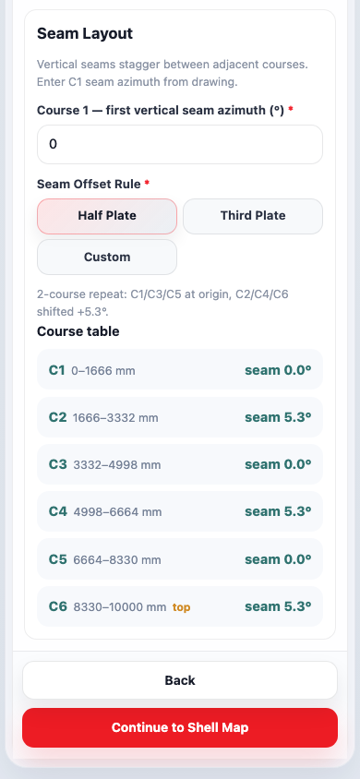
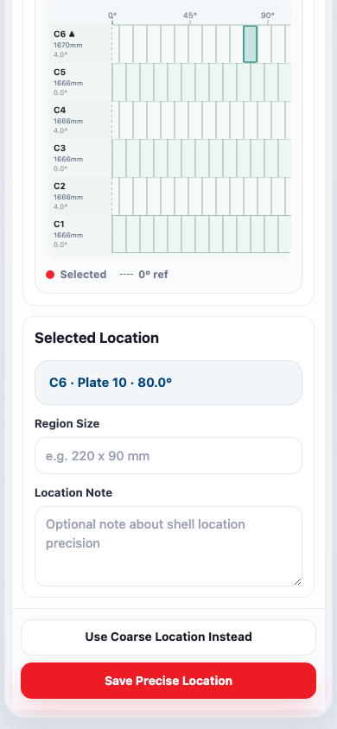
FIELD CAPTURE · STEP 4
Location intelligence by surface
The right level of mapping for each surface — from coarse UT position to precise repeatable coordinates.
Shell
Strake + compass direction for coarse UT. Tap-on-canvas for precise plate coordinates.
Roof
Plate-based entry for routine UT readings across ring and section.
Shell nozzles
Course + clock position before readings — linked to shell location.
Roof nozzles
Roof map registration before N/E/S/W + pad measurements.
Why precise location matters
Most reports record location as prose: "near the third strake, north side." That cannot be mapped, trended, or reliably returned to in the next inspection cycle. A repeatable coordinate can.
Field Capture Step 4 · S7

Slide 8
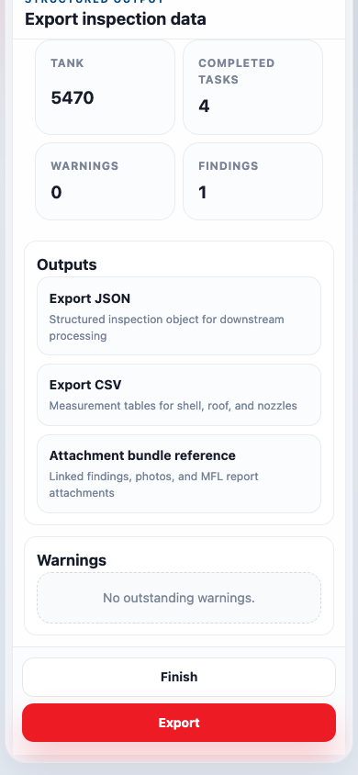
OUTPUT VALUE
What the customer gets at the end
The value is not just the capture flow. It is the inspection package that is ready for review, handover, and downstream use.
UT Tables
Findings Register
Shell, roof, and nozzle readings structured for reporting
Type, severity, measurement, and linked photo evidence
Location Record
MFL Section
Coarse UT position or precise shell coordinate per finding
Contractor reference and attachment context included
Structured Export
JSON + CSV for CMMS, analytics, or digital twin ingestion
Commercial message
The inspector leaves site with structured inspection data — not disconnected notes and photos.
Output Value · S8

Slide 9
BUYER VALUE
Why it matters commercially
Less admin load
Better traceability
Reduce re-keying and post-site report reconstruction
Tie findings, photos, and location to the original UT task record
Cleaner contractor handover
Analytics-ready data
Standard structure instead of multiple custom templates
Structured output suitable for trend analysis and asset systems
Positioning statement
Tank Inspection Copilot is not just a mobile form. It is a structured inspection workflow that improves how inspection data is captured, checked, handed over, and reused.
Buyer Value · S9

Slide 10
MARKET CONTEXT
Why now — and who buys
API 653 & audit pressure
Workforce knowledge risk
▸ More demand for clearer finding evidence
▸ Good practice must be encoded in tools
▸ Traceability across inspection cycles now expected
▸ Less dependence on inspector memory and personal templates
Digital asset initiatives
Mobile field readiness
▸ Operators want structured inspection data in CMMS
▸ Rugged tablets and phones are already field-standard
▸ PDF-only workflows slow analysis and reuse
▸ The missing layer is the structured workflow itself
Primary buyers
▸ Inspection companies
Faster delivery and stronger data quality positioning
▸ Asset owners / operators
Standard output across tanks and contractors
▸ Inspection consultancies
Move away from bespoke Excel reporting packs
Market Context · S10

Slide 11
NEXT STEP
Recommended pilot
Pilot scope
Users
1 tank type or 1 contractor inspection workflow
2–4 field inspectors + 1 report reviewer
Pilot goal
Success criteria
Verify capture flow, output usability, and data completeness
Less manual rework · Clearer linked evidence · Usable export
Suggested close
Run a controlled pilot on one inspection workflow, prove the output package is useful, then expand surface coverage and reporting depth from there.
Tank Inspection Copilot turns inspection work into structured inspection data that is easier to check, easier to hand over, and easier to reuse.
Pilot Proposal · S11

Slide 12
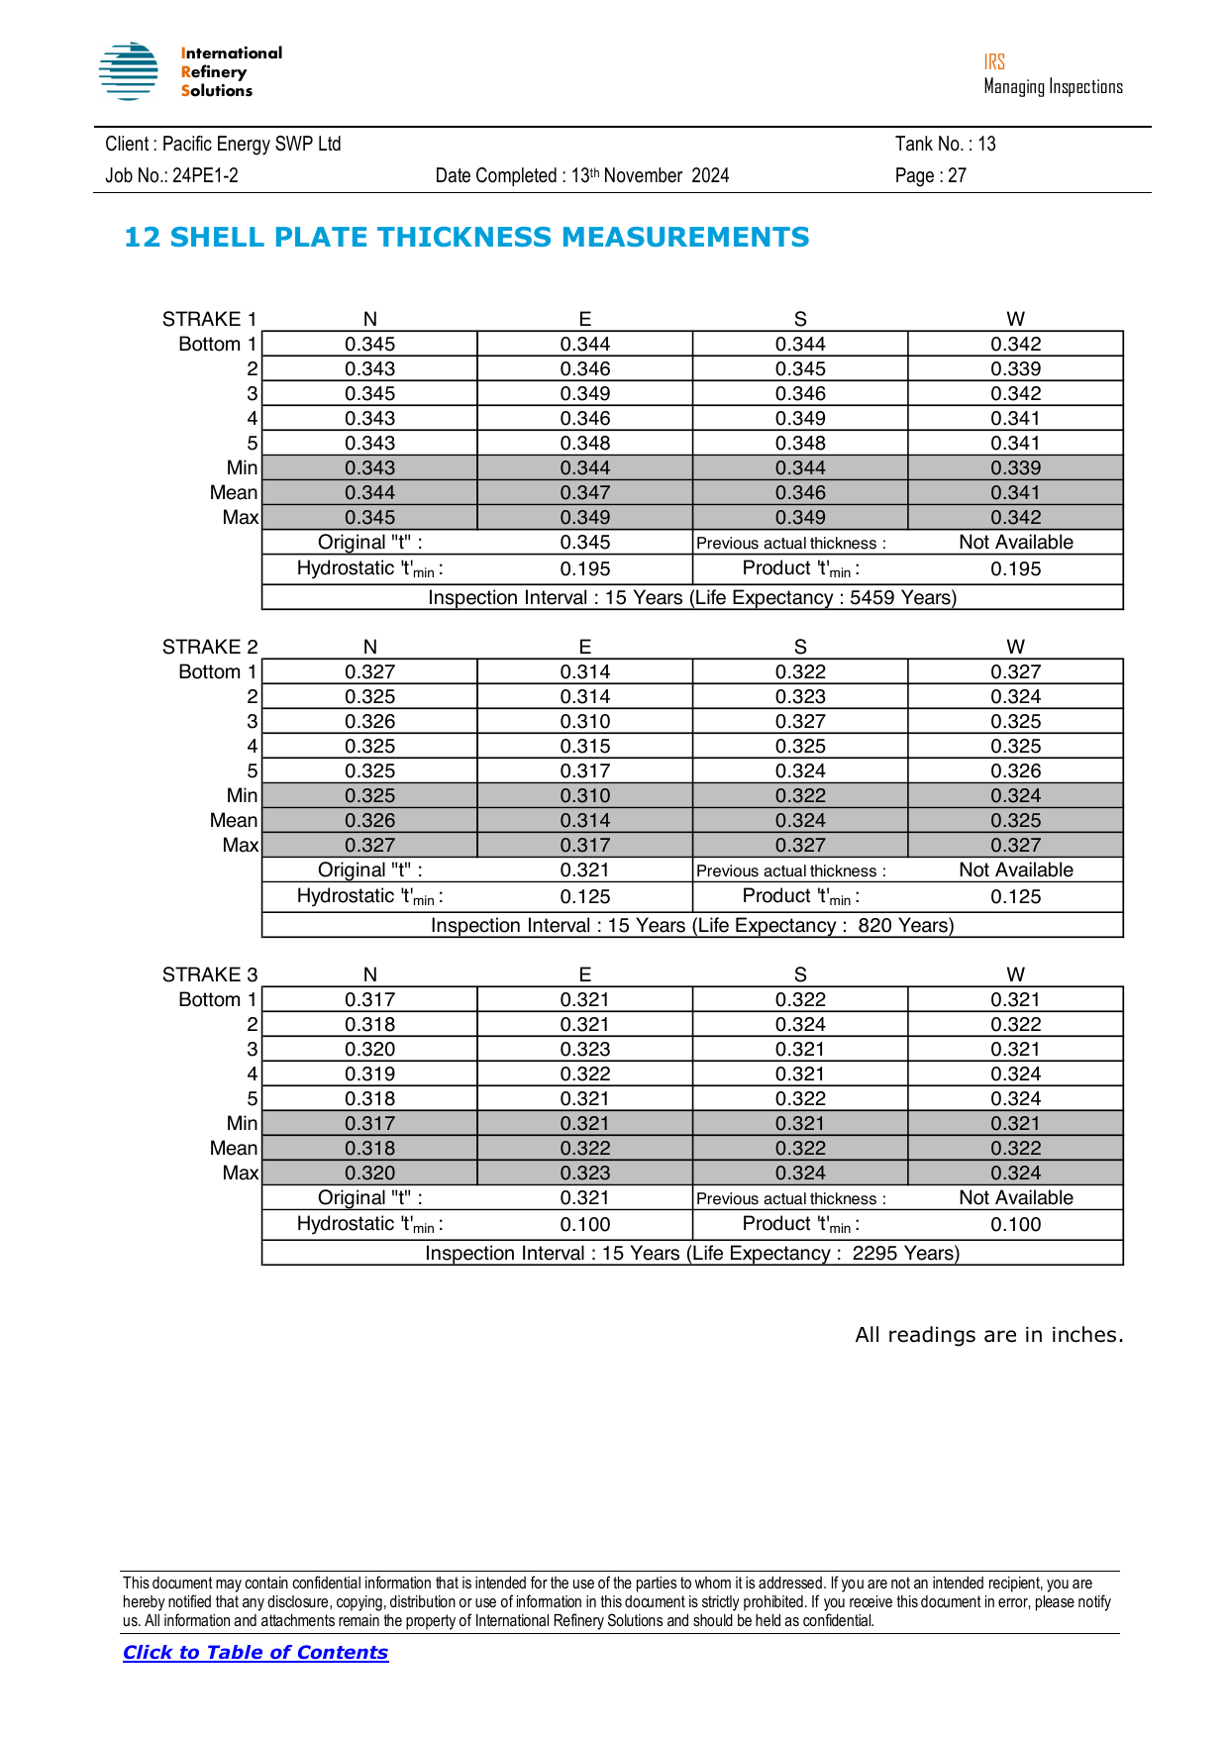
FINAL VALUE
From captured data to report in one click
Convert the structured inspection record into a report-ready document package — without rebuilding the story manually.
Sample report output
AI
Report Intelligence
→
→
Normalise · Map to template Assemble draft · Package output
LAIQ · Tank Inspection Copilot · Confidential · April 2026
• UT tables:
Auto-filled from shell, roof, and nozzle captured data
• Linked evidence:
Finding photos and context tied to each UT record
• Location:
Shell coordinates or coarse references flow into output
• Handover ready:
Clean review package for customer, operator, or consultant

Slide 13
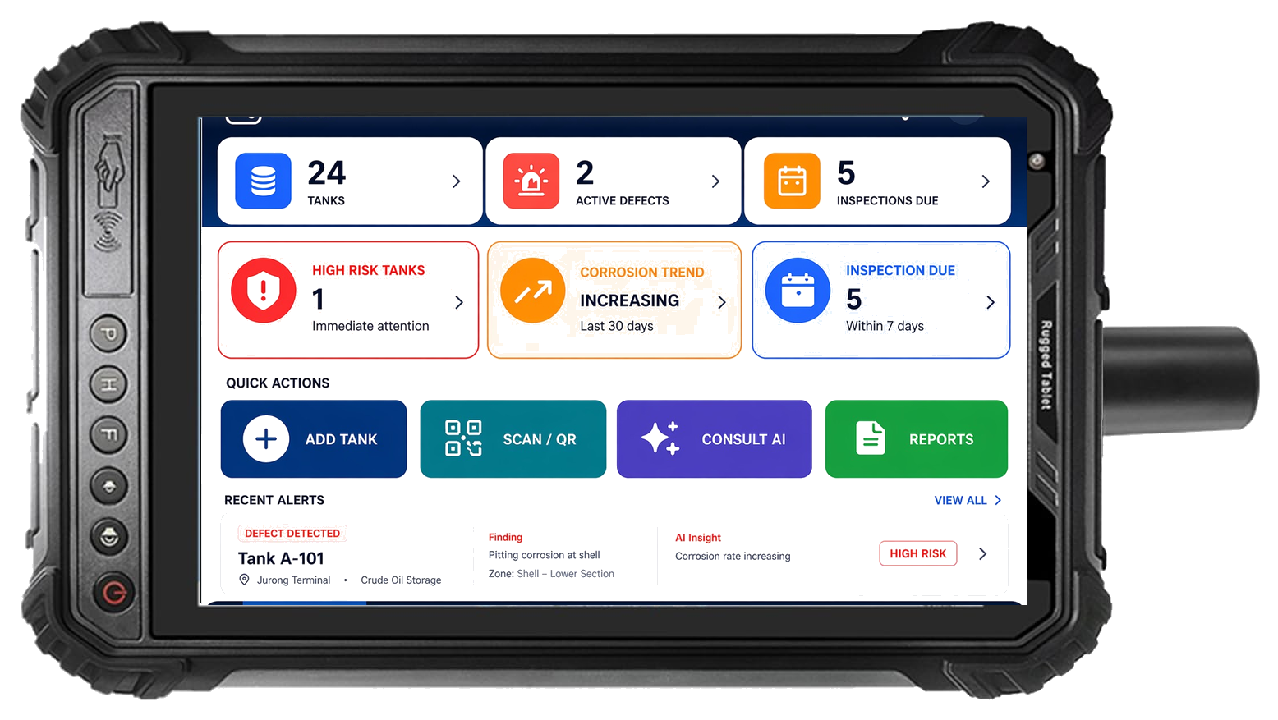
HARDWARE & OUTCOMES
Purpose-built hardware. Measurable business results.
Field reality — why a smartphone is not enough
Solution — Explosion-Proof ATEX / IECEx PDA Tablet
LAIQ outcomes — what customers measure
Sunlight
Inspection Cycle Time
Data Loss
Automated Report
☀
Consumer screens wash out at >80 klux. Inspectors cannot see the app.
↓ 40–70%
Zero
1-Click
⚠
ATEX Zone 1/2
▶
▶
Smartphones & consumer tablets are prohibited by law in hazardous areas.
▸ Re-keying eliminated
▸ Offline-first — writes instantly
▸ Structured data → report draft
💧
IP rating
▸ Completeness check on site
▸ No paper transcription errors
▸ UT tables auto-populated
Rain, dust, chemicals — IP54 minimum. Touch must work with wet gloves.
• ATEX / IECEx Zone 1 & 2 · IP68 · –20 °C to +60 °C
• 1000 nit sunlight-readable · glove-friendly touch
• 100% offline — no network needed
e.g. Ecom Tab-Ex 02 · Bartec ZONE 2 · Pepperl+Fuchs BM-T35
▸ Report assembly automated
▸ Photos linked at capture
▸ Findings register pre-built
✈
Offline
No Wi-Fi or cellular on many tank farms. Device must work air-gapped.
LAIQ · Upskill People · Uplift the Standard · Uptime
Hardware & Outcomes · S13

