Slide 1

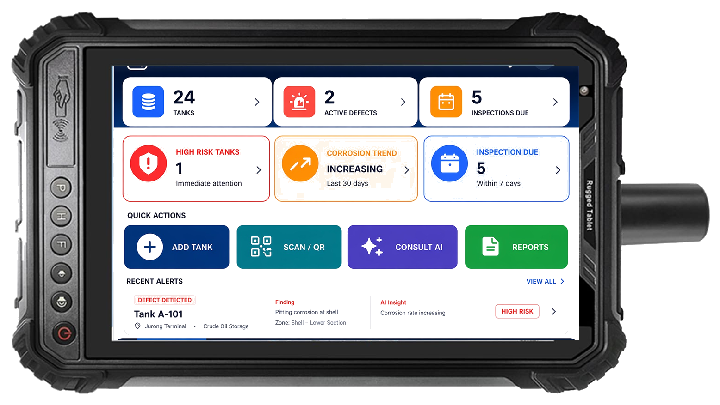
Leave Site with a
Report-Ready Inspection Package
AI-powered field inspection and asset intelligence · starting with oil & gas
Field Inspection
▶
Structured Capture
▶
AI Report Package
▶
Asset Knowledge
▶
Weak Point / FMEA Intel
Beachhead: Oil & Gas
Model: Free Capture + Paid Reports
Hardware: ATEX/IECEx Device
Moat: Asset Intelligence
ATEX/IECEx certified rugged tablet with LAIQ Field App
S1 · Cover
LAIQ · Confidential

Slide 2
PROBLEM + SOLUTION
Manual Inspection Data Capture Breaks Report Generation
Most tank inspections still move through notebooks, phone photos, spreadsheets, and back-office report assembly. LAIQ replaces that with one structured capture path.
TODAY
WITH LAIQ
Current inspection workflow
Structured capture to report-ready package
▶
X
▶
▶
Guided Capture
▶
Structured Record
▶
AI Report Package
▶
Asset History
Field Notes
Excel Entry
Photo Folder
Manual Report
▸ Duplicate entry: field notes are typed again in the office
▸ One-time capture: measurements, findings, and photos stay in one record
▸ Broken evidence chain: photos and findings live outside the UT record
▸ Structured evidence: shell, roof, nozzle, and MFL context stay linked
▸ Weak traceability: location is reconstructed later from memory
▸ Faster report draft: AI assembles tables and evidence from the same record
▸ Slow turnaround: report assembly starts after the site visit ends
▸ Asset history: every finished job becomes reusable inspection memory
INSPECTION PACKAGE OUTPUT
UT Tables
Findings Register
Linked Evidence
Report Package
Shell · Roof · Nozzle
Severity · note · measurement
Photo → task → finding
Structured export + draft
The value is not the form. The value is a structured inspection record that becomes a report-ready package.
S2 · Pain vs LAIQ
LAIQ · Confidential

Slide 3
THE PROBLEM
Inspection Data Breaks Before It Becomes a Report
Inspector on Site
Every inspection creates valuable data.
↓
Notebook / Photos / Excel
─
⚠ Duplicate entry
Most of it is trapped in reports, photos, Excel files, and individual inspector experience.
↓
Back-Office Re-keying
─
⚠ Missing photo evidence
↓
Duplicate entry
Manual Context Rebuild
UT readings typed once in field, again in office
─
⚠ Weak location traceability
↓
Missing evidence
Report QA
Photos, findings, and readings stored separately
↓
Slow report turnaround
Static PDF Archive
Report assembled back-office after site visit
Weak location traceability
Defects described in prose, impossible to trend
No reusable intelligence
Every report starts from scratch — no asset memory
S2 · Problem
LAIQ · Confidential

Slide 4
LAIQ SOLUTION
Capture Once, Deliver a Report-Ready Package
TODAY
WITH LAIQ
X
↺
▶
▶
▶
▶
▶
AI
▶
Field Notes
Excel Entry
Photo Folder
Manual Report
Guided Capture
Canonical Record
AI Report Package
Asset History
✕ Duplicate entry...
✓ Guided capture
✓ Faster transport
✓ Structured evidence
✓ Asset history
INSPECTION PACKAGE OUTPUT
UT Tables
Findings Register
Linked Evidence
Location Map
Shell · Roof · Nozzle MFL-linked readings
Defect · severity measurement · note
Photo → task → finding → location
Surface · plate · coord · direction
•
The value is not the form. The value is the structured inspection package.
S3 · Target Workflow
LAIQ · Confidential

Slide 5
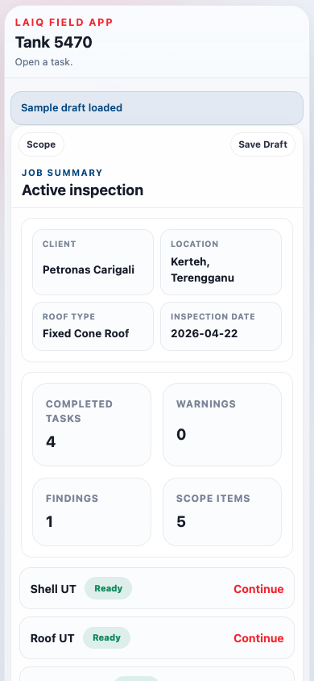
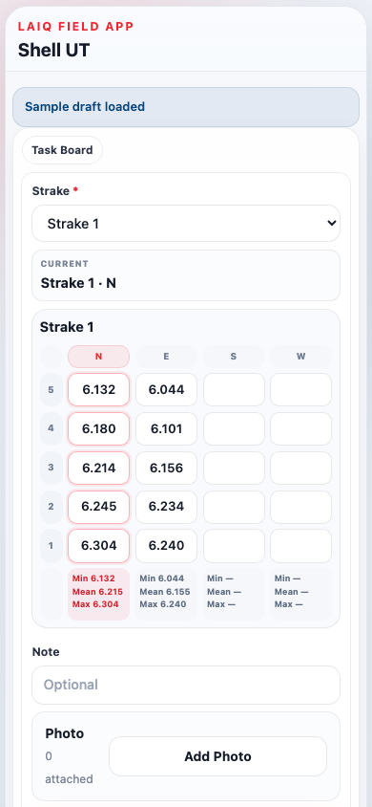
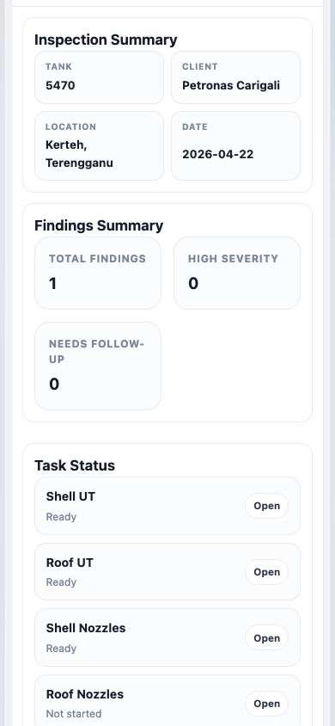
PRODUCT ARCHITECTURE
Field-to-Report Architecture
Field Layer
ATEX/IECEx PDA
Offline Capture
UT Readings
Photos
Checklist
App screenshots
↓ sync / process ↓
Data Layer
Canonical Inspection Record
Asset · Surface
Finding · Evidence
Inspection History
↓
Field · task board & scope setup
AI Layer
Report Agent
QA Check
Missing Field Detection
Template Mapping
↓
Output Layer
PDF / Word Report
CSV / JSON Export
CMMS Ready
Digital Twin Ready
Data · UT readings matrix
↓
Intelligence Layer
Weak Point Analysis
Remaining Life
FMEA Library
Spare Part Signals
S4 · Product Architecture
Output · review & report package
LAIQ · Confidential

Slide 6
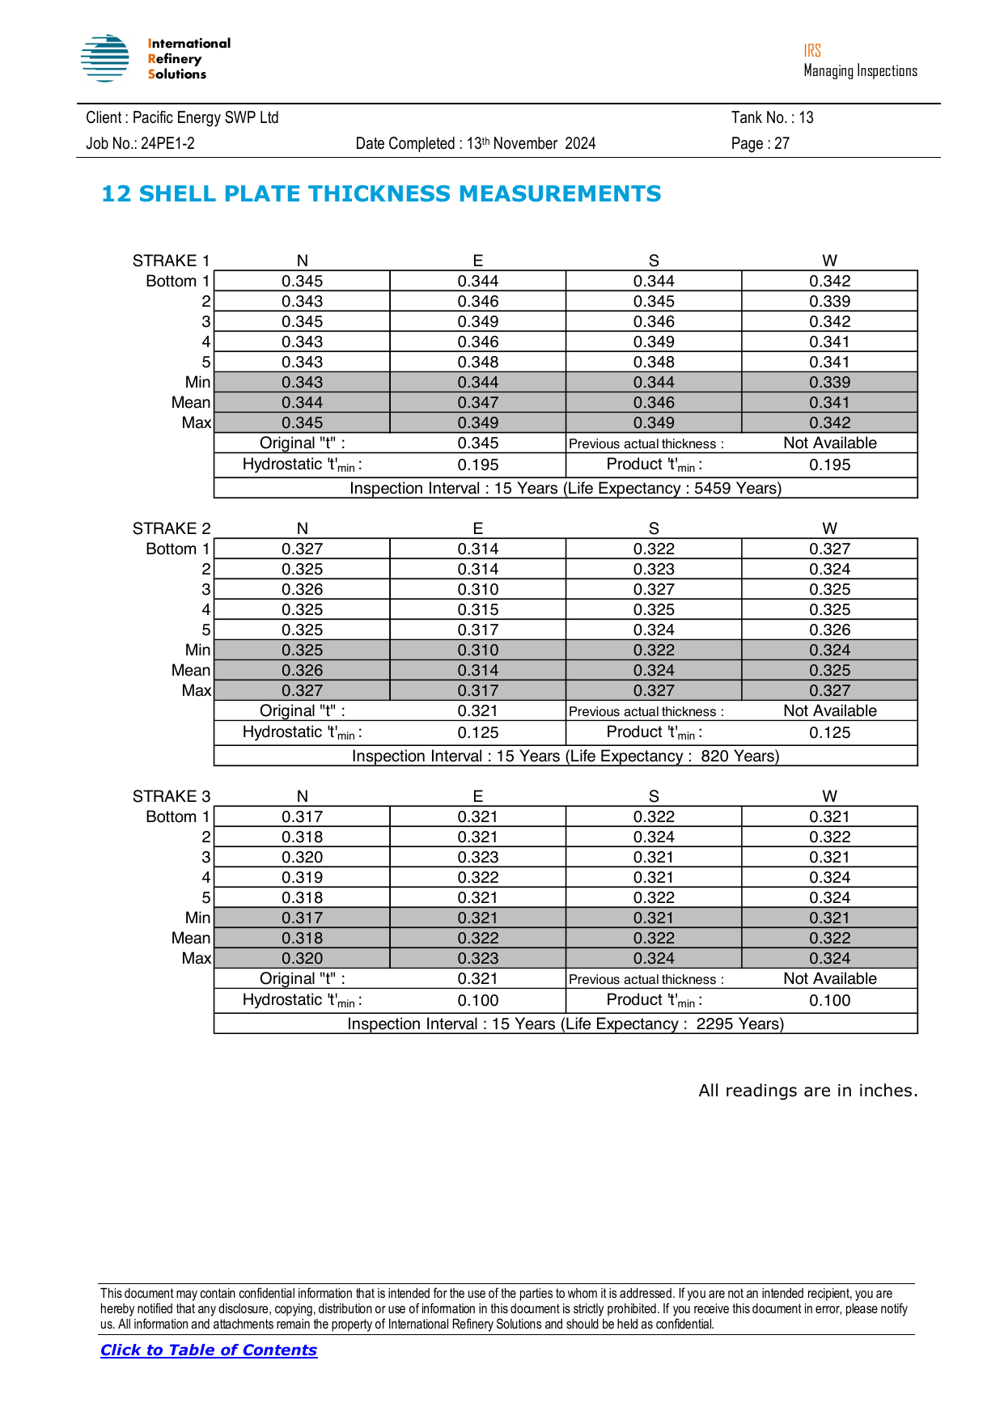
BEACHHEAD MARKET
Start with Oil & Gas Tank Inspection
Why this beachhead first: high-frequency inspection workflows, heavy capture burden, and reports that are still largely assembled manually.
Inspection scale and burden
Solution — structured field capture to AI report package
What LAIQ changes
Public tank counts are fragmented. Commercial terminal datasets still show a very large installed base.
Today: notebook → Excel → photo folder → report assembly
One-time capture
10,100+
12,600+
No notebook → Excel → report re-key chain
Field Capture
▶
Excel Re-key
▶
Photo Folder
tank terminals worldwide in TankTerminals demo scope
tank storage facilities in broader platform scope
↓
Structured evidence
Manual Report
UT, findings, photos, and MFL stay linked at source
~1,000–2,000+
580+
AI
1-click report draft
terminal-level external inspection cycles per year at a 5-year cadence
structured capture points in one sample tank report before photos and MFL maps
Tables, findings register, and evidence pack assemble from the same record
▶
▶
Asset history starts now
Sample report burden
Every finished report becomes reusable inspection memory
36–74 pages 9.5k–12.3k words 195 checklist items ~385 UT readings
LAIQ field workflow
AI report output
1 capture path → structured record → report draft
Source note: TankTerminals commercial database pages; 5-year external inspection cadence from API 653 market-practice references; sample-report burden from LAIQ analysis of 3 reports in /data.
S5 · Beachhead
LAIQ · Confidential

Slide 7
BUSINESS MODEL
Free Capture Creates Paid Report Volume
The model starts with low-friction adoption, then monetises the report package and expands into recurring intelligence products.
Commercial stack
Data flywheel
1. Device
ATEX/IECEx field device
Free Capture
More Records
USD 5,000 / device
▶
more inspectors
structured history
▲
▼
2. Seats
Inspectors and reviewers
Better Report Agent
USD 50–80 / user / year
3. Reports
AI-generated inspection package
Asset Memory
Paid Reports
USD 50–300 / report
◀
better recommendations
faster output
4. Enterprise
Asset memory + reliability modules
Premium subscription
Why this matters
Every completed report improves the structured dataset, which improves future report generation and makes higher-value intelligence products more credible.
Free capture is an acquisition strategy. Paid value starts when LAIQ assembles the report package.
S6 · Business Model
LAIQ · Confidential

Slide 8
MARKET SIZE
Focused Oil & Gas Entry, Larger Industrial Inspection TAM
Use a narrow entry wedge first, then expand the same structured workflow into adjacent asset-heavy inspections.
Addressable ladder
Revenue pools inside the wedge
TAM
USD 1.9B–6.5B
Industrial inspection workflow + report layer
Report generation
USD 900M–3.6B / yr
Field devices
SAM
USD 36M–134M
Digitally ready oil & gas inspection workflows
USD 1.0B–3.0B
Subscriptions
SOM
USD 0.9M–7.1M
3-year beachhead in oil & gas tank inspection
USD 30M–144M / yr
Assumptions
Illustrative sizing based on device, seat, and report-generation layers.
▸ USD 5k certified field device
▸ USD 50–80 user subscription per year
▸ USD 50–300 per report package
Expansion industries:
Oil & Gas
Chemical
Petrochemical
Power
Mining
Marine
Utilities
Heavy Machinery
S7 · Market Size
LAIQ · Confidential

Slide 9
EXPANSION STRATEGY
From Report Generation to Asset Intelligence
The report is the entry point. The asset knowledge base is the platform.
Three horizons, one data spine
1
Report-ready workflow
2
Structured asset memory
3
Reliability intelligence
Win the inspection workflow and the report package
Accumulate inspection history across tanks, contractors, and cycles
Turn structured history into weak-point, life, and maintenance signals
▶
▶
Per-device + per-report
Subscription / dashboard
Premium enterprise module
Expansion industries
Oil & Gas
Chemical
Petrochemical
Power
Mining
Marine
Utilities
Heavy Machinery
Expansion principle: keep the same structured capture and report spine, then add higher-value memory and intelligence layers on top.
S8 · Expansion
LAIQ · Confidential

Slide 10
COMPETITIVE MOAT
Every Report Builds the Customer's Asset Intelligence
Compounding moat loop
Why this is hard to copy
Customer-specific report logic
Templates and evidence logic embed inside the workflow.
Captured Data
▶
Better Reports
UT · findings · photos
faster, more consistent
Inspection history
▲
Structured Asset Memory
▼
Every cycle adds more context than a static report archive.
Model tuning from real field data
Better structured data improves future AI output quality.
Higher Retention
◀
Intelligence Modules
workflow becomes sticky
life · weak points · FMEA
Workflow lock-in
Once the report package is trusted, replacement becomes harder.
Generic AI can generate text. LAIQ's moat comes from owning the structured inspection memory behind every report.
S9 · Moat
LAIQ · Confidential

