Slide 1
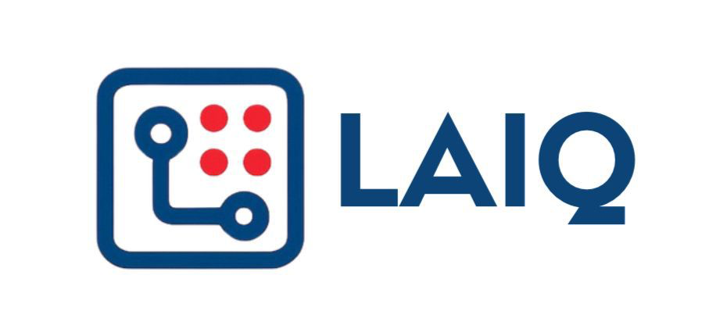
PRODUCT ROADMAP
From Oil & Gas Inspection Copilot to Industrial Service Network
Start with oil & gas tank inspection, expand into wider industrial inspection, then build multi-agent maintenance intelligence and a service network connecting clients, inspectors, workshops, OEMs, and spare-part providers.
Four-stage roadmap
1
Oil & Gas Inspection Copilot
2
Industrial Inspection Copilot
3
Multi-Agent Maintenance & Reliability Intelligence
4
Inspection-to- Service Network
Leave site with a report-ready tank inspection package
Apply the same inspection-to-report workflow across more assets and industries
Turn inspection and maintenance history into weak-point, lifetime, FMEA, and repair-priority decisions
Connect findings to workshops, OEMs, spare parts, service execution, and follow-up
▶
▶
▶
Prove the wedge
Expand the workflow
Decide what to fix next
Act through the network
• Offline tank capture
• Vessels, piping, valves, pumps
• Report, review, planning, FMEA agents
• Repair package + service routing
• UT, checklist, findings, photos
• Utilities, power, marine, heavy equipment
• Reliability + weak-point analysis
• Quote / work-order flow
• Location + MFL/NDT reference
• Configurable inspection templates
• CMMS / work-order linkage
• Spare-part demand + OEM feedback
• AI report draft
• More reports, more devices, more customers
• Premium intelligence module
• Partner / marketplace revenue
Structured inspection data spine
Field data
Report package
Asset history
Reliability decisions
Service execution
Roadmap principle: keep one structured inspection data spine, then expand from oil & gas reports to industrial inspection, maintenance intelligence, reliability management, and service execution.
Tank Inspection · One-page product roadmap
LAIQ · Confidential

