Slide 1
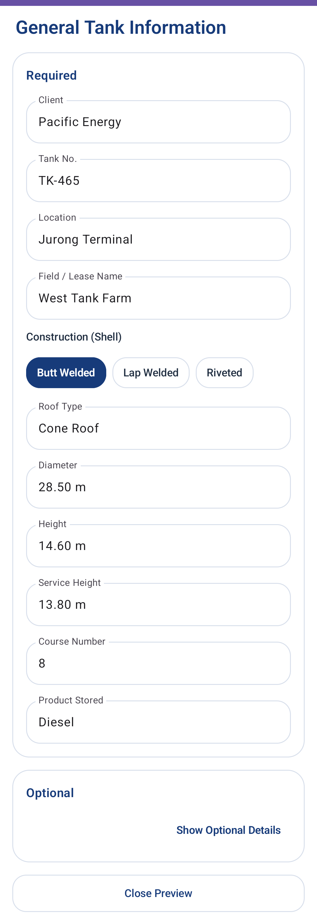
Tank Inspection Copilot · Field Android V2
01
General Tank Information
Capture only the layout-driving tank facts first.
What this screen does
Required identity and baseline geometry are separated from optional report details.
Units are visible at the field level so diameter, height, and plate inputs stay unambiguous.
Temporary layout assumptions can be corrected later during map setup.
Live Android app screenshot

Slide 2
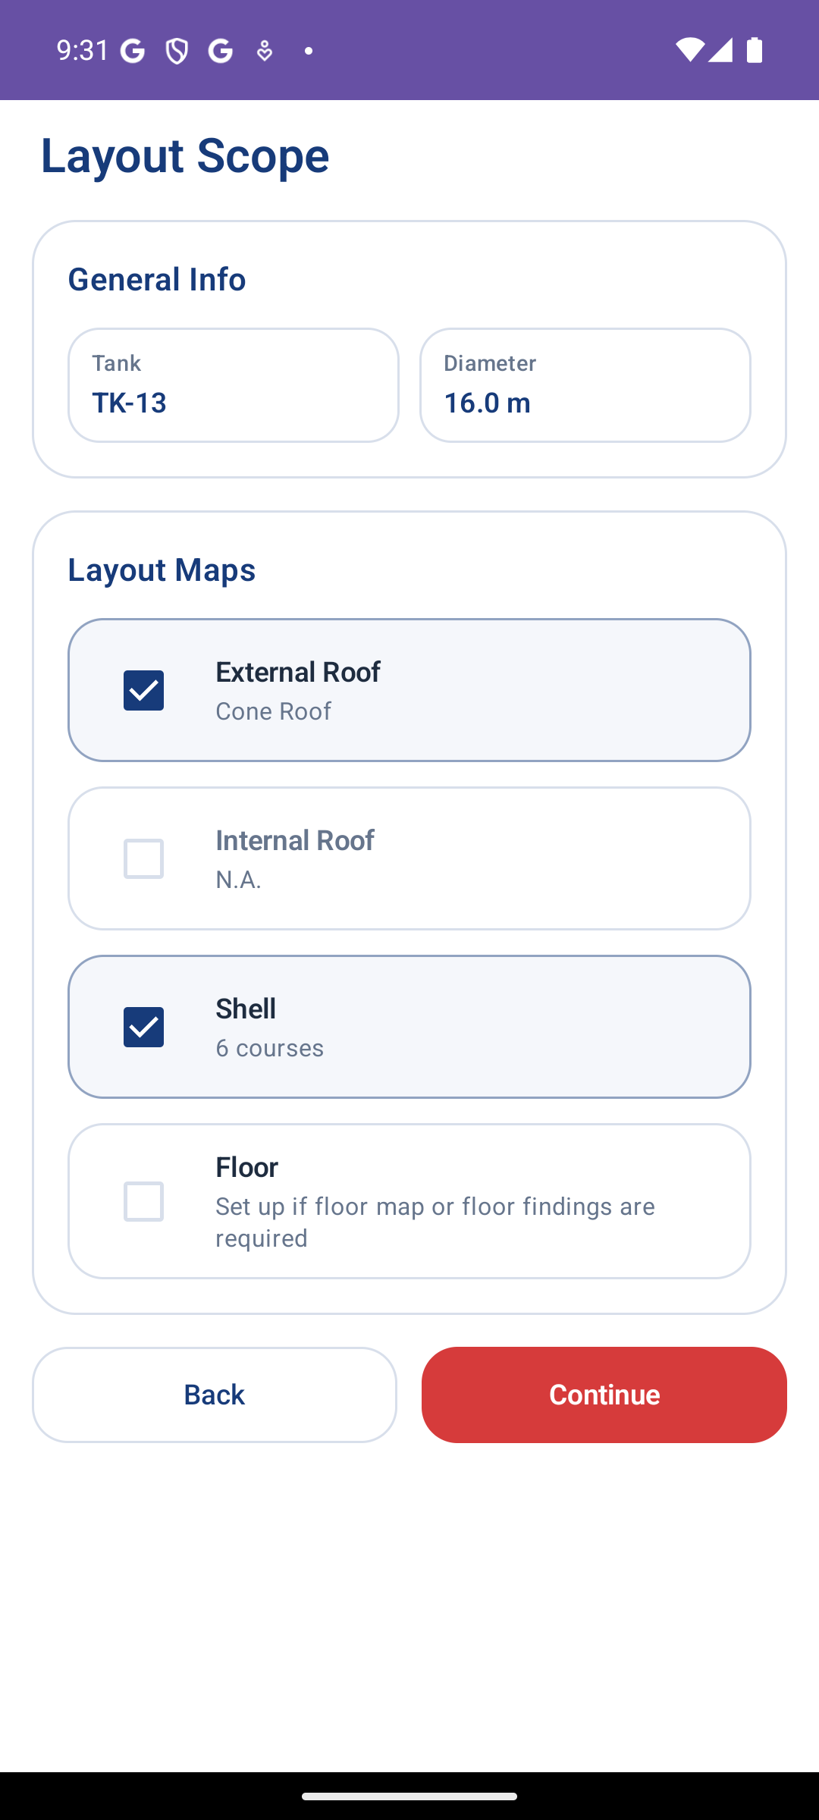
Tank Inspection Copilot · Field Android V2
02
Layout Scope
Decide which tank surfaces need map setup.
What this screen does
External roof, internal roof, shell, and floor can be selected independently.
The next layout tabs are generated from this scope, left to right.
This prevents users from configuring maps that are not part of the job.
Live Android app screenshot

Slide 3
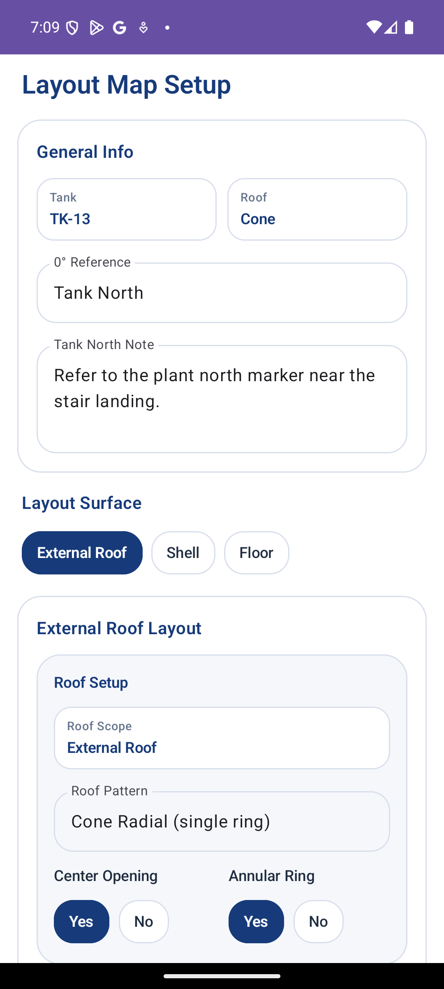
Tank Inspection Copilot · Field Android V2
03
Layout Map Setup
Configure parameters, preview the map, then approve.
What this screen does
The 0 degree reference is shared across roof, shell, and floor layouts.
Roof, shell, and floor setup are isolated in their own tabs, not mixed in one long form.
Approved maps become the source geometry for elements, UT, and findings.
Live Android app screenshot

Slide 4
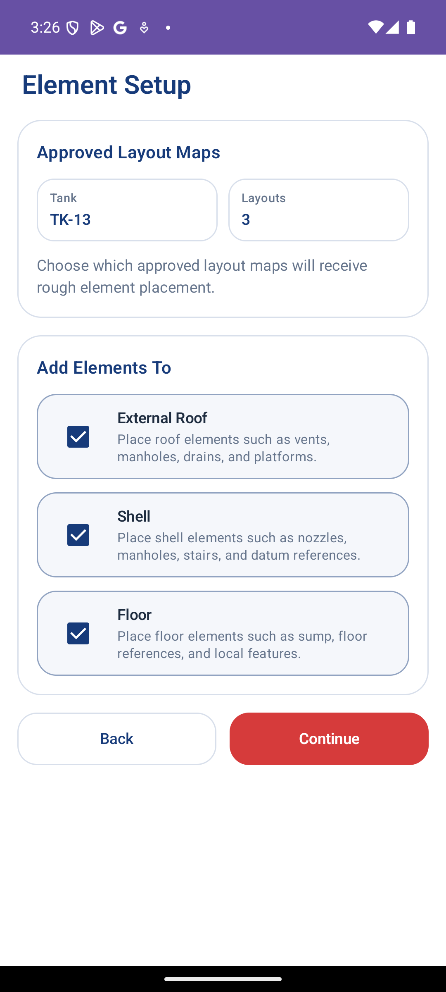
Tank Inspection Copilot · Field Android V2
04
Element Setup
Choose which approved maps need physical elements.
What this screen does
Maps without elements can skip placement but still continue into UT scope.
The screen mirrors the layout scope logic so the workflow stays predictable.
Element work is separated from plate/map generation for less field confusion.
Live Android app screenshot

Slide 5
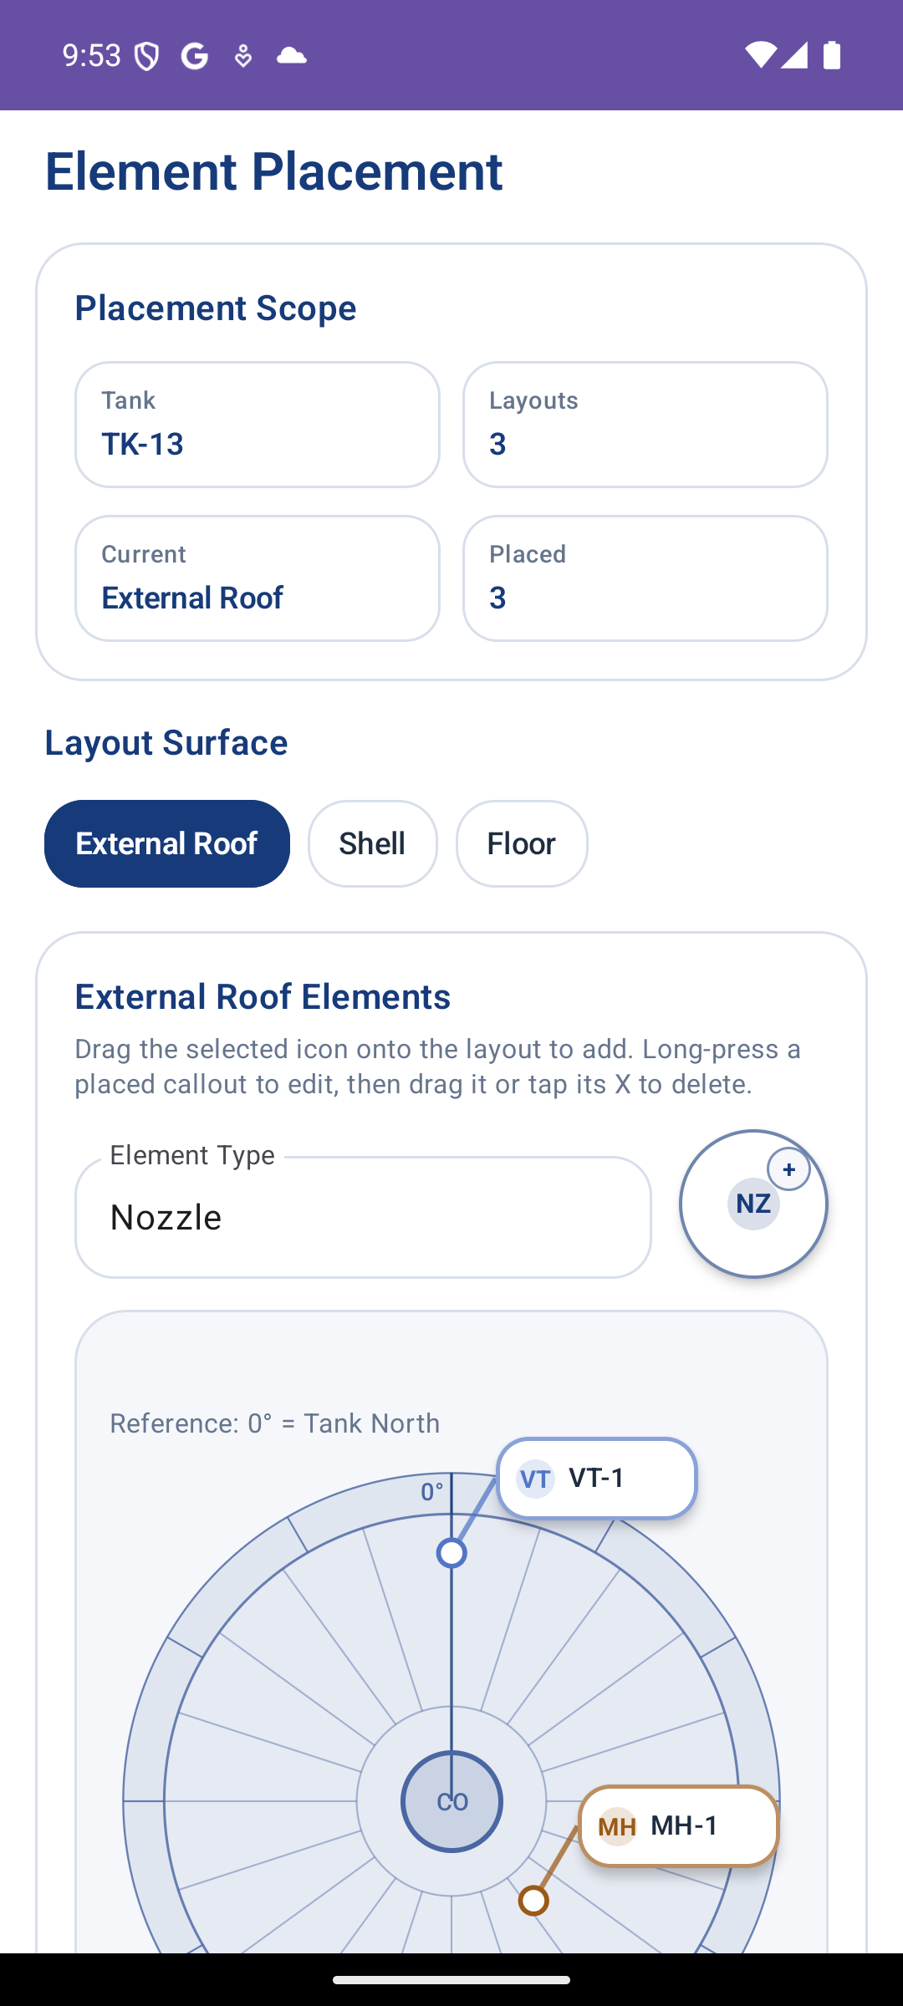
Tank Inspection Copilot · Field Android V2
05
Element Placement
Place nozzles, manholes, stairs, and vents directly on the map.
What this screen does
Users drag the selected element icon onto the approved layout map.
Placed callouts use a point plus leader label so exact placement remains readable.
Double-tap edit mode supports moving or deleting placed elements.
Live Android app screenshot

Slide 6
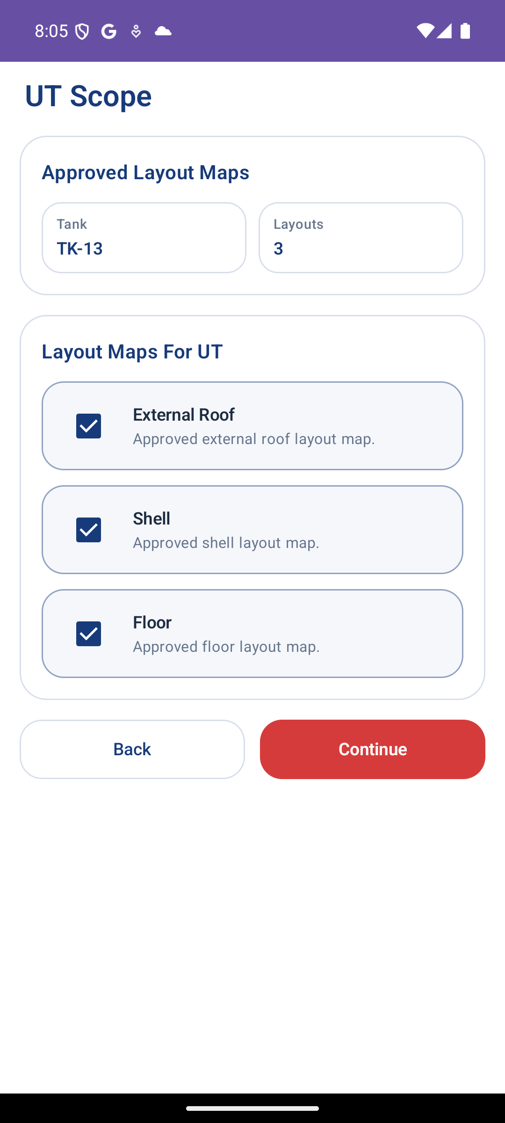
Tank Inspection Copilot · Field Android V2
06
UT Scope
Select approved maps that require UT survey.
What this screen does
Every approved layout can be included, even when no elements were placed.
The operator sees the UT survey surfaces without extra element/no-element noise.
The selected UT scope drives the measurement tabs in the next screen.
Live Android app screenshot

Slide 7
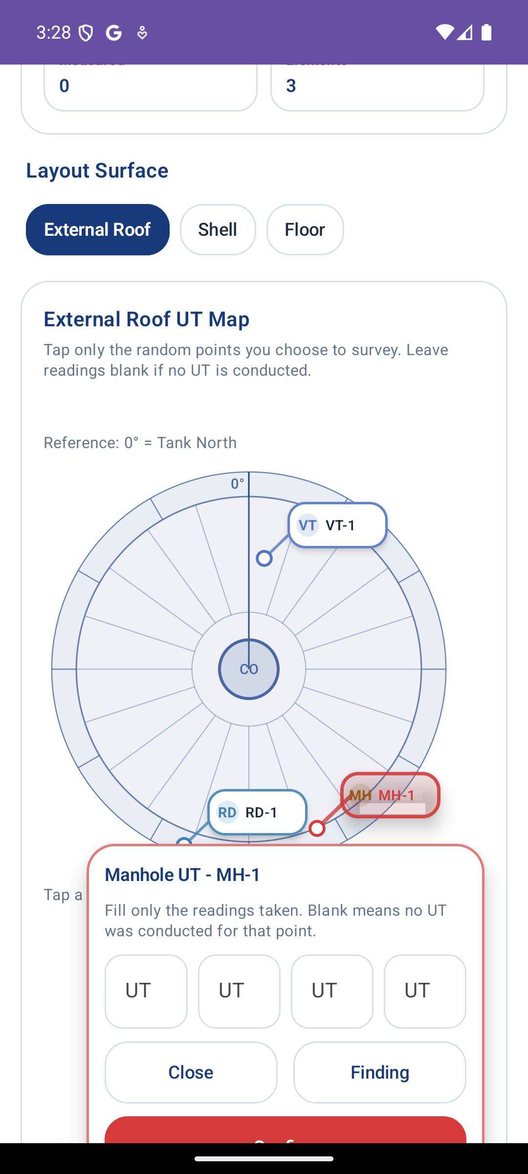
Tank Inspection Copilot · Field Android V2
07
UT Measurements
Tap any plate, lane/course region, or element to record readings.
What this screen does
Measurement cards appear near the selected target instead of forcing a new page.
Blank readings are allowed, supporting random UT points and “not measured” cases.
Completed targets are highlighted so inspectors can see measured coverage.
Live Android app screenshot

Slide 8
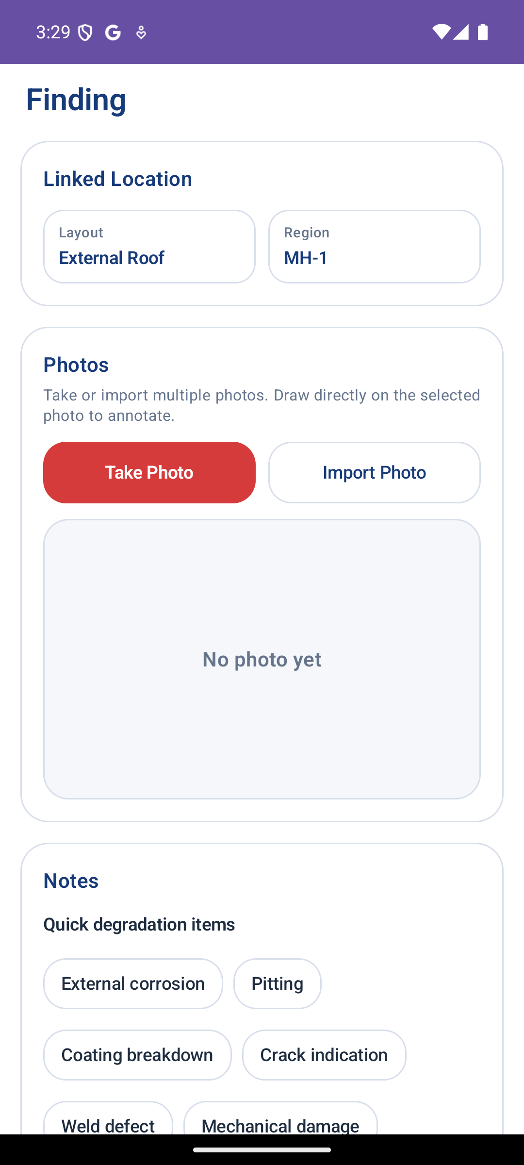
Tank Inspection Copilot · Field Android V2
08
Linked UT Findings
Create field evidence directly from a selected UT target.
What this screen does
Findings stay linked to the region, plate, lane/course, or element being inspected.
Photo capture and import support multi-photo evidence for each finding.
Quick degradation notes help standardize corrosion, pitting, and crack observations.
Live Android app screenshot

