Slide 1

Anotaciones de tipo
y validación de datos
PEP, mypy y Pydantic
Programación para Inteligencia Artificial
01
Notes:
https://peps.python.org/pep-0484/
https://pydantic.dev/docs/validation/latest/get-started/
Imagen: https://www.python.org/community/logos/

Slide 2
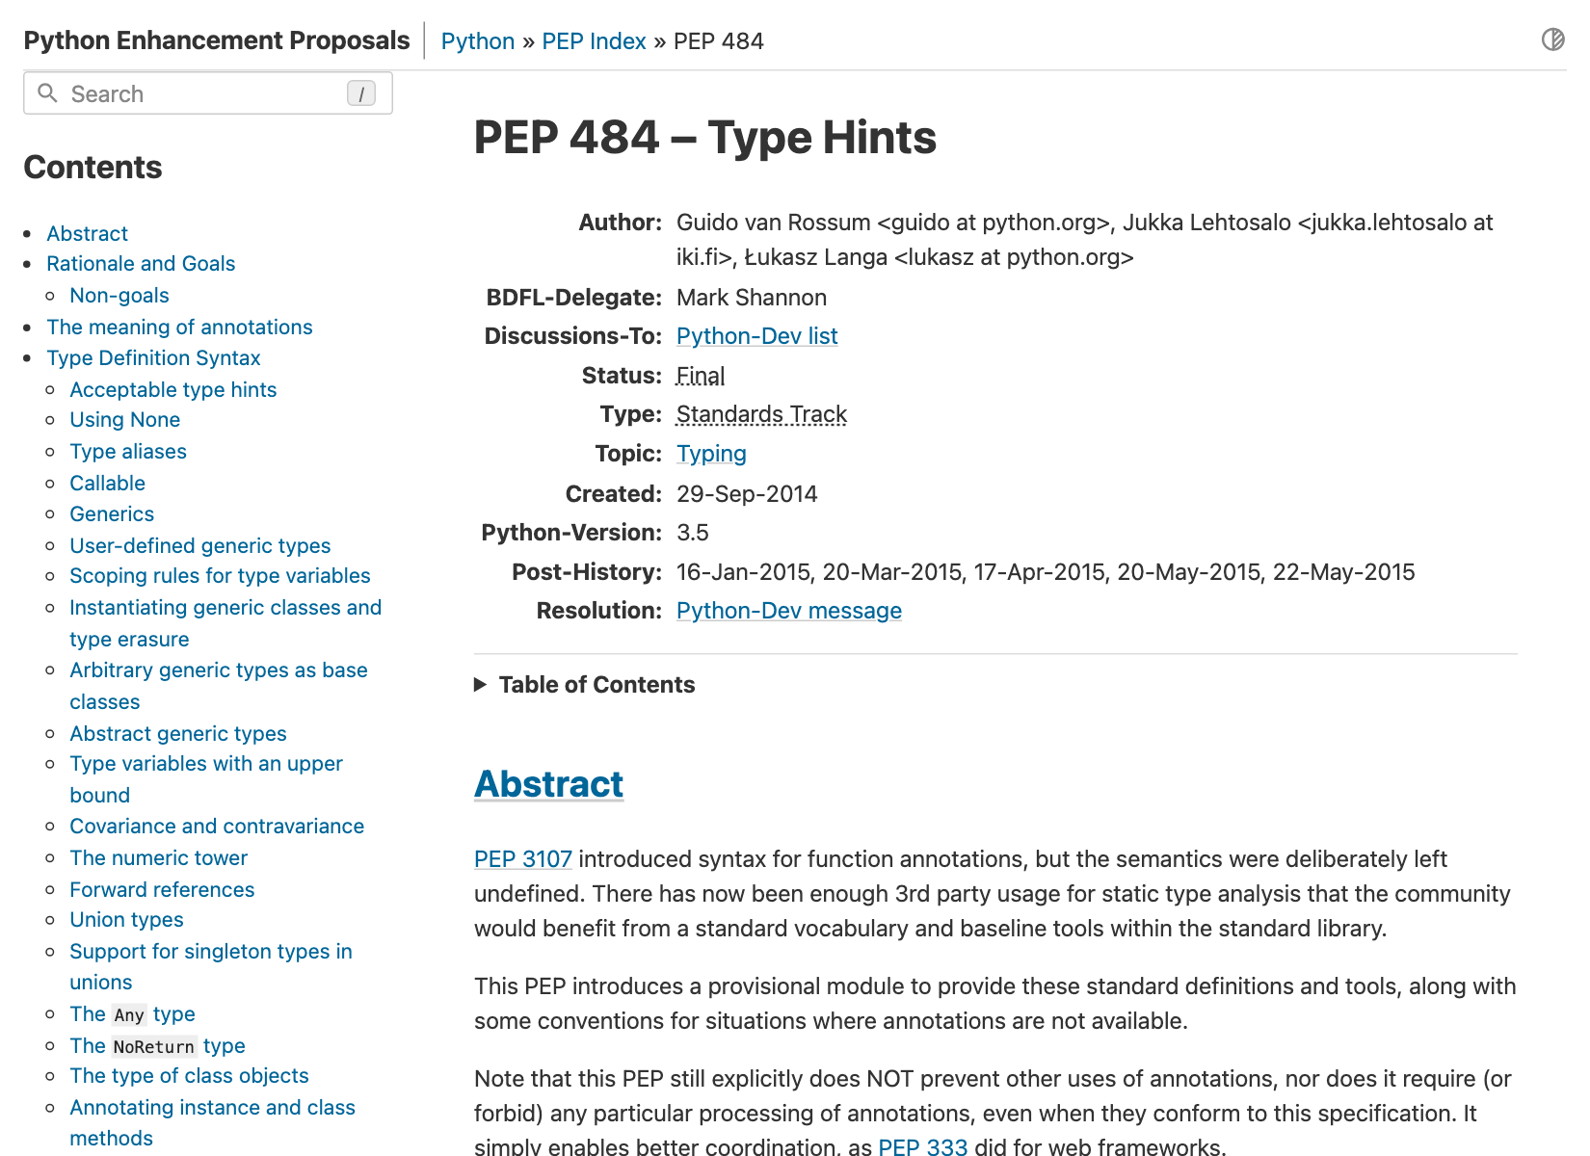
Python Enhancement Proposal
Una PEP documenta una propuesta de diseño, su motivación y sus decisiones técnicas.
También existen PEP informativas y de proceso. Su estado indica si la propuesta sigue en discusión o ya tiene una resolución.
02
Notes:
https://peps.python.org/pep-0001/
Captura de PEP 484: https://peps.python.org/pep-0484/

Slide 3
Historia de las anotaciones
Python 3.0
Python 3.5
Python 3.6
PEP 3107
PEP 484
PEP 526
Sintaxis para anotar parámetros y retornos.
La propuesta deja abierta su interpretación.
Convenciones de type hints para el análisis estático.
Incorpora el módulo typing.
Sintaxis para anotar variables.
price: float = 19.5
03
Notes:
https://peps.python.org/pep-3107/
https://peps.python.org/pep-0484/
https://peps.python.org/pep-0526/

Slide 4
Sintaxis moderna
Python 3.9 · PEP 585
list[str] dict[str, int]
Python 3.10 · PEP 604
float | None str | int
04
Notes:
https://peps.python.org/pep-0585/
https://peps.python.org/pep-0604/

Slide 5
Anatomía de una anotación
def greet(name: str) -> str:
return f"Hello, {name}!"
name: str Tipo esperado del argumento
-> str Tipo declarado del retorno
05
Notes:
https://peps.python.org/pep-0484/
https://peps.python.org/pep-0526/

Slide 6
Anotaciones y ejecución
def repeat_text(text: str, times: int) -> str:
return text * times
repeat_text("hi", 2) # "hihi"
repeat_text(3, 2) # 6
Python ejecuta ambas llamadas. Las anotaciones por sí solas
no comprueban los argumentos ni convierten sus valores.
06
Notes:
https://peps.python.org/pep-0484/

Slide 7
Análisis estático con mypy
mypy examina el código sin ejecutarlo y señala operaciones incompatibles con los tipos declarados.
def square(value: float) -> float:
return value * value
square("3")
Argumento recibido
str
Tipo esperado
float
python -m mypy example.py
07
Notes:
https://mypy.readthedocs.io/en/stable/
https://peps.python.org/pep-0484/

Slide 8

ArjanCodes: contrato de retorno
calculate_discounts
El original anota Iterable[float], aunque devuelve una lista.
Iterable garantiza un recorrido, pero no garantiza longitud ni acceso por índice.
len(discounted_items)
discounted_items[0]
08
Notes:
https://github.com/ArjanCodes/examples/blob/main/2025/typehints/generic_return.py
Video de referencia: https://www.youtube.com/watch?v=0oBLMwHdZ2Y
Miniatura: https://i.ytimg.com/vi/0oBLMwHdZ2Y/hqdefault.jpg
Código adaptado de ArjanCodes. Copyright (c) 2023 ArjanCodes. MIT. Véase ARJANCODES_LICENSE.txt.
MIT License
Copyright (c) 2023 ArjanCodes
Permission is hereby granted, free of charge, to any person obtaining a copy
of this software and associated documentation files (the "Software"), to deal
in the Software without restriction, including without limitation the rights
to use, copy, modify, merge, publish, distribute, sublicense, and/or sell
copies of the Software, and to permit persons to whom the Software is
furnished to do so, subject to the following conditions:
The above copyright notice and this permission notice shall be included in all
copies or substantial portions of the Software.
THE SOFTWARE IS PROVIDED "AS IS", WITHOUT WARRANTY OF ANY KIND, EXPRESS OR
IMPLIED, INCLUDING BUT NOT LIMITED TO THE WARRANTIES OF MERCHANTABILITY,
FITNESS FOR A PARTICULAR PURPOSE AND NONINFRINGEMENT. IN NO EVENT SHALL THE
AUTHORS OR COPYRIGHT HOLDERS BE LIABLE FOR ANY CLAIM, DAMAGES OR OTHER
LIABILITY, WHETHER IN AN ACTION OF CONTRACT, TORT OR OTHERWISE, ARISING FROM,
OUT OF OR IN CONNECTION WITH THE SOFTWARE OR THE USE OR OTHER DEALINGS IN THE
SOFTWARE.

Slide 9
Un retorno que conserva la información
from collections.abc import Iterable
def calculate_discounts(
items: Iterable[float], discount: float
) -> list[float]:
return [item * (1 - discount) for item in items]
prices = calculate_discounts([100.0, 200.0], 0.2)
print(len(prices), prices[0]) # 2 80.0
09
Notes:
https://github.com/ArjanCodes/examples/blob/main/2025/typehints/generic_return.py
Código adaptado de ArjanCodes, MIT. Véase ARJANCODES_LICENSE.txt.
MIT License
Copyright (c) 2023 ArjanCodes
Permission is hereby granted, free of charge, to any person obtaining a copy
of this software and associated documentation files (the "Software"), to deal
in the Software without restriction, including without limitation the rights
to use, copy, modify, merge, publish, distribute, sublicense, and/or sell
copies of the Software, and to permit persons to whom the Software is
furnished to do so, subject to the following conditions:
The above copyright notice and this permission notice shall be included in all
copies or substantial portions of the Software.
THE SOFTWARE IS PROVIDED "AS IS", WITHOUT WARRANTY OF ANY KIND, EXPRESS OR
IMPLIED, INCLUDING BUT NOT LIMITED TO THE WARRANTIES OF MERCHANTABILITY,
FITNESS FOR A PARTICULAR PURPOSE AND NONINFRINGEMENT. IN NO EVENT SHALL THE
AUTHORS OR COPYRIGHT HOLDERS BE LIABLE FOR ANY CLAIM, DAMAGES OR OTHER
LIABILITY, WHETHER IN AN ACTION OF CONTRACT, TORT OR OTHERWISE, ARISING FROM,
OUT OF OR IN CONNECTION WITH THE SOFTWARE OR THE USE OR OTHER DEALINGS IN THE
SOFTWARE.

Slide 10
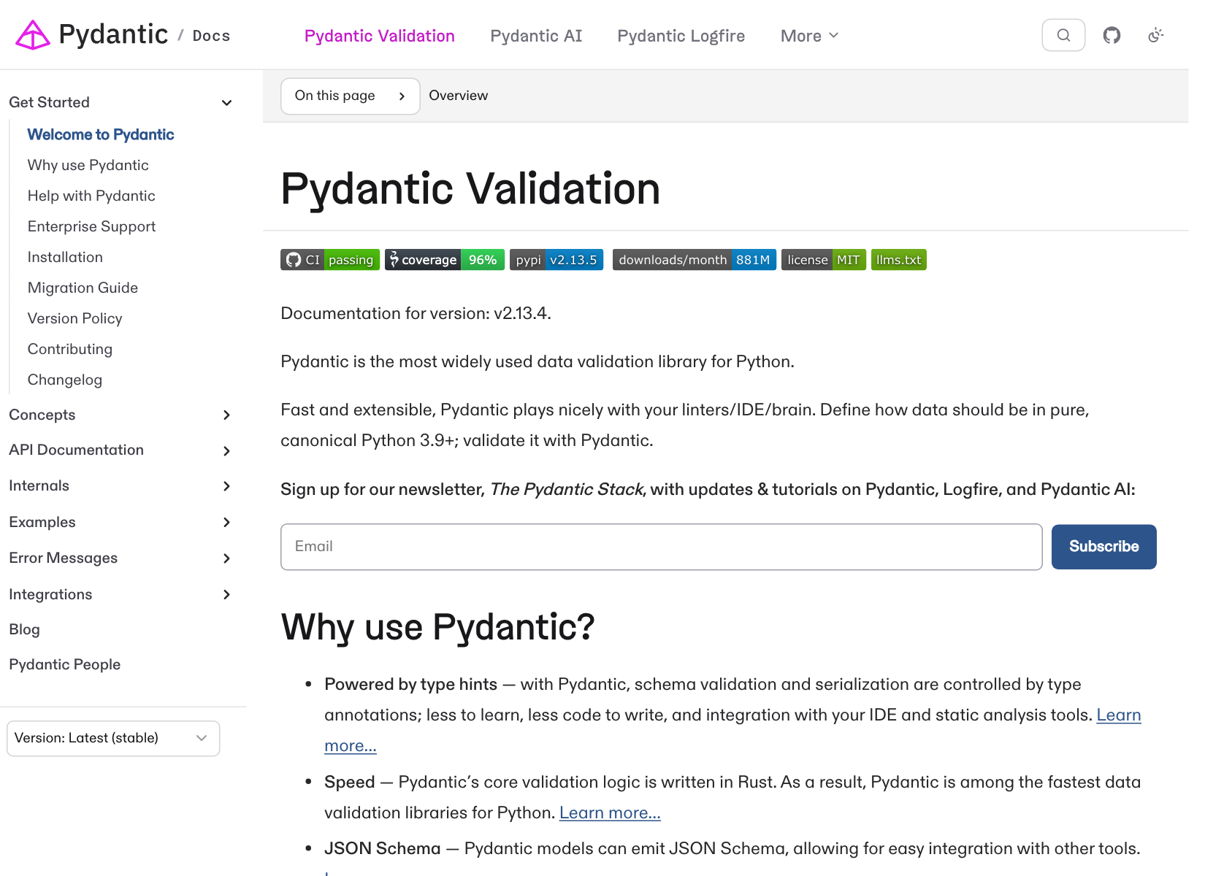
Pydantic
Biblioteca de validación de datos basada en anotaciones de tipo.
Un modelo declara los campos y sus restricciones. Al recibir datos, Pydantic crea una instancia válida o genera un ValidationError.
10
Notes:
https://pydantic.dev/docs/validation/latest/get-started/
Captura: https://pydantic.dev/docs/validation/latest/get-started/

Slide 11
Validación y conversión
from pydantic import BaseModel
class Product(BaseModel):
name: str
price: float
product = Product(name="Notebook", price="19.5")
print(product.price) # 19.5
El campo price contiene un float después de la validación.
El modo estricto permite restringir conversiones.
11
Notes:
https://docs.pydantic.dev/latest/concepts/models/
https://pydantic.dev/docs/validation/latest/get-started/

Slide 12
Restricciones y errores
from pydantic import BaseModel, Field
class Product(BaseModel):
name: str
price: float = Field(gt=0)
Entrada
price = -5
Campo: price
Regla: valor mayor que cero
Resultado: ValidationError
12
Notes:
https://docs.pydantic.dev/latest/concepts/fields/
https://docs.pydantic.dev/latest/concepts/models/

Slide 13
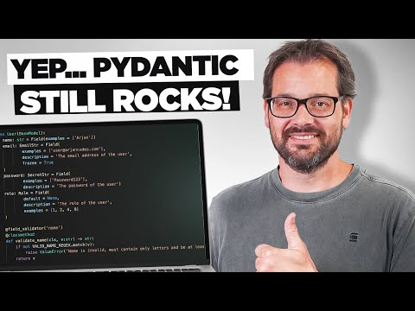
ArjanCodes: un modelo User
name
Nombre requerido
email
Formato validado con EmailStr
role
Valores permitidos y valor por defecto
13
Notes:
https://github.com/ArjanCodes/examples/blob/main/2024/pydantic_refresh/example.py
Video de referencia: https://www.youtube.com/watch?v=502XOB0u8OY
Miniatura: https://i.ytimg.com/vi/502XOB0u8OY/hqdefault.jpg
Adaptación simplificada, licencia MIT. Véase ARJANCODES_LICENSE.txt.
MIT License
Copyright (c) 2023 ArjanCodes
Permission is hereby granted, free of charge, to any person obtaining a copy
of this software and associated documentation files (the "Software"), to deal
in the Software without restriction, including without limitation the rights
to use, copy, modify, merge, publish, distribute, sublicense, and/or sell
copies of the Software, and to permit persons to whom the Software is
furnished to do so, subject to the following conditions:
The above copyright notice and this permission notice shall be included in all
copies or substantial portions of the Software.
THE SOFTWARE IS PROVIDED "AS IS", WITHOUT WARRANTY OF ANY KIND, EXPRESS OR
IMPLIED, INCLUDING BUT NOT LIMITED TO THE WARRANTIES OF MERCHANTABILITY,
FITNESS FOR A PARTICULAR PURPOSE AND NONINFRINGEMENT. IN NO EVENT SHALL THE
AUTHORS OR COPYRIGHT HOLDERS BE LIABLE FOR ANY CLAIM, DAMAGES OR OTHER
LIABILITY, WHETHER IN AN ACTION OF CONTRACT, TORT OR OTHERWISE, ARISING FROM,
OUT OF OR IN CONNECTION WITH THE SOFTWARE OR THE USE OR OTHER DEALINGS IN THE
SOFTWARE.

Slide 14
Campos del modelo User
from typing import Literal
from pydantic import BaseModel, EmailStr, Field, SecretStr
class User(BaseModel):
name: str = Field(min_length=2)
email: EmailStr
password: SecretStr = Field(exclude=True)
role: Literal["author", "editor", "admin"] = "author"
SecretStr oculta el valor al representarlo. No cifra la contraseña.
exclude=True la omite al serializar el modelo.
14
Notes:
https://github.com/ArjanCodes/examples/blob/main/2024/pydantic_refresh/example.py
https://docs.pydantic.dev/latest/api/types/#pydantic.types.SecretStr
Adaptación de ArjanCodes, licencia MIT. Véase ARJANCODES_LICENSE.txt.
MIT License
Copyright (c) 2023 ArjanCodes
Permission is hereby granted, free of charge, to any person obtaining a copy
of this software and associated documentation files (the "Software"), to deal
in the Software without restriction, including without limitation the rights
to use, copy, modify, merge, publish, distribute, sublicense, and/or sell
copies of the Software, and to permit persons to whom the Software is
furnished to do so, subject to the following conditions:
The above copyright notice and this permission notice shall be included in all
copies or substantial portions of the Software.
THE SOFTWARE IS PROVIDED "AS IS", WITHOUT WARRANTY OF ANY KIND, EXPRESS OR
IMPLIED, INCLUDING BUT NOT LIMITED TO THE WARRANTIES OF MERCHANTABILITY,
FITNESS FOR A PARTICULAR PURPOSE AND NONINFRINGEMENT. IN NO EVENT SHALL THE
AUTHORS OR COPYRIGHT HOLDERS BE LIABLE FOR ANY CLAIM, DAMAGES OR OTHER
LIABILITY, WHETHER IN AN ACTION OF CONTRACT, TORT OR OTHERWISE, ARISING FROM,
OUT OF OR IN CONNECTION WITH THE SOFTWARE OR THE USE OR OTHER DEALINGS IN THE
SOFTWARE.

Slide 15
Serialización
Instancia
Diccionario
user.name
user.email
user.model_dump()
Texto JSON
user.model_dump_json()
15
Notes:
https://docs.pydantic.dev/latest/concepts/models/

Slide 16
Ejemplos en la notebook
Anotaciones y diagnósticos de mypy
Descuentos y tipos de retorno
Modelo User y errores de validación
Registros, configuración y serialización
01_tipado_pydantic.ipynb
16
Notes:
https://github.com/ArjanCodes/examples/blob/main/2025/typehints/generic_return.py
https://github.com/ArjanCodes/examples/blob/main/2024/pydantic_refresh/example.py
https://pydantic.dev/docs/validation/latest/get-started/
MIT License
Copyright (c) 2023 ArjanCodes
Permission is hereby granted, free of charge, to any person obtaining a copy
of this software and associated documentation files (the "Software"), to deal
in the Software without restriction, including without limitation the rights
to use, copy, modify, merge, publish, distribute, sublicense, and/or sell
copies of the Software, and to permit persons to whom the Software is
furnished to do so, subject to the following conditions:
The above copyright notice and this permission notice shall be included in all
copies or substantial portions of the Software.
THE SOFTWARE IS PROVIDED "AS IS", WITHOUT WARRANTY OF ANY KIND, EXPRESS OR
IMPLIED, INCLUDING BUT NOT LIMITED TO THE WARRANTIES OF MERCHANTABILITY,
FITNESS FOR A PARTICULAR PURPOSE AND NONINFRINGEMENT. IN NO EVENT SHALL THE
AUTHORS OR COPYRIGHT HOLDERS BE LIABLE FOR ANY CLAIM, DAMAGES OR OTHER
LIABILITY, WHETHER IN AN ACTION OF CONTRACT, TORT OR OTHERWISE, ARISING FROM,
OUT OF OR IN CONNECTION WITH THE SOFTWARE OR THE USE OR OTHER DEALINGS IN THE
SOFTWARE.

