Slide 1
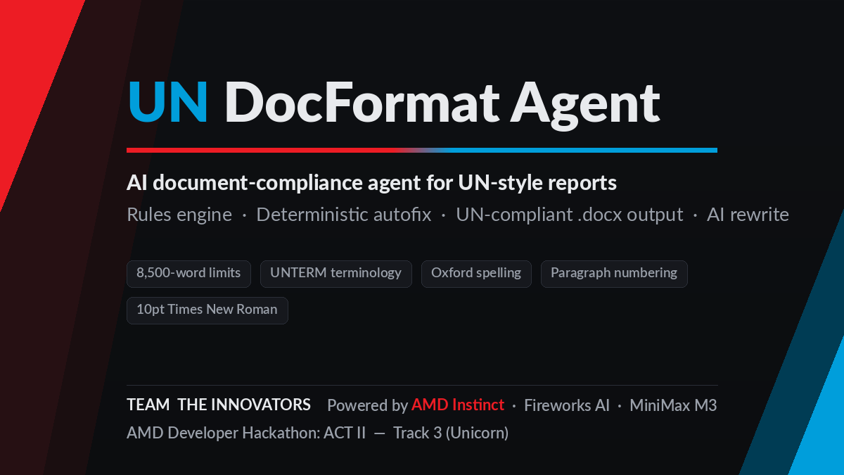

Slide 2
The world's strictest style guide is enforced by hand
UN documents follow the DGACM Editorial Manual — hundreds of binding rules covering structure, terminology, spelling and layout.
Every Secretariat report is checked manually today. Compliance review is slow, inconsistent, and competes with substantive work.
Thousands of documents per year, across every UN agency, fund, programme and mission — plus the NGOs and ministries that file to the same standard.
From the rule book:
“Initial capitals only for the first word” — headings, bold, sentence case
“Viet Nam”, never “Vietnam” — UNTERM geographical names
“United Nations” — never abbreviated in running text
“programme”, “judgement” — Concise Oxford, first-listed form
(a), (b) … with (i), (ii) indented — sub-listing hierarchy
Numbers under 10 in words; footnotes only, never endnotes; paragraph numbers cited, never pages…
8,500
word ceiling for a Secretariat report — one of many hard limits

Slide 3
An agent that reads the rule book — then applies it
1
2
3
4
Check
Autofix
AI rewrite
Verify
15+ rule checks against the citable DGACM standard. Every finding: rule ID, location, exact fix.
Mechanical violations fixed deterministically — spelling, terminology, numbering — no model, no risk.
Judgement calls go to MiniMax M3 on AMD Instinct via Fireworks. Constrained: fix only what was flagged.
Rules engine re-checks the result. Output: compliant .docx + a separate change-log document.
Degrades gracefully:
with no model configured, the deterministic pipeline still delivers a formatted, verified document.

Slide 4
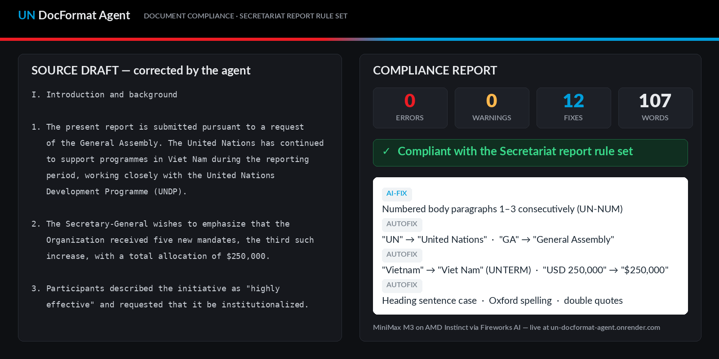
Live: dirty draft in, compliant report out
un-docformat-agent.onrender.com

Slide 5
Complete, tested, containerized
Rules engine
Deterministic autofix
15+ checks mapped 1:1 to DGACM sources in docs/UN_RULES.md — no invented rules, everything verifiable.
24 mechanical fixes on the demo document alone, each logged. Works with zero model access.
Constrained AI fix
Engineering
The model receives the draft + structured findings, may fix only those, and is re-checked afterwards.
57-test suite · Docker · MIT license · stdlib OOXML writer for the .docx output · Flask UI · CLI + API

Slide 6
Built on AMD — not wrapped around an API
All inference runs on AMD Instinct GPUs through the Fireworks AI serverless API — the exact stack this hackathon is built around.
Model: MiniMax M3 (one of the families featured for ACT II). The client is OpenAI-compatible and model-agnostic — one environment variable swaps in any Fireworks-hosted model, including Gemma on a dedicated deployment.
Mock-first architecture meant the entire pipeline was built and 57-test-verified before credits existed — then went live with zero code changes.
< $0.01
inference cost per document processed
1 env var
to swap models — Gemma-ready via dedicated deployment
0 → live
same code path from mocked tests to AMD production

Slide 7
Every organization with a house style is a customer
Today
Next
Beyond
UN Secretariat reports — the strictest, best-documented rule set. Agencies, funds, programmes, missions and the NGOs filing to them.
More UN document types — resolutions, briefing notes, correspondence — by adding rules, not code. The engine is document-type-driven.
Any editorial standard: EU institutions, ISO, legal houses, corporate brand-language compliance. Same agent, different rule book.
Business model:
per-seat SaaS for compliance teams; API pricing for document-pipeline integration. The rules engine is the moat — it encodes institutional knowledge that generic chatbots hallucinate.

Slide 8
Small. Finished. Real.
A working product against a real, citable standard — live demo, open source, containerized, tested end to end.
Live demo
Source
un-docformat-agent.onrender.com
github.com/oscarowais/un-docformat-agent (MIT)
The Innovators · AMD Developer Hackathon: ACT II · Track 3 (Unicorn) · Powered by AMD Instinct + Fireworks AI

