Slide 1
Equity Research Engine
Oscar Schjelderup
Kid – A wonderful business at a fair price
Initiation of coverage – HOLD, target price NOK 126.00
23.09.2026
Private and Confidential

Slide 2
Analyst
Presenting a model-driven investment case on Kid ASA.
OS
University: Copenhagen Business School
Year of study: 2nd year
Experience: HA Invest member
Oscar Schjelderup
Sources: Company reports, Yahoo Finance, Equity Research Engine estimates
For illustration only — not investment advice
Equity Research Engine
2

Slide 3
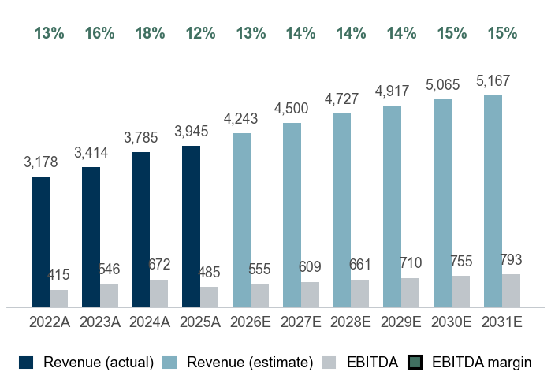
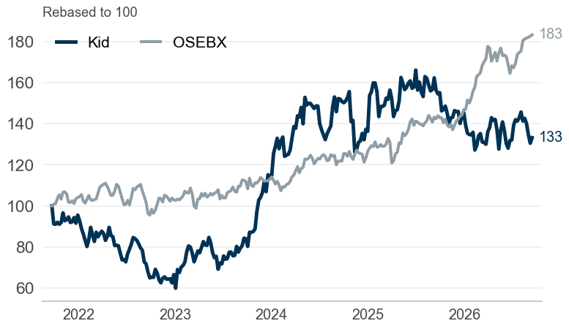
#1 The equity story of Kid
Company overview
Kid ASA – Home furnishing retail in Norway, Sweden, Finland, Estonia
7.5% revenue CAGR, 12.3% EBITDA margin and 1.5x net debt/EBITDA — market cap NOK 5.0bn
Company snapshot
1
Investment highlights
2
Management team
3
Sector: Home furnishing retail
Footprint: Norway, Sweden, Finland, Estonia
Business model: Vertically integrated private-label retail (Kid, Hemtex)
Scale: Employees: 454 | Revenue 2025A: NOK 3,945m
Market cap: NOK 4,967m | EV NOK 6,048m
Share price: NOK 122.20 | 52w range 112.0–154.6
Consistent growth: revenue compounded at 7.5% p.a. over 2022–2025, reaching NOK 3,945m
Margin profile: pre-IFRS 16 EBITDA margin of 12.3% in 2025A (down from 13.1% in 2022A), EBIT margin 8.7%
Weak cash conversion: unlevered FCF of NOK 13m in 2025A, 3% of EBITDA (average 44% over 2022–2025), ROIC 13%
Balance sheet: net debt of NOK 1,081m equals 1.5x EBITDA, a conservative leverage level
MF
Marianne Fulford
CEO
MK
Mads Kigen
CFO
SB
Stian Brandhagen
Head of Sustainability
JG
Josephine Gisaeus
Sourcing Director & Primary Insider
Revenue and EBITDA (NOKm)
4
Share price vs OSEBX (5 years)
5
Key ratios
6
 | 2023A | 2024A | 2025A | 2026E | 2027E
Revenue growth | 7.4% | 10.9% | 4.2% | 7.6% | 6.1%
EBITDA margin | 16.0% | 17.8% | 12.3% | 13.1% | 13.5%
EBIT margin | 12.8% | 14.3% | 8.7% | 9.7% | 10.1%
FCF margin | 12.9% | 9.5% | 0.3% | 5.1% | 5.9%
ROIC | 18.6% | 21.3% | 12.5% | – | –
Net debt / EBITDA | 0.5x | 0.4x | 1.5x | – | –
Payout ratio | 74% | 66% | 133% | – | –
Sources: Company reports, Yahoo Finance, Equity Research Engine estimates
For illustration only — not investment advice
Equity Research Engine
3

Slide 4
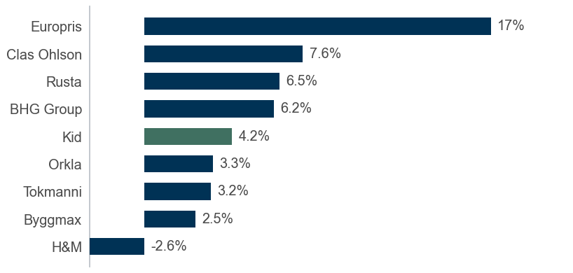
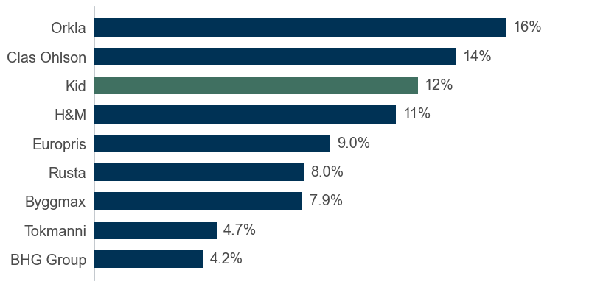
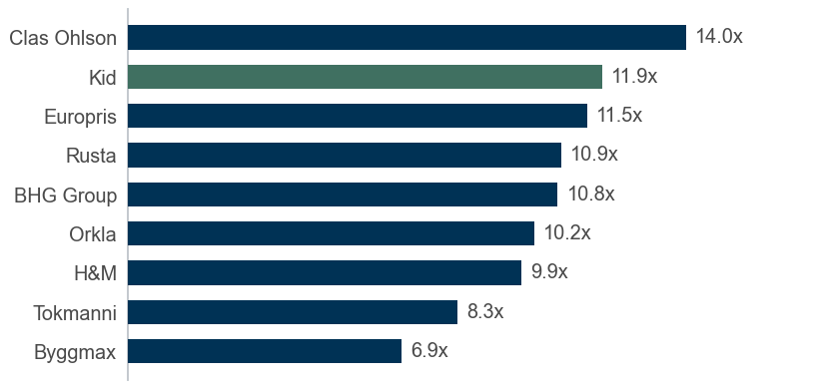
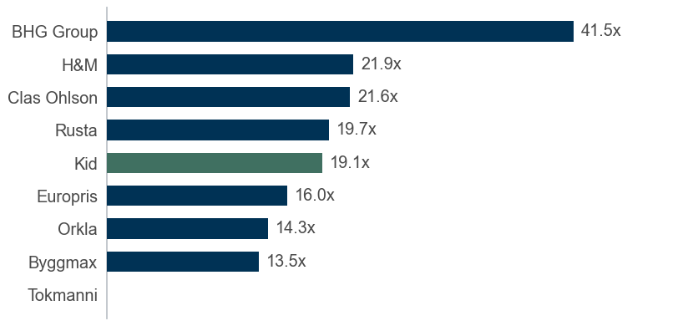
#2 Market overview and peer landscape
Market overview
Kid versus its peer group: growth, profitability and the drivers behind the case
Revenue growth vs peers (last fiscal year)
1
EBITDA margin vs peers (lease-adjusted)
2
Opportunities
Swedish recovery supports the Hemtex segment
Opportunity to increase square metres per store and sell the full range in existing stores
Disruption
Direct-to-consumer online players threaten in-store sales
Competitors adopting AI-driven inventory management
EV/EBITDA vs peers
3
P/E vs peers (trailing)
4
Threats
Potential cost spikes in raw material and freight prices
Tariffs on Chinese production would hit sourcing costs
Sources: Company reports; Statistics Norway; Equity Research Engine estimates
For illustration only — not investment advice
Equity Research Engine
4

Slide 5
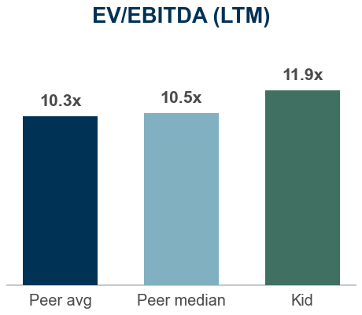
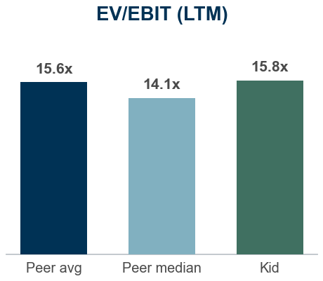
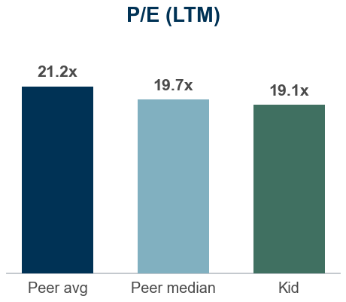
#3 Historical analysis and forecasts
Financials and estimates
Kid financials, pre-IFRS 16 basis (NOKm)
 | HISTORICAL |  |  |  | FORECAST
NOKm | 2022A | 2023A | 2024A | 2025A | 2026E | 2027E | 2028E | 2029E | 2030E | 2031E | TV
Revenue | 3,178 | 3,414 | 3,785 | 3,945 | 4,243 | 4,500 | 4,727 | 4,917 | 5,065 | 5,167 | 5,270
Growth | – | 7.4% | 10.9% | 4.2% | 7.6% | 6.1% | 5.0% | 4.0% | 3.0% | 2.0% | 2.0%
EBITDA | 415 | 546 | 672 | 485 | 555 | 609 | 661 | 710 | 755 | 793 | 809
Margin | 13.1% | 16.0% | 17.8% | 12.3% | 13.1% | 13.5% | 14.0% | 14.4% | 14.9% | 15.3% | 15.3%
EBIT | 330 | 438 | 541 | 343 | 410 | 456 | 500 | 542 | 582 | 617 | 629
Margin | 10.4% | 12.8% | 14.3% | 8.7% | 9.7% | 10.1% | 10.6% | 11.0% | 11.5% | 11.9% | 11.9%
NOPAT | 258 | 342 | 433 | 273 | 320 | 355 | 390 | 423 | 454 | 481 | 491
Margin | 8.1% | 10.0% | 11.4% | 6.9% | 7.5% | 7.9% | 8.3% | 8.6% | 9.0% | 9.3% | 9.3%
Unlevered FCF | 162 | 442 | 358 | 13 | 216 | 266 | 316 | 368 | 419 | 468 | 478
FCF margin | 5.1% | 12.9% | 9.5% | 0.3% | 5.1% | 5.9% | 6.7% | 7.5% | 8.3% | 9.1% | 9.1%
Financial commentary
Kid grew revenue by 4.2% in 2025A to NOK 3,945m, with pre-IFRS 16 EBITDA of NOK 485m (12.3% margin)
2026E is built on the 2 reported quarters: revenue +8.1% year-to-date at a 9.0% EBITDA margin (8.2% a year earlier); the rest of the year at +7.2% growth on last year's seasonal margins gives NOK 4,243m (+7.6%) and a 13.1% margin; growth then follows consensus (4 analysts) and fades to 2.0% by 2031E
EBITDA margin path: 13.1% in 2026E to 15.3% in 2031E; D&A 3.4% and capex 5.6% normalising to 3.6% of revenue; tax rate 22%
Unlevered FCF rises from NOK 216m to NOK 468m over the forecast period (9.1% FCF margin in 2031E)
Valuation vs peers: Kid trades at 11.9x LTM EV/EBITDA versus a peer median of 10.5x (+13%) and 19.1x P/E versus 19.7x
Street view: consensus target of NOK 139.50 across 4 analysts (+14% vs current price)
Multiples (at current price) | 2025A | 2026E | 2027E | 2028E
EV/Sales | 1.5x | 1.4x | 1.3x | 1.3x
EV/EBITDA | 12.5x | 10.9x | 9.9x | 9.1x
EV/EBIT | 17.7x | 14.7x | 13.3x | 12.1x
P/E | 21.7x | 17.9x | 15.9x | 14.3x
FCF yield | 0.3% | 4.4% | 5.4% | 6.4%
Consensus (4 analysts)
Target: NOK 139.50 (range 125–155)
Ratings: 2 buy / 2 hold / 0 sell
Engine: HOLD, TP NOK 126.00 (+3%)
Sources: Company reports, Yahoo Finance, Equity Research Engine estimates; peer multiples on last reported fiscal year
For illustration only — not investment advice
Equity Research Engine
5

Slide 6
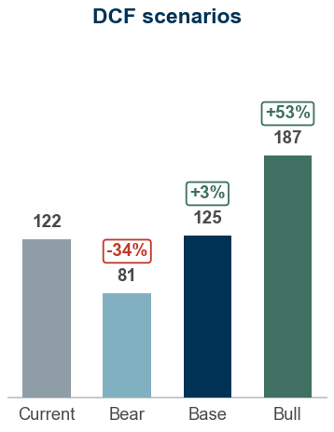
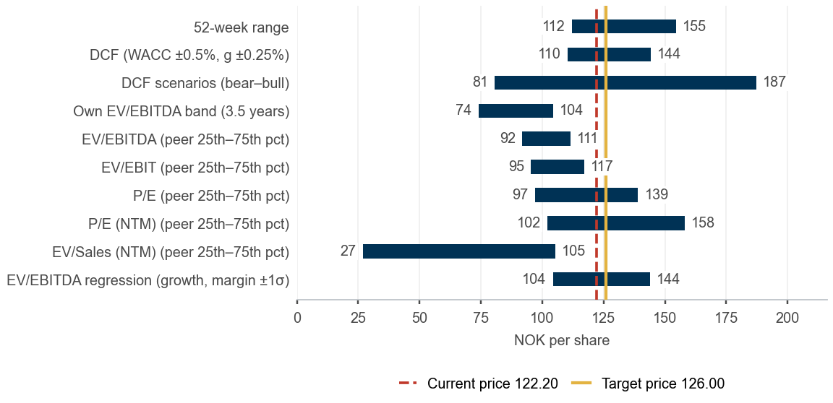
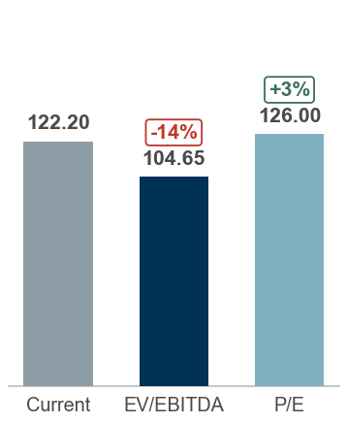
#4 Valuation and concluding thoughts
Valuation and recommendation
We recommend a HOLD. Our 12-month target price of NOK 126.00 implies +3% upside and a +11% total return including dividend; 10.9x 2026E EV/EBITDA.
DCF fair value NOK 125.26, peer multiples NOK 105.82, scenario-weighted NOK 129.60 versus a share price of NOK 122.20 — HOLD
HOLD – 12m TP NOK 126.00 · medium agreement
DCF valuation – Sensitivity analysis (value per share)
DCF value of NOK 125.26 per share (WACC 8.6%, terminal growth 2.0%); terminal value is 76% of EV, implying 9.1x exit EV/EBITDA
Peer multiples imply NOK 105.82 per share (median of EV/EBITDA, EV/EBIT and P/E-based values)
Scenarios: bear NOK 81 / base NOK 125 / bull NOK 187; probability-weighted NOK 129.60
12-month target price NOK 126.00: fair value NOK 125.26 (valued at 23.09.2026) rolled forward at the 8.8% cost of equity less NOK 10.00 dividend; expected total return +11%, rating HOLD
Terminal growth \ WACC | 7.10% | 7.60% | 8.10% | 8.60% | 9.10% | 9.60% | 10.10%
1.25% | 150.6 | 135.9 | 123.5 | 112.7 | 103.4 | 95.1 | 87.8
1.50% | 157.1 | 141.4 | 128.1 | 116.6 | 106.7 | 98.0 | 90.3
1.75% | 164.3 | 147.3 | 133.0 | 120.8 | 110.2 | 101.1 | 93.0
2.00% | 172.2 | 153.7 | 138.3 | 125.3 | 114.0 | 104.3 | 95.8
2.25% | 180.8 | 160.7 | 144.1 | 130.1 | 118.1 | 107.8 | 98.8
2.50% | 190.5 | 168.5 | 150.4 | 135.3 | 122.5 | 111.5 | 102.0
2.75% | 201.2 | 177.0 | 157.3 | 141.0 | 127.3 | 115.5 | 105.4
Valuation summary – Football field
Multiple valuation and what the price implies
Trading at a premium: 11.9x EV/EBITDA vs 10.5x peer median (13% premium)
Earnings multiple: 19.1x trailing P/E vs 19.7x for peers (-3%); 13.0x vs 13.4x on next-twelve-month consensus
Versus own history: 11.6x trailing EV/EBITDA is above the 3.5-year median of 9.5x (85% of weeks were cheaper)
EV/EBITDA-implied value: NOK 104.65 at the peer median of 10.5x (range 92–111 across the 25th–75th percentile)
Market-implied WACC 8.7%, in line with our 8.6%: the price discounts our cash flows at 13bp more than we do
Market-implied margin: at our WACC the price is consistent with a 2031E EBITDA margin of 15.1% versus 15.3% in our base case
Cross-check – medium agreement: the DCF is 18% above the peer-multiple value (NOK 105.82) and our target is 10% below the consensus of 4 analysts (NOK 139.50); review the growth, margin and WACC assumptions before relying on the target
Sources: Company reports, Yahoo Finance, Equity Research Engine estimates; WACC 8.6% (Yahoo Finance (5y monthly); regression vs OSEBX rejected (R2=0.03 < 0.10), Blume-adjusted); terminal growth 2.0%
For illustration only — not investment advice
Equity Research Engine
6

Slide 7
Appendix #4.1
Cost of capital and DCF build-up
WACC 8.60% and terminal growth 2.00% give a fair value of NOK 125.26 per share
WACC build-up
1
DCF build-up (NOKm)
2
What the share price implies
3
Component | Value
Risk-free rate | 3.80%
Beta (raw) | 0.56
Beta (adjusted, used) | 0.71
Equity risk premium | 5.00%
Size premium | 1.50%
Cost of equity | 8.83%
Cost of debt (pre-tax) | 9.01%
Tax rate | 22.0%
Cost of debt (after tax) | 7.02%
Weight of equity | 87.3%
Weight of debt | 12.7%
WACC | 8.60%
 | 2026E | 2027E | 2028E | 2029E | 2030E | 2031E
Unlevered FCF | 216 | 266 | 316 | 368 | 419 | 468
Share still to come | 50% | 100% | 100% | 100% | 100% | 100%
Years to discount | 0.27 | 1.27 | 2.27 | 3.27 | 4.27 | 5.27
Discount factor | 0.978 | 0.900 | 0.829 | 0.763 | 0.703 | 0.647
PV of FCF | 107 | 239 | 262 | 281 | 295 | 303
Implied WACC: 8.73% vs our 8.60%
Implied terminal growth: 1.83% vs our 2.00%
Implied 2031E EBITDA margin: 15.1% vs our 15.3%
Each figure solves for the one input that makes the DCF equal today's price, holding the others at the base case
Bridge to value per share | NOKm
Sum of PV of FCF | 1,487
Terminal value (Gordon growth) | 7,238
PV of terminal value | 4,685
Enterprise value | 6,172
Less: net debt (30.06.2026) | (1,081)
Less: minority interest | 0
Equity value | 5,091
Shares outstanding (m) | 40.6
Fair value per share (NOK, 23.09.2026) | 125.26
x (1 + cost of equity 8.83%) | 136.31
Less: expected dividend per share | (10.00)
12-month target price (NOK, rounded) | 126.00
Key checks
4
Terminal value is 76% of enterprise value
Implied exit multiple: 9.1x EV/EBITDA vs 11.9x today
WACC − g spread: 6.60%
Net debt / EBITDA: 1.5x
Beta: Yahoo Finance (5y monthly); regression vs OSEBX rejected (R2=0.03 < 0.10), Blume-adjusted.
Cross-check: bottom-up beta 0.94 (8 peers, unlevered median 0.82).
Size premium 1.50% (market cap USD 0.5bn).
Cost of debt: interest expense / average debt.
Sources: Company reports, Yahoo Finance, Equity Research Engine estimates
For illustration only — not investment advice
Equity Research Engine
7

Slide 8
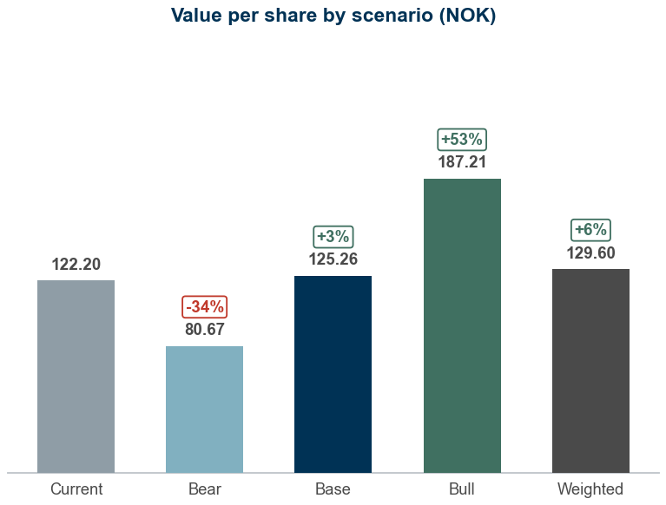
Appendix #4.2
Scenario analysis
Probability-weighted value of NOK 129.60 per share versus a share price of NOK 122.20
Scenario table
1
Value per share by scenario
3
Scenario | Probability | Growth shift | Margin shift | WACC | Terminal g | Revenue CAGR | 2031E margin | Value (NOK) | vs price
Bear | 25% | -2.0% | -1.5% | 9.10% | 1.75% | 2.6% | 13.8% | 80.67 | -34%
Base | 50% | +0.0% | +0.0% | 8.60% | 2.00% | 4.6% | 15.3% | 125.26 | +3%
Bull | 25% | +2.0% | +1.5% | 8.10% | 2.25% | 6.6% | 16.8% | 187.21 | +53%
Probability-weighted | 100% |  |  |  |  |  |  | 129.60 | +6%
What drives each case
2
Bear (25%): Growth 2pp lower, margin 1.5pp lower, WACC +50bp; revenue CAGR 2.6%, 2031E margin 13.8%, WACC 9.1% gives NOK 80.67 (-34% vs price)
Base (50%): Base-case drivers; revenue CAGR 4.6%, 2031E margin 15.3%, WACC 8.6% gives NOK 125.26 (+3% vs price)
Bull (25%): Growth 2pp higher, margin 1.5pp higher, WACC -50bp; revenue CAGR 6.6%, 2031E margin 16.8%, WACC 8.1% gives NOK 187.21 (+53% vs price)
Shifts are additive to the base case: growth applies to every forecast year, the margin shift to the whole EBITDA margin path; capex and working capital follow revenue as in the base case
Sources: Company reports, Yahoo Finance, Equity Research Engine estimates
For illustration only — not investment advice
Equity Research Engine
8

Slide 9
Appendix #4.3
Peer group detail
Last-twelve-month multiples where the quarters are reported; EV on today's market cap, the latest net debt and the same lease basis as the target company
Company | Group | Mkt cap (NOKm) | EV (NOKm) | Rev. growth | EBITDA margin | EV/Sales | EV/EBITDA | EV/EBIT | P/E | P/E (NTM)
Europris | Nordic retail | 13,780 | 15,454 | 16.7% | 9.0% | 1.0x | 11.5x | 13.1x | 16.0x | 13.0x
Clas Ohlson | Nordic retail | 26,048 | 23,936 | 7.6% | 13.7% | 1.9x | 14.0x | 15.5x | 21.6x | 18.4x
Rusta | Nordic retail | 11,288 | 10,725 | 6.5% | 8.0% | 0.9x | 10.9x | 13.7x | 19.7x | 16.2x
Tokmanni | Nordic retail | 4,431 | 7,336 | 3.2% | 4.7% | 0.4x | 8.3x | 28.4x | – | 9.6x
BHG Group | Nordic retail | 3,499 | 4,678 | 6.2% | 4.2% | 0.4x | 10.8x | 15.1x | 41.5x | 10.4x
Byggmax | Nordic retail | 3,021 | 3,200 | 2.5% | 7.9% | 0.5x | 6.9x | 12.0x | 13.5x | 11.0x
Orkla | Nordic consumer | 90,499 | 112,907 | 3.3% | 15.7% | 1.6x | 10.2x | 12.4x | 14.3x | 13.8x
H&M | Nordic consumer | 257,383 | 239,422 | -2.6% | 11.5% | 1.1x | 9.9x | 14.6x | 21.9x | 20.2x
Peer median |  |  |  | 4.8% | 8.5% | 0.9x | 10.5x | 14.1x | 19.7x | 13.4x
Peer average |  |  |  | 5.4% | 9.3% | 1.0x | 10.3x | 15.6x | 21.2x | 14.1x
25th percentile |  |  |  | 3.0% | 7.1% | 0.5x | 9.5x | 12.9x | 15.2x | 10.8x
75th percentile |  |  |  | 6.8% | 12.0% | 1.2x | 11.0x | 15.2x | 21.8x | 16.8x
Kid | Target | 4,967 | 6,048 | 4.2% | 12.5% | 1.5x | 11.9x | 15.8x | 19.1x | 13.0x
Sources: Company reports, Yahoo Finance, Equity Research Engine estimates; income basis: Kid LTM Jun 2026; peers LTM Jun 2026 (5), LTM Jul 2026 (2), LTM May 2026 (1); n.m. = not meaningful (negative or above 60x)
For illustration only — not investment advice
Equity Research Engine
9

Slide 10
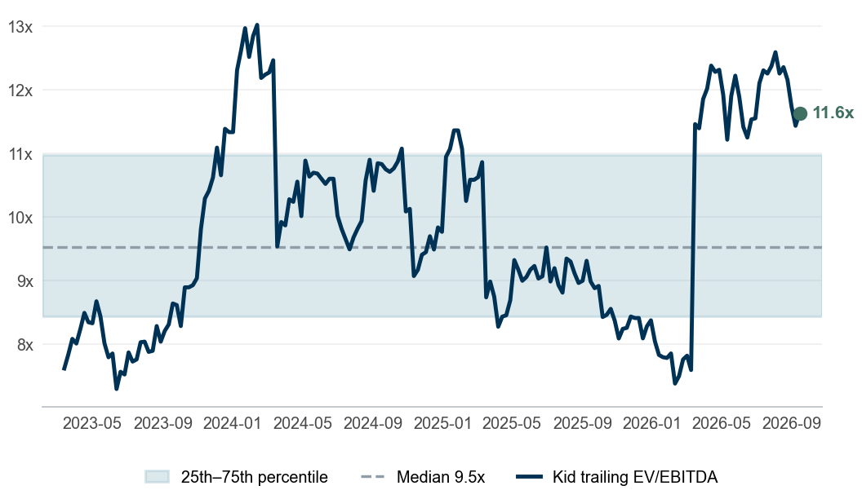
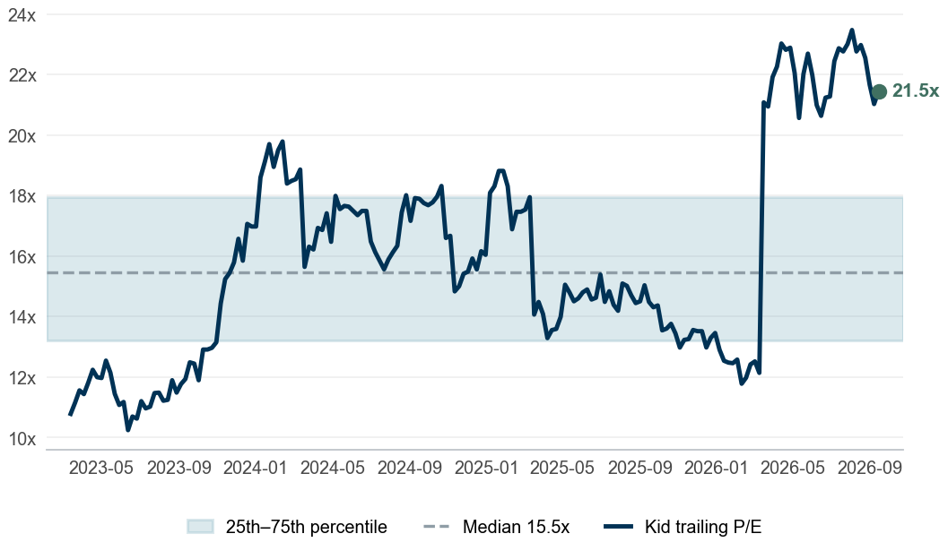
Appendix #4.4
Valuation through time
Kid trades at 11.6x trailing EV/EBITDA against a 3.5-year median of 9.5x
Trailing EV/EBITDA
1
Trailing P/E
2
Reading the bands
3
EV/EBITDA: 11.6x today vs a median of 9.5x and an interquartile band of 8.4x–11.0x; 85% of weeks were cheaper. At its own median the share is worth NOK 87.05 (-29% vs price)
P/E: 21.5x today vs a median of 15.5x and an interquartile band of 13.2x–18.0x; 90% of weeks were cheaper. At its own median the share is worth NOK 87.23 (-29% vs price)
Cross-check – medium agreement between the anchors: the DCF is 18% above the peer-multiple value (NOK 105.82) and our target is 10% below the consensus of 4 analysts (NOK 139.50); review the growth, margin and WACC assumptions before relying on the target
Each weekly close is paired with the latest fiscal year that was public at the time (75-day reporting lag), on the same lease basis as the model; net debt and the share count step once a year
Sources: Company reports, Yahoo Finance, Equity Research Engine estimates
For illustration only — not investment advice
Equity Research Engine
10

Slide 11
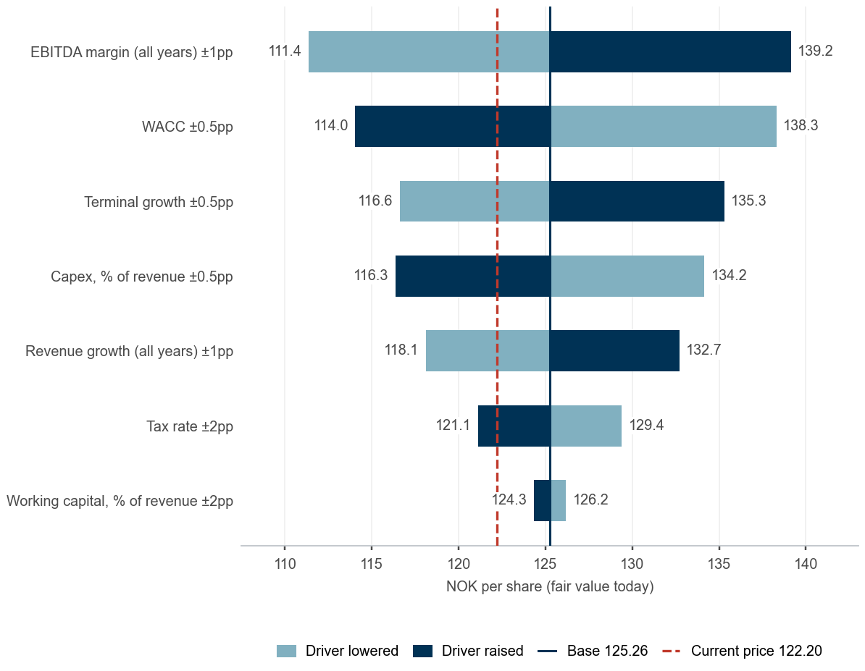
Appendix #4.5
Estimates vs consensus and value drivers
Our 2026E EPS of NOK 6.83 is 16% below consensus; estimate momentum is negative
Our estimates vs consensus
1
What moves the value – one driver at a time
3
Estimate | Ours | Consensus | Difference | Low | High | Analysts
Revenue 2026E (NOKm) | 4,243 | 4,230 | +0.3% | 4,201 | 4,270 | 4
Revenue 2027E (NOKm) | 4,500 | 4,486 | +0.3% | 4,422 | 4,552 | 4
EPS 2026E (NOK) | 6.83 | 8.16 | -16.3% | 7.57 | 8.75 | 4
EPS 2027E (NOK) | 7.70 | 9.89 | -22.2% | 8.70 | 10.85 | 4
Variant view, estimate momentum and catalysts
2
EPS 2026E NOK 6.83 vs consensus NOK 8.16 (-16%): we are below the 4 analysts – outside the range of estimates; 2027E -22%; our view rests on a 13.1% 2026E EBITDA margin and a 22% tax rate
Revenue 2026E NOK 4,243m vs consensus NOK 4,230m (+0.3%): in line by construction – our growth is anchored on consensus, so the differentiated view sits in margins
Estimate momentum negative: consensus EPS over the last 90 days 2026E -6.1%, 2027E -6.0%; 2 upward and 6 downward revisions in the last 30 days
05.11.2026 – Quarterly results: consensus revenue 984, EPS 1.76
Sources: Company reports, Yahoo Finance, Equity Research Engine estimates; consensus: Yahoo Finance (mean of analyst estimates), revisions over 90 days; value drivers move one input at a time with everything else at the base case
For illustration only — not investment advice
Equity Research Engine
11

Slide 12
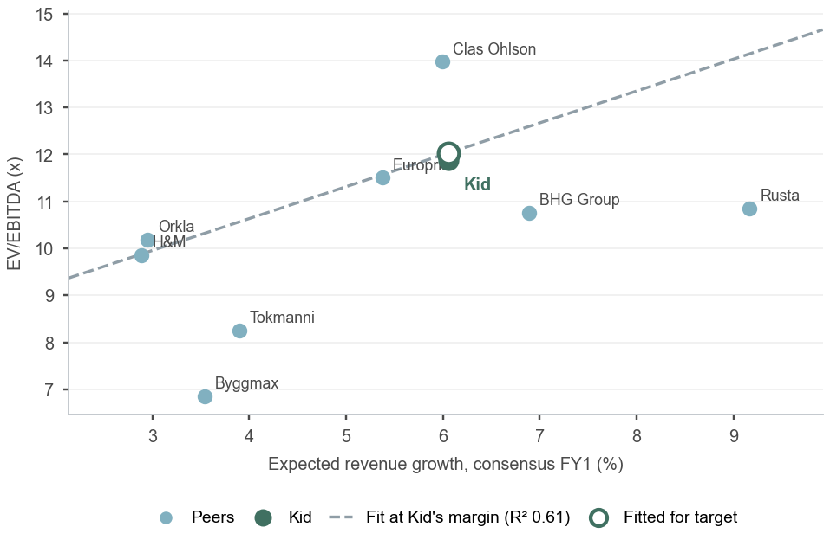
Appendix #4.6
Multiples in depth
Growth and margin explain 61% of the dispersion in peer EV/EBITDA; fundamentals justify 12.0x for Kid against 11.9x today
EV/EBITDA against expected revenue growth
1
Forward multiples and quality – consensus, calendarised to the next twelve months
2
Company | EV/Sales NTM | EV/EBITDA NTM* | P/E FY0 | P/E FY1 | P/E NTM | EPS growth | PEG | FCF yield | Div. yield
Europris | 1.0x | 10.8x | 15.4x | 12.3x | 13.0x | +25% | 0.51 | 3.2% | 4.5%
Clas Ohlson | 1.7x | 12.5x | 19.0x | 17.7x | 18.4x | +7% | 2.53 | 5.2% | 2.2%
Rusta | 0.8x | 9.6x | 17.3x | 14.9x | 16.2x | +16% | 1.00 | 3.2% | 2.3%
Tokmanni | 0.4x | 7.8x | 11.8x | 8.9x | 9.6x | +32% | 0.30 | 2.0% | 4.8%
BHG Group | 0.4x | 9.9x | 12.9x | 9.7x | 10.4x | +33% | 0.31 | 6.9% | –
Byggmax | 0.5x | 6.6x | 11.7x | 10.8x | 11.0x | +9% | 1.25 | 9.6% | 3.1%
Orkla | 1.6x | 10.0x | 14.2x | 13.7x | 13.8x | +4% | 3.60 | 6.6% | 4.3%
H&M | 1.1x | 9.6x | 21.0x | 20.0x | 20.2x | +5% | 3.88 | 3.0% | 4.2%
Peer median | 0.9x | 9.8x | 14.8x | 13.0x | 13.4x | +13% | 1.12 | 4.2% | 4.2%
Kid | 1.4x | 11.0x | 15.0x | 12.4x | 13.0x | +21% | 0.61 | -1.7% | 8.2%
Reading the multiples
3
* NTM revenue at the LTM EBITDA margin: Yahoo Finance carries no EBITDA consensus. FY0 = fiscal year in progress; NTM = 27% of FY to 2026-12 + the rest of the following year. EV in each company's reporting currency (market cap converted from the listing currency) with the latest net debt; FCF yield is levered, after lease payments; n.m. = negative or above the cap.
On next-twelve-month consensus Kid trades at 13.0x P/E (peers 13.4x), 1.4x EV/Sales (peers 0.9x), 11.0x EV/EBITDA at the LTM margin (peers 9.8x); PEG 0.61 vs 1.12
Growth and margin explain 61% of the dispersion in peer EV/EBITDA (8 peers): fundamentals justify 12.0x against the 10.5x median (+15%); the actual 11.9x leaves -1% unexplained. Evidence strong
Regression-implied value NOK 124.12 per share (NOK 104–144 within one residual standard deviation)
Cash and payout: -1.7% levered FCF yield vs 4.2% for peers; 8.2% dividend yield vs 4.2%
Consensus EPS growth FY1: +21% for Kid vs +13% for the peer median – the growth the forward multiple is buying
Sources: Company reports, Yahoo Finance, Equity Research Engine estimates; consensus: Yahoo Finance mean estimates; regression: OLS with an intercept over the peers shown
For illustration only — not investment advice
Equity Research Engine
12

