Slide 1
Equity Research Engine
Oscar Schjelderup
Mowi – BUY: +59% to our NOK 308.50 target
Initiation of coverage – BUY, target price NOK 308.50
23.09.2026
Private and Confidential

Slide 2
Analyst
Presenting a model-driven investment case on Mowi ASA.
OS
University: Copenhagen Business School
Year of study: 2nd year
Experience: HA Invest member
Oscar Schjelderup
Sources: Company reports, Yahoo Finance, Equity Research Engine estimates
For illustration only — not investment advice
Equity Research Engine
2

Slide 3
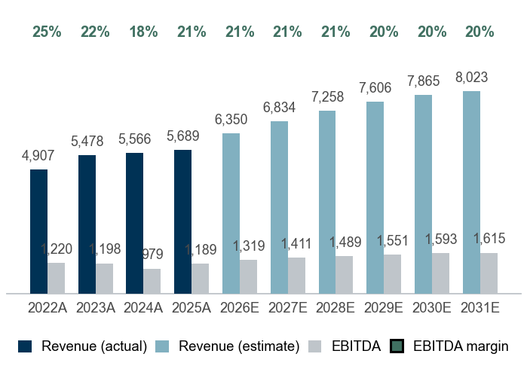
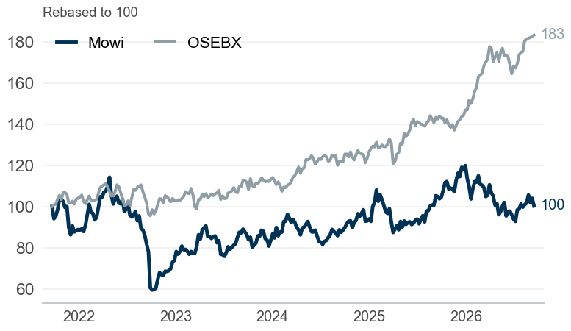
#1 The equity story of Mowi
Company overview
Mowi ASA – Farm Products in Norway
5.0% revenue CAGR, 20.9% EBITDA margin and 2.2x net debt/EBITDA — market cap EUR 9.4bn
Company snapshot
1
Investment highlights
2
Management team
3
Sector: Farm Products
Footprint: Norway
Business model: Farm Products
Scale: Employees: 12,174 | Revenue 2025A: EUR 5,689m
Market cap: EUR 9,426m | EV EUR 12,445m | reports in EUR, trades in NOK
Share price: NOK 193.70 | 52w range 179.4–245.8
Consistent growth: revenue compounded at 5.0% p.a. over 2022–2025, reaching EUR 5,689m
Margin profile: pre-IFRS 16 EBITDA margin of 20.9% in 2025A (down from 24.9% in 2022A), EBIT margin 16.5%
Cash generative: unlevered FCF of EUR 634m in 2025A, 53% of EBITDA, ROIC 11%
Balance sheet: net debt of EUR 2,826m equals 2.2x EBITDA, a moderate leverage level
IV
Ivan Vindheim
CEO
KE
Kristian Ellingsen
CFO
DC
Catarina Martins
Chief Sustainability Officer & CTO
OB
Ola Brattvoll
COO of Sales & Marketing
Revenue and EBITDA (EURm)
4
Share price vs OSEBX (5 years)
5
Key ratios
6
 | 2023A | 2024A | 2025A | 2026E | 2027E
Revenue growth | 11.6% | 1.6% | 2.2% | 11.6% | 7.6%
EBITDA margin | 21.9% | 17.6% | 20.9% | 20.8% | 20.6%
EBIT margin | 18.1% | 13.5% | 16.5% | 16.7% | 16.6%
FCF margin | 2.2% | 6.7% | 11.1% | 5.1% | 7.2%
ROIC | 8.5% | 9.4% | 10.9% | – | –
Net debt / EBITDA | 1.5x | 1.9x | 2.2x | – | –
Payout ratio | 73% | 63% | 41% | – | –
Sources: Company reports, Yahoo Finance, Equity Research Engine estimates
For illustration only — not investment advice
Equity Research Engine
3

Slide 4
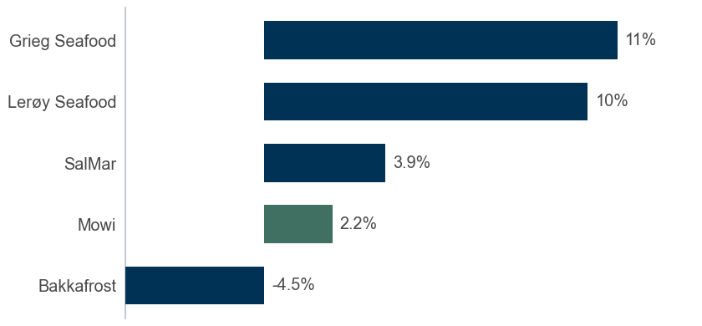
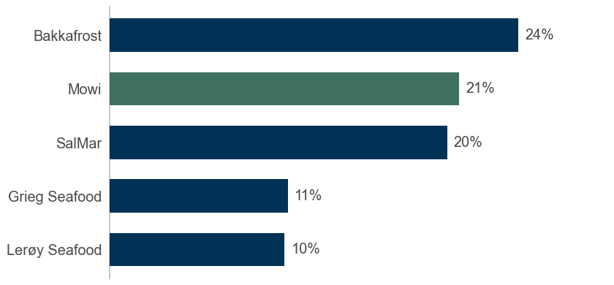
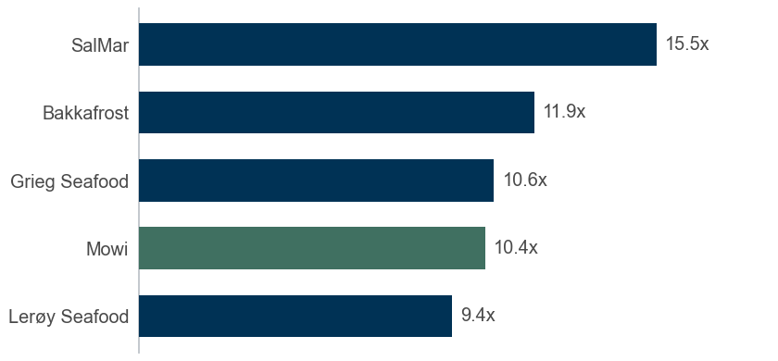
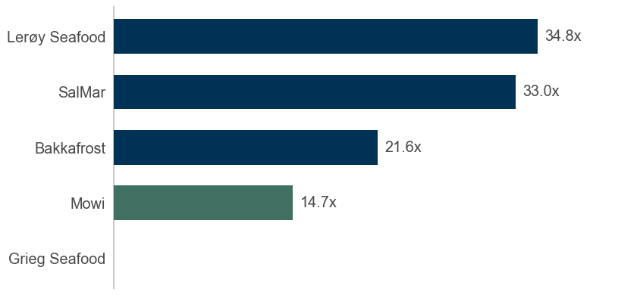
#2 Market overview and peer landscape
Market overview
Mowi versus its peer group: growth, profitability and the drivers behind the case
Revenue growth vs peers (last fiscal year)
1
EBITDA margin vs peers (lease-adjusted)
2
Opportunities
Growth runway: consensus expects 11.6% revenue growth in 2026E
Operating leverage: every 1pp of EBITDA margin is worth roughly EUR 80m of EBITDA in 2031E
Disruption
Business model shifts in the sector may change the competitive set
EV/EBITDA vs peers
3
P/E vs peers (trailing)
4
Threats
Macro: consumer spending, interest rates and FX can move revenue and the discount rate simultaneously
Sources: Company reports, Yahoo Finance, Equity Research Engine estimates
For illustration only — not investment advice
Equity Research Engine
4

Slide 5
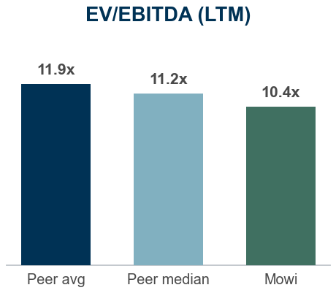
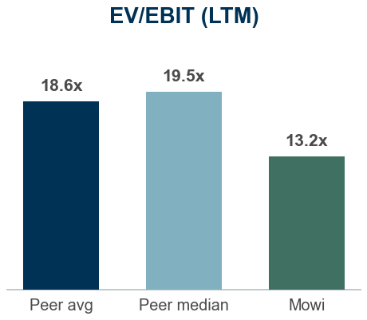
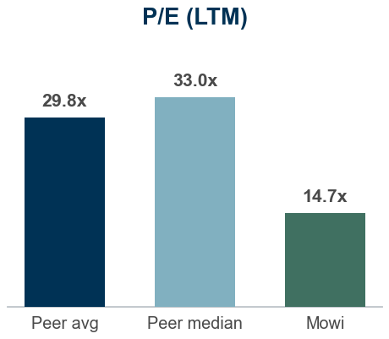
#3 Historical analysis and forecasts
Financials and estimates
Mowi financials, pre-IFRS 16 basis (EURm)
 | HISTORICAL |  |  |  | FORECAST
EURm | 2022A | 2023A | 2024A | 2025A | 2026E | 2027E | 2028E | 2029E | 2030E | 2031E | TV
Revenue | 4,907 | 5,478 | 5,566 | 5,689 | 6,350 | 6,834 | 7,258 | 7,606 | 7,865 | 8,023 | 8,183
Growth | – | 11.6% | 1.6% | 2.2% | 11.6% | 7.6% | 6.2% | 4.8% | 3.4% | 2.0% | 2.0%
EBITDA | 1,220 | 1,198 | 979 | 1,189 | 1,319 | 1,411 | 1,489 | 1,551 | 1,593 | 1,615 | 1,647
Margin | 24.9% | 21.9% | 17.6% | 20.9% | 20.8% | 20.6% | 20.5% | 20.4% | 20.3% | 20.1% | 20.1%
EBIT | 1,033 | 991 | 753 | 939 | 1,060 | 1,132 | 1,192 | 1,240 | 1,272 | 1,287 | 1,312
Margin | 21.0% | 18.1% | 13.5% | 16.5% | 16.7% | 16.6% | 16.4% | 16.3% | 16.2% | 16.0% | 16.0%
NOPAT | 810 | 485 | 566 | 797 | 827 | 883 | 930 | 967 | 992 | 1,004 | 1,024
Margin | 16.5% | 8.8% | 10.2% | 14.0% | 13.0% | 12.9% | 12.8% | 12.7% | 12.6% | 12.5% | 12.5%
Unlevered FCF | 171 | 122 | 374 | 634 | 323 | 489 | 594 | 701 | 807 | 909 | 928
FCF margin | 3.5% | 2.2% | 6.7% | 11.1% | 5.1% | 7.2% | 8.2% | 9.2% | 10.3% | 11.3% | 11.3%
Financial commentary
Mowi grew revenue by 2.2% in 2025A to EUR 5,689m, with pre-IFRS 16 EBITDA of EUR 1,189m (20.9% margin)
We forecast 2026E revenue of EUR 6,350m (+11.6%), anchored on consensus (9 analysts), fading to 2.0% terminal growth by 2031E
EBITDA margin path: 20.8% in 2026E to 20.1% in 2031E; D&A 4.1% and capex 6.9% normalising to 4.3% of revenue; tax rate 22%
Unlevered FCF rises from EUR 323m to EUR 909m over the forecast period (11.3% FCF margin in 2031E)
Valuation vs peers: Mowi trades at 10.4x LTM EV/EBITDA versus a peer median of 11.2x (-8%) and 14.7x P/E versus 33.0x
Street view: consensus target of NOK 224.40 across 11 analysts (+16% vs current price)
Multiples (at current price) | 2025A | 2026E | 2027E | 2028E
EV/Sales | 2.2x | 2.0x | 1.8x | 1.7x
EV/EBITDA | 10.5x | 9.4x | 8.8x | 8.4x
EV/EBIT | 13.3x | 11.7x | 11.0x | 10.4x
P/E | 13.0x | 12.7x | 11.8x | 11.1x
FCF yield | 6.7% | 3.4% | 5.2% | 6.3%
Consensus (11 analysts)
Target: NOK 224.40 (range 194–248)
Ratings: 8 buy / 4 hold / 0 sell
Engine: BUY, TP NOK 308.50 (+59%)
Sources: Company reports, Yahoo Finance, Equity Research Engine estimates; peer multiples on last reported fiscal year
For illustration only — not investment advice
Equity Research Engine
5

Slide 6
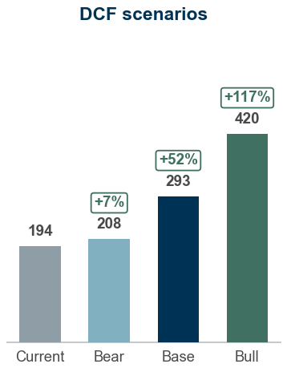
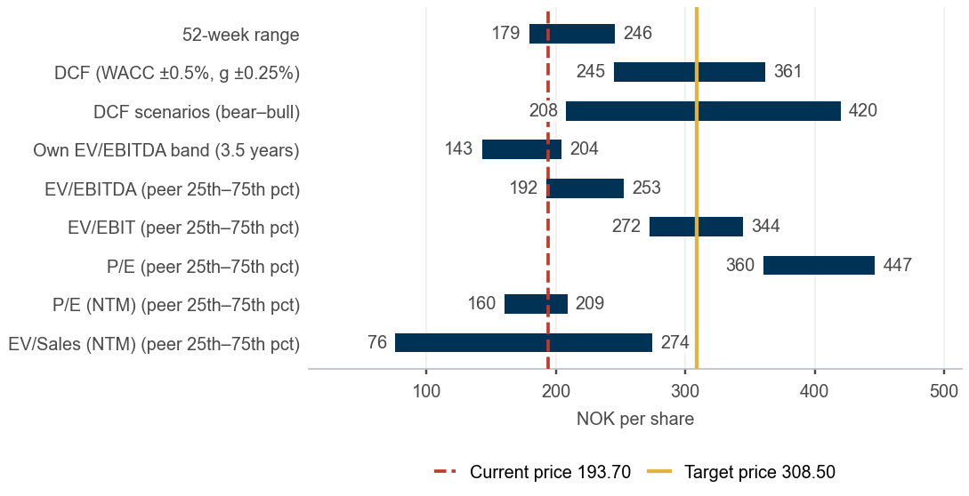
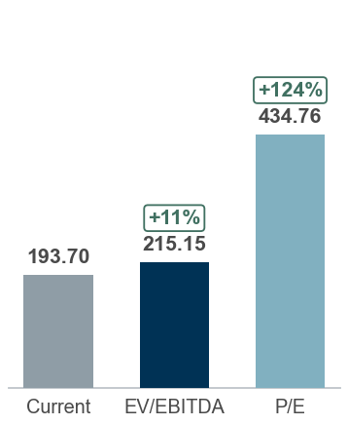
#4 Valuation and concluding thoughts
Valuation and recommendation
We recommend a BUY. Our 12-month target price of NOK 308.50 implies +59% upside and a +63% total return including dividend; 9.4x 2026E EV/EBITDA.
DCF fair value NOK 293.47, peer multiples NOK 203.35, scenario-weighted NOK 303.68 versus a share price of NOK 193.70 — BUY
BUY – 12m TP NOK 308.50 · low agreement
DCF valuation – Sensitivity analysis (value per share)
DCF value of NOK 293.47 per share (WACC 6.6%, terminal growth 2.0%); terminal value is 83% of EV, implying 12.5x exit EV/EBITDA
Peer multiples imply NOK 203.35 per share (median of EV/EBITDA, EV/EBIT and P/E-based values)
Scenarios: bear NOK 208 / base NOK 293 / bull NOK 420; probability-weighted NOK 303.68
12-month target price NOK 308.50: fair value NOK 293.47 (valued at 23.09.2026) rolled forward at the 7.7% cost of equity less NOK 7.60 dividend; expected total return +63%, rating BUY
Terminal growth \ WACC | 5.11% | 5.61% | 6.11% | 6.61% | 7.11% | 7.61% | 8.11%
1.25% | 378.1 | 325.7 | 284.2 | 250.4 | 222.4 | 198.8 | 178.7
1.50% | 405.1 | 346.4 | 300.3 | 263.3 | 233.0 | 207.6 | 186.1
1.75% | 436.2 | 369.6 | 318.3 | 277.6 | 244.5 | 217.1 | 194.0
2.00% | 472.3 | 396.1 | 338.5 | 293.5 | 257.2 | 227.5 | 202.7
2.25% | 514.6 | 426.6 | 361.4 | 311.1 | 271.3 | 238.8 | 212.0
2.50% | 565.1 | 461.9 | 387.3 | 330.9 | 286.8 | 251.3 | 222.2
2.75% | 626.2 | 503.4 | 417.2 | 353.3 | 304.1 | 265.0 | 233.3
Valuation summary – Football field
Multiple valuation and what the price implies
Trading at a discount: 10.4x EV/EBITDA vs 11.2x peer median (8% discount)
Earnings multiple: 14.7x trailing P/E vs 33.0x for peers (-55%); 13.6x vs 12.7x on next-twelve-month consensus
Versus own history: 10.4x trailing EV/EBITDA is above the 3.5-year median of 9.1x (64% of weeks were cheaper)
EV/EBITDA-implied value: NOK 215.15 at the peer median of 11.2x (range 192–253 across the 25th–75th percentile)
Market-implied WACC 8.3%, above our 6.6%: the price discounts our cash flows at 170bp more than we do
Market-implied margin: at our WACC the price is consistent with a 2031E EBITDA margin of 16.2% versus 20.1% in our base case
Cross-check – low agreement: the DCF is 44% above the peer-multiple value (NOK 203.35) and our target is 37% above the consensus of 11 analysts (NOK 224.40); the recommendation rests on the DCF assumptions alone — treat the target as a hypothesis, not a result
Sources: Company reports, Yahoo Finance, Equity Research Engine estimates; WACC 6.6% (3y weekly regression vs OSEBX (n=156, R2=0.15), Blume-adjusted); terminal growth 2.0%
For illustration only — not investment advice
Equity Research Engine
6

Slide 7
Appendix #4.1
Cost of capital and DCF build-up
WACC 6.61% and terminal growth 2.00% give a fair value of NOK 293.47 per share
WACC build-up
1
DCF build-up (EURm)
2
What the share price implies
3
Component | Value
Risk-free rate | 3.80%
Beta (raw) | 0.66
Beta (adjusted, used) | 0.77
Equity risk premium | 5.00%
Size premium | 0.00%
Cost of equity | 7.66%
Cost of debt (pre-tax) | 4.18%
Tax rate | 22.0%
Cost of debt (after tax) | 3.26%
Weight of equity | 76.2%
Weight of debt | 23.8%
WACC | 6.61%
 | 2026E | 2027E | 2028E | 2029E | 2030E | 2031E
Unlevered FCF | 323 | 489 | 594 | 701 | 807 | 909
Share still to come | 50% | 100% | 100% | 100% | 100% | 100%
Years to discount | 0.27 | 1.27 | 2.27 | 3.27 | 4.27 | 5.27
Discount factor | 0.983 | 0.922 | 0.865 | 0.811 | 0.761 | 0.713
PV of FCF | 160 | 451 | 513 | 568 | 614 | 649
Implied WACC: 8.32% vs our 6.61%
Implied terminal growth: -0.21% vs our 2.00%
Implied 2031E EBITDA margin: 16.2% vs our 20.1%
Each figure solves for the one input that makes the DCF equal today's price, holding the others at the base case
Bridge to value per share | EURm
Sum of PV of FCF | 2,956
Terminal value (Gordon growth) | 20,105
PV of terminal value | 14,344
Enterprise value | 17,300
Less: net debt (30.06.2026) | (2,826)
Less: minority interest | (192)
Equity value | 14,282
Shares outstanding (m) | 527.3
FX (EUR per NOK) | 0.0923
Fair value per share (NOK, 23.09.2026) | 293.47
x (1 + cost of equity 7.66%) | 315.95
Less: expected dividend per share | (7.60)
12-month target price (NOK, rounded) | 308.50
Key checks
4
Terminal value is 83% of enterprise value
Implied exit multiple: 12.5x EV/EBITDA vs 10.4x today
WACC − g spread: 4.61%
Net debt / EBITDA: 2.2x
Beta: 3y weekly regression vs OSEBX (n=156, R2=0.15), Blume-adjusted.
Cross-check: bottom-up beta 0.72 (3 peers, unlevered median 0.47).
Size premium 0.00% (market cap USD 10.8bn).
Cost of debt: interest expense / average debt.
Sources: Company reports, Yahoo Finance, Equity Research Engine estimates
For illustration only — not investment advice
Equity Research Engine
7

Slide 8
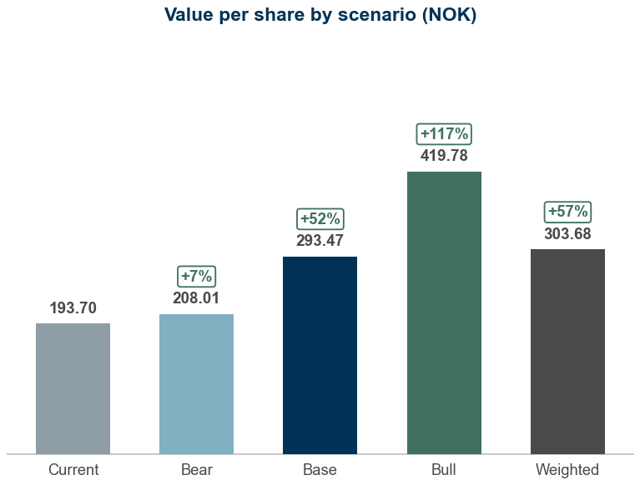
Appendix #4.2
Scenario analysis
Probability-weighted value of NOK 303.68 per share versus a share price of NOK 193.70
Scenario table
1
Value per share by scenario
3
Scenario | Probability | Growth shift | Margin shift | WACC | Terminal g | Revenue CAGR | 2031E margin | Value (NOK) | vs price
Bear | 25% | -2.0% | -1.5% | 7.11% | 1.75% | 3.9% | 18.6% | 208.01 | +7%
Base | 50% | +0.0% | +0.0% | 6.61% | 2.00% | 5.9% | 20.1% | 293.47 | +52%
Bull | 25% | +2.0% | +1.5% | 6.11% | 2.25% | 7.9% | 21.6% | 419.78 | +117%
Probability-weighted | 100% |  |  |  |  |  |  | 303.68 | +57%
What drives each case
2
Bear (25%): Growth 2pp lower, margin 1.5pp lower, WACC +50bp; revenue CAGR 3.9%, 2031E margin 18.6%, WACC 7.1% gives NOK 208.01 (+7% vs price)
Base (50%): Base-case drivers; revenue CAGR 5.9%, 2031E margin 20.1%, WACC 6.6% gives NOK 293.47 (+52% vs price)
Bull (25%): Growth 2pp higher, margin 1.5pp higher, WACC -50bp; revenue CAGR 7.9%, 2031E margin 21.6%, WACC 6.1% gives NOK 419.78 (+117% vs price)
Shifts are additive to the base case: growth applies to every forecast year, the margin shift to the whole EBITDA margin path; capex and working capital follow revenue as in the base case
Sources: Company reports, Yahoo Finance, Equity Research Engine estimates
For illustration only — not investment advice
Equity Research Engine
8

Slide 9
Appendix #4.3
Peer group detail
Last-twelve-month multiples where the quarters are reported; EV on today's market cap, the latest net debt and the same lease basis as the target company
Company | Group | Mkt cap (EURm) | EV (EURm) | Rev. growth | EBITDA margin | EV/Sales | EV/EBITDA | EV/EBIT | P/E | P/E (NTM)
SalMar | Salmon farming | 6,742 | 8,706 | 3.9% | 20.2% | 3.1x | 15.5x | 20.7x | 33.0x | 16.2x
Lerøy Seafood | Salmon farming | 2,274 | 3,045 | 10.4% | 10.5% | 1.0x | 9.4x | 21.5x | 34.8x | 11.4x
Bakkafrost | Salmon farming | 2,355 | 2,895 | -4.5% | 24.5% | 2.9x | 11.9x | 18.3x | 21.6x | 14.1x
Grieg Seafood | Salmon farming | 262 | 387 | 11.4% | 10.7% | 1.1x | 10.6x | 13.8x | – | 10.9x
Peer median |  |  |  | 7.1% | 15.4% | 2.0x | 11.2x | 19.5x | 33.0x | 12.7x
Peer average |  |  |  | 5.3% | 16.5% | 2.0x | 11.9x | 18.6x | 29.8x | 13.2x
25th percentile |  |  |  | 1.8% | 10.6% | 1.1x | 10.3x | 17.2x | 27.3x | 11.3x
75th percentile |  |  |  | 10.6% | 21.3% | 3.0x | 12.8x | 20.9x | 33.9x | 14.7x
Mowi | Target | 9,426 | 12,445 | 2.2% | 19.6% | 2.0x | 10.4x | 13.2x | 14.7x | 13.6x
Sources: Company reports, Yahoo Finance, Equity Research Engine estimates; income basis: Mowi LTM Jun 2026; peers LTM Jun 2026 (3), FY2025 (1); n.m. = not meaningful (negative or above 60x)
For illustration only — not investment advice
Equity Research Engine
9

Slide 10
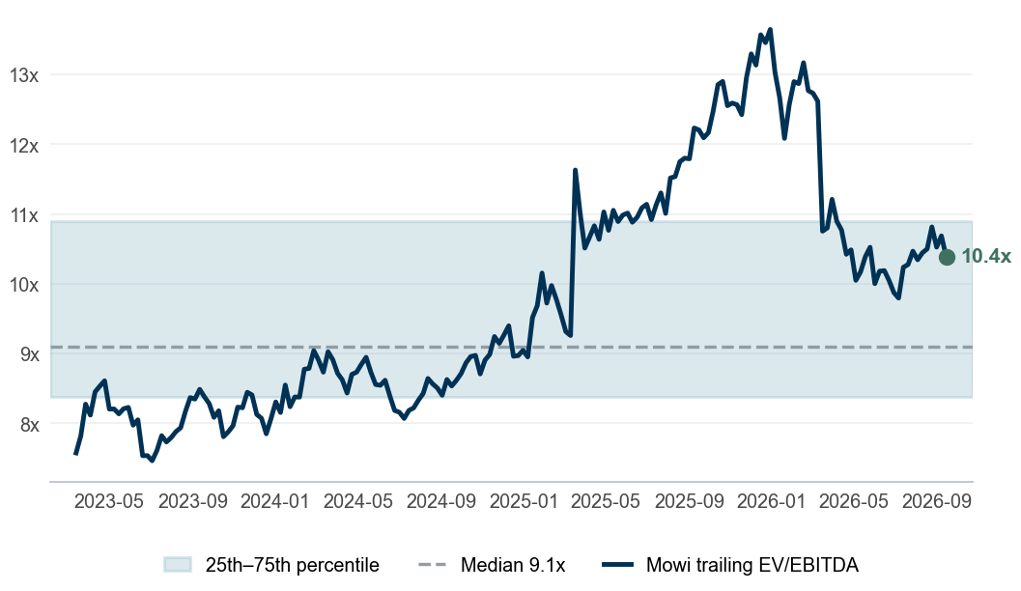
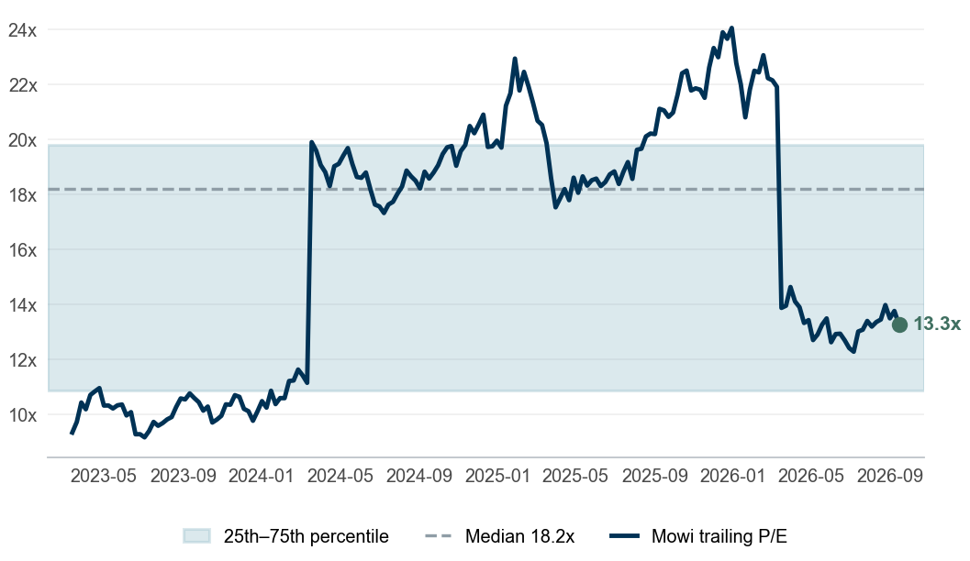
Appendix #4.4
Valuation through time
Mowi trades at 10.4x trailing EV/EBITDA against a 3.5-year median of 9.1x
Trailing EV/EBITDA
1
Trailing P/E
2
Reading the bands
3
EV/EBITDA: 10.4x today vs a median of 9.1x and an interquartile band of 8.4x–10.9x; 64% of weeks were cheaper. At its own median the share is worth NOK 160.31 (-17% vs price)
P/E: 13.3x today vs a median of 18.2x and an interquartile band of 10.9x–19.8x; 36% of weeks were cheaper. At its own median the share is worth NOK 272.26 (+41% vs price)
Cross-check – low agreement between the anchors: the DCF is 44% above the peer-multiple value (NOK 203.35) and our target is 37% above the consensus of 11 analysts (NOK 224.40); the recommendation rests on the DCF assumptions alone — treat the target as a hypothesis, not a result
Each weekly close is paired with the latest fiscal year that was public at the time (75-day reporting lag), on the same lease basis as the model; net debt and the share count step once a year
Sources: Company reports, Yahoo Finance, Equity Research Engine estimates
For illustration only — not investment advice
Equity Research Engine
10

Slide 11
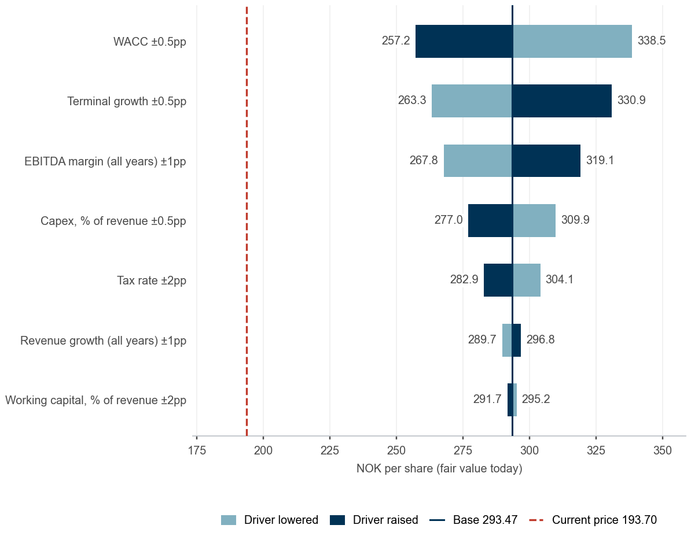
Appendix #4.5
Estimates vs consensus and value drivers
Our 2026E EPS of NOK 15.28 is 22% above consensus; estimate momentum is negative
Our estimates vs consensus
1
What moves the value – one driver at a time
3
Estimate | Ours | Consensus | Difference | Low | High | Analysts
Revenue 2026E (EURm) | 6,350 | 6,385 | -0.6% | 5,944 | 6,740 | 9
Revenue 2027E (EURm) | 6,834 | 6,871 | -0.6% | 6,461 | 7,375 | 9
EPS 2026E (NOK) | 15.28 | 12.50 | +22.3% | 11.25 | 13.87 | 9
EPS 2027E (NOK) | 16.43 | 14.90 | +10.3% | 12.79 | 17.28 | 9
Variant view, estimate momentum and catalysts
2
EPS 2026E NOK 15.28 vs consensus NOK 12.50 (+22%): we are above the 9 analysts – outside the range of estimates; 2027E +10%; our view rests on a 20.8% 2026E EBITDA margin and a 22% tax rate
Revenue 2026E EUR 6,350m vs consensus EUR 6,385m (-0.6%): in line by construction – our growth is anchored on consensus, so the differentiated view sits in margins
Estimate momentum negative: consensus EPS over the last 90 days 2026E -7.3%, 2027E -16.4%; 2 upward and 6 downward revisions in the last 30 days
Tension: our BUY runs against falling consensus estimates – shares rarely re-rate before revisions turn, so the timing of the case depends on the next reports
04.11.2026 – Quarterly results: consensus revenue 1,600, EPS 2.39
Sources: Company reports, Yahoo Finance, Equity Research Engine estimates; consensus: Yahoo Finance (mean of analyst estimates), revisions over 90 days; value drivers move one input at a time with everything else at the base case
For illustration only — not investment advice
Equity Research Engine
11

Slide 12
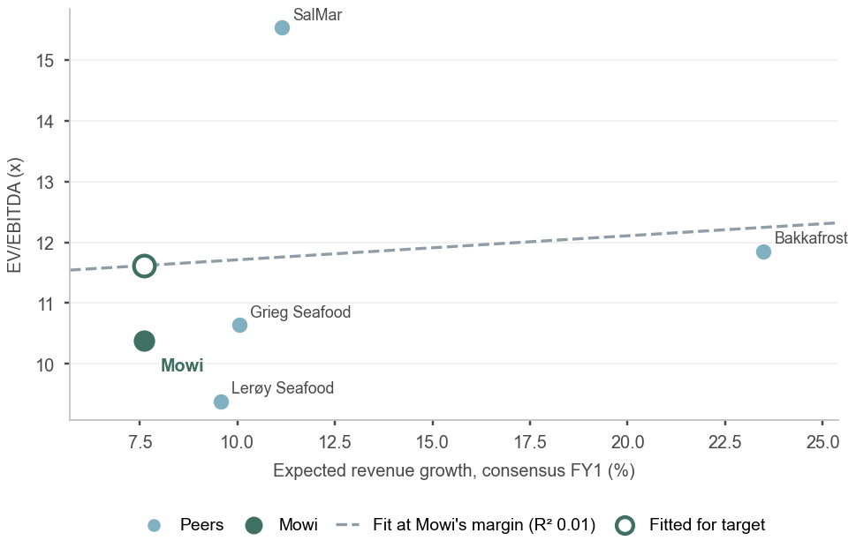
Appendix #4.6
Multiples in depth
Growth and margin explain 1% of the dispersion in peer EV/EBITDA; fundamentals justify 11.6x for Mowi against 10.4x today
EV/EBITDA against expected revenue growth
1
Forward multiples and quality – consensus, calendarised to the next twelve months
2
Company | EV/Sales NTM | EV/EBITDA NTM* | P/E FY0 | P/E FY1 | P/E NTM | EPS growth | PEG | FCF yield | Div. yield
SalMar | 2.7x | 13.4x | 20.4x | 15.1x | 16.2x | +35% | 0.46 | 1.0% | 1.9%
Lerøy Seafood | 0.9x | 8.7x | 13.6x | 10.7x | 11.4x | +27% | 0.42 | 10.2% | 6.0%
Bakkafrost | 2.3x | 9.5x | 18.5x | 13.0x | 14.1x | +42% | 0.33 | -1.3% | 1.2%
Grieg Seafood | 1.0x | 9.6x | 24.4x | 9.1x | 10.9x | +170% | 0.06 | -21.9% | –
Peer median | 1.7x | 9.6x | 19.5x | 11.8x | 12.7x | +39% | 0.38 | -0.2% | 1.9%
Mowi | 1.8x | 9.4x | 15.5x | 13.0x | 13.6x | +19% | 0.71 | 3.1% | 3.9%
* NTM revenue at the LTM EBITDA margin: Yahoo Finance carries no EBITDA consensus. FY0 = fiscal year in progress; NTM = 27% of FY to 2026-12 + the rest of the following year. EV in each company's reporting currency (market cap converted from the listing currency) with the latest net debt; FCF yield is levered, after lease payments; n.m. = negative or above the cap.
Reading the multiples
3
On next-twelve-month consensus Mowi trades at 13.6x P/E (peers 12.7x), 1.8x EV/Sales (peers 1.7x), 9.4x EV/EBITDA at the LTM margin (peers 9.6x); PEG 0.71 vs 0.38
Growth and margin explain 1% of the dispersion in peer EV/EBITDA (4 peers): fundamentals justify 11.6x against the 11.2x median (+3%); the actual 10.4x leaves -11% unexplained. Evidence weak: multiples in this group are set by something the regression does not see – leverage, geography, liquidity or the cycle
Cash and payout: 3.1% levered FCF yield vs -0.2% for peers; 3.9% dividend yield vs 1.9%
Consensus EPS growth FY1: +19% for Mowi vs +39% for the peer median – the growth the forward multiple is buying
Sources: Company reports, Yahoo Finance, Equity Research Engine estimates; consensus: Yahoo Finance mean estimates; regression: OLS with an intercept over the peers shown
For illustration only — not investment advice
Equity Research Engine
12

