Slide 1
Equity Research Engine
Oscar Schjelderup
Bouvet – Compounding consultants
Initiation of coverage – BUY, target price NOK 78.50
21.09.2026
Private and Confidential

Slide 2
Analyst
Presenting a model-driven investment case on Bouvet ASA.
OS
University: Copenhagen Business School
Year of study: 2nd year
Experience: HA Invest member
Oscar Schjelderup
Sources: Company reports, Yahoo Finance, Equity Research Engine estimates
For illustration only — not investment advice
Equity Research Engine
2

Slide 3
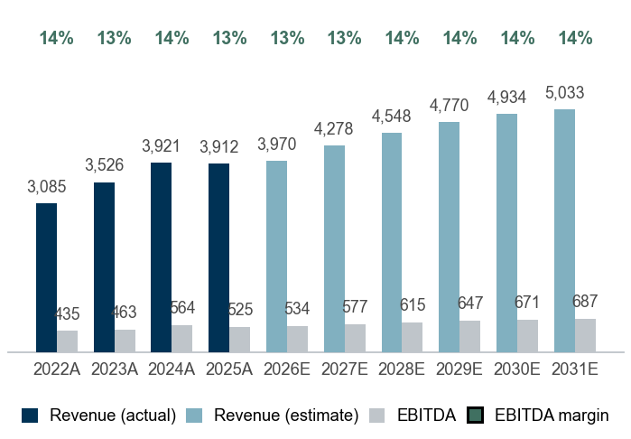
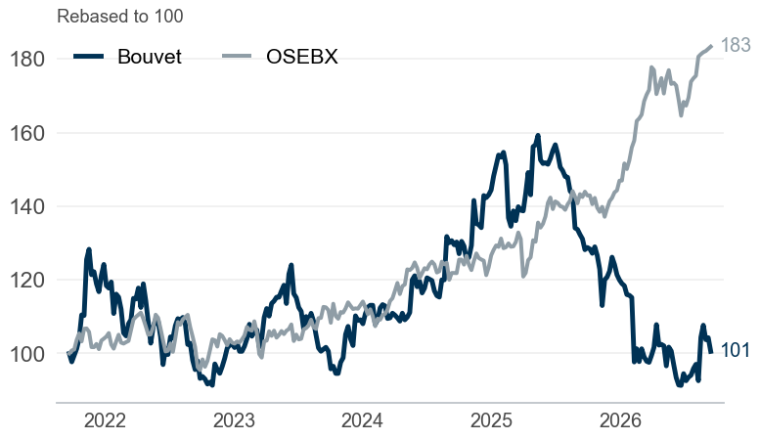
#1 The equity story of Bouvet
Company overview
Bouvet ASA – IT consulting & digital services in Norway and Sweden
8.2% revenue CAGR, 13.4% EBITDA margin and a net cash balance sheet — market cap NOK 4.8bn
Company snapshot
1
Investment highlights
2
Management team
3
Sector: IT consulting & digital services
Footprint: Norway and Sweden
Business model: Time-and-material consulting, mainly public sector and energy clients
Scale: Employees: 2,403 | Revenue 2025A: NOK 3,912m
Market cap: NOK 4,847m | EV NOK 4,267m
Share price: NOK 47.35 | 52w range 42.1–67.8
Consistent growth: revenue compounded at 8.2% p.a. over 2022–2025, reaching NOK 3,912m
Margin profile: pre-IFRS 16 EBITDA margin of 13.4% in 2025A (down from 14.1% in 2022A), EBIT margin 12.4%
Cash generative: unlevered FCF of NOK 276m in 2025A, 53% of EBITDA, ROIC 87%
Balance sheet: net cash of NOK 580m, no financial leverage
PG
Per Gunnar Tronsli
President & CEO
SG
Steffen Garder
CFO
LS
Lisbeth Sneve Viker
Chief accounting officer
SS
Simen Sommerfeldt
CTO
Revenue and EBITDA (NOKm)
4
Share price vs OSEBX (5 years)
5
Key ratios
6
 | 2023A | 2024A | 2025A | 2026E | 2027E
Revenue growth | 14.3% | 11.2% | -0.2% | 1.5% | 7.8%
EBITDA margin | 13.1% | 14.4% | 13.4% | 13.5% | 13.5%
EBIT margin | 11.9% | 12.8% | 12.4% | 12.2% | 12.2%
FCF margin | 11.0% | 19.0% | 7.1% | 9.9% | 10.3%
ROIC | 72.1% | 84.1% | 86.5% | – | –
Net debt / EBITDA | net cash | net cash | net cash | – | –
Payout ratio | 97% | 97% | 106% | – | –
Sources: Company reports, Yahoo Finance, Equity Research Engine estimates
For illustration only — not investment advice
Equity Research Engine
3

Slide 4
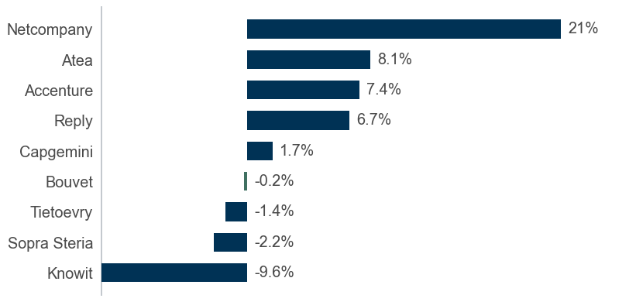
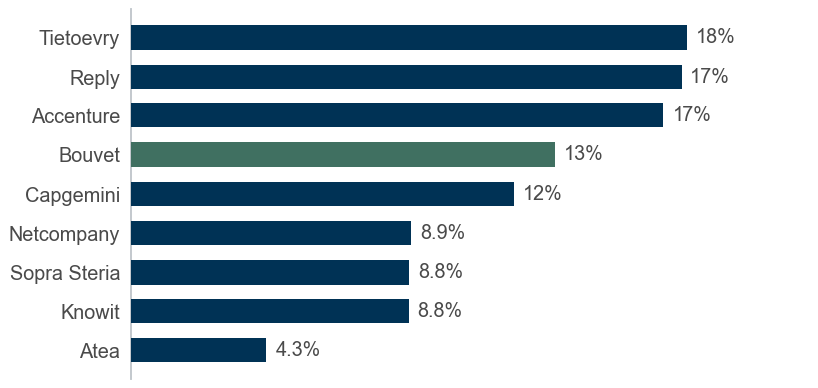
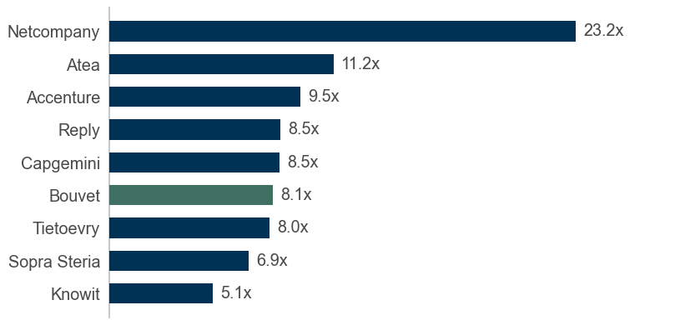
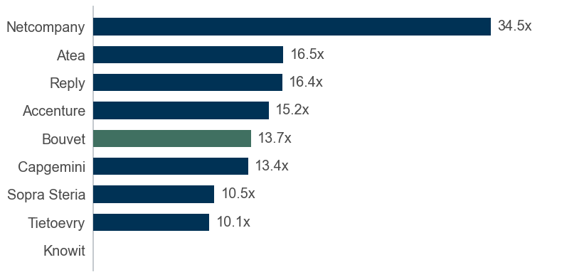
#2 Market overview and peer landscape
Market overview
Bouvet versus its peer group: growth, profitability and the drivers behind the case
Revenue growth vs peers (last fiscal year)
1
EBITDA margin vs peers (lease-adjusted)
2
Opportunities
Public-sector digitalisation in Norway keeps demand for senior consultants high
Energy transition clients (grid, oil & gas, renewables) grow their IT budgets
Disruption
Generative AI raises consultant productivity but pressures billable hours
EV/EBITDA vs peers
3
P/E vs peers (trailing)
4
Threats
Wage inflation outpacing price increases would compress margins
Public-sector budget cuts could reduce framework-agreement volumes
Sources: Company reports; Equity Research Engine estimates
For illustration only — not investment advice
Equity Research Engine
4

Slide 5
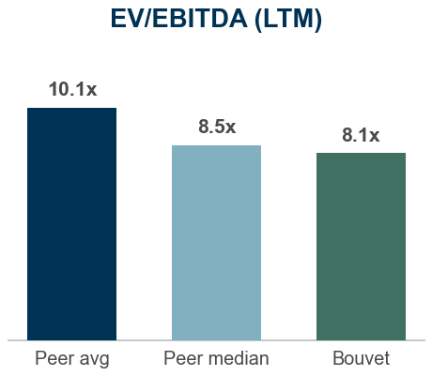
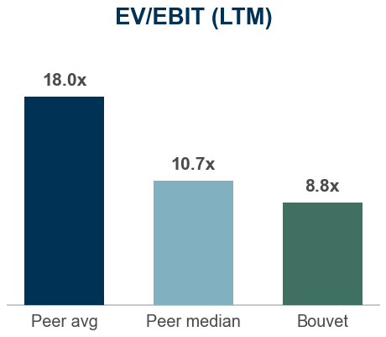
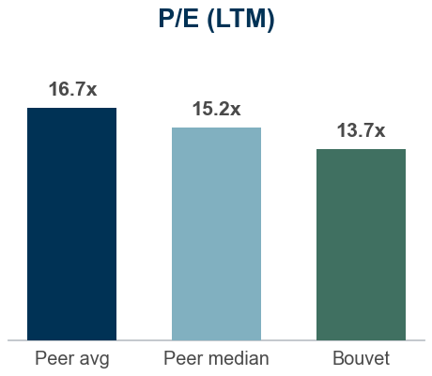
#3 Historical analysis and forecasts
Financials and estimates
Bouvet financials, pre-IFRS 16 basis (NOKm)
 | HISTORICAL |  |  |  | FORECAST
NOKm | 2022A | 2023A | 2024A | 2025A | 2026E | 2027E | 2028E | 2029E | 2030E | 2031E | TV
Revenue | 3,085 | 3,526 | 3,921 | 3,912 | 3,970 | 4,278 | 4,548 | 4,770 | 4,934 | 5,033 | 5,134
Growth | – | 14.3% | 11.2% | -0.2% | 1.5% | 7.8% | 6.3% | 4.9% | 3.4% | 2.0% | 2.0%
EBITDA | 435 | 463 | 564 | 525 | 534 | 577 | 615 | 647 | 671 | 687 | 700
Margin | 14.1% | 13.1% | 14.4% | 13.4% | 13.5% | 13.5% | 13.5% | 13.6% | 13.6% | 13.6% | 13.6%
EBIT | 402 | 420 | 501 | 483 | 483 | 522 | 556 | 585 | 607 | 621 | 634
Margin | 13.0% | 11.9% | 12.8% | 12.4% | 12.2% | 12.2% | 12.2% | 12.3% | 12.3% | 12.3% | 12.3%
NOPAT | 317 | 327 | 391 | 367 | 376 | 407 | 434 | 457 | 474 | 485 | 494
Margin | 10.3% | 9.3% | 10.0% | 9.4% | 9.5% | 9.5% | 9.5% | 9.6% | 9.6% | 9.6% | 9.6%
Unlevered FCF | 203 | 387 | 745 | 276 | 391 | 440 | 465 | 485 | 499 | 505 | 516
FCF margin | 6.6% | 11.0% | 19.0% | 7.1% | 9.9% | 10.3% | 10.2% | 10.2% | 10.1% | 10.0% | 10.0%
Financial commentary
Bouvet grew revenue by -0.2% in 2025A to NOK 3,912m, with pre-IFRS 16 EBITDA of NOK 525m (13.4% margin)
We forecast 2026E revenue of NOK 3,970m (+1.5%), anchored on consensus (2 analysts), fading to 2.0% terminal growth by 2031E
EBITDA margin path: 13.5% in 2026E to 13.6% in 2031E; D&A 1.3% and capex 1.0% of revenue; tax rate 22%
Unlevered FCF rises from NOK 391m to NOK 505m over the forecast period (10.0% FCF margin in 2031E)
Valuation vs peers: Bouvet trades at 8.1x LTM EV/EBITDA versus a peer median of 8.5x (-4%) and 13.7x P/E versus 15.2x
Street view: consensus target of NOK 50.00 across 2 analysts (+6% vs current price)
Multiples (at current price) | 2025A | 2026E | 2027E | 2028E
EV/Sales | 1.1x | 1.1x | 1.0x | 0.9x
EV/EBITDA | 8.1x | 8.0x | 7.4x | 6.9x
EV/EBIT | 8.8x | 8.8x | 8.2x | 7.7x
P/E | 13.7x | 13.2x | 12.2x | 11.4x
FCF yield | 5.7% | 8.1% | 9.1% | 9.6%
Consensus (2 analysts)
Target: NOK 50.00 (range 50–50)
Ratings: 0 buy / 2 hold / 0 sell
Engine: BUY, TP NOK 78.50 (+66%)
Sources: Company reports, Yahoo Finance, Equity Research Engine estimates; peer multiples on last reported fiscal year
For illustration only — not investment advice
Equity Research Engine
5

Slide 6
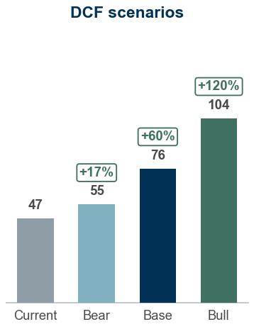
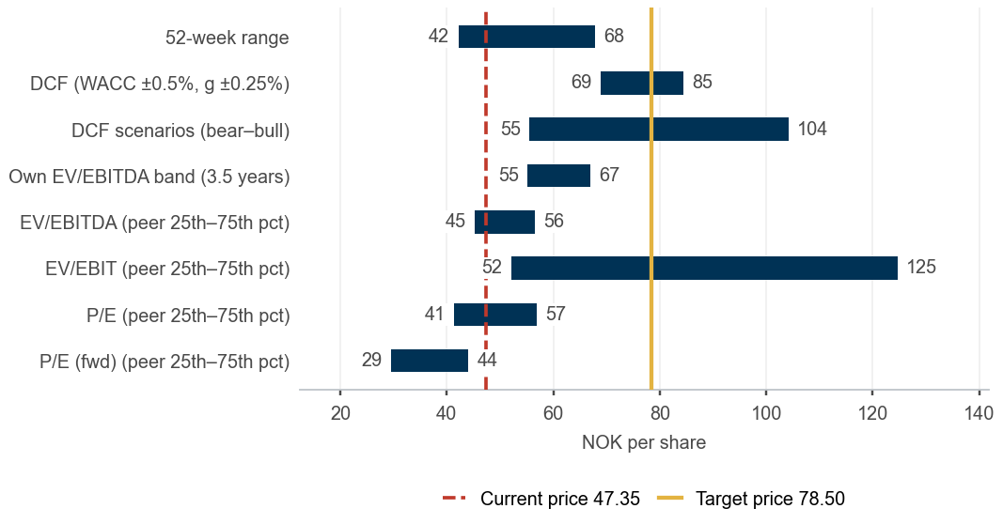
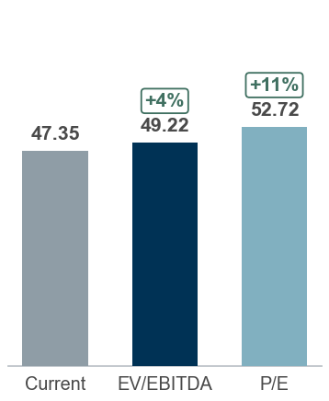
#4 Valuation and concluding thoughts
Valuation and recommendation
We recommend a BUY. Our 12-month target price of NOK 78.50 implies +66% upside and a +74% total return including dividend; 8.0x 2026E EV/EBITDA.
DCF fair value NOK 75.76, peer multiples NOK 52.13, scenario-weighted NOK 77.79 versus a share price of NOK 47.35 — BUY
BUY – 12m TP NOK 78.50 · low agreement
DCF valuation – Sensitivity analysis (value per share)
DCF value of NOK 75.76 per share (WACC 8.3%, terminal growth 2.0%); terminal value is 71% of EV, implying 11.9x exit EV/EBITDA
Peer multiples imply NOK 52.13 per share (median of EV/EBITDA, EV/EBIT and P/E-based values)
Scenarios: bear NOK 55 / base NOK 76 / bull NOK 104; probability-weighted NOK 77.79
12-month target price NOK 78.50: fair value NOK 75.76 rolled forward at the 8.3% cost of equity less NOK 3.71 dividend; expected total return +74%, rating BUY
Terminal growth \ WACC | 6.80% | 7.30% | 7.80% | 8.30% | 8.80% | 9.30% | 9.80%
1.25% | 87.9 | 81.0 | 75.2 | 70.2 | 65.8 | 62.0 | 58.6
1.50% | 90.9 | 83.5 | 77.2 | 71.9 | 67.3 | 63.3 | 59.7
1.75% | 94.3 | 86.2 | 79.5 | 73.8 | 68.9 | 64.6 | 60.9
2.00% | 97.9 | 89.1 | 81.9 | 75.8 | 70.5 | 66.1 | 62.1
2.25% | 102.0 | 92.4 | 84.5 | 77.9 | 72.4 | 67.6 | 63.4
2.50% | 106.5 | 96.0 | 87.4 | 80.3 | 74.3 | 69.2 | 64.8
2.75% | 111.6 | 99.9 | 90.6 | 82.9 | 76.5 | 71.0 | 66.3
Valuation summary – Football field
Multiple valuation and what the price implies
Trading at a discount: 8.1x EV/EBITDA vs 8.5x peer median (4% discount)
Earnings multiple: 13.7x trailing P/E vs 15.2x for peers (-10%)
Versus own history: 8.3x trailing EV/EBITDA is below the 3.5-year median of 11.3x (11% of weeks were cheaper)
EV/EBITDA-implied value: NOK 49.22 at the peer median of 8.5x (range 45–56 across the 25th–75th percentile)
Market-implied WACC 12.5%, above our 8.3%: the price discounts our cash flows at 422bp more than we do
Market-implied margin: at our WACC the price is consistent with a 2031E EBITDA margin of 8.4% versus 13.6% in our base case
Cross-check – low agreement: the DCF is 45% above the peer-multiple value (NOK 52.13) and our target is 57% above the consensus of 2 analysts (NOK 50.00); the recommendation rests on the DCF assumptions alone — treat the target as a hypothesis, not a result
Sources: Company reports, Yahoo Finance, Equity Research Engine estimates; WACC 8.3% (Yahoo Finance (5y monthly); regression vs OSEBX rejected (R2=0.01 < 0.10), Blume-adjusted); terminal growth 2.0%
For illustration only — not investment advice
Equity Research Engine
6

Slide 7
Appendix #4.1
Cost of capital and DCF build-up
WACC 8.30% and terminal growth 2.00% give a fair value of NOK 75.76 per share
WACC build-up
1
DCF build-up (NOKm)
2
What the share price implies
3
Component | Value
Risk-free rate | 3.80%
Beta (raw) | 0.35
Beta (adjusted, used) | 0.60
Equity risk premium | 5.00%
Size premium | 1.50%
Cost of equity | 8.30%
Cost of debt (pre-tax) | 5.80%
Tax rate | 22.0%
Cost of debt (after tax) | 4.52%
Weight of equity | 100.0%
Weight of debt | 0.0%
WACC | 8.30%
 | 2026E | 2027E | 2028E | 2029E | 2030E | 2031E
Unlevered FCF | 391 | 440 | 465 | 485 | 499 | 505
Discount factor | 0.923 | 0.853 | 0.787 | 0.727 | 0.671 | 0.620
PV of FCF | 361 | 375 | 366 | 353 | 335 | 313
Implied WACC: 12.52% vs our 8.30%
Implied terminal growth: -5.40% vs our 2.00%
Implied 2031E EBITDA margin: 8.4% vs our 13.6%
Each figure solves for the one input that makes the DCF equal today's price, holding the others at the base case
Bridge to value per share | NOKm
Sum of PV of FCF | 2,104
Terminal value (Gordon growth) | 8,183
PV of terminal value | 5,072
Enterprise value | 7,175
Less: net debt | 580
Less: minority interest | 0
Equity value | 7,755
Shares outstanding (m) | 102.4
Fair value per share (NOK) | 75.76
x (1 + cost of equity 8.30%) | 82.05
Less: expected dividend per share | (3.71)
12-month target price (NOK, rounded) | 78.50
Key checks
4
Terminal value is 71% of enterprise value
Implied exit multiple: 11.9x EV/EBITDA vs 8.1x today
WACC − g spread: 6.30%
Net debt / EBITDA: net cash
Beta: Yahoo Finance (5y monthly); regression vs OSEBX rejected (R2=0.01 < 0.10), Blume-adjusted.
Size premium 1.50% (market cap USD 0.5bn).
Cost of debt: risk-free + 200bp.
Sources: Company reports, Yahoo Finance, Equity Research Engine estimates
For illustration only — not investment advice
Equity Research Engine
7

Slide 8
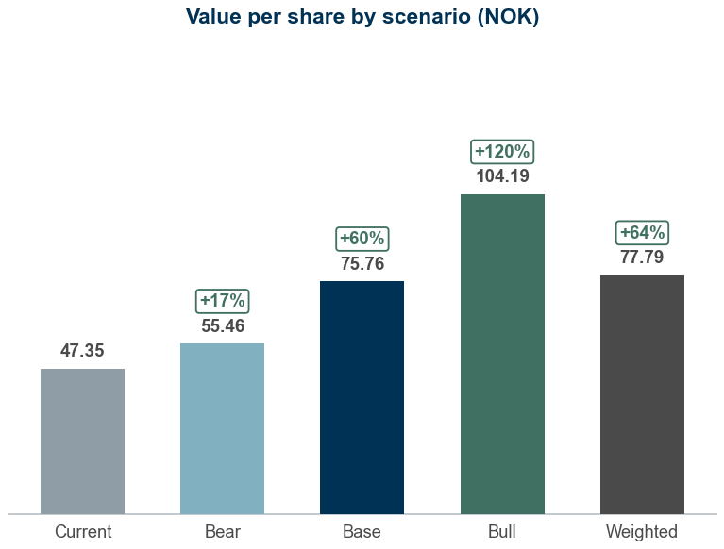
Appendix #4.2
Scenario analysis
Probability-weighted value of NOK 77.79 per share versus a share price of NOK 47.35
Scenario table
1
Value per share by scenario
3
Scenario | Probability | Growth shift | Margin shift | WACC | Terminal g | Revenue CAGR | 2031E margin | Value (NOK) | vs price
Bear | 25% | -2.0% | -1.5% | 8.80% | 1.75% | 2.3% | 12.1% | 55.46 | +17%
Base | 50% | +0.0% | +0.0% | 8.30% | 2.00% | 4.3% | 13.6% | 75.76 | +60%
Bull | 25% | +2.0% | +1.5% | 7.80% | 2.25% | 6.3% | 15.1% | 104.19 | +120%
Probability-weighted | 100% |  |  |  |  |  |  | 77.79 | +64%
What drives each case
2
Bear (25%): Growth 2pp lower, margin 1.5pp lower, WACC +50bp; revenue CAGR 2.3%, 2031E margin 12.1%, WACC 8.8% gives NOK 55.46 (+17% vs price)
Base (50%): Base-case drivers; revenue CAGR 4.3%, 2031E margin 13.6%, WACC 8.3% gives NOK 75.76 (+60% vs price)
Bull (25%): Growth 2pp higher, margin 1.5pp higher, WACC -50bp; revenue CAGR 6.3%, 2031E margin 15.1%, WACC 7.8% gives NOK 104.19 (+120% vs price)
Shifts are additive to the base case: growth applies to every forecast year, the margin shift to the whole EBITDA margin path; capex and working capital follow revenue as in the base case
Sources: Company reports, Yahoo Finance, Equity Research Engine estimates
For illustration only — not investment advice
Equity Research Engine
8

Slide 9
Appendix #4.3
Peer group detail
Multiples on the last reported fiscal year, enterprise value on the same lease basis as the target company
Company | Group | Mkt cap (NOKm) | EV (NOKm) | Rev. growth | EBITDA margin | EV/Sales | EV/EBITDA | EV/EBIT | P/E | P/E (fwd)
Knowit | Nordic IT services | 2,497 | 2,501 | -9.6% | 8.8% | 0.5x | 5.1x | – | – | 9.3x
Tietoevry | Nordic IT services | 22,628 | 28,051 | -1.4% | 17.6% | 1.4x | 8.0x | 37.2x | 10.1x | 11.4x
Netcompany | Nordic IT services | 20,082 | 23,435 | 20.7% | 8.9% | 2.1x | 23.2x | 36.1x | 34.5x | 13.3x
Atea | Nordic IT services | 18,898 | 17,896 | 8.1% | 4.3% | 0.5x | 11.2x | 14.3x | 16.5x | 14.6x
Sopra Steria | European IT services | 34,043 | 37,341 | -2.2% | 8.8% | 0.6x | 6.9x | 8.1x | 10.5x | 8.1x
Capgemini | European IT services | 189,192 | 249,041 | 1.7% | 12.1% | 1.0x | 8.5x | 9.9x | 13.4x | 7.7x
Reply | European IT services | 44,793 | 39,143 | 6.7% | 17.4% | 1.5x | 8.5x | 9.7x | 16.4x | 13.7x
Accenture | Global IT services | 1,090,733 | 1,041,316 | 7.4% | 16.8% | 1.6x | 9.5x | 10.7x | 15.2x | 13.0x
Peer median |  |  |  | 4.2% | 10.5% | 1.2x | 8.5x | 10.7x | 15.2x | 12.2x
Peer average |  |  |  | 3.9% | 11.8% | 1.1x | 10.1x | 18.0x | 16.7x | 11.4x
25th percentile |  |  |  | -1.6% | 8.8% | 0.6x | 7.7x | 9.8x | 12.0x | 9.0x
75th percentile |  |  |  | 7.5% | 17.0% | 1.5x | 9.9x | 25.2x | 16.4x | 13.4x
Bouvet | Target | 4,847 | 4,267 | -0.2% | 13.4% | 1.1x | 8.1x | 8.8x | 13.7x | 14.4x
Sources: Company reports, Yahoo Finance, Equity Research Engine estimates; n.m. = not meaningful (negative or above 60x)
For illustration only — not investment advice
Equity Research Engine
9

Slide 10
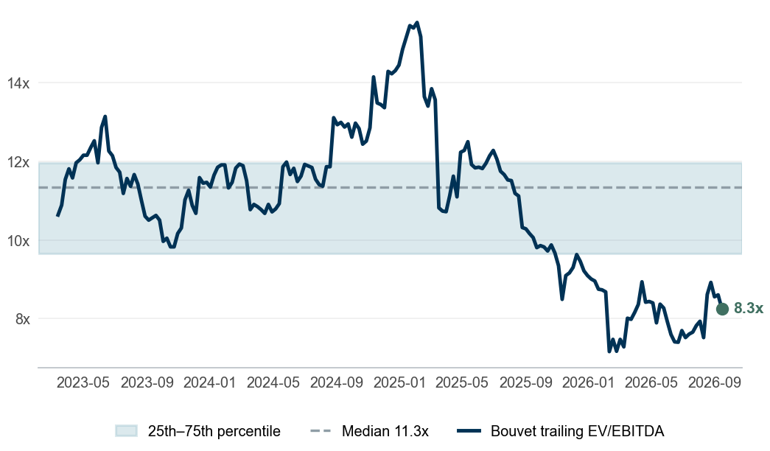
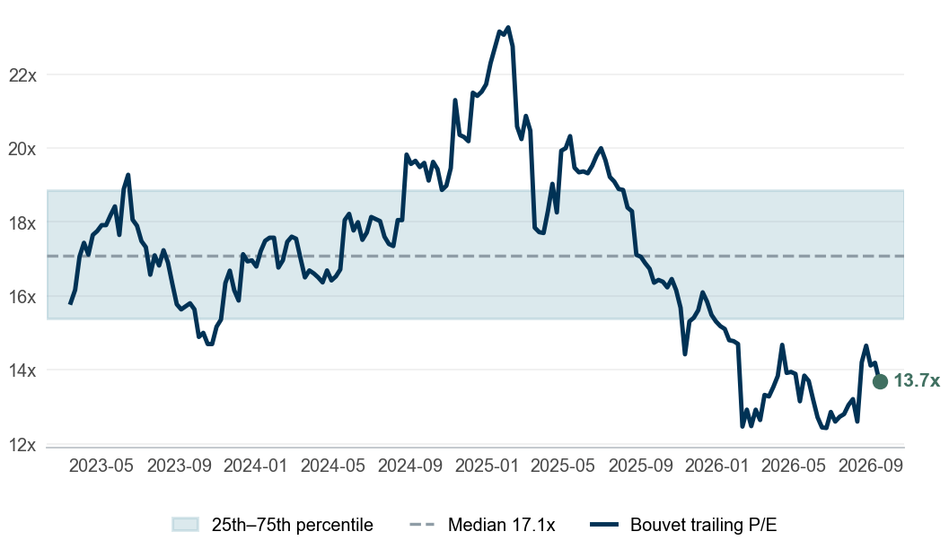
Appendix #4.4
Valuation through time
Bouvet trades at 8.3x trailing EV/EBITDA against a 3.5-year median of 11.3x
Trailing EV/EBITDA
1
Trailing P/E
2
Reading the bands
3
EV/EBITDA: 8.3x today vs a median of 11.3x and an interquartile band of 9.7x–12.0x; 11% of weeks were cheaper. At its own median the share is worth NOK 63.79 (+35% vs price)
P/E: 13.7x today vs a median of 17.1x and an interquartile band of 15.4x–18.9x; 11% of weeks were cheaper. At its own median the share is worth NOK 59.10 (+25% vs price)
Cross-check – low agreement between the anchors: the DCF is 45% above the peer-multiple value (NOK 52.13) and our target is 57% above the consensus of 2 analysts (NOK 50.00); the recommendation rests on the DCF assumptions alone — treat the target as a hypothesis, not a result
Each weekly close is paired with the latest fiscal year that was public at the time (75-day reporting lag), on the same lease basis as the model; net debt and the share count step once a year
Sources: Company reports, Yahoo Finance, Equity Research Engine estimates
For illustration only — not investment advice
Equity Research Engine
10

