Slide 1
Equity Research Engine
Oscar Schjelderup
SATS – Healthy body, healthy margins
Equity research case
21.09.2026
Private and Confidential

Slide 2
Analyst
Presenting a model-driven investment case on SATS ASA.
OS
University: Copenhagen Business School
Year of study: 2nd year
Experience: HA Invest member
Oscar Schjelderup
Sources: Company reports, Yahoo Finance, Equity Research Engine estimates
For illustration only — not investment advice
Equity Research Engine
2

Slide 3
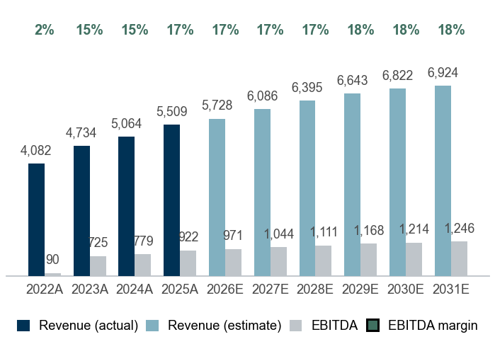
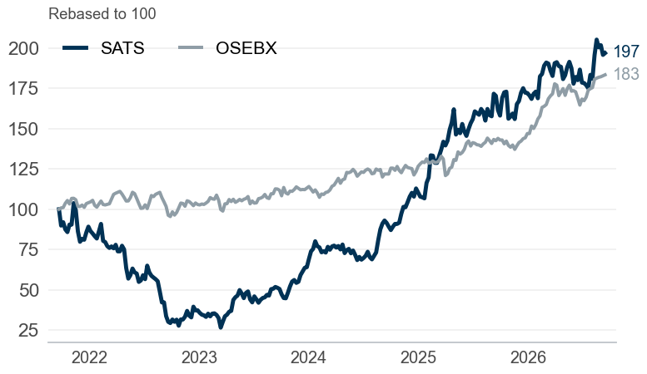
#1 The equity story of SATS
Company overview
SATS ASA – Fitness & well-being in Norway, Sweden, Denmark, Finland
10.5% revenue CAGR, 16.7% EBITDA margin and 1.1x net debt/EBITDA — market cap NOK 8.6bn
Company snapshot
1
Investment highlights
2
Management team
3
Sector: Fitness & well-being
Footprint: Norway, Sweden, Denmark, Finland
Business model: Membership subscriptions & other
Scale: Employees: 10,000 | Revenue 2025A: NOK 5,509m
Market cap: NOK 8,573m | EV NOK 9,576m
Share price: NOK 44.35 | 52w range 35.0–47.5
Consistent growth: revenue compounded at 10.5% p.a. over 2022–2025, reaching NOK 5,509m
Margin profile: pre-IFRS 16 EBITDA margin of 16.7% in 2025A (up from 2.2% in 2022A), EBIT margin 12.7%
Cash generative: unlevered FCF of NOK 518m in 2025A, 56% of EBITDA, ROIC 18%
Balance sheet: net debt of NOK 1,003m equals 1.1x EBITDA, a conservative leverage level
SG
Sondre Gravir
CEO
CE
Cecilie Elde
CFO
WE
Wenche Evertsen
Country Manager of Norway
KG
Karolina Gutke
Country Manager of Sweden
Revenue and EBITDA (NOKm)
4
Share price vs OSEBX (5 years)
5
Key ratios
6
 | 2023A | 2024A | 2025A | 2026E | 2027E
Revenue growth | 16.0% | 7.0% | 8.8% | 4.0% | 6.3%
EBITDA margin | 15.3% | 15.4% | 16.7% | 16.9% | 17.2%
EBIT margin | 10.5% | 10.7% | 12.7% | 12.4% | 12.6%
FCF margin | 8.3% | 7.8% | 9.4% | 9.9% | 10.4%
ROIC | 12.8% | 14.6% | 18.3% | – | –
Net debt / EBITDA | 2.0x | 1.4x | 1.1x | – | –
Payout ratio | – | – | 27% | – | –
Sources: Company reports, Yahoo Finance, Equity Research Engine estimates
For illustration only — not investment advice
Equity Research Engine
3

Slide 4
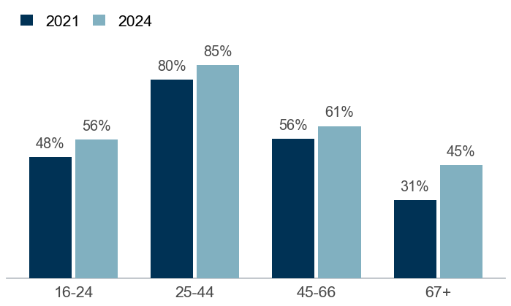
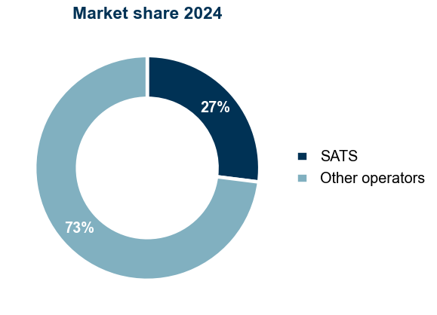
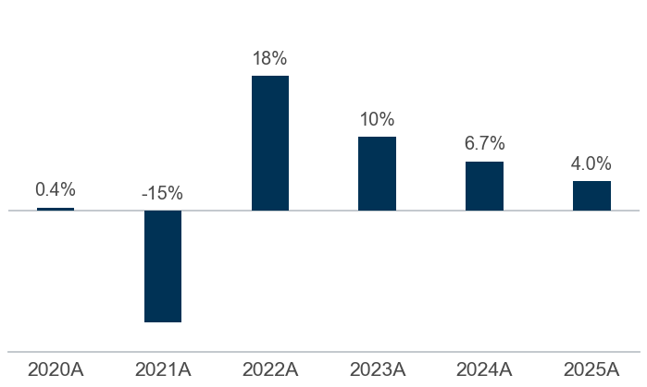
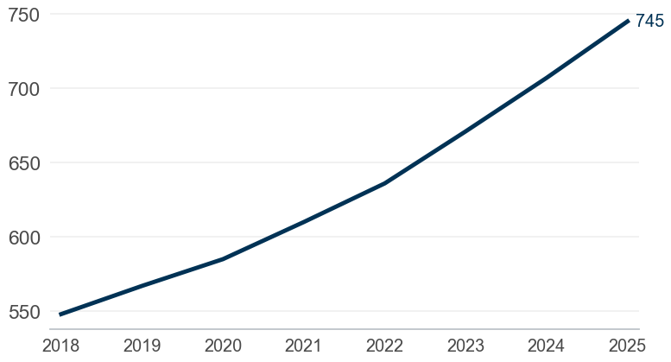
#2 Market overview and peer landscape
Market overview
SATS versus its peer group: growth, profitability and the drivers behind the case
High and growing participation in strength training
1
Leading market position in Scandinavia
2
Opportunities
Proven ability to raise prices above CPI through product tiers
Continued ARPM growth from dynamic pricing and premium concept roll-outs
Structural under-penetration versus the US (9% vs 24%) leaves a long runway
Disruption
Countering boutique studios by integrating high-end concepts inside existing clubs
SATS App and online training act as retention tools
Proven pricing power: ARPM growth
3
Rising disposable income supports affordability
4
Threats
Macro headwinds: prolonged high interest rates could pressure disposable income
Aggressive low-cost competition could limit pricing flexibility
Sources: Statistics Norway (SSB) training trends; MarketLine Gyms, Health & Fitness Clubs Scandinavia; company reports
For illustration only — not investment advice
Equity Research Engine
4

Slide 5
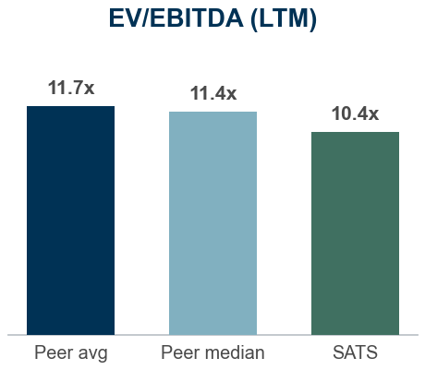
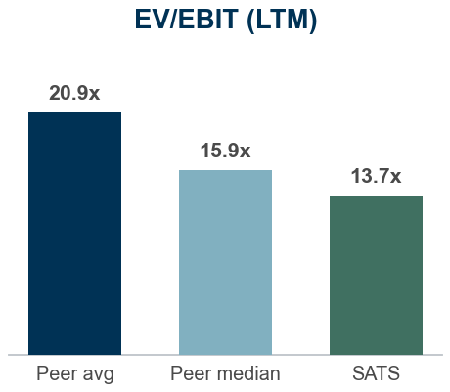
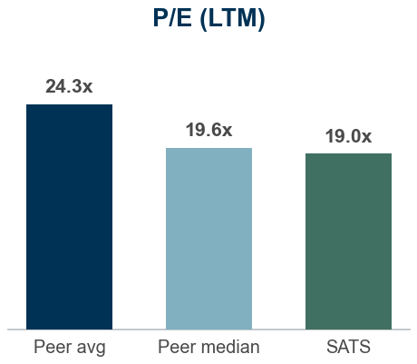
#3 Historical analysis and forecasts
Financials and estimates
SATS financials, pre-IFRS 16 basis (NOKm)
 | HISTORICAL |  |  |  | FORECAST
NOKm | 2022A | 2023A | 2024A | 2025A | 2026E | 2027E | 2028E | 2029E | 2030E | 2031E | TV
Revenue | 4,082 | 4,734 | 5,064 | 5,509 | 5,728 | 6,086 | 6,395 | 6,643 | 6,822 | 6,924 | 7,028
Growth | – | 16.0% | 7.0% | 8.8% | 4.0% | 6.3% | 5.1% | 3.9% | 2.7% | 1.5% | 1.5%
EBITDA | 90 | 725 | 779 | 922 | 971 | 1,044 | 1,111 | 1,168 | 1,214 | 1,246 | 1,265
Margin | 2.2% | 15.3% | 15.4% | 16.7% | 16.9% | 17.2% | 17.4% | 17.6% | 17.8% | 18.0% | 18.0%
EBIT | (165) | 495 | 543 | 697 | 711 | 768 | 821 | 867 | 904 | 932 | 946
Margin | -4.0% | 10.5% | 10.7% | 12.7% | 12.4% | 12.6% | 12.8% | 13.0% | 13.3% | 13.5% | 13.5%
NOPAT | (129) | 354 | 408 | 537 | 555 | 599 | 640 | 676 | 705 | 727 | 738
Margin | -3.2% | 7.5% | 8.1% | 9.8% | 9.7% | 9.8% | 10.0% | 10.2% | 10.3% | 10.5% | 10.5%
Unlevered FCF | (174) | 395 | 393 | 518 | 565 | 631 | 666 | 694 | 714 | 727 | 738
FCF margin | -4.3% | 8.3% | 7.8% | 9.4% | 9.9% | 10.4% | 10.4% | 10.4% | 10.5% | 10.5% | 10.5%
Financial commentary
SATS grew revenue by 8.8% in 2025A to NOK 5,509m, with pre-IFRS 16 EBITDA of NOK 922m (16.7% margin)
We forecast 2026E revenue of NOK 5,728m (+4.0%), anchored on consensus (5 analysts), fading to 1.5% terminal growth by 2031E
EBITDA margin path: 16.9% in 2026E to 18.0% in 2031E; D&A 4.5% and capex 4.9% of revenue; tax rate 22%
Unlevered FCF rises from NOK 565m to NOK 727m over the forecast period (10.5% FCF margin in 2031E)
Valuation vs peers: SATS trades at 10.4x LTM EV/EBITDA versus a peer median of 11.4x (-9%) and 19.0x P/E versus 19.6x
Street view: consensus target of NOK 52.00 across 5 analysts (+17% vs current price)
Multiples (at current price) | 2025A | 2026E | 2027E | 2028E
EV/Sales | 1.7x | 1.7x | 1.6x | 1.5x
EV/EBITDA | 10.4x | 9.9x | 9.2x | 8.6x
EV/EBIT | 13.7x | 13.5x | 12.5x | 11.7x
P/E | 19.0x | 17.4x | 16.0x | 14.9x
FCF yield | 6.0% | 6.6% | 7.4% | 7.8%
Consensus (5 analysts)
Target: NOK 52.00 (range 45–60)
Ratings: 3 buy / 2 hold / 0 sell
Engine: HOLD, TP NOK 47.00 (+6%)
Sources: Company reports, Yahoo Finance, Equity Research Engine estimates; peer multiples on last reported fiscal year
For illustration only — not investment advice
Equity Research Engine
5

Slide 6
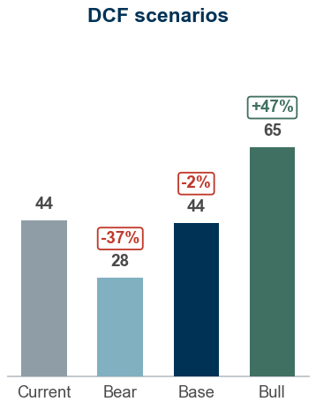
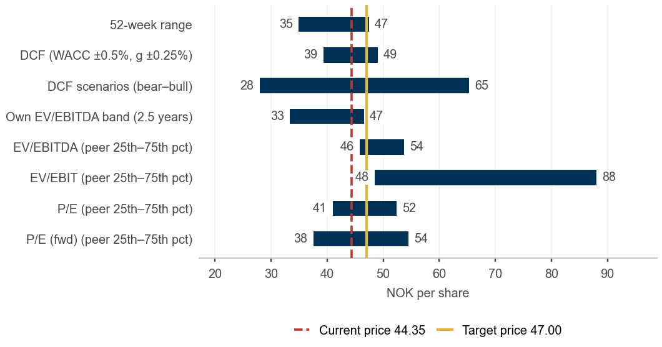
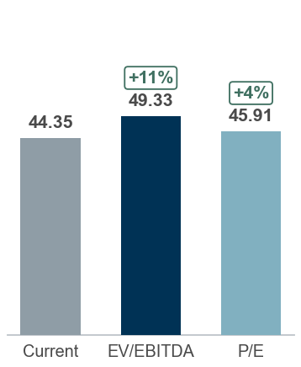
#4 Valuation and concluding thoughts
Valuation and recommendation
We recommend a HOLD. Our 12-month target price of NOK 47.00 implies +6% upside and a +7% total return including dividend; 9.9x 2026E EV/EBITDA.
DCF fair value NOK 43.67, peer multiples NOK 45.91, scenario-weighted NOK 45.17 versus a share price of NOK 44.35 — HOLD
HOLD – 12m TP NOK 47.00
DCF valuation – Sensitivity analysis (value per share)
DCF value of NOK 43.67 per share (WACC 8.5%, terminal growth 1.5%); terminal value is 68% of EV, implying 8.4x exit EV/EBITDA
Peer multiples imply NOK 45.91 per share (median of EV/EBITDA, EV/EBIT and P/E-based values)
Scenarios: bear NOK 28 / base NOK 44 / bull NOK 65; probability-weighted NOK 45.17
12-month target price NOK 47.00: fair value NOK 43.67 rolled forward at the 9.2% cost of equity less NOK 0.66 dividend; expected total return +7%, rating HOLD
Terminal growth \ WACC | 7.01% | 7.51% | 8.01% | 8.51% | 9.01% | 9.51% | 10.01%
0.75% | 51.4 | 47.1 | 43.4 | 40.2 | 37.4 | 34.9 | 32.7
1.00% | 53.2 | 48.6 | 44.7 | 41.3 | 38.3 | 35.7 | 33.4
1.25% | 55.1 | 50.2 | 46.0 | 42.4 | 39.3 | 36.6 | 34.1
1.50% | 57.2 | 51.9 | 47.5 | 43.7 | 40.4 | 37.5 | 34.9
1.75% | 59.5 | 53.8 | 49.1 | 45.0 | 41.5 | 38.4 | 35.7
2.00% | 62.1 | 55.9 | 50.8 | 46.4 | 42.7 | 39.5 | 36.6
2.25% | 64.9 | 58.1 | 52.6 | 47.9 | 44.0 | 40.5 | 37.6
Valuation summary – Football field
Multiple valuation and what the price implies
Trading at a discount: 10.4x EV/EBITDA vs 11.4x peer median (9% discount)
Earnings multiple: 19.0x trailing P/E vs 19.6x for peers (-3%)
Versus own history: 10.9x trailing EV/EBITDA is above the 2.5-year median of 10.2x (76% of weeks were cheaper)
EV/EBITDA-implied value: NOK 49.33 at the peer median of 11.4x (range 46–54 across the 25th–75th percentile)
Market-implied WACC 8.4%, in line with our 8.5%: the price discounts our cash flows at 9bp less than we do
Market-implied margin: at our WACC the price is consistent with a 2031E EBITDA margin of 18.2% versus 18.0% in our base case
Sources: Company reports, Yahoo Finance, Equity Research Engine estimates; WACC 8.5% (Yahoo Finance (5y monthly); regression vs OSEBX rejected (R2=0.02 < 0.10), Blume-adjusted); terminal growth 1.5%
For illustration only — not investment advice
Equity Research Engine
6

Slide 7
Appendix #4.1
Cost of capital and DCF build-up
WACC 8.51% and terminal growth 1.50% give a fair value of NOK 43.67 per share
WACC build-up
1
DCF build-up (NOKm)
2
What the share price implies
3
Component | Value
Risk-free rate | 3.80%
Beta (raw) | 0.83
Beta (adjusted, used) | 0.89
Equity risk premium | 5.00%
Size premium | 1.00%
Cost of equity | 9.24%
Cost of debt (pre-tax) | 5.50%
Tax rate | 22.0%
Cost of debt (after tax) | 4.29%
Weight of equity | 85.2%
Weight of debt | 14.8%
WACC | 8.51%
 | 2026E | 2027E | 2028E | 2029E | 2030E | 2031E
Unlevered FCF | 565 | 631 | 666 | 694 | 714 | 727
Discount factor | 0.922 | 0.849 | 0.783 | 0.721 | 0.665 | 0.613
PV of FCF | 520 | 536 | 521 | 500 | 475 | 445
Implied WACC: 8.42% vs our 8.51%
Implied terminal growth: 1.63% vs our 1.50%
Implied 2031E EBITDA margin: 18.2% vs our 18.0%
Each figure solves for the one input that makes the DCF equal today's price, holding the others at the base case
Bridge to value per share | NOKm
Sum of PV of FCF | 2,998
Terminal value (Gordon growth) | 10,525
PV of terminal value | 6,447
Enterprise value | 9,445
Less: net debt | (1,003)
Less: minority interest | 0
Equity value | 8,442
Shares outstanding (m) | 193.3
Fair value per share (NOK) | 43.67
x (1 + cost of equity 9.24%) | 47.71
Less: expected dividend per share | (0.66)
12-month target price (NOK, rounded) | 47.00
Key checks
4
Terminal value is 68% of enterprise value
Implied exit multiple: 8.4x EV/EBITDA vs 10.4x today
WACC − g spread: 7.01%
Net debt / EBITDA: 1.1x
Beta: Yahoo Finance (5y monthly); regression vs OSEBX rejected (R2=0.02 < 0.10), Blume-adjusted.
Size premium from config.
Cost of debt: interest expense / average debt.
Sources: Company reports, Yahoo Finance, Equity Research Engine estimates
For illustration only — not investment advice
Equity Research Engine
7

Slide 8
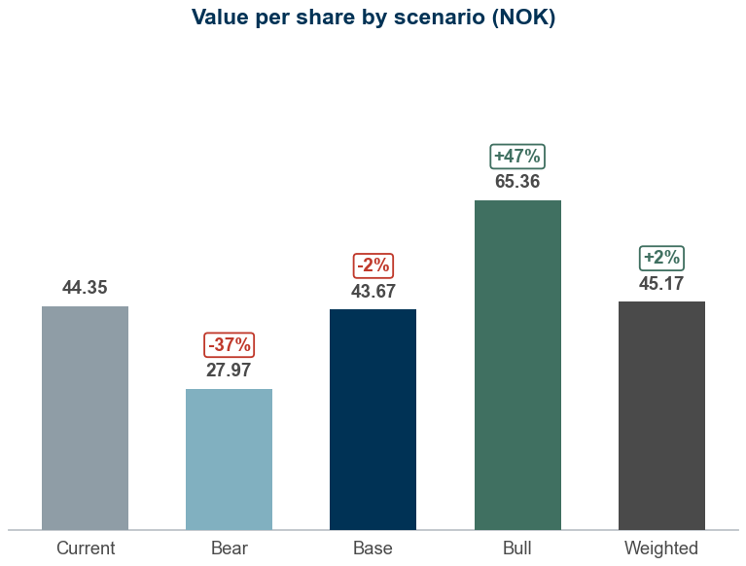
Appendix #4.2
Scenario analysis
Probability-weighted value of NOK 45.17 per share versus a share price of NOK 44.35
Scenario table
1
Value per share by scenario
3
Scenario | Probability | Growth shift | Margin shift | WACC | Terminal g | Revenue CAGR | 2031E margin | Value (NOK) | vs price
Bear | 25% | -2.0% | -2.0% | 9.01% | 1.25% | 1.9% | 16.0% | 27.97 | -37%
Base | 50% | +0.0% | +0.0% | 8.51% | 1.50% | 3.9% | 18.0% | 43.67 | -2%
Bull | 25% | +2.0% | +2.0% | 8.01% | 1.75% | 5.9% | 20.0% | 65.36 | +47%
Probability-weighted | 100% |  |  |  |  |  |  | 45.17 | +2%
What drives each case
2
Bear (25%): Low-cost competition caps price increases and member growth stalls; revenue CAGR 1.9%, 2031E margin 16.0%, WACC 9.0% gives NOK 27.97 (-37% vs price)
Base (50%): Consensus growth; margin expands to 18% on operating leverage; revenue CAGR 3.9%, 2031E margin 18.0%, WACC 8.5% gives NOK 43.67 (-2% vs price)
Bull (25%): Premium concepts lift ARPM faster and club utilisation normalises; revenue CAGR 5.9%, 2031E margin 20.0%, WACC 8.0% gives NOK 65.36 (+47% vs price)
Shifts are additive to the base case: growth applies to every forecast year, the margin shift to the whole EBITDA margin path; capex and working capital follow revenue as in the base case
Sources: Company reports, Yahoo Finance, Equity Research Engine estimates
For illustration only — not investment advice
Equity Research Engine
8

Slide 9
Appendix #4.3
Peer group detail
Multiples on the last reported fiscal year, enterprise value on the same lease basis as the target company
Company | Group | Mkt cap (NOKm) | EV (NOKm) | Rev. growth | EBITDA margin | EV/Sales | EV/EBITDA | EV/EBIT | P/E | P/E (fwd)
Basic-Fit | Global fitness | 22,902 | 34,883 | 16.9% | 21.3% | 2.3x | 10.7x | 46.9x | 46.8x | 13.8x
Planet Fitness | Global fitness | 35,535 | 55,509 | 12.1% | 41.9% | 4.5x | 10.7x | 14.9x | 17.2x | 13.7x
Life Time Group | Global fitness | 86,698 | 98,882 | 14.3% | 22.1% | 3.5x | 16.0x | 28.8x | 22.7x | 20.3x
The Gym Group | Global fitness | 4,117 | 4,861 | 8.2% | 18.8% | 1.6x | 8.4x | 30.2x | 47.3x | 33.1x
Xponential Fitness | Global fitness | 1,750 | 5,203 | -1.7% | -1.1% | 1.8x | – | – | – | 5.8x
Europris | Nordic consumer | 13,633 | 14,541 | 16.7% | 8.6% | 1.0x | 11.4x | 13.2x | 15.9x | 12.2x
Kid | Nordic consumer | 4,829 | 5,551 | 4.2% | 12.3% | 1.4x | 11.4x | 16.2x | 18.6x | 12.0x
Orkla | Nordic consumer | 87,662 | 103,402 | 3.3% | 16.5% | 1.4x | 8.8x | 11.2x | 13.9x | 13.3x
Clas Ohlson | Nordic consumer | 25,836 | 24,080 | 7.6% | 13.4% | 2.0x | 15.0x | 16.9x | 21.5x | 33.3x
Thule Group | Nordic consumer | 20,482 | 24,069 | 9.3% | 19.5% | 2.4x | 12.4x | 14.9x | 19.1x | 14.0x
Rusta | Nordic consumer | 11,514 | 11,361 | 6.5% | 7.7% | 0.9x | 12.2x | 15.5x | 20.2x | 16.6x
Peer median |  |  |  | 8.2% | 16.5% | 1.8x | 11.4x | 15.9x | 19.6x | 13.8x
Peer average |  |  |  | 8.9% | 16.4% | 2.1x | 11.7x | 20.9x | 24.3x | 17.1x
25th percentile |  |  |  | 5.4% | 10.5% | 1.4x | 10.7x | 14.9x | 17.5x | 12.7x
75th percentile |  |  |  | 13.2% | 20.4% | 2.3x | 12.4x | 25.9x | 22.4x | 18.5x
SATS | Target | 8,573 | 9,576 | 8.8% | 16.7% | 1.7x | 10.4x | 13.7x | 19.0x | 15.0x
Sources: Company reports, Yahoo Finance, Equity Research Engine estimates; n.m. = not meaningful (negative or above 60x)
For illustration only — not investment advice
Equity Research Engine
9

Slide 10
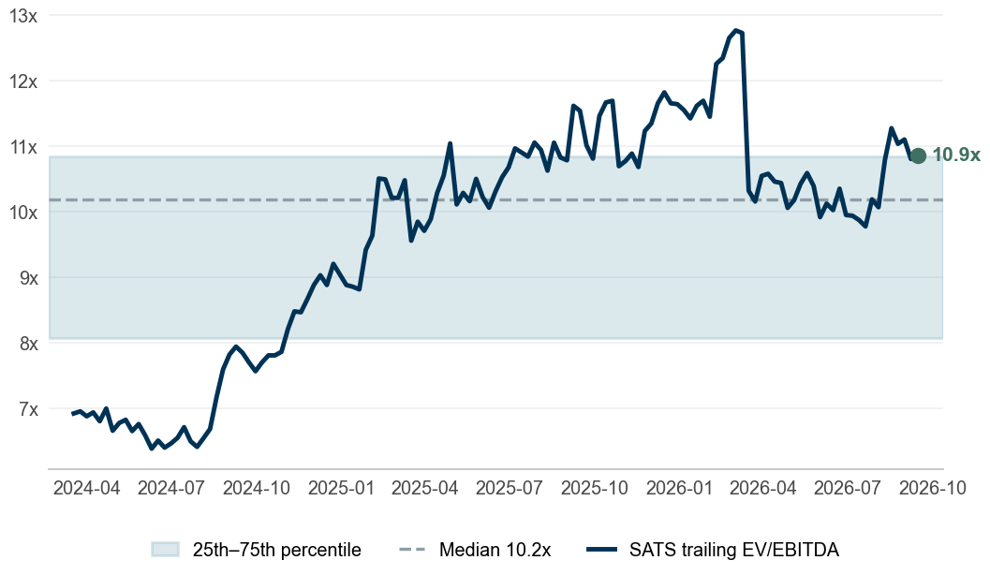
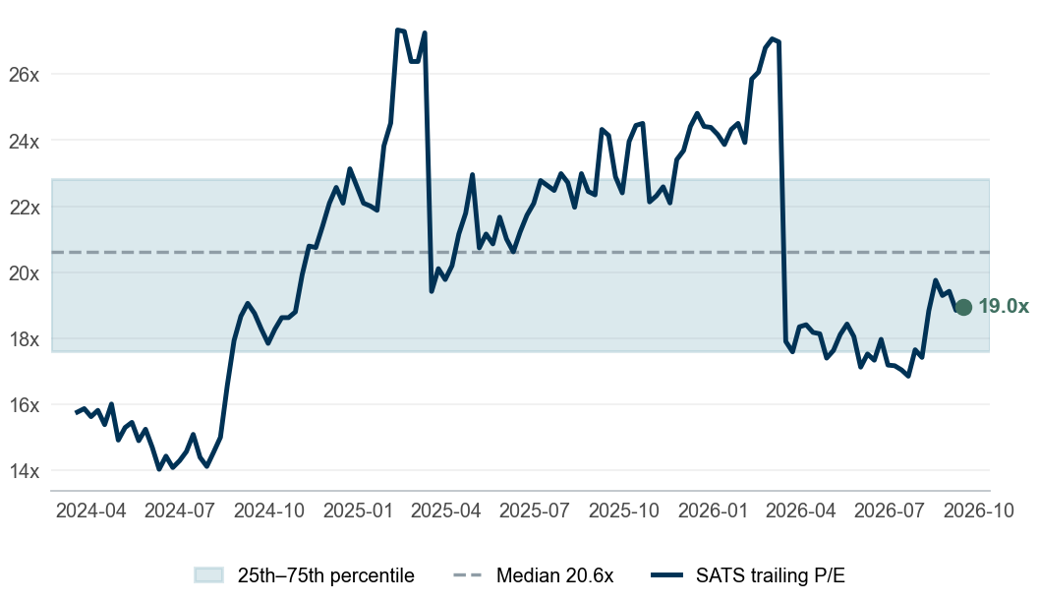
Appendix #4.4
Valuation through time
SATS trades at 10.9x trailing EV/EBITDA against a 2.5-year median of 10.2x
Trailing EV/EBITDA
1
Trailing P/E
2
Reading the bands
3
EV/EBITDA: 10.9x today vs a median of 10.2x and an interquartile band of 8.1x–10.8x; 76% of weeks were cheaper. At its own median the share is worth NOK 43.39 (-2% vs price)
P/E: 19.0x today vs a median of 20.6x and an interquartile band of 17.6x–22.8x; 43% of weeks were cheaper. At its own median the share is worth NOK 48.24 (+9% vs price)
Cross-check – high agreement between the anchors: the DCF is 5% below the peer-multiple value (NOK 45.91) and our target is 10% below the consensus of 5 analysts (NOK 52.00); the anchors agree
Each weekly close is paired with the latest fiscal year that was public at the time (75-day reporting lag), on the same lease basis as the model; net debt and the share count step once a year
Sources: Company reports, Yahoo Finance, Equity Research Engine estimates
For illustration only — not investment advice
Equity Research Engine
10

