Slide 1
ELIXIR-EXCELERATE HPC course
6-7 April 2017 – Malaga – Train-the-Researcher
Instructors: Oscar Torreno, Oswaldo Trelles Support: Esteban Perez-Wohlfeil Advisors: Pedro Fernandes, Brane Leskosek

Slide 2
Wifi connection
SSID: WifiUma, Password: wifi-uma (only for local network)
SSID: alumnos (Students of the University of Malaga)
SSID: eduroam (Students from other universities)
SSID: pas (for the rest of students)
You need to enter as username the one provided in the piece of paper
The password is: EXCELERATE
More info about how to configure it in each device

Slide 3
SSH connection
Open a web browser
Download the file: https://chirimoyo.ac.uma.es/compartir/hpc-excelerate/private-keys-hpc-course.zip
Extract all the files and pick the corresponding one to the username you have been provided (e.g. griduser001 – ida_rsa_griduser001)

Slide 4
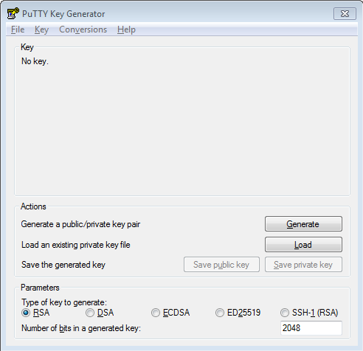
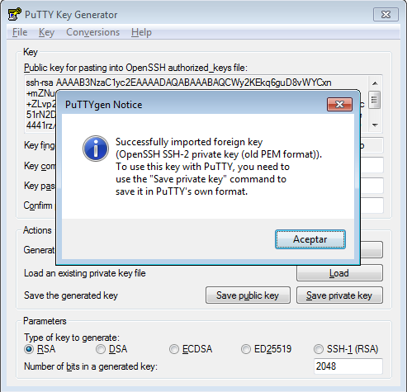
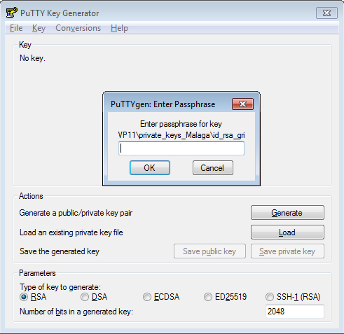
SSH connection (Windows users)
Open PuTTY gen (Key Generator)
Load your corresponding ida_rsa_griduser001 file (Choose All Files *.* option)
Browse to the file
Enter the passphrase provided in the piece of paper
Save the private key in .ppk to be used in PuTTy and FileZilla

Slide 5
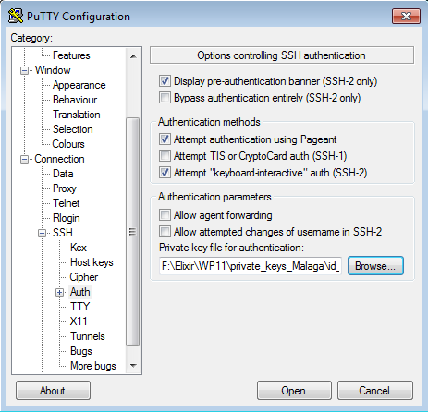
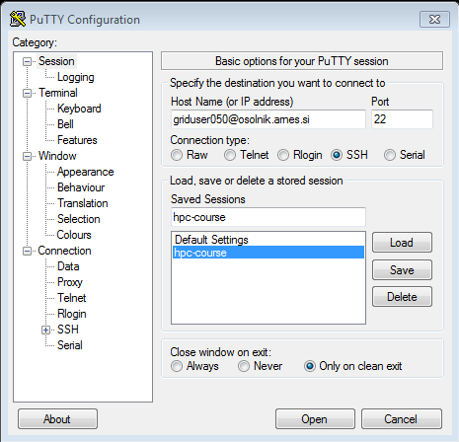
SSH connection (Windows users)
Open PuTTY
Type ‘griduserXXX@osolnik.arnes.si’ in hostname
Navigate to SSH->Auth and browse to the previously generated .ppk file
Type a session name of your preference in the “Saved sessions” text field and click “Save”
Click “Open”
Type the private key passphrase contained in the piece of paper, press enter

Slide 6
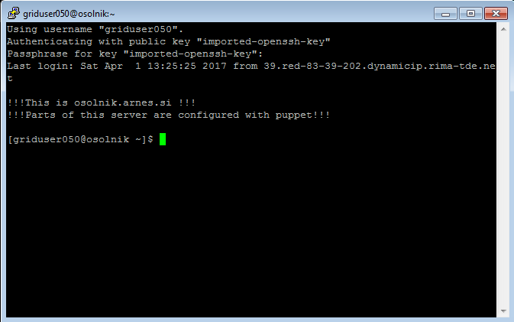
SSH connection (Windows users)

Slide 7
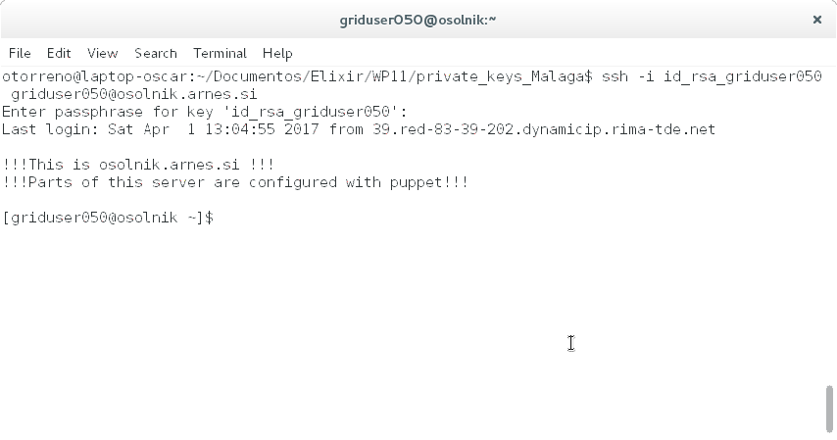
SSH connection (Linux users)
Open a terminal window
Type ‘ssh –i id_rsa_griduserXXX griduserXXX@osolnik.arnes.si’ and press enter (change ‘XXX’ to the provided user account)
Then you will be asked for the certificate passphrase which is in the piece of paper together with the user name

Slide 8
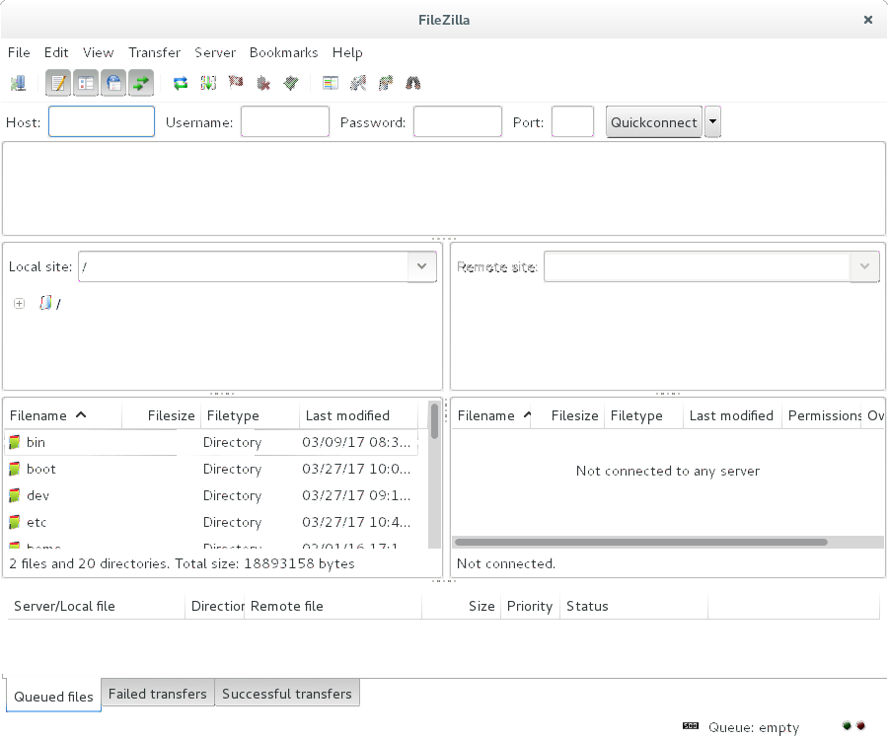
File transfer (FileZilla)
Open FileZilla

Slide 9
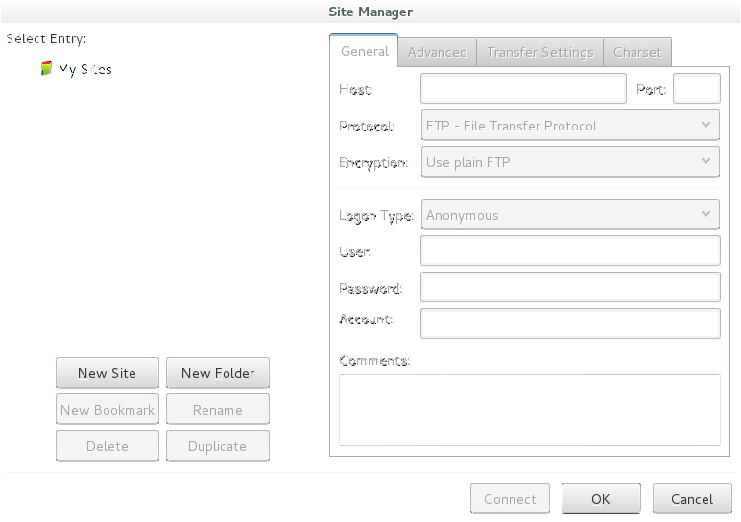
File transfer (FileZilla)
Creating a new ‘site’ (I)

Slide 10
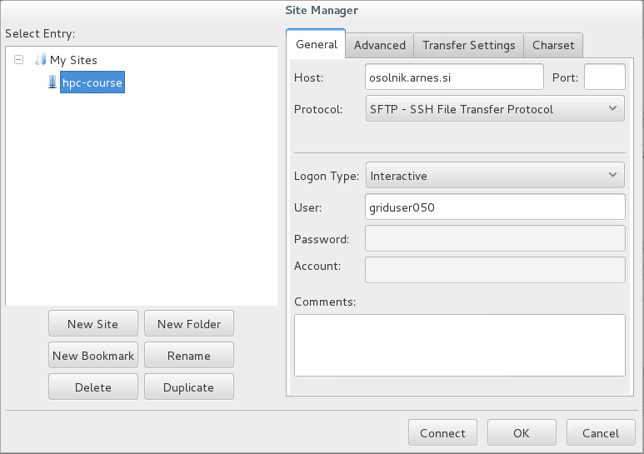
File transfer (FileZilla)
Creating a new ‘site’ (II)

Slide 11
File transfer (FileZilla)
Open the ‘Sites manager’ again

Slide 12
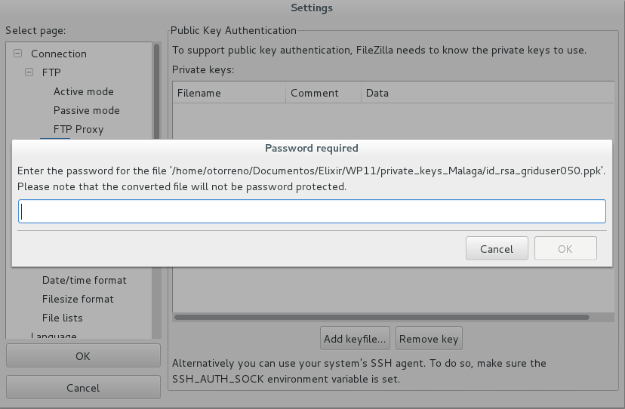
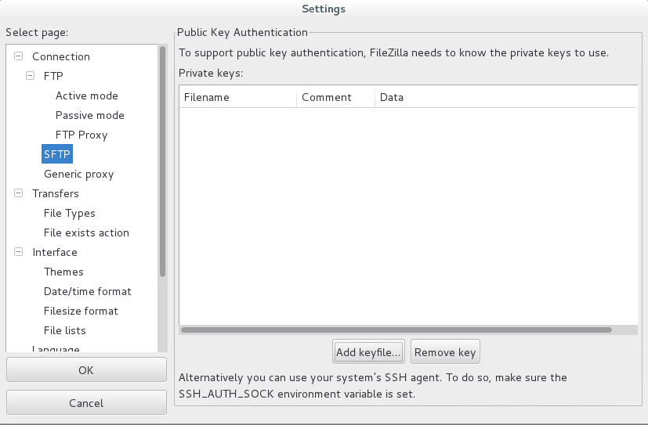
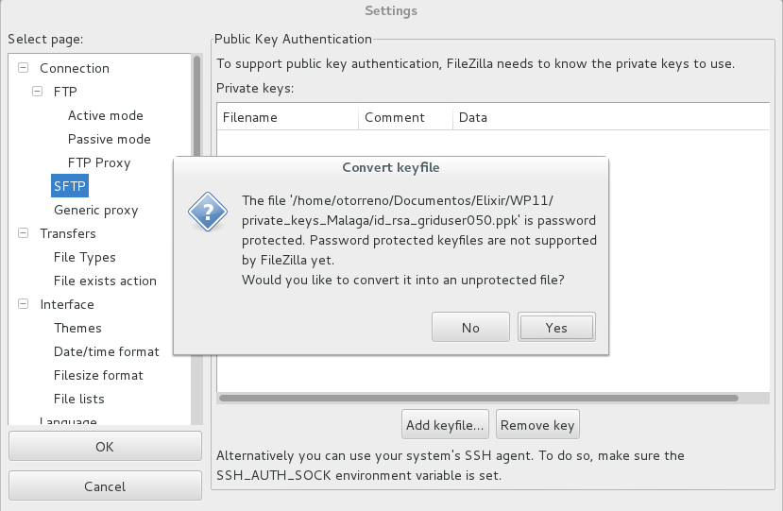
File transfer (FileZilla)
Click ‘Edit -> Settings’
Save the unprotected key file

Slide 13
File transfer (FileZilla)
Connect to the created site

Slide 14
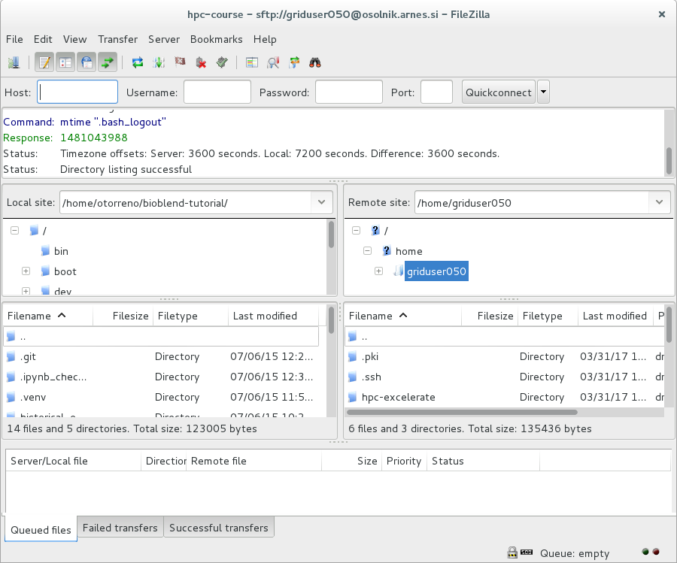
File transfer (FileZilla)
File browsing and transfer

Slide 15
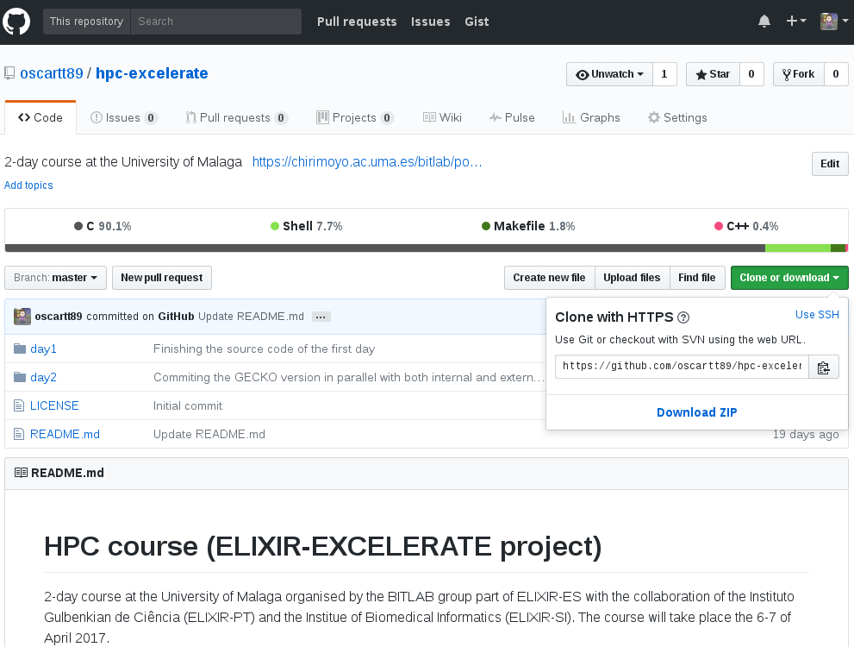
Downloading the course material
Open the GitHub web: https://github.com/oscartt89/hpc-excelerate

Slide 16
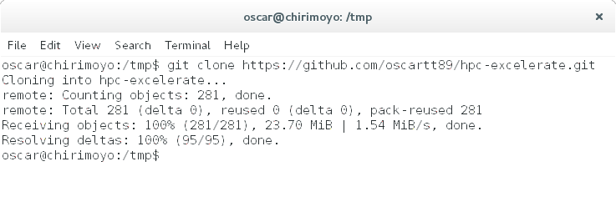
Downloading the course material
Open a terminal window
Type: git clone https://github.com/oscartt89/hpc-excelerate.git

