Slide 1
ELIXIR-EXCELERATE HPC course
6-7 April 2017 – Malaga – Train-the-Researcher
Instructors: Oscar Torreno, Oswaldo Trelles Support: Esteban Perez-Wohlfeil Advisors: Pedro Fernandes, Brane Leskosek

Slide 2

SLURM
Simple Linux Utility for Resources Management
Free and open-source job scheduler for Linux
Used in many supercomputers and clusters
It provides 3 key functions:
Resources allocation
Framework for starting, executing and monitoring jobs
Arbitrates resources contention implementing a queue of pending jobs
Is the workload manager of about 60% of the TOP500 supercomputers
Uses a best-fit algorithm based on Hilbert Curve scheduling to optimize tasks assignments

Slide 3
Modules
Software packages are encapsulated into modules
Is a way to simplify dependencies and the system administration
List the available modules for loading: module avail
Load a given module: module load openmpi
Unload a given module: module unload openmpi

Slide 4
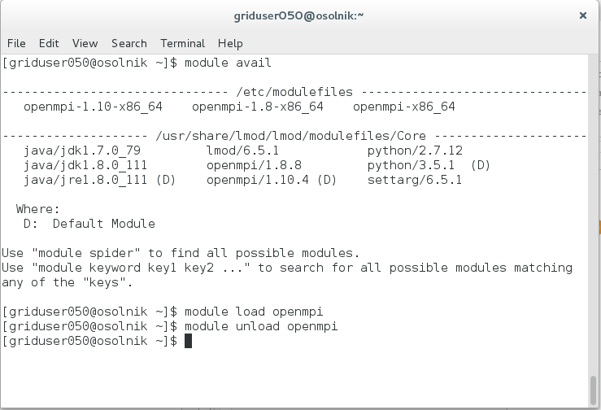
Modules

Slide 5
Job management in SLURM
Submit an interactive job: srun --cores 4 --nodes 1 -p local ./bin/omp_hello
Encapsulate the command in a bash script (hellompi.sh): #!/bin/bash module load openmpi mpirun -np 4 ~/hpc-excelerate/day1/bin/mpi_hello_world echo "Done."
Send the bash script to the queue: sbatch -n4 -p local hellompi.sh
Monitor the job: squeue –p local scontrol show job <JOB_ID>
Cancel a job: scancel <JOB_ID>

Slide 6
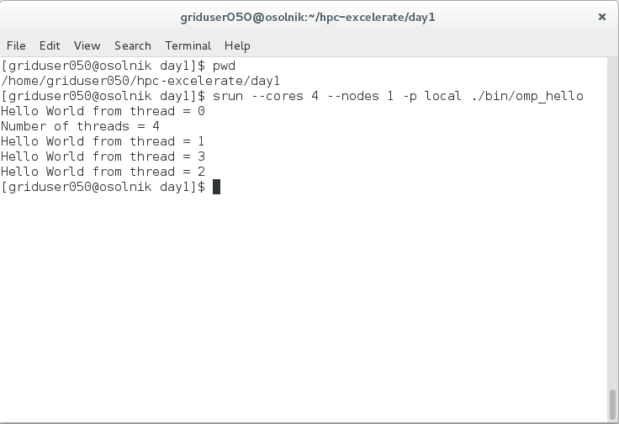
Job management in SLURM

Slide 7
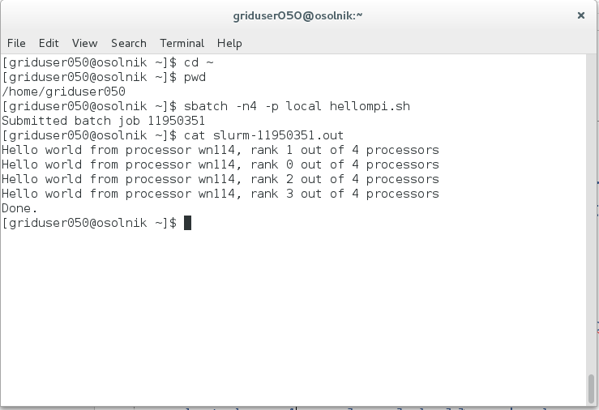
Job management in SLURM

Slide 8
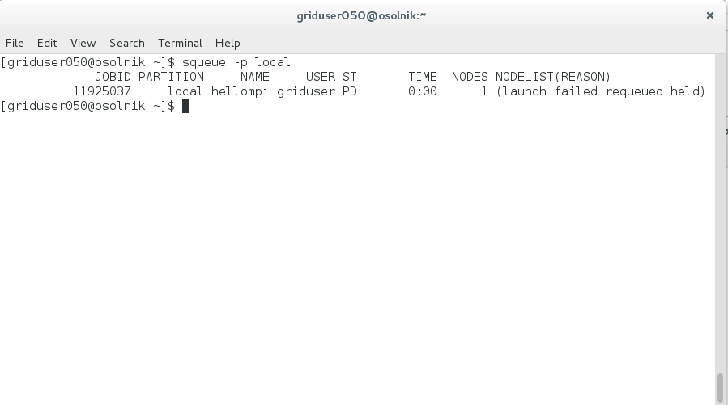
Job management in SLURM

Slide 9
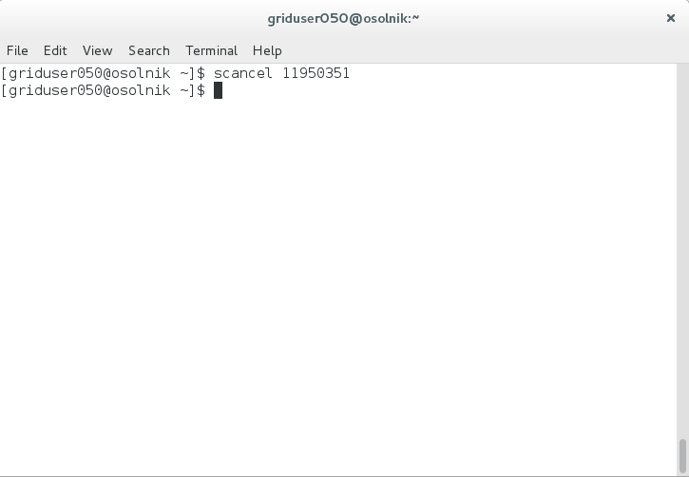
Job management in SLURM

Slide 10
Job parameters in SLURM
Number of cores (same machine)
Number of tasks (potentially in different machines)
Wall time
Main memory (RAM)
Job name
Standard output and error filenames
Partition

Slide 11
Job parameters in SLURM
Inside the bash script (as comments)
#!/bin/bash
# number of tasks:
#SBATCH -n 4
# memory:
#SBATCH --mem=2gb
# time:
#SBATCH --time=00:10:00
# Set output and error files (deactivated here)
##SBATCH --error=job.%J.err
##SBATCH --output=job.%J.out
# partition:
#SBATCH --partition=local
module load openmpi
echo "time mpirun -np 4 ~/hpc-excelerate/day1/bin/mpi_hello_world"
time mpirun -np 4 ~/hpc-excelerate/day1/bin/mpi_hello_world
echo "Done."
In the submission line:
sbatch -n4 --time=00:10:00 --mem=2gb -p local hellompi.sh

Slide 12
Job parameters in SLURM
In the submission line (overrides the parameters defined in the script):
sbatch -n4 --time=00:10:00 --mem=2gb -p local hellompi.sh

