Slide 1
ELIXIR-EXCELERATE HPC course
6-7 April 2017 – Malaga – Train-the-Researcher
Instructors: Oscar Torreno, Oswaldo Trelles Support: Esteban Perez-Wohlfeil Advisors: Pedro Fernandes, Brane Leskosek

Slide 2

OpenMP
An API for direct multi-threaded, shared memory parallelism
Comprised of 3 primary API components:
Compiler directives
Runtime library routines
Environment variables
An abbreviation of Open Multi-Processing

Slide 3
OpenMP is not …
Designed for distributed memory systems
Guaranteed to make the most efficient use of memory
Required to check data dependencies, race conditions, deadlocks
Designed to handle parallel I/O

Slide 4
Goals of OpenMP
Standardization:
Standard, platform-independent, and endorsed by major hardware and software vendors
Lean and Mean:
Simple and limited yet effective set of directives to obtain significant parallelism
Ease of use:
Capability to incrementally parallelize a serial program bboth with coarse-grain and fine-grain parallelism
Portability:
Source code portability for most major platforms (Unix/Linux and Windows)

Slide 5
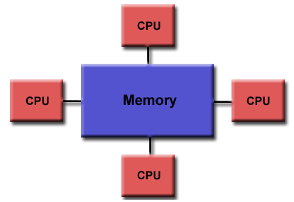
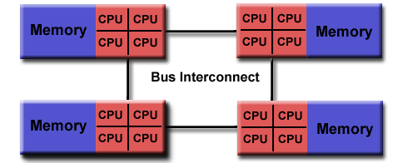
OpenMP Programming model
Shared memory
UMA or NUMA

Slide 6
OpenMP Programming model
Thread-based parallelism
Parallelism is accomplished exclusively by the use of threads
A thread is the smallest execution unit that can be scheduled by the OS
Threads exist within the resources of a single process
Explicit parallelism
OpenMP is an explicit (not automatic) programming model
Parallelisation can be as simple as adding compiler directives or more complex by inserting subroutines

Slide 7
OpenMP Programming model
Fork-join model
All OpenMP programs begin as a single process: the master thread. The master thread executes sequentially until the first parallel region construct is encountered
FORK: the master thread then creates a team of parallel threads.
The statements of the parallel region construct are then executed by the threads
JOIN: When the threads complete the statements, they synchronize and terminate
The number of parallel regions and the threads that comprise them are arbitrary.

Slide 8
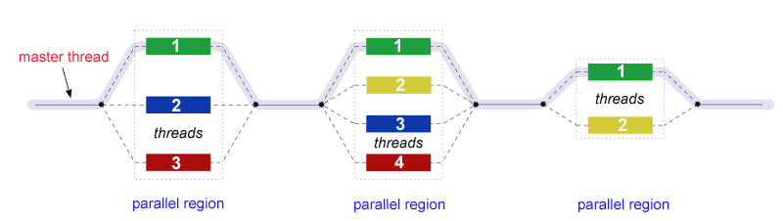
OpenMP Programming model
Fork-join model

Slide 9
OpenMP Programming model
Compiler Directive Based:
Most OpenMP parallelism is specified through the use of compiler directives imbedded in the source code.
Nested Parallelism:
Parallel regions can have other parallel regions inside
Dynamic threads:
It is possible to dynamically alter the number of threads. Intended to promote more efficient use of resources
I/O:
OpenMP does not provide parallel I/O. It is up to the programmer to ensure I/O is correctly conducted in a multi-threaded program

Slide 10
Compiler directives
Compiler directives appear as comments in your source code and are ignored by compilers unless you specify the OpenMP compiler flag
OpenMP compiler directives are used for various purposes:
Spawning a parallel region
Dividing blocks of code among threads
Distributing loop iterations between threads
Serializing sections of code
Synchronization of work among threads
Compiler directives have the following syntax:
sentinel directive-name [clause, ...]
#pragma omp parallel default(shared) private(beta,pi)

Slide 11
Run-time library routines
The OpenMP API includes a number of run-time library routines for:
Setting and querying the number of threads
Querying a thread's unique identifier (thread ID), a thread's ancestor's identifier, the thread team size
Setting and querying the dynamic threads feature
Querying if in a parallel region, and at what level
Setting and querying nested parallelism
Setting, initializing and terminating locks and nested locks
Querying wall clock time and resolution
#include <omp.h>
int omp_get_num_threads(void)

Slide 12
Environment variables
OpenMP provides several environment variables for controlling the execution of parallel code at run-time:
Setting the number of threads
Specifying how loop interations are divided
Binding threads to processors
Enabling/disabling nested parallelism; setting the maximum levels of nested parallelism
Enabling/disabling dynamic threads
Setting thread stack size
Setting thread wait policy
export OMP_NUM_THREADS=8

Slide 13
OpenMP sample code
#include <omp.h>
main () {
int var1, var2, var3;
//Serial code
//Beginning of parallel region. Fork a team of threads.
//Specify variable scoping
#pragma omp parallel private(var1, var2) shared(var3)
{
//Parallel region executed by all threads
.
//Other OpenMP directives
.
//Run-time Library calls
.
//All threads join master thread and disband
}
//Resuming serial code
}

Slide 14
Questions?

Slide 15
Practical session

Slide 16

Practical session
Where is the source code?
https://github.com/oscartt89/hpc-excelerate/tree/master/day1
All the omp_*.c files inside the ‘src’ folder
5 exercises
Hello world
Loop-work sharing
Sections-work sharing
Reduction
Varying the number of threads

Slide 17
Practical session – Hello world
In this example each OpenMP thread will provide a greeting, printing its rank. The master process will print the total number of OpenMP threads
Open ‘omp_hello.c’
Compile
gcc -O3 -fopenmp omp_hello.c -o ../bin/omp_hello
Execute (local)
./bin/omp_hello
Execute (cluster)
srun –-cores 4 --nodes 1 –p local ./bin/omp_hello

Slide 18
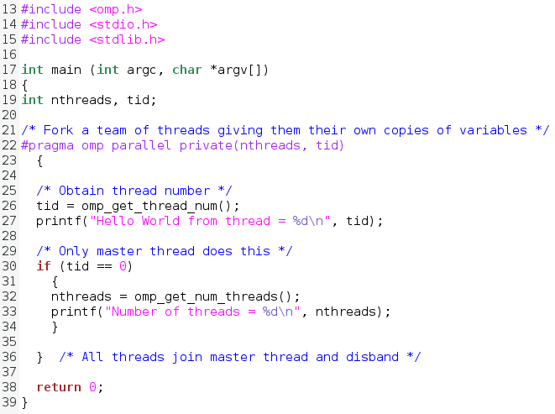
omp_hello.c

Slide 19
Practical session – Hello world
In this example each OpenMP thread will provide a greeting, printing its rank. The master process will print the total number of OpenMP threads
Open ‘omp_hello.c’
Compile
gcc -O3 -fopenmp omp_hello.c -o ../bin/omp_hello
Execute (local)
./bin/omp_hello
Execute (cluster)
srun –-cores 4 --nodes 1 –p local ./bin/omp_hello

Slide 20
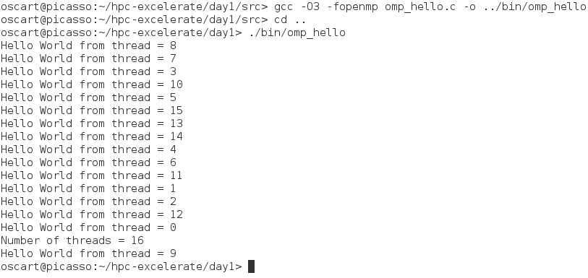
Practical session – Hello world

Slide 21
Practical session – Loop-work sharing
In this example each OpenMP thread will dynamically process a chunk of a given size of the for loop. They will print their rank, which position they calculated and the actual computed value
Open ‘omp_workshare1.c’
Compile
gcc -O3 -fopenmp omp_workshare1.c -o ../bin/omp_workshare1
Execute (local)
./bin/omp_workshare1
Execute (cluster)
srun –-cores 4 --nodes 1 –p local ./bin/omp_workshare1

Slide 22
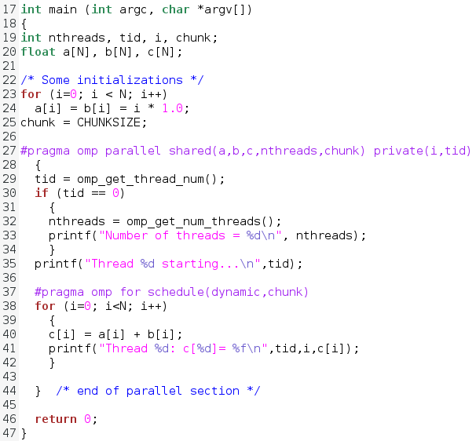
omp_workshare1.c

Slide 23
Practical session – Loop-work sharing
In this example each OpenMP thread will dynamically process a chunk of a given size of the for loop. They will print their rank, which position they calculated and the actual computed value
Open ‘omp_workshare1.c’
Compile
gcc -O3 -fopenmp omp_workshare1.c -o ../bin/omp_workshare1
Execute (local)
./bin/omp_workshare1
Execute (cluster)
srun –-cores 4 --nodes 1 –p local ./bin/omp_workshare1

Slide 24
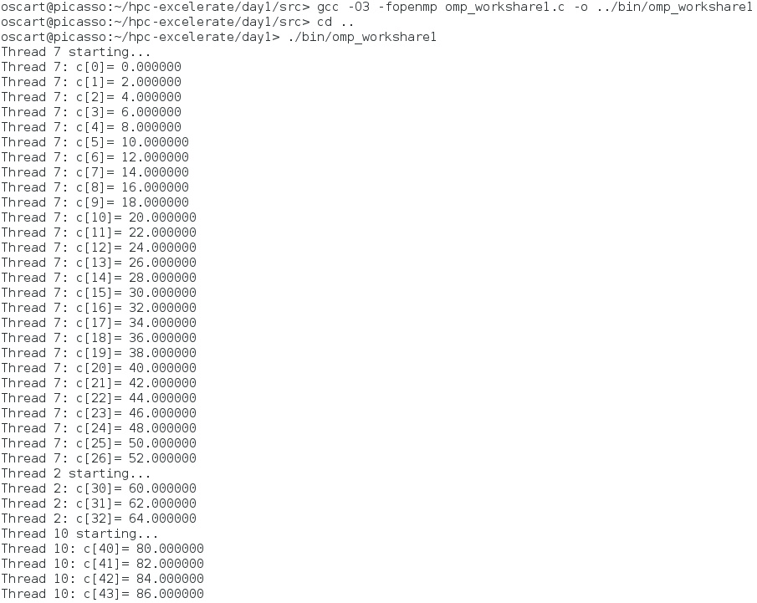
Practical session – Loop-work sharing

Slide 25
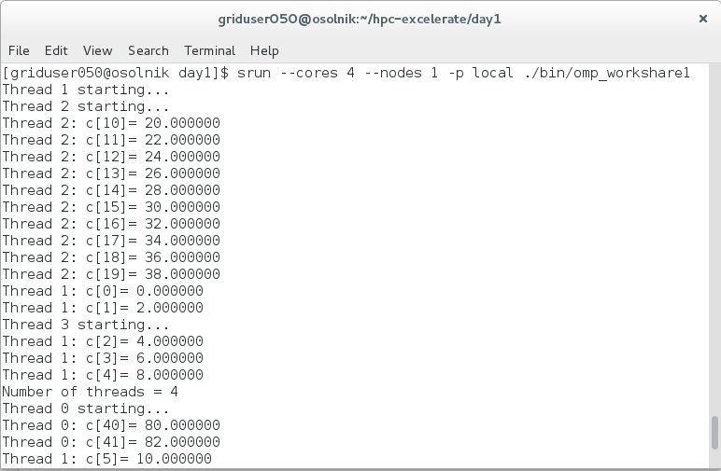
Practical session – Loop-work sharing

Slide 26
Practical session – Sections-work sharing
In this example each of the OpenMP sections will be executed in parallel. The thread(s) executing the sections will print their rank, which position they calculated and the actual computed value
Open ‘omp_workshare2.c’
Compile
gcc -O3 -fopenmp omp_workshare2.c -o ../bin/omp_workshare2
Execute (local)
./bin/omp_workshare2
Execute (cluster)
srun –-cores 4 --nodes 1 –p local ./bin/omp_workshare2

Slide 27
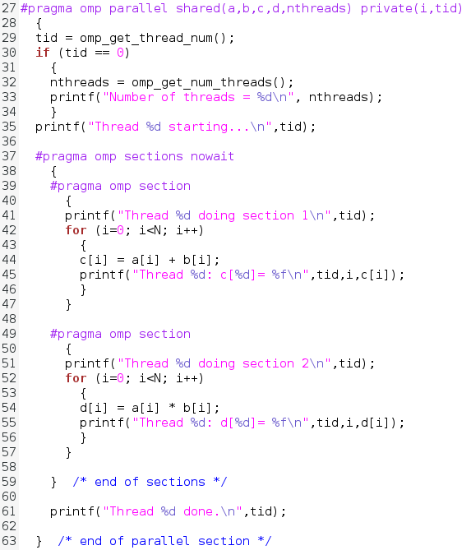
omp_workshare2.c

Slide 28
Practical session – Sections-work sharing
In this example each of the OpenMP sections will be executed in parallel. The thread(s) executing the sections will print their rank, which position they calculated and the actual computed value
Open ‘omp_workshare2.c’
Compile
gcc -O3 -fopenmp omp_workshare2.c -o ../bin/omp_workshare2
Execute (local)
./bin/omp_workshare2
Execute (cluster)
srun –-cores 4 --nodes 1 –p local ./bin/omp_workshare2

Slide 29
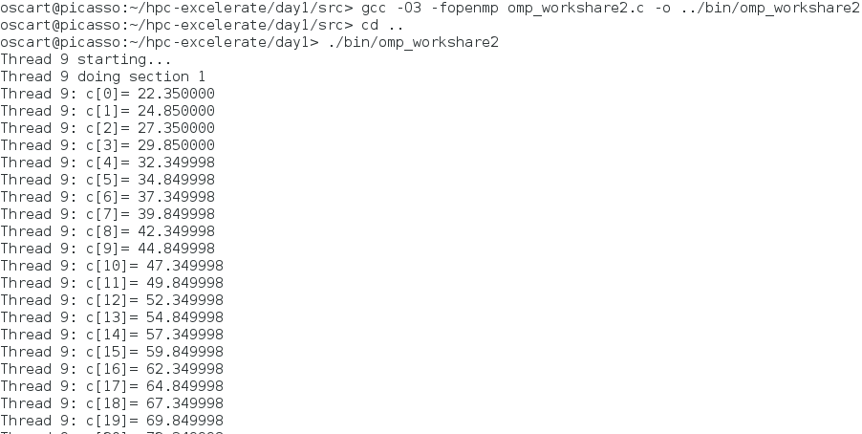
Practical session – Sections-work sharing

Slide 30
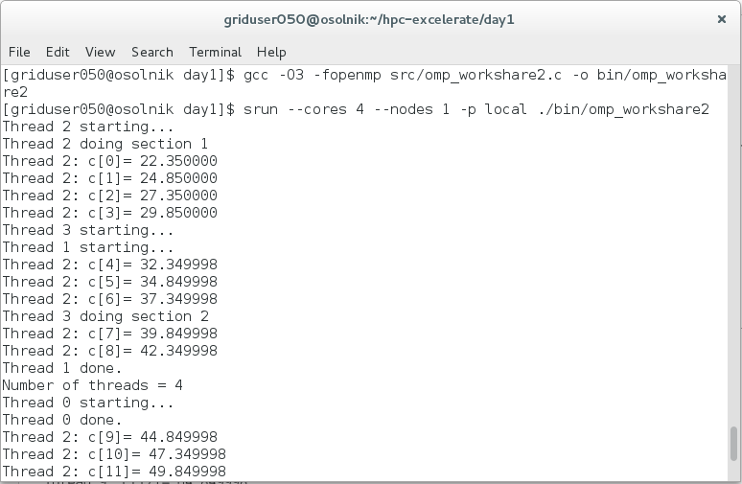
Practical session – Sections-work sharing

Slide 31
Practical session – Reduction
In this example the sum of a given vector is calculated in a parallel for OpenMP construct. OpenMP is instructed to reduce the partial results using the '+' operator
Open ‘omp_reduction.c’
Compile
gcc -O3 -fopenmp omp_reduction.c -o ../bin/omp_reduction
Execute (local)
./bin/omp_reduction
Execute (cluster)
srun –-cores 4 --nodes 1 –p local ./bin/omp_reduction

Slide 32
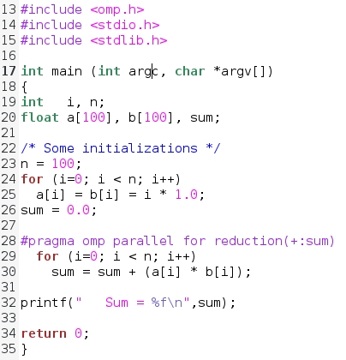
omp_reduction.c

Slide 33
Practical session – Reduction
In this example the sum of a given vector is calculated in a parallel for OpenMP construct. OpenMP is instructed to reduce the partial results using the '+' operator
Open ‘omp_reduction.c’
Compile
gcc -O3 -fopenmp omp_reduction.c -o ../bin/omp_reduction
Execute (local)
./bin/omp_reduction
Execute (cluster)
srun –-cores 4 --nodes 1 –p local ./bin/omp_reduction

Slide 34

Practical session – Reduction

Slide 35
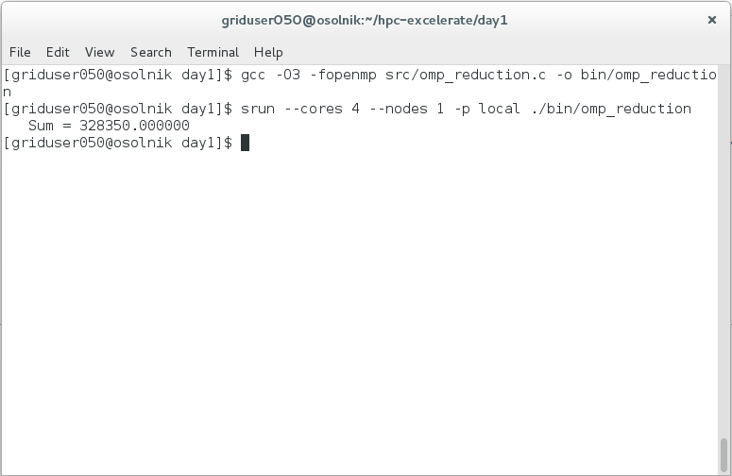
Practical session – Reduction

Slide 36
Practical session – Varying # of threads
To vary the number of OpenMP threads you can do it both inside and outside the code:
Exporting an environment variable to the desired value:
export OMP_NUM_THREADS=8
Using the omp_set_num_threads function inside the source code and before the OpenMP section:
omp_set_num_threads(8);
Execute (change the number of threads and re-run the omp_hello program)
export OMP_NUM_THREADS=8
./bin/omp_hello
Execute (change the number of cores in srun)
srun –-cores 8 --nodes 1 –p local ./bin/omp_hello

Slide 37
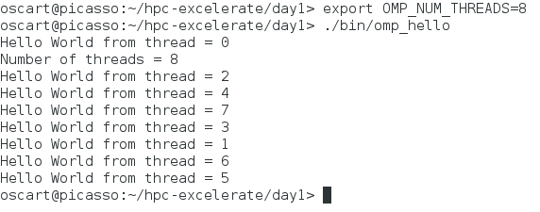
Practical session – Varying # of threads

Slide 38
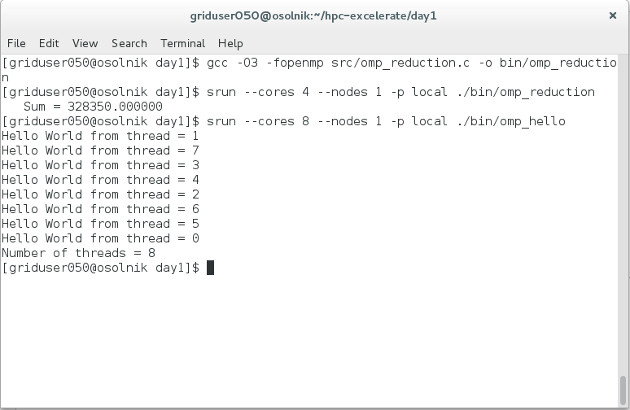
Practical session – Varying # of threads

Slide 39
Acknowledgements
OpenMP tutorial of Blaise Barney, Lawrence Livermore National laboratory: https://computing.llnl.gov/tutorials/openMP/

