Slide 1
ELIXIR-EXCELERATE HPC course
6-7 April 2017 – Malaga – Train-the-Researcher
Instructors: Oscar Torreno, Oswaldo Trelles Support: Esteban Perez-Wohlfeil Advisors: Pedro Fernandes, Brane Leskosek

Slide 2

Practical session
Where is the source code?
https://github.com/oscartt89/hpc-excelerate/tree/master/day2/gecko
All the files inside the ‘src’ folder
Main GitHub repository of GECKO:
https://github.com/oscartt89/gecko

Slide 3
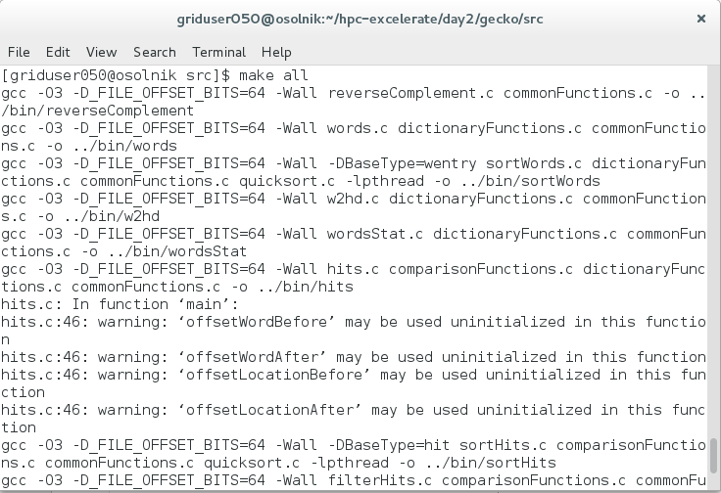
Compilation instructions
First you need to enter in the gecko/src folder of the day2 folder. Then the following line will compile all the GECKO modules:
make all

Slide 4
Pairwise comparison
The fist exercise consists on comparing the 2 genomes inside the exp1 folder
To do that you should enter such folder and execute the following line: ../../bin/workflow.sh G1.fna G2.fna 100 65 32 The parameters mean the following:
G1.fna - query sequence
G2.fna - reference sequence
100 - minimal HSP length
65 - minimal HSP similarity (i.e. actual score/max score * 100.0)
32 - K-mer size for the hits/seeds step. Lower values increase sensitivity and running time

Slide 5
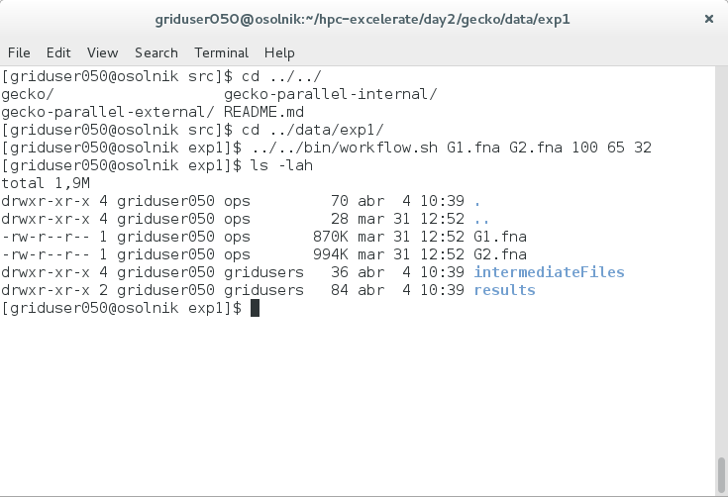
Pairwise comparison

Slide 6
Pairwise comparison
This execution will generate two folders:
intermediateFiles - which will contain the input sequence dictionaries and the hits/seeds of the comparison
results - which will contain the resulting CSV, frags, frags.INF and frags.MAT files.

Slide 7
Multiple genome comparison
This second exercise compares 6 - n genomes following an all-versus-all study. This study leads to 15 - c=n·(n-1)/2 genome comparisons given the symmetric property of genome comparisons.
To execute this exercise you need to use the following line (being at the exp2 folder): ../../bin/allVsAll.sh . 100 65 16 fasta
. - folder where the genomes are stored (current directory in this case)
100 - minimal HSP length
65 - minimal HSP similarity (i.e. actual score/max score * 100.0)
16 - K-mer size for the hits/seeds step. Lower values increase sensitivity and running time
fasta - Extension of the genome files to be compared

Slide 8
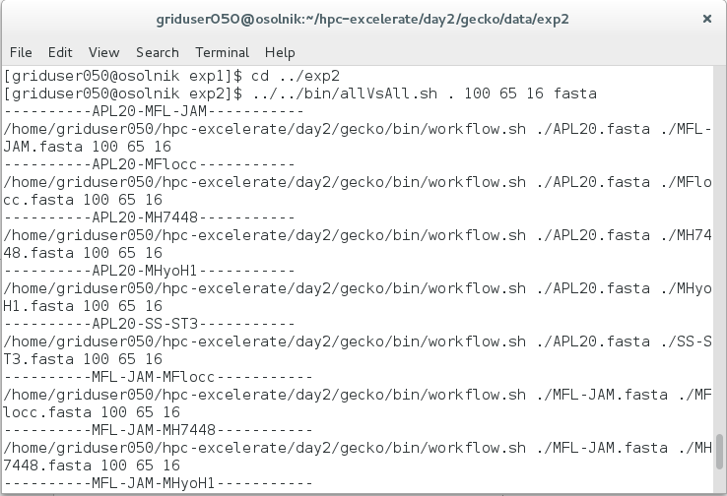
Multiple genome comparison

Slide 9
Multiple genome comparison
This execution will generate two folders:
intermediateFiles - which will contain the input sequence dictionaries and the hits/seeds of the comparison
results - which will contain the resulting CSV, frags, frags.INF and frags.MAT files.

Slide 10
Visualizing the results
The GECKO-MGV web visualization tool can be used to explore the results. It is available at: https://pistacho.ac.uma.es/
For our simple exercise you should download the CSV from the cluster to your local computer. After that you have to load the file in the web application using the "Load from local" button (i.e. the floppy disk one).
A complete user manual of the web application is available at (in case you want to explore further functionality): https://chirimoyo.ac.uma.es/gecko/documents/GeckoMGV-ECCB-SupplementaryMaterial.pdf

Slide 11
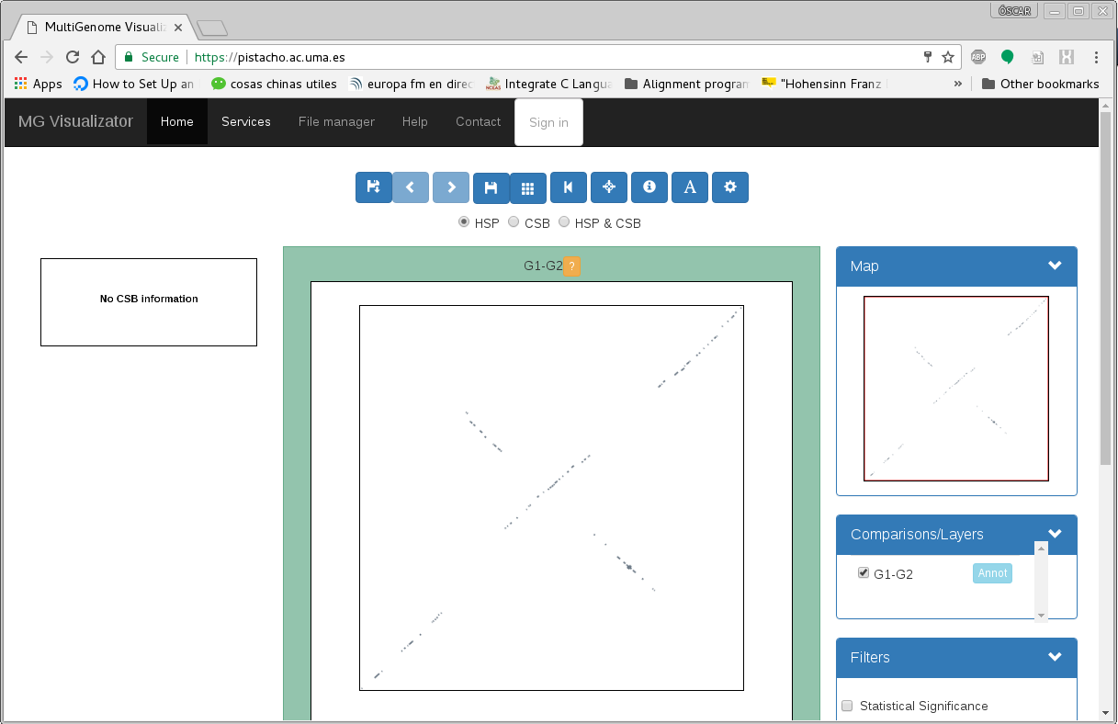
Visualizing the results

