Slide 1
ELIXIR-EXCELERATE HPC course
6-7 April 2017 – Malaga – Train-the-Researcher
Instructors: Oscar Torreno, Oswaldo Trelles Support: Esteban Perez-Wohlfeil Advisors: Pedro Fernandes, Brane Leskosek

Slide 2
Motivation
Multiple genome comparisons represent the common approach to study such relations between species and how they have evolved over time
Comparing 2 genomes is a computationally-heavy task
Even harder for multiple genomes at once
Cardinality of biological sequence databases
Mixture of lightweight and heavyweight tasks or the dissimilar combination of computation and I/O operations.
Other multiple-level parallel strategies exist for multiple genome comparison
Related approaches face several limitations such as the limit in input sequence length

Slide 3
Related work
GPUs, FPGAs, multicores and/or Intel Xeon Phi being able to compare at most sequences of up to hundreds of millions of characters (10⁸)
Some solutions only report the alignment score but not the actual alignment
Hybrid approaches following two-level parallelization schemes
Long sequences comparison still take 9 hours for human chromosomes

Slide 4
GECKO software
Out-of-core pairwise genome comparison
Modular software which reduces execution time in pairwise and multiple genome comparison studies
Breaking the barriers on the length of the input sequence
Reducing the computational space to accelerate long sequences comparison
Sequence length is one of the parameters governing the execution time
Sequential program with room to be improved

Slide 5
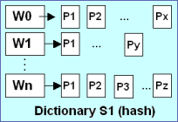
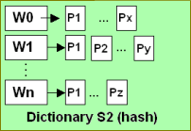
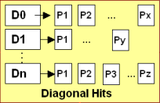


GECKO software
Hashing
(including sub-processes such as sorting, grouping, etc)
Calculate HITS
Hits are perfect matches between words
HITS by diagonal
Sort Hits by diagonal
HITS Extension
Search for larger HSPs using hits as seed poitns
Sequence 1 (W size)
Sequence 2
Notes:
First of all given the two sequences we need to perform tha calculation of the dictionaries. This step is composed by several sub-processes
After that we calculate the HITS that will work as seed point from where to extend the HSPs
Before the calculation of the HSPs is neccesary to sort the Hits by diagonal, to be able after that to filter the hits
After all the process we have a lot of post-processing processes such as the visualization, frequencies, words distribution etc.

Slide 6
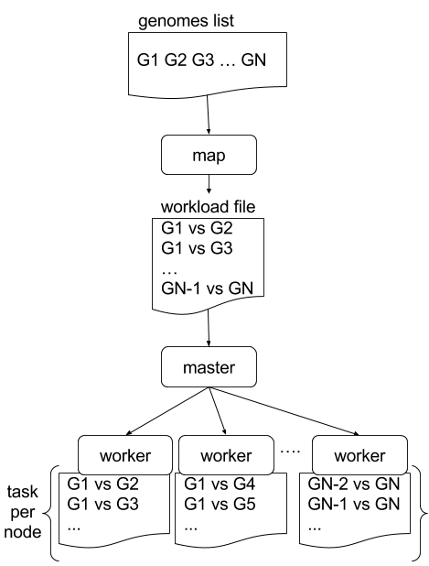
Two-level parallel strategy
Multiple genome comparison level (1st level)

Slide 7
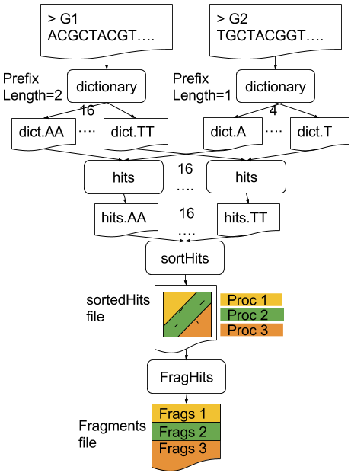
Two-level parallel strategy
Pairwise genome comparison level (2nd level)

Slide 8
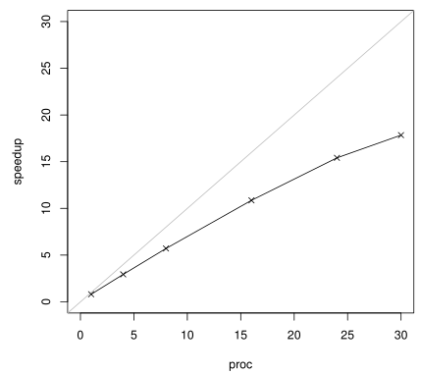
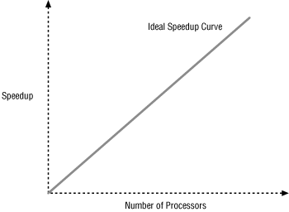
Measuring application speedup and efficiency
Speedup is calculated dividing the time spent with n cores by the time spent with 1 core

Slide 9
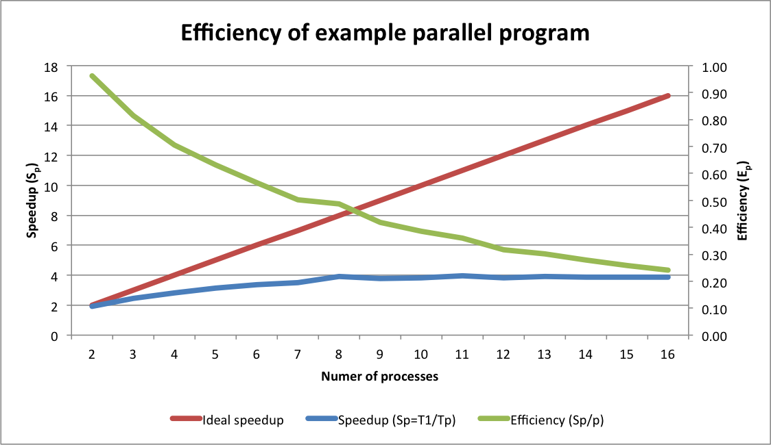
Measuring application speedup and efficiency
Efficiency is calculated dividing the obtained speedup with the ideal one (which is the number of cores being used)

Slide 10
Results: Infrastructure & datasets
Infrastructure:
Fat nodes of the Picasso supercomputer located at the University of Málaga (Spain). Each node (2 TB of RAM and eight Intel E7-4870 processors). Only one node has been used (no MPI communications over the network) except for the first level 128 cores measurement. Lustre shared filesystem.
Datasets:
In the first level, two sets of 30 and 40 small sequences with an average length of 1 Mbp.
In the second level, a set of bacteria and mammalian sequences ranging from 5 to 410 Mbp.

Slide 11
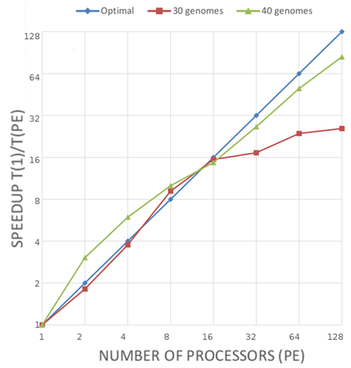
Results: 1st level speedup

Slide 12
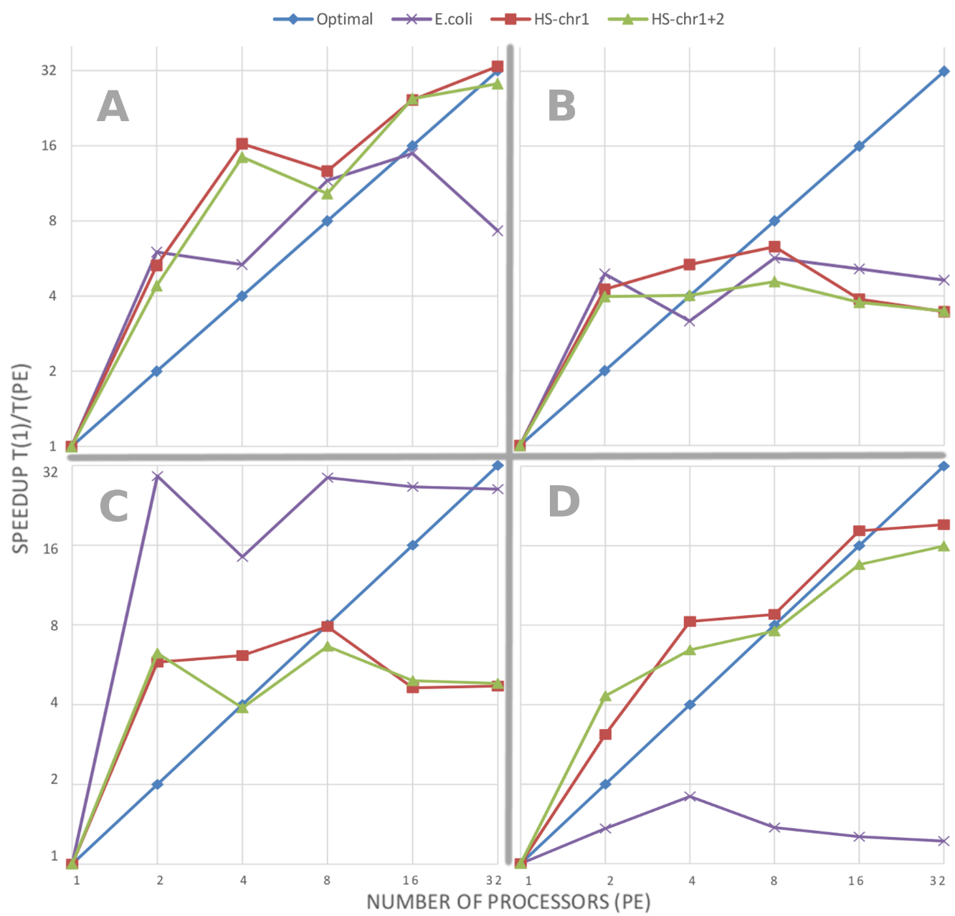
Results: 2nd level speedup

Slide 13
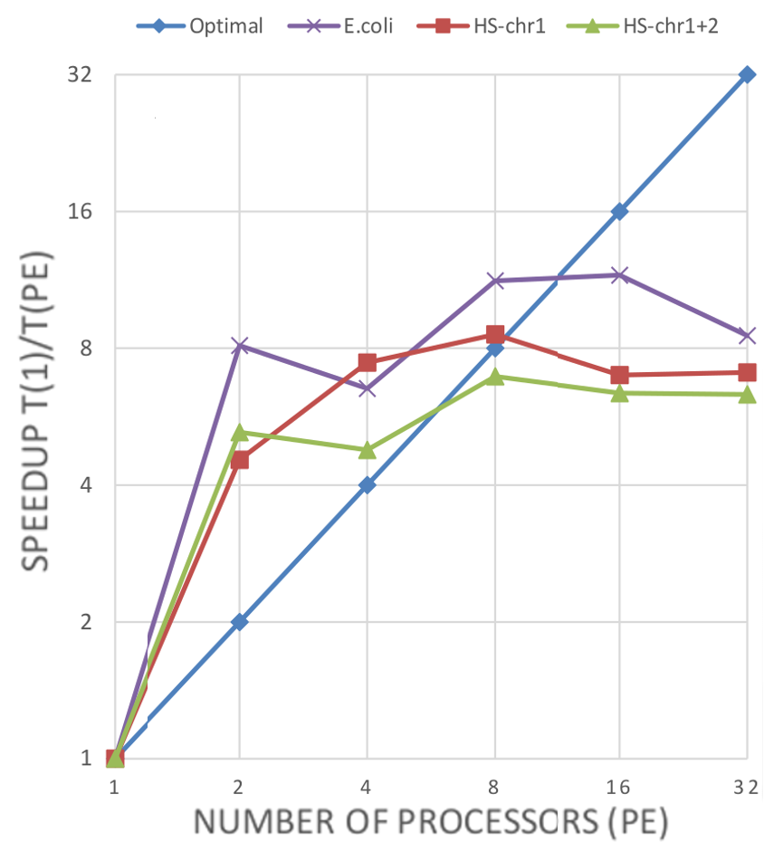
Results: 2nd level speedup

Slide 14
Results: Time reduction
A 30 genomes multiple comparison can be performed in 10 seconds compared to the 250 seconds of the sequential version
A comparison of two concatenated human chromosomes can be carried out in 49 minutes compared to the 5 hours and 11 minutes of the original code

Slide 15
Conclusions
We approach the parallelization of multiple genome comparisons following a two-level strategy.
Although the second parallelization level is customised for GECKO, the first one is generic enough to be used with any of the GECKO equivalent applications.
The tasks per core parameter allows overlapping the execution of tasks, what we found specially useful in terms of performance while working with a disparate combination of CPU and I/O bounded applications.
The obtained results show that all GECKO modules reduce significantly their execution time.
Analysing the speedup, we can extract the correct number of PE for each of the modules.

Slide 16
Conclusions
The different values of number of PE suggest that the use of auto-scaling architectures such as cloud computing could be suitable for GECKO.
The original version of GECKO was already able to compare two concatenated chromosomes in less time than parallel methods, which take 9 hours. The parallel version presented in this document reduces the execution time even further reducing it to 49 minutes.

