Slide 1
ELIXIR-EXCELERATE HPC course
6-7 April 2017 – Malaga – Train-the-Researcher
Instructors: Oscar Torreno, Oswaldo Trelles Support: Esteban Perez-Wohlfeil Advisors: Pedro Fernandes, Brane Leskosek

Slide 2

Practical session
Where is the source code?
https://github.com/oscartt89/hpc-excelerate/tree/master/day2/gecko-parallel-internal
https://github.com/oscartt89/hpc-excelerate/tree/master/day2/gecko-parallel-external
All the files inside the ‘src’ folder

Slide 3
Exercise
Execute the pairwise and multiple genome comparisons with the help of these slides or the GitHub README
Create an Excel/Libre Office Calc file with the speedup obtained using the different number of cores
(Optional) Open ‘gecko-parallel-internal/src/dictionary.c’ and ‘gecko-parallel-external/src/scheduler.c’ to observe how you can build OpenMP and MPI hybrid applications

Slide 4
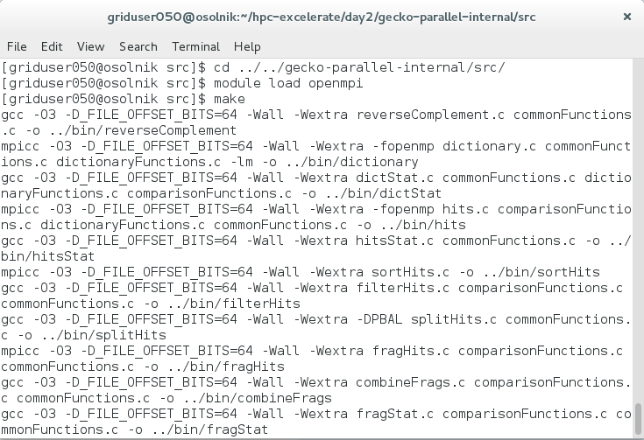
Compilation instructions
First you need to enter in the gecko-parallel-internal/src folder of the day2 folder. Then the following line will compile all the GECKO modules:
module load openmpi
make all

Slide 5
Running your first comparison in parallel
The test folder present at the same level as the src folder contains five folders:
run2 which contains the genomes, and the workload files for the dictionary and hits programs. The workload in this case is the following: A,C G,T
run4 is equivalent to the previous folder but the workloads vary to match 4 cores and 4 tasks per core
run8 is equivalent to the previous folder but the workloads vary to match 8 cores and 2 tasks per core
run16 is equivalent to the previous folder but the workloads vary to match 16 cores and 2 tasks per core

Slide 6
Running your first comparison in parallel
Before executing a comparison in parallel you need to modify the BASE_DIR variable of the workflow.sh script which is in the bin folder. This variable should point to the full path of the bin folder.
After this modification, you can navigate to one of the test/runX folders in order to execute the the parallel version of GECKO with a given number of cores (2, 4, 8 and 16 in these examples).

Slide 7
Running your first comparison in parallel
# Running with 2 cores
sbatch --ntasks 5 --mem=10gb --time=00:15:00 -p local ../../bin/workflow.sh S1 S2 100 65 32 3 2
# Running with 4 cores
sbatch --ntasks 9 --mem=10gb --time=00:15:00 -p local ../../bin/workflow.sh S1 S2 100 65 32 5 4
# Running with 8 cores
sbatch --ntasks 17 --mem=10gb --time=00:15:00 -p local ../../bin/workflow.sh S1 S2 100 65 32 9 2
# Running with 16 cores
sbatch --ntasks 65 --mem=10gb --time=00:15:00 -p local ../../bin/workflow.sh S1 S2 100 65 32 17 4

Slide 8
Running your first comparison in parallel
As you may have noticed, the execution line is similar to the one of the sequential version but with 2 additional parameters at the end. For the first execution line:
3 which is the number of cores
2 which is the number of simultaneous tasks per core

Slide 9
Running your first comparison in parallel
What precedes the workflow.sh script in the submission line are specific parameters of the distributed resources manager:
ntasks: number of cores (not necessarily in the same node)
mem: amount of memory required
time: walltime required to run the application
The execution generates a number of intermediate files and also the .frags and .csv resulting files. In addition the file time.txt will contain the execution time ([h]:mm:ss format) of the parallelised modules.

Slide 10
External parallelization level
The gecko-parallel-external folder contains the code, scripts and data to be used to illustrate the external parallelisation level.

Slide 11
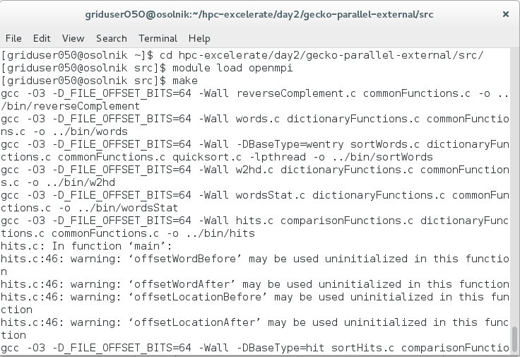
Compilation instructions
You need to enter in the gecko-parallel-external/src folder of the day2 folder. Then the following lines will compile all the GECKO modules:
module load openmpi
make all

Slide 12
Running the all-vs-all comparison in parallel
In this exercise we will compare the same 6 genomes as in the multiple genome comparison exercise of the original and sequential version of GECKO. For this exercise you need to enter the data folder. Once in the mentioned folder, you need to perform the following steps

Slide 13
Running the all-vs-all comparison in parallel
Generate all the reverse complementary sequences with the following steps:
Calculate the once reverses:
../bin/generateReversesWorkload.sh fasta > workloadReverses.sh
sbatch --ntasks 4 --mem=5gb --time=00:15:00 --partition=local ../bin/slurmWrapperMPI.sh mpirun -np 4 /home/griduser050/hpc-excelerate/day2/gecko-parallel-external/bin/scheduler workloadReverses.sh 2
Move them to the reverses folder:
mkdir reverses
mv *-revercomp.fasta reverses/

Slide 14
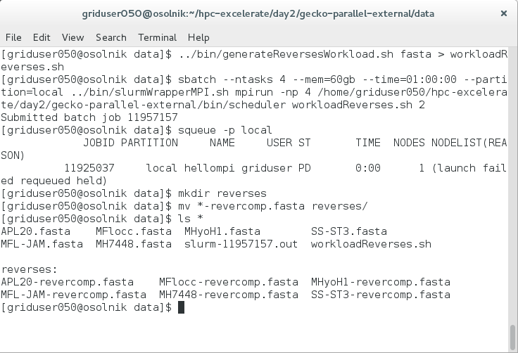
Running the all-vs-all comparison in parallel

Slide 15
Running the all-vs-all comparison in parallel
Generate all the dictionaries for the forward and reverse complementary sequences with the following steps:
Calculate the once dictionaries:
../bin/generateDictionariesWorkload.sh fasta > workloadDictionaries.sh
sbatch --ntasks 7 --mem=10gb --time=00:15:00 --partition=local ../bin/slurmWrapperMPI.sh mpirun -np 7 /home/griduser050/hpc-excelerate/day2/gecko-parallel-external/bin/scheduler workloadDictionaries.sh 2
Move them to the dictionaries folder:
mkdir dictionaries
mv *.d2h* dictionaries/
rm -rf *.words.sort

Slide 16
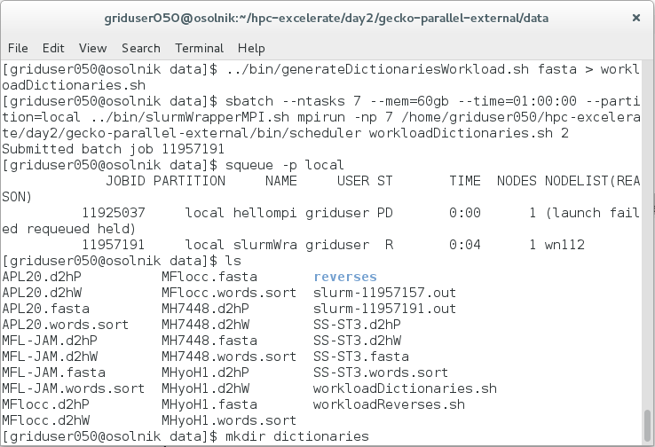
Running the all-vs-all comparison in parallel

Slide 17
Running the all-vs-all comparison in parallel
Generate all the fragment files for all the comparisons with the following steps:
Calculate the fragments:
../bin/allVsAll.sh 100 65 16 fasta > workloadFrags.sh
sbatch --ntasks 7 --mem=10gb --time=00:15:00 --partition=local ../bin/slurmWrapperMPI.sh mpirun -np 7 /home/griduser050/hpc-excelerate/day2/gecko-parallel-external/bin/scheduler workloadFrags.sh 2
The results will be placed in the ‘frags’ folder

Slide 18
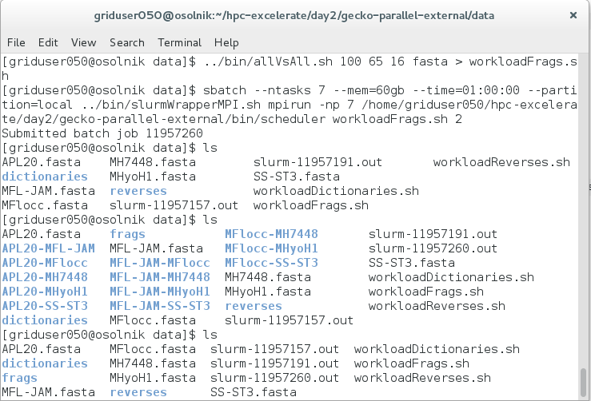
Running the all-vs-all comparison in parallel

