Slide 1
ELIXIR-EXCELERATE HPC course
6-7 April 2017 – Malaga – Train-the-Researcher
Instructors: Oscar Torreno, Oswaldo Trelles Support: Esteban Perez-Wohlfeil Advisors: Pedro Fernandes, Brane Leskosec

Slide 2
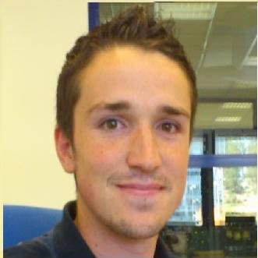
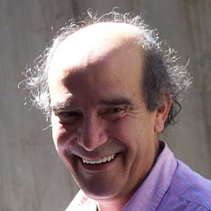

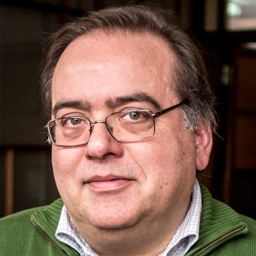
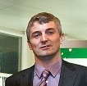
Instructors, support and advisors
Oscar Torreno
ELIXIR-Spain
Training coordinator
and instructor
Oswaldo Trelles
ELIXIR-Spain
Training coordinator
and instructor
Esteban Perez-Wohlfeil
ELIXIR-Spain
Support
Pedro Fernandes
ELIXIR-Portugal
Subtask leader
and advisor
Brane L. Leskosek (SI)
ELIXIR-Slovenia
eLearning / advisor

Slide 3
Overview
This course aims at introducing the participants in the complexities of parallel programming with emphasis on genome-scale comparison algorithms.
The theoretical aspects of this course cover (a) the parallel programing background, with a quick overview in the architectures and programming models; and (b) the basis for genome-scale sequence comparison algorithms.
The practical aspects are organised to master the concepts of data distribution and balancing using a Map-Reduce strategy and internal coding with MPI and OpenMP.

Slide 4
Schedule
6 April
9:00 – 9:15 Welcome and introduction
9:15 – 10:00 Introduction to HPC concepts (theoretical part)
10:00 – 11:00 SSH connection, file transfers and SLURM introduction
11:00 – 11:30 Coffee break
11:30 – 13:30 Introduction and practical sessions on OpenMP and MPI
13:30 – 14:30 Lunch
14:30 – 15:00 Introduction to sequence database search and dynamic data distribution
15:00 – 16:00 Practical session on sequence database search with MPI and with dynamic data distribution (part 1)
16:00 – 16:30 Coffee break
16:30 – 17:45 Practical session on sequence database search with MPI and with dynamic data distribution (part 2)
17:45 – 18:00 Summary of the day

Slide 5
Schedule
7 April
8:00 – 8:45 Second day presentation.
Background on pairwise and multiple genome comparison.
Introduction to GECKO.
08:45 – 9:45 Practical session with GECKO
taking a look at GECKO structure looking for possible parallelization strategies.
09:45 – 10:15 Description and pseudo-code of the ideal parallel strategy. 10:15 – 10:45 Coffee break
10:45 – 11:00 Measuring application speedup and efficiency
11:00 – 13:00 Groups organization and start outlining the parallel strategy.
13:00 – 14:00 Lunch
14:00 – 14:30 Presenting the benchmarking results (5 minutes per group)
14:30 – 14:45 Quick recapitulation of the course

Slide 6
Computing resources
We will use the supercomputing facilities of ELIXIR-Slovenia, which are part of the European Grid Infrastructure (EGI)
Total reservation for this course:
Login node: osolnik.arnes.si
3 nodes:
96 cores (32 cores / node)
192 GB of memory (64GB / node)
1,5TB disk space (500GB / node)

