Slide 1
ELIXIR-EXCELERATE HPC course
6-7 April 2017 – Malaga – Train-the-Researcher
Instructors: Oscar Torreno, Oswaldo Trelles Support: Esteban Perez-Wohlfeil Advisors: Pedro Fernandes, Brane Leskosec

Slide 2

MPI – Message Passing Interface
Is a specification of message passing libraries
Addresses the message-passing programming model
The interface attempts to be:
Practical
Portable
Efficient
Flexible
The specification is implemented by different libraries
Available for a number of programming languages

Slide 3
Reasons for using MPI
Standardization:
MPI is the only message passing library that can be considered a standard. It is supported on virtually all HPC platforms.
Portability:
There is little or no need to modify your source code when you port your application to a different platform that supports (and is compliant with) the MPI standard
Performance opportunities:
Vendor implementations should be able to exploit native hardware features to optimize performance.
Functionality:
Over 430 routines available, but most MPI programs can be written using a dozen or less

Slide 4
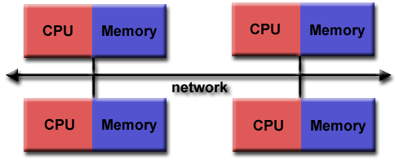
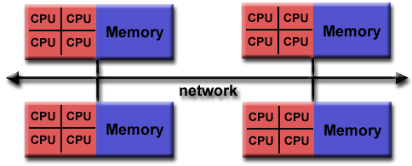
MPI Programming model
Distributed memory

Slide 5
MPI Programming model
MPI was designed for distributed memory architectures
MPI runs on virtually any hardware platform:
Distributed memory
Shared memory
Hybrid
The programming model clearly remains a distributed memory model
Explicit parallelism
the programmer is responsible for correctly identifying parallelism and implementing it

Slide 6
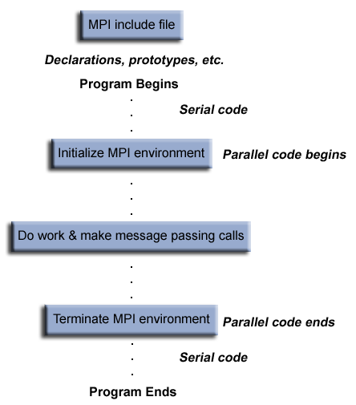
General MPI program structure

Slide 7
MPI – header, format, communicators
MPI header:
#include “mpi.h”
MPI functions format:
rc = MPI_Xxxxx(parameter, ... )
rc = MPI_Bsend(&buf,count,type,dest,tag,comm)
Communicators and groups:
define which collection of processes may communicate with each other
Most MPI routines require you to specify a communicator as an argument
MPI_COMM_WORLD is the predefined communicator that includes all of your MPI processes

Slide 8
MPI – rank
Within a communicator, every process has its own unique, integer identifier
A rank is sometimes also called a "task ID“
Ranks are contiguous and begin at zero.
Used by the programmer to specify the source and destination of messages
Often used conditionally by the application to control program execution (if rank=0 do this / if rank=1 do that).

Slide 9
MPI – environment management routines
This group of routines is used for interrogating and setting the MPI execution environment
Cover different purposes:
initializing and terminating the MPI environment
querying a rank's identity
querying the MPI library's version
etc.

Slide 10
MPI – environment management routines
#include "mpi.h"
#include <stdio.h>
int main(int argc, char *argv[]) {
int numtasks, rank, len, rc;
char hostname[MPI_MAX_PROCESSOR_NAME];
// initialize MPI
MPI_Init(&argc,&argv);
// get number of tasks
MPI_Comm_size(MPI_COMM_WORLD,&numtasks);
// get my rank
MPI_Comm_rank(MPI_COMM_WORLD,&rank);
// get processor name
MPI_Get_processor_name(hostname, &len);
printf ("Number of tasks= %d My rank= %d Running on %s\n", numtasks,rank,hostname);
// do some work with message passing
// done with MPI
MPI_Finalize();
}

Slide 11
MPI – Point-to-Point communications
Involve message passing between two, and only two, different MPI tasks. One task is performing a send operation and the other task is performing a matching receive operation.
There are different types of send and receive routines used for different purposes:
Synchronous
Blocking / Non-blocking
Any type of send routine can be paired with any type of receive routine.
MPI also provides routines to wait for a message's arrival or probe to find out if a message has arrived.

Slide 12
MPI – Point-to-point communication example
#include "mpi.h"
#include <stdio.h>
main(int argc, char *argv[]) {
int numtasks, rank, dest, source, rc, count, tag=1;
char inmsg, outmsg='x';
MPI_Status Stat; // required variable for receive routines
MPI_Init(&argc,&argv);
MPI_Comm_size(MPI_COMM_WORLD, &numtasks);
MPI_Comm_rank(MPI_COMM_WORLD, &rank);
.
.
.
.

Slide 13
MPI – Point-to-point communication example
// task 0 sends to task 1 and waits to receive a return message
if (rank == 0) {
dest = 1;
source = 1;
MPI_Send(&outmsg, 1, MPI_CHAR, dest, tag, MPI_COMM_WORLD);
MPI_Recv(&inmsg, 1, MPI_CHAR, source, tag, MPI_COMM_WORLD, &Stat);
}
// task 1 waits for task 0 message then returns a message
else if (rank == 1) {
dest = 0;
source = 0;
MPI_Recv(&inmsg, 1, MPI_CHAR, source, tag, MPI_COMM_WORLD, &Stat);
MPI_Send(&outmsg, 1, MPI_CHAR, dest, tag, MPI_COMM_WORLD);
}
// query recieve Stat variable and print message details
MPI_Get_count(&Stat, MPI_CHAR, &count);
printf("Task %d: Received %d char(s) from task %d with tag %d \n",
rank, count, Stat.MPI_SOURCE, Stat.MPI_TAG);
MPI_Finalize();
}

Slide 14
MPI – Buffering in the communications
In a perfect world, every send operation would be perfectly synchronized with its matching receive. This is rarely the case
Consider the following two cases:
A send operation occurs 5 seconds before the receive is ready - where is the message while the receive is pending?
Multiple sends arrive at the same receiving task which can only accept one send at a time - what happens to the messages that are "backing up"?
Typically, a system buffer area is reserved to hold data in transit.

Slide 15
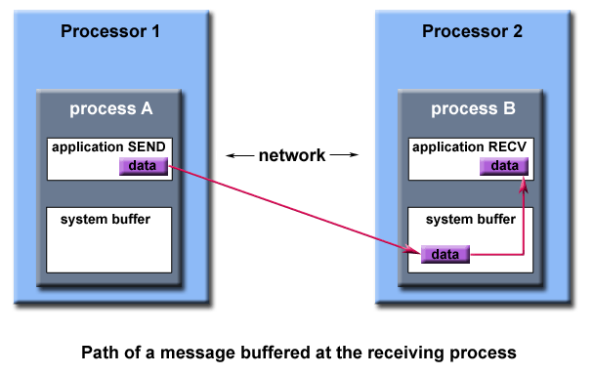
MPI – Buffering in the communications

Slide 16
MPI – Buffering in the communications
System buffer space is:
Opaque to the programmer and managed entirely by the MPI library
A finite resource that can be easy to exhaust
Able to exist on the sending side, the receiving side, or both
Something that may improve program performance because it allows send - receive operations to be asynchronous.

Slide 17
MPI – Order and fairness
Order:
MPI guarantees that messages will not overtake each other.
If a sender sends two messages (Message 1 and Message 2) in succession to the same destination, Message 1 will be received before Message 2.
Same happens with receives
Fairness:
MPI does not guarantee fairness - it's up to the programmer to prevent "operation starvation".
Example: task 0 sends a message to task 2. However, task 1 sends a competing message that matches task 2's receive. Only one of the sends will complete.

Slide 18
MPI – Collective communication routines
Types of Collective Operations:
Synchronization - processes wait until all members of the group have reached the synchronization point.
Data Movement - broadcast, scatter/gather, all to all.
Collective Computation (reductions) - one member of the group collects data from the other members and performs an operation (min, max, add, multiply, etc.) on that data.
Scope:
Collective communication routines must involve all processes within the scope of a communicator.
Unexpected behaviour, including program failure, can occur if even one task in the communicator doesn't participate.
It is the programmer's responsibility to ensure that all processes within a communicator participate in any collective operations.

Slide 19
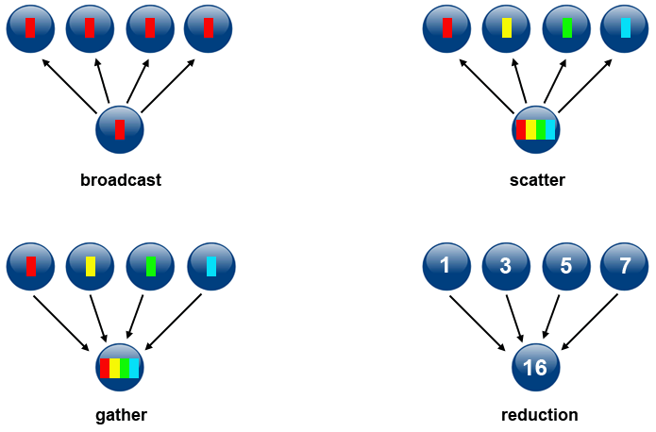
MPI – Collective communication routines
MPI_Bcast
MPI_Scatter
MPI_Gather
MPI_Reduce

Slide 20
MPI – Collective communication routines
#include "mpi.h"
#include <stdio.h>
#define SIZE 4
main(int argc, char *argv[]) {
int numtasks, rank, sendcount, recvcount, source;
float sendbuf[SIZE][SIZE] = {
{1.0, 2.0, 3.0, 4.0},
{5.0, 6.0, 7.0, 8.0},
{9.0, 10.0, 11.0, 12.0},
{13.0, 14.0, 15.0, 16.0} };
float recvbuf[SIZE];
MPI_Init(&argc,&argv);
MPI_Comm_rank(MPI_COMM_WORLD, &rank);
MPI_Comm_size(MPI_COMM_WORLD, &numtasks);
...

Slide 21
MPI – Collective communication routines
if (numtasks == SIZE) {
// define source task and elements to send/receive, then perform collective scatter
source = 1;
sendcount = SIZE;
recvcount = SIZE;
MPI_Scatter(sendbuf,sendcount,MPI_FLOAT,recvbuf,recvcount,
MPI_FLOAT,source,MPI_COMM_WORLD);
printf("rank= %d Results: %f %f %f %f\n",rank,recvbuf[0],
recvbuf[1],recvbuf[2],recvbuf[3]);
}
else
printf("Must specify %d processors. Terminating.\n",SIZE);
MPI_Finalize();
}

Slide 22
Questions?

Slide 23
Practical session

Slide 24

Practical session
Where is the source code?
https://github.com/oscartt89/hpc-excelerate/tree/master/day1
All the mpi_*.c files inside the ‘src’ folder
4 exercises
Hello world
Bandwidth benchmark
MapReduce static data distribution
MapReduce dynamic data distribution

Slide 25
Practical session – Hello world
In this example each MPI process will provide a greeting, printing the host name and its rank
Open ‘mpi_hello_world.c’
Compile
mpicc -O3 mpi_hello_world.c -o ../bin/mpi_hello_world
Execute (srun)
srun --ntasks 8 -p local --mpi=pmi2 ./bin/mpi_hello_world
Execute (sbatch, hellompi.sh required)
sbatch bin/hellompi.sh

Slide 26
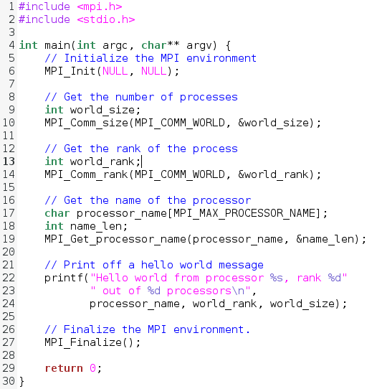
mpi_hello_world.c

Slide 27
Practical session – Hello world
In this example each MPI process will provide a greeting, printing the host name and its rank
Open ‘mpi_hello_world.c’
Compile
mpicc -O3 mpi_hello_world.c -o ../bin/mpi_hello_world
Execute (srun)
srun --ntasks 8 -p local --mpi=pmi2 ./bin/mpi_hello_world
Execute (sbatch, hellompi.sh required)
sbatch bin/hellompi.sh

Slide 28
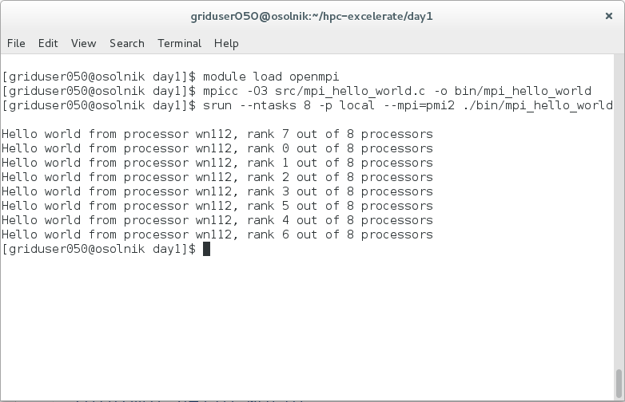
Practical session – Hello world

Slide 29
Practical session – Hello world
#!/bin/bash
# number of tasks:
#SBATCH -n 8
# memory:
#SBATCH --mem=2gb
# time:
#SBATCH --time=00:10:00
# Set output and error files (deactivated here)
##SBATCH --error=job.%J.err
##SBATCH --output=job.%J.out
# partition:
#SBATCH --partition=local
module load openmpi
echo "time mpirun -np 8 ~/hpc-excelerate/day1/bin/mpi_hello_world"
time mpirun -np 8 ~/hpc-excelerate/day1/bin/mpi_hello_world
echo "Done."

Slide 30
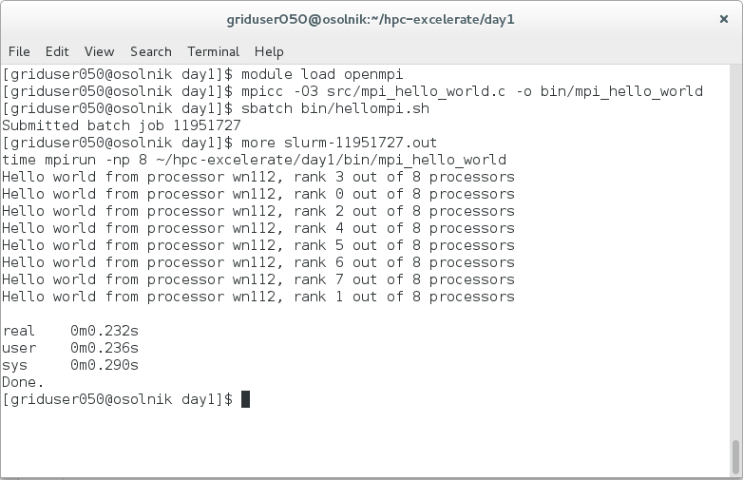
Practical session – Hello world

Slide 31
Practical session – MPI Bandwidth
In this example we are using 4 nodes, which exchange messages of different sizes to evaluate the network bandwidth
Open ‘mpi_bandwidth.c’
Compile
mpicc -O3 mpi_bandwidth.c -o ../bin/mpi_bandwidth
Execute (srun)
srun --ntasks 8 -p local --mpi=pmi2 ./bin/mpi_bandwidth
Execute (sbatch, bandwidthmpi.sh required)
sbatch bin/bandwidthmpi.sh

Slide 32
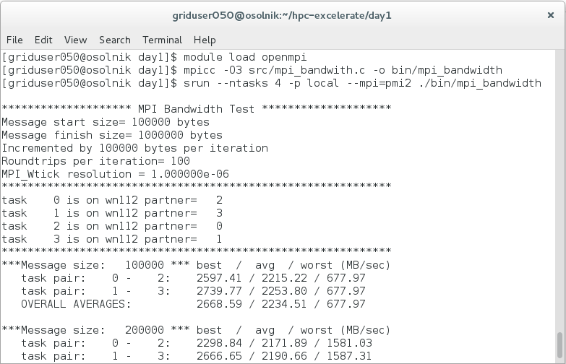
Practical session – MPI Bandwidth

Slide 33
Practical session – MPI Bandwidth
#!/bin/bash
# number of tasks:
#SBATCH -n 4
# memory:
#SBATCH --mem=2gb
# time:
#SBATCH --time=00:10:00
# Set output and error files (deactivated here)
##SBATCH --error=job.%J.err
##SBATCH --output=job.%J.out
# partition:
#SBATCH --partition=local
module load openmpi
echo "time mpirun -np 4 ~/hpc-excelerate/day1/bin/mpi_bandwidth"
time mpirun -np 4 ~/hpc-excelerate/day1/bin/mpi_bandwidth
echo "Done."

Slide 34
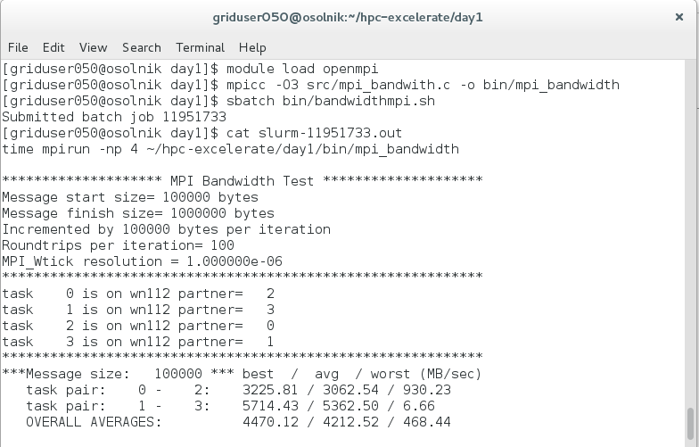
Practical session – MPI Bandwidth

Slide 35
Practical session – MapReduce static
This example reads a binary file containing a vector of N integers and then splits such file into C partes, being C the number of available cores
Open ‘mpi_mapreduce_static_distribution.c’
Compile
mpicc -O3 mpi_mapreduce_static_distribution.c -o ../bin/mpi_mapreduce_static_distribution
Execute (srun)
srun --ntasks 5 -p local --mpi=pmi2 ./bin/mpi_mapreduce_static_distribution myfile myfile.out
Execute (sbatch, mapreduce-staticmpi.sh required)
sbatch bin/mapreduce-staticmpi.sh

Slide 36
Practical session – MapReduce static

Slide 37
Practical session – MapReduce static
#!/bin/bash
# number of tasks:
#SBATCH -n 5
# memory:
#SBATCH --mem=2gb
# time:
#SBATCH --time=00:10:00
# Set output and error files (deactivated here)
##SBATCH --error=job.%J.err
##SBATCH --output=job.%J.out
# partition:
#SBATCH --partition=local
module load openmpi
time mpirun -np 5 ~/hpc-excelerate/day1/bin/mpi_mapreduce_static_distribution myfile ~/hpc-excelerate/day1/myfile.out
echo "Done."

Slide 38
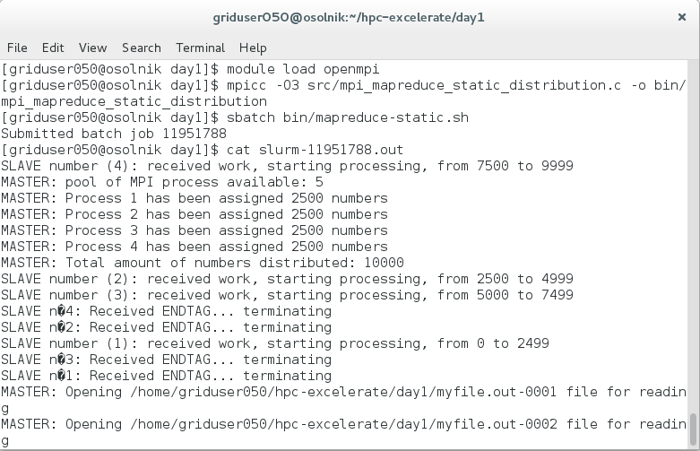
Practical session – MapReduce static

Slide 39
Acknowledgements
MPI tutorial of Blaise Barney, Lawrence Livermore National laboratory: https://computing.llnl.gov/tutorials/mpi/

