Slide 1

Taming the SBOM Chaos
LLM
Using AI Agents for Audit SBOMs for OSS Compliance
By Oscar Valenzuela B.

Slide 2

About me
Background in Software Engineering & Electronic Engineering.
10 years experience in Telecommunications.
20+ Years Experience in Open Source, Compliance Tooling, Community Building.
Active in Yocto Project, OpenChain, Software Heritage, FSF LA, Xpertians.
Principal Open Source Engineer @ Amazon
Leading strategy for the Open Source License Compliance team.
Driving initiatives to scale compliance & adopt best practices/standards.
Led numerous M&A technical due diligence & compliance projects (from spaceships to IoT).
Fun Fact: Also known as Andrew/Andres!
Copyright 2025 Oscar Valenzuela B. Licensed under CC BY-ND 4.0.

Slide 3
Open Source License Compliance Understanding the problem

Slide 4
License Compliance: Beyond Static Risk Analysis
Open Source Licenses are static documents, but conditions are dynamic and depend on the specific use case.
Factors such as technical implementation, modifications, customer interaction, and internal use versus externalization change the parameters for the risk analysis.
Dynamic conditions also create challenges in scaling analysis capabilities and managing use case complexity.
Open Source License
Software
Grants
Grants
Obligations
Obligations
Obligations
Obligations
Copyright 2025 Oscar Valenzuela B. Licensed under CC BY-ND 4.0.

Slide 5
License Compliance: Beyond Static Risk Analysis
Problem 1: Use Cases can trigger different License Obligations
Software
Open Source License
Grants
Grants
Obligations
…
Obligations
Obligations
Obligations
Internal Use
Distribution
Special Cases
Copyright 2025 Oscar Valenzuela B. Licensed under CC BY-ND 4.0.

Slide 6
License Compliance: Beyond Static Risk Analysis
Problem 1: Use Cases can trigger different License Obligations
Software
Open Source License
Grants
Grants
Grants
Grants
Grants
Grants
Obligations
Obligations
Obligations
…
Obligations
Obligations
Obligations
Obligations
Obligations
Obligations
Obligations
Obligations
Obligations
Internal Use
Distribution
Special Cases
Copyright 2025 Oscar Valenzuela B. Licensed under CC BY-ND 4.0.

Slide 7
License Compliance: Beyond Static Risk Analysis
Problem 1: Use Cases can trigger different License Obligations
Server Side
Desktop App
Embedded Device
Software
Open Source License
Grants
Grants
Grants
Grants
Grants
Obligations
Obligations
Obligations
Obligations
Obligations
Obligations
Obligations
Obligations
Obligations
Obligations
Obligations
Obligations
Obligations
LGPL-3.0
LGPL-3.0
LGPL-3.0
Copyright 2025 Oscar Valenzuela B. Licensed under CC BY-ND 4.0.

Slide 8
License Compliance: Beyond Static Risk Analysis
Problem 2: Technical Implementation Affects License Applicability
Build configuration can enable/disable Licenses
FFmpeg
Grants
Grants
Grants
Grants
Grants
Grants
Grants
Grants
Grants
Grants
Obligations
Obligations
Obligations
Obligations
Obligations
Obligations
Obligations
Obligations
Obligations
Obligations
Obligations
Obligations
Obligations
Obligations
Obligations
Obligations
Obligations
Obligations
Obligations
Obligations
Copyright 2025 Oscar Valenzuela B. Licensed under CC BY-ND 4.0.

Slide 9
License Compliance: Beyond Static Risk Analysis
Problem 2: Technical Implementation Affects License Applicability
Build configuration can enable/disable Licenses
Ffmpeg
FFmpeg
Grants
Grants
Grants
Grants
Grants
Grants
Grants
Grants
Obligations
Obligations
Obligations
Obligations
Obligations
Obligations
Obligations
Obligations
Obligations
Obligations
Obligations
Obligations
Obligations
Obligations
Obligations
Obligations
Product A
Product B
Copyright 2025 Oscar Valenzuela B. Licensed under CC BY-ND 4.0.

Slide 10
License Compliance: Beyond Static Risk Analysis
Problem 3: Technical Implementation affects the Scope of the License
Main Program
Copyleft Effect
LGPL-2.1
Dynamic Linking
Copyright 2025 Oscar Valenzuela B. Licensed under CC BY-ND 4.0.

Slide 11
License Compliance: Beyond Static Risk Analysis
Problem 3: Technical Implementation affects the Scope of the License
Copyleft Effect
Main Program
LGPL-2.1
Copyright 2025 Oscar Valenzuela B. Licensed under CC BY-ND 4.0.

Slide 12
License Compliance: Beyond Static Risk Analysis
Problem 3: Technical Implementation affects the Scope of the License
Copyleft Effect
Linux Kernel
Generic
Proprietary
GPL-only
Copyright 2025 Oscar Valenzuela B. Licensed under CC BY-ND 4.0.

Slide 13
License Compliance: Beyond Static Risk Analysis
Problem 3: Technical Implementation affects the Scope of the License
Copyleft Effect
Linux Kernel
Generic
Proprietary
GPL-only
Copyright 2025 Oscar Valenzuela B. Licensed under CC BY-ND 4.0.

Slide 14
License Compliance: Beyond Static Risk Analysis
Problem 4: Programming Language affects the Scope of the License
Risk Analysis: Python Package under LGPL-3.0
Domain
License
Ingestion
Consumption
 |  | Internal Use |  | Distribution (Externalization)
Obligations | Ingestion (Import) | Dev/Testing tools | Server Side | Linux OS | Customer Desktop App | Customer Mobile App | Consumer Devices
Source Compliance | No | No | No | Yes | Yes | Yes | Yes
Legal Notices | No | No | No | Yes | Yes | Yes | Yes
Copyleft Risks | No | No | No | No | No | Maybe | Yes
Patent Risks | No | No | No | No | No | Maybe | Yes
Void DRM Protection | No | No | No | No | No | Maybe | Yes
Example Risk Analysis
Copyright 2025 Oscar Valenzuela B. Licensed under CC BY-ND 4.0.

Slide 15
License Compliance: Beyond Static Risk Analysis
Problem 4: Programming Language affects the Scope of the License
Risk Analysis: Rust Package under LGPL-3.0
Domain
License
Ingestion
Consumption
 |  | Internal Use |  | Distribution (Externalization)
Obligations | Ingestion (Import) | Dev/Testing tools | Server Side | Linux OS | Customer Desktop App | Customer Mobile App | Consumer Devices
Source Compliance | No | No | No | Yes | Yes | Yes | Yes
Legal Notices | No | No | No | Yes | Yes | Yes | Yes
Copyleft Risks | Maybe | Maybe | No | Maybe | Yes | Yes | Yes
Patent Risks | Maybe | Maybe | No | Maybe | Yes | Yes | Yes
Void DRM Protection | No | No | No | No | No | Maybe | Yes
Example Risk Analysis
Copyright 2025 Oscar Valenzuela B. Licensed under CC BY-ND 4.0.

Slide 16
License Compliance: INTERNAL Vs. distribution
Problem 5: Responsibility for OSS Obligations Shifts
Understand
Use Case
Ingestion
Review
Identify
Obligations
Closing
Conditions
Resolution
Deployment
Under Company Control
Risk Management:
Package Curation (scanned pre-import).
Source Code available in the Code Vault.
Copyright 2025 Oscar Valenzuela B. Licensed under CC BY-ND 4.0.

Slide 17
License Compliance: INTERNAL Vs. distribution
Problem 5: Responsibility for OSS Obligations Shifts
Deployment
OEM
Deployment
Identify
Supply Chain
Identify
Use Case
Identify
Obligations
Identify
Distribution
Channels
Closing
Conditions
Resolution
Deployment
Under Company Control
Deployment
Risks Management:
A defined package curation process during ingestion is absent
Source Code is not always available as software is built by partners.
The software is used by Company, OEM or partners.
Copyright 2025 Oscar Valenzuela B. Licensed under CC BY-ND 4.0.

Slide 18
NUANCE and interpretation are required
Problem 6: Tailored guidance per case is required
Case Type A
Case Type B
Compliance Cases
Case Type C
Automatically Rejected
Copyright 2025 Oscar Valenzuela B. Licensed under CC BY-ND 4.0.

Slide 19
Software Composition Analysis Tools are not magic wands

Slide 20
TOOLS cannot address all scenarios
Tools expect binary input, but OSS compliance is rarely black and white:
Nuance and interpretation are frequently required.
Tooling “over-trust” means accepting an Opinionated Output.
Tools struggle with complex technical scenarios.
Commercial tools with proprietary/locked Compliance Databases prevent contributions or corrections, acting as a Black Box.
Open Source Tools tend to suffer from Swiss Army Knife Syndrome.
Copyright 2025 Oscar Valenzuela B. Licensed under CC BY-ND 4.0.

Slide 21
SOFTWARE COMPOSITION Analysis
Dynamic vs. Static Analysis can produce different results.
Static Software Composition Analysis (Static SCA)
Dynamic Software Composition Analysis (Dynamic SCA)
Analyzes the software's source code, binaries, or other static artifacts (e.g., package manifests, dependency files) without executing the program.
Analyzes the software during execution, tracking the actual dependencies and components being loaded, called, or used at runtime.
It cannot detect vulnerabilities or dependencies that are dynamically loaded or resolved at runtime.
Requires a working runtime environment, which may not always reflect real-world usage or edge cases.
Copyright 2025 Oscar Valenzuela B. Licensed under CC BY-ND 4.0.

Slide 22
SOFTWARE COMPOSITION Analysis
Dynamic vs. Static Analysis can produce different results.
FFmpeg
FFmpeg
Grants
Grants
Grants
Grants
Grants
Grants
Grants
Grants
Grants
Grants
Grants
Grants
Grants
Obligations
Obligations
Obligations
Obligations
Obligations
Obligations
Obligations
Obligations
Obligations
Obligations
Obligations
Obligations
Obligations
Obligations
Obligations
Obligations
Obligations
Obligations
Obligations
Obligations
Obligations
Obligations
Obligations
Obligations
Obligations
Obligations
Obligations
Source Code
Binary Implementation
Copyright 2025 Oscar Valenzuela B. Licensed under CC BY-ND 4.0.

Slide 23
SOFTWARE COMPOSITION Analysis
Binary Static Analysis – Methodology Matters for results quality.
Methodology | Details
Fuzzy Hashing | Use a preexistent dataset of hashes to determine proximity between binary artifacts.
Symbols Extraction | Utilize symbols like literal strings, export symbols, and other signatures to identify binaries.
Package Metadata | Extract package identification evidence from package metadata or other official sources.
Compression redundancy | Identify overlaps (code cloning) when compressing two software artifacts.
Binary Deltas | Identify diff between two artifacts, inferring identification when delta is close to 0.
Most SCA tools implement Package Metadata and Symbol Extraction. However, their output typically requires manual confirmation. This is because package metadata only works when packages embed that information, and symbols are only present if debug information is available and hasn't been scrambled for security reasons.
Copyright 2025 Oscar Valenzuela B. Licensed under CC BY-ND 4.0.

Slide 24
Agentic AI A tool that learns to use tools

Slide 25
The “agentic approach”
Why using the Agentic approach is good option?
Open Source License Compliance is dynamically complex and requires technical experience (learning technology) and a detailed understanding of the use case.
The traditional approach is always challenging to scale, requiring tailored guidance.
Tools are not automatic solutions; not all tools produce the same data (format and quality). Most knowledge databases are opinionated, which doesn’t mean they are correct.
Copyright 2025 Oscar Valenzuela B. Licensed under CC BY-ND 4.0.

Slide 26
The “agentic approach”
Let’s define the problem and build a goal
We can teach AI to do the heavy lifting of OSLC (code scanning, data enrichment, verifying external sources, identifying license texts, compiling risk analysis reports, generating compliance artifacts, etc.)
We can use the information generated to build a conclusion.
AI will not replace the need for an Open Source Compliance Engineer to make decisions, but it will help handle much of the work—potentially most of it if the tasks are limited to scanning and data gathering.
Copyright 2025 Oscar Valenzuela B. Licensed under CC BY-ND 4.0.

Slide 27
Agentic AI The Basics

Slide 28
What’s the difference between LLM and AGENTIC AI?
LLM
LLM
Provides Knowledge
Understand & Generate Language
Answering questions, summarizing, content creation
Applies Knowledge to Act
Act Autonomously & Achieve Goals
Planning, using tools (incl. LLMs), learning, adapting
Copyright 2025 Oscar Valenzuela B. Licensed under CC BY-ND 4.0.

Slide 29
Types of agentic ai
Simple Reflex Agents: These agents react to specific inputs with predefined actions, lacking the ability to learn or adapt to new situations.
Goal-Based Agents: These agents are equipped with specific goals and use strategies or plans to achieve desired outcomes, employing search and planning algorithms to determine the best course of action.
Utility-Based Agents: These agents use complex reasoning algorithms to help users maximize desired outcomes by comparing different scenarios and their respective utility values, choosing the option that provides the most rewards.
Learning Agents: These agents can improve their behavior over time by interacting with their environment and learning from their experiences, using various learning mechanisms to optimize their performance.
Hierarchical Agents: These agents engage and coordinate multiple agents to pursue a common goal, which is helpful in fail-safe environments or regulated industries where oversight of workflows is crucial.
Multi-agent systems: These systems are designed to act as autonomous agents capable of performing complex tasks, making decisions, and interacting with their environments independently
LLM
Copyright 2025 Oscar Valenzuela B. Licensed under CC BY-ND 4.0.

Slide 30
Agentic AI resolving a practical problem: sbomS

Slide 31
SBOMs in an ideal world
Open Source License Policy Tools
Allowed
SBOM
Conditional Approved
✓
Rejected
Tarball
OSS Notices
Copyright 2025 Oscar Valenzuela B. Licensed under CC BY-ND 4.0.

Slide 32
Communication protocol vs. message quality
Quality
Party A
Message
Party B
Protocol
Protocol
SBOMs define the structure, content, and interpretation between parties.
SBOMs facilitate data sharing, they do not guarantee the quality or accuracy of the information conveyed.
Quality of the SBOM depends on the capacity of the tool we choose.
Copyright 2025 Oscar Valenzuela B. Licensed under CC BY-ND 4.0.

Slide 33
Practical Example: Using Agentic AI for SBOM Analysis
Problem: SBOM Analysis for OSS Compliance is practically impossible to automate.
Reasons:
File Format:
Multiple formats (SPDX and CycloneDX) and versions, which tooling doesn't fully implement.
Commercial tools don’t produce compatible SBOMs (valid JSON schema files, but the information is incompatible).
Lack of Data:
No assertions. No hashes, incorrect hashes, or manually edited hash strings. Some SBOMs will include license data, while others don’t, as there’s no formal requirement to include such data.
There’s no definition for data quality on SBOMs.
Problems in handling SBOMs lead to difficulties in drawing conclusions.
Copyright 2025 Oscar Valenzuela B. Licensed under CC BY-ND 4.0.

Slide 34
Choosing the right strategy
LLM
LLM
LLM
Simple Reflex Agent
Utility-Based Agent
Goal-Based Agents
Process SBOM files and parse package information.
Identify data gaps autonomously and use tools to enrich data.
Use information from other agents to build a summary, produce compliance artifacts, and generate a conclusion.
Copyright 2025 Oscar Valenzuela B. Licensed under CC BY-ND 4.0.

Slide 35
Let’s build our agentic ai project
PROBLEM 1: Parsing information from an SBOM.
Package URL
pkg:pypi/django@1.11.1
pkg:npm/foobar@12.3.1
pkg:gem/ruby-advisory-db-check@0.12.4
SBOM
LLM
Simple Reflex Agent
Copyright 2025 Oscar Valenzuela B. Licensed under CC BY-ND 4.0.

Slide 36







Let’s build our agentic ai project
PROBLEM 2: Detecting data GAPs and collecting data from trusted sources.
LLM
Utility-Based Agent
Copyright 2025 Oscar Valenzuela B. Licensed under CC BY-ND 4.0.

Slide 37
Let’s build our agentic ai project
PROBLEM 3: Review complementary information to address a GOAL.
Prompt Request
(Goal)
Results
LLM
Data
Goal-Based Agents
Role Definition
Context
Expectation
Copyright 2025 Oscar Valenzuela B. Licensed under CC BY-ND 4.0.

Slide 38
Let’s build our agentic ai project
What do you need?
A place where agents will live (the workflow).
An LLM to support operations.
An input/output for the workflow.
“Tools” to enrich data (APIs, tooling, etc.).
An SBOM (to test the workflow).
Coffee.
Let’s “Flowgrammer” a solution!
Copyright 2025 Oscar Valenzuela B. Licensed under CC BY-ND 4.0.

Slide 39
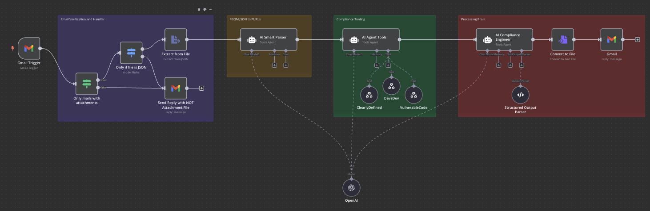
Let’s build our Agentic AI project
Let’s define the problem and build a goal
Copyright 2025 Oscar Valenzuela B. Licensed under CC BY-ND 4.0.

Slide 40
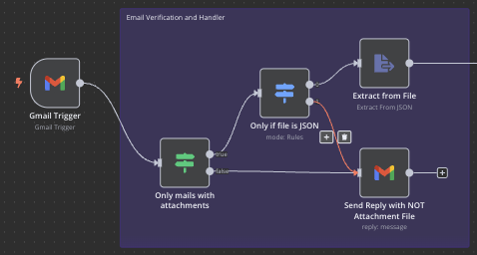
Let’s build our agentic ai project
Copyright 2025 Oscar Valenzuela B. Licensed under CC BY-ND 4.0.

Slide 41
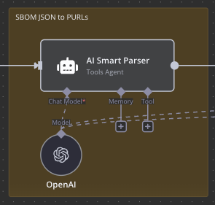
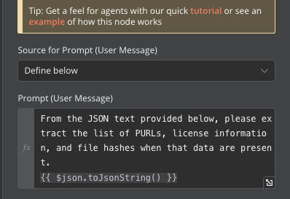
Let’s build our agentic ai project
LLM
AI Smart Parser
Simple Reflex Agent
Copyright 2025 Oscar Valenzuela B. Licensed under CC BY-ND 4.0.

Slide 42
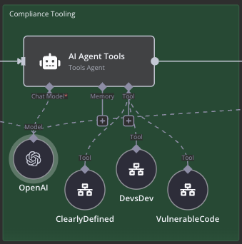
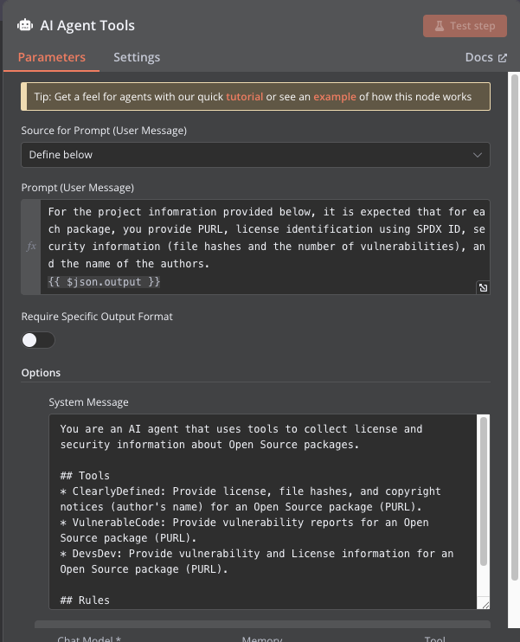
Let’s build our agentic ai project
LLM
Utility-Based Agent
Copyright 2025 Oscar Valenzuela B. Licensed under CC BY-ND 4.0.

Slide 43
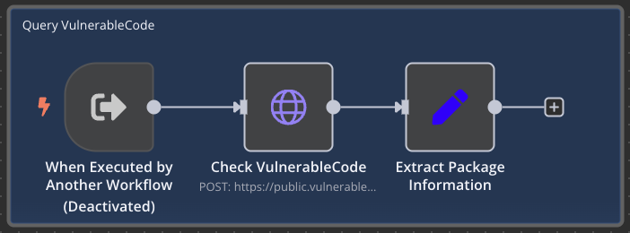
Let’s build our agentic ai project
LLM
Utility-Based Agent
Copyright 2025 Oscar Valenzuela B. Licensed under CC BY-ND 4.0.

Slide 44

Let’s build our agentic ai project
LLM
Utility-Based Agent
Copyright 2025 Oscar Valenzuela B. Licensed under CC BY-ND 4.0.

Slide 45
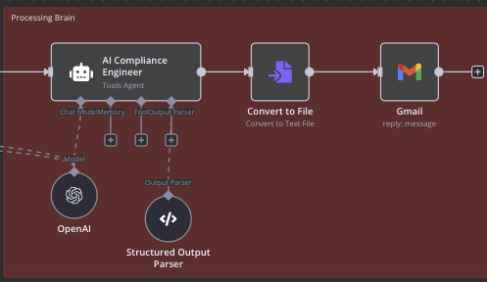
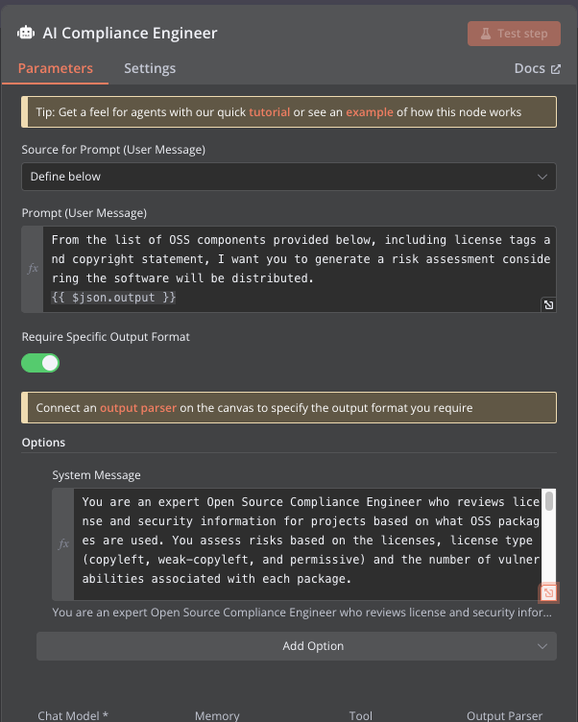
Let’s build our agentic ai project
LLM
Goal-Based Agents
Copyright 2025 Oscar Valenzuela B. Licensed under CC BY-ND 4.0.

Slide 46
The future of Oss compliance: data feeds of knowledge
The growth of Agentic AI and the 'no-code' movement will continue to drive automation. You won't necessarily need coding skills to implement Agentic AI.
We'll likely see data feed providers become increasingly central to this technological shift. While traditional tools often aim for capability parity, “Swiss Army knife Syndrome,” the focus will shift toward entities specializing in providing the high-quality data that AI Agents require.
AI won't replace Open Source Engineers – human oversight and final decision-making remain essential. However, roles heavily focused on routine operational tasks, like running scanners and reading raw reports, will need to evolve, adapting to leverage these powerful new AI capabilities.
Copyright 2025 Oscar Valenzuela B. Licensed under CC BY-ND 4.0.

Slide 47
Organizations that are PAVING the way
Custom KDB for Snippet Detection.
Cryptographic Algorithms Open Dataset.
PURL to CPE Relationship mapping project.
Dataset Geo Provenance (ex: Export Control).
A free and open vulnerabilities database.
Open database of all the licenses.
Scanning as a service (ScanCode.io)
A free and open vulnerabilities database.
Open database of all the licenses.
Scanning as a service (ScanCode.io)
Copyright 2025 Oscar Valenzuela B. Licensed under CC BY-ND 4.0.

Slide 48
Organizations that are PAVING the way
OpenSSF Scorecard: Project Health
Vulnerability information
License Metadata
Source Code Location
Copyright and Author information.
License Metadata
Source Code Location
Copyright and Author information.
Copyright 2025 Oscar Valenzuela B. Licensed under CC BY-ND 4.0.

Slide 49
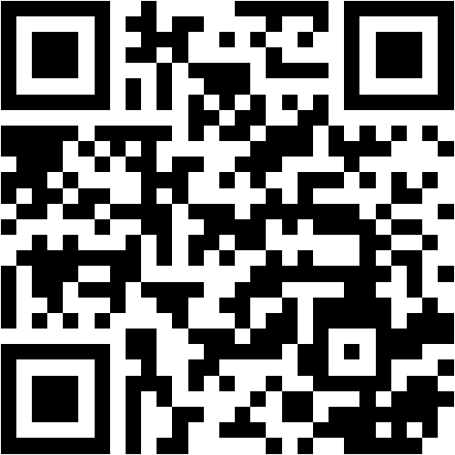
Thank you!
LLM
Copyright 2025 Oscar Valenzuela B. Licensed under CC BY-ND 4.0.

