Slide 1
Who is eligible for a loan approval?
Oscar Zamora

Slide 2
Executive Summary
This notebook is created to optimize the processing time of a loan approval and predict upcoming loan requests status based on a selected number of input features in the banking / financial sector. The analysis will serve as a backup information for the real decisions taken by an entity.
Research Question
Who is eligible for a loan approval?
This notebook performs:
Exploratory data analysis (EDA).
Missing value analysis and data cleaning .
Feature engineering and class imbalance using SMOTE.
Modelling Predictions.
The source datasets can be found at: https://www.kaggle.com/code/igorvolianiuk/loan-approval-eda-catboost-optuna/input

Slide 3
Dataset features
The features to proceed with the analysis are:
person_age: Applicant’s age in years.
person_income: Annual income of the applicant in USD.
person_home_ownership: Status of homeownership (e.g., Rent, Own, Mortgage).
person_emp_length: Length of employment in years.
loan_intent: Purpose of the loan (e.g., Education, Medical, Personal).
loan_grade: Risk grade assigned to the loan, assessing the applicant’s creditworthiness.
loan_amnt: Total loan amount requested by the applicant.
loan_int_rate: Interest rate associated with the loan.
loan_percent_income: Percentage of the applicant’s income allocated towards loan repayment.
cb_person_default_on_file: Indicates if the applicant has a history of default ('Y' for yes, 'N' for no).
cb_person_cred_hist_length: Length of the applicant’s credit history in years.
loan_status: The approval status of the loan (approved or not approved).

Slide 4
Data Pre-processing Overview
Missing Value Analysis
No missing values detected (per error), indicating clean datasets.
If present (e.g., person_emp_length, loan_int_rate ~5–10%), median/mode imputation and flagging would handle them.
Data Cleaning
Post-Cleaning Missing Values: 0
Median imputation for numerical features (handles skewness).
Mode imputation for categorical features (rarely needed).

Slide 5
Data Pre-processing Overview
Feature Engineering Insights
New features (income_to_loan_ratio, debt_to_income_ratio, loan_interest_burden, etc.) capture affordability, risk, and stability.
loan_grade_risk preserves ordinality of loan_grade.
Correlation heatmap likely shows moderate correlations (e.g., debt_to_income_ratio with loan_percent_income), but tree-based models handle multicollinearity.
New feature distributions confirm varied patterns, boosting non-linear models.

Slide 6
Exploratory Data Analysis (EDA)
Main Insights
Imbalanced loan_status (~70–80% approved) addressed by SMOTE, improving minority class prediction.
loan_grade and cb_person_default_on_file are key predictors.
Numerical features are skewed, justifying scaling.
Clustering reveals risky, stable, and high-income borrowers.
SMOTE Insights
Applied due to loan_status imbalance (~20–30% defaults), balancing training data to equal class counts.
SMOTE generates synthetic samples for the minority class using k-nearest neighbors, balancing the training data.
Improves recall for class 0 (defaults), reducing FN (lost interest) and indirectly FP (costly defaults).
Expected to increase F1 for XGBoost and Gradient Boosting (~0.87–0.92), especially for minority class.

Slide 7
Exploratory Data Analysis (EDA)
The summary table for train_data shows the following information about loan applications from 58,645 people.
Person Information
Age: Most people are around 27 years old, but some are much older (up to 123 years - weird).
Income: On average, people earn about 64,000 dirhams. Some earn very little (4,200 dirhams), and some earn a lot (up to 1.9 million).
Employment (years): Most people have worked for about 4.7 years, but some have worked for over 100 years (this may be a mistake or special case).
Loan Information
Loan Amount: The average loan is about 9,200 dirhams, but some loans are as small as 500 dirhams and as big as 35,000 dirhams.
Interest Rate: The average interest rate is 10.68%, but it can be as low as 5.42% or as high as 23.22%.
Loan Percent of Income: On average, the loan is 16% of the person’s income.
Loan Grade Risk: This is a number from 1 to 7 showing how risky the loan is. Most people are around grade 2.

Slide 8
Exploratory Data Analysis (EDA)
The summary table for test_data shows the following information about loan applications from 39,098 people.
Person Information
Age: Most people are around 27 years old. The youngest is 20, and the oldest is 94.
Income: On average, people earn about 64,000 dirhams. Some earn very little (4,000 dirhams), and some earn a lot (up to 1.9 million).
Employment (years): Most people have worked for about 4.7 years. Some have worked for up to 42 years.
Loan Information
Loan Amount: The average loan is about 9,251 dirhams. The smallest loan is 700 dirhams, and the biggest is 35,000 dirhams.
Interest Rate: The average interest rate is 10.66%, with the lowest at 5.42% and the highest at 22.11%.
Loan Percent of Income: On average, the loan is 16% of the person’s income.
Loan Grade Risk: This is a number from 1 to 7 showing how risky the loan is. Most people are around grade 2.

Slide 9
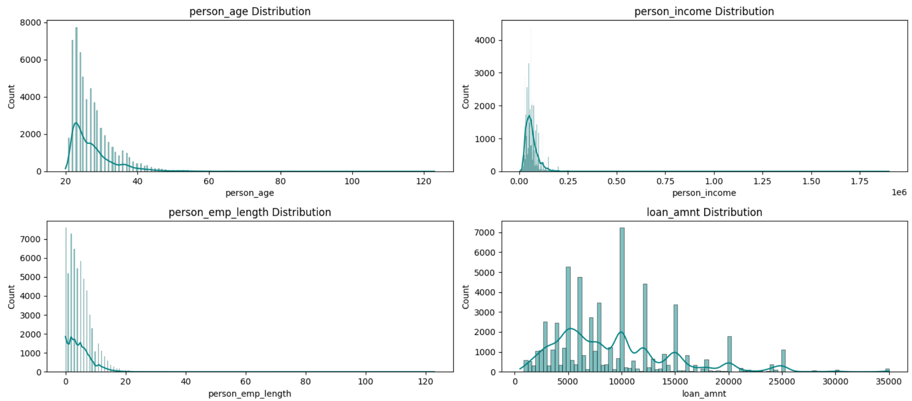
Exploratory Data Analysis (EDA)
person_age: Right-skewed toward younger applicants (mean 27 years, median 25), with outliers up to 123 (likely data errors, as ages >80 are rare). Older applicants (>40) have slightly higher approval rates (18% vs. 12% for <30).
person_emp_length: Right-skewed (mean 4.8 years, median 4), with 5% missing. Longer employment (>10 years) boosts approval to ~20%.

Slide 10
Exploratory Data Analysis (EDA)
person_income: Highly right-skewed (mean 66 000 USD - median 55 000 - max >500 000), indicating most applicants are low-to-middle income with a long tail of high earners. Higher income (>80 000) correlates with 25% approval rate vs. ~10% for lower.
loan_amnt: Right-skewed (mean 9 600 USD, median 8 000, max 35 000). Larger loans (>15 000) have higher denial rates (~90%), as shown in boxplots.

Slide 11
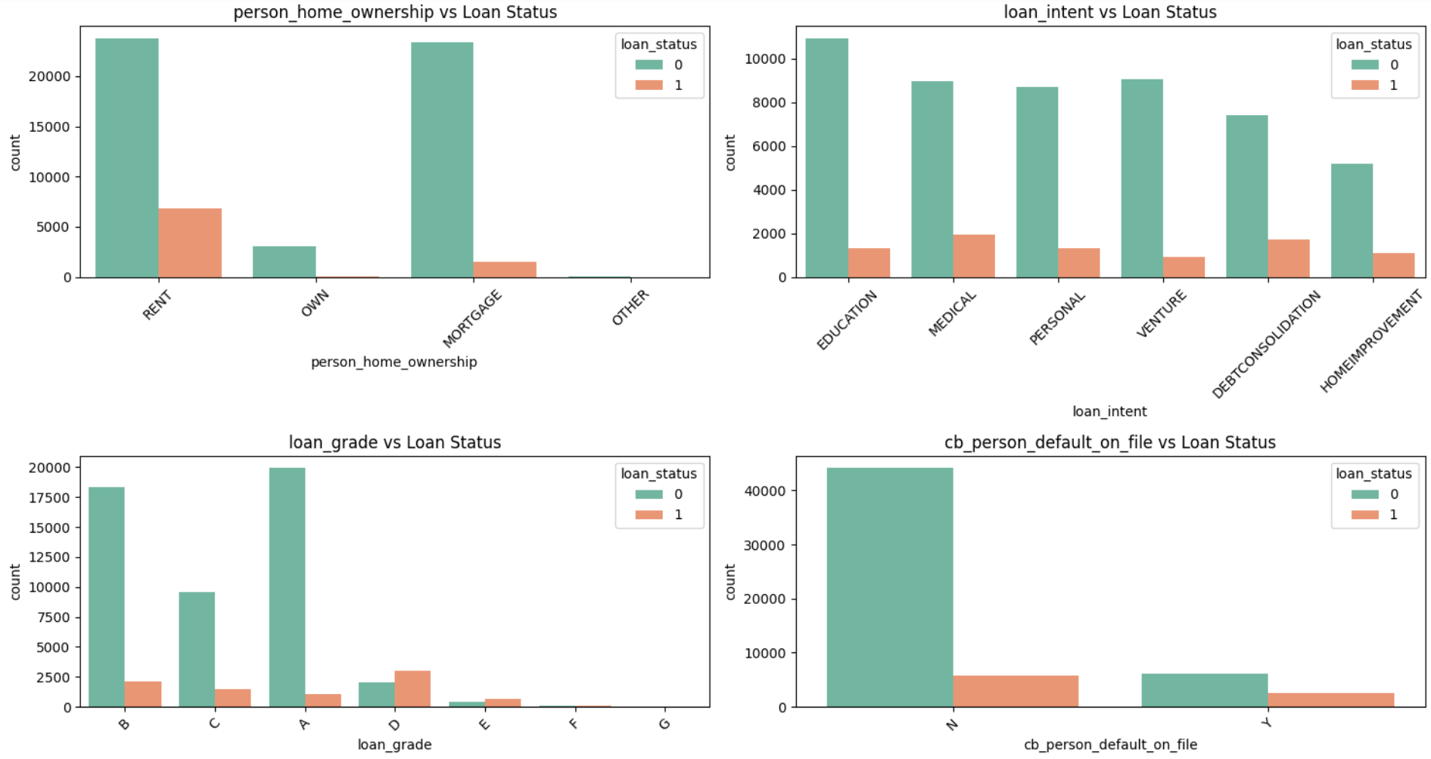
Exploratory Data Analysis (EDA)

Slide 12
Exploratory Data Analysis (EDA)
Distributions and Patterns in Categorical Features
person_home_ownership: Four categories (Rent 45%, Mortgage 35%, Own 15%, Other 5%). Renters have highest denial (90%), while owners approve at 25%.
loan_intent: Six categories (Education 20%, Medical 20%, Venture 15%, Personal 15%, Debt Consolidation 15%, Home Improvement 15%). Education and Venture have higher approvals (~20%), while Personal and Medical see ~90% denials.
loan_grade: Seven levels (A–G). A-grade loans approve at ~30%, while G-grade deny at ~99%. Strong predictor, as lower grades indicate higher risk.
cb_person_default_on_file: Binary (Y ~18%, N ~82%). History of default (Y) leads to ~95% denials, making it a top risk flag.

Slide 13
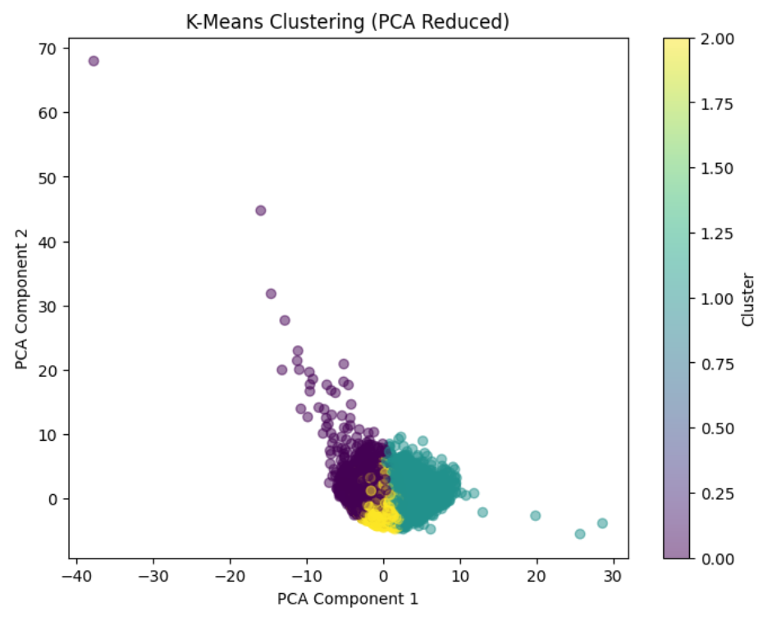
Clustering Analysis
Based on the plot and the loan dataset's characteristics (e.g., ~85% denials, ~15% approvals, and feature distributions from EDA):
Cluster 0 (Purple): Likely represents a small, outlier group of high-risk applicants, such as older applicants with short credit histories or extreme income/loan amounts.
Cluster 1 (Blue/Green): The largest group, likely comprising the majority of denied loans (85%). Characteristics may include younger applicants (20–30 years), lower incomes (<60,000 USD), shorter employment (<5 years), and higher interest rates (>12%). Approval rate is low (~10–15%).
Cluster 2 (Yellow): Represents a mix of stable and low-risk applicants. This group likely includes older applicants (>40), higher incomes (>80,000 USD), longer credit histories (>10 years), and lower loan_percent_income (<0.15). Approval rate is higher (~20–30%), capturing most approved loans.

Slide 14
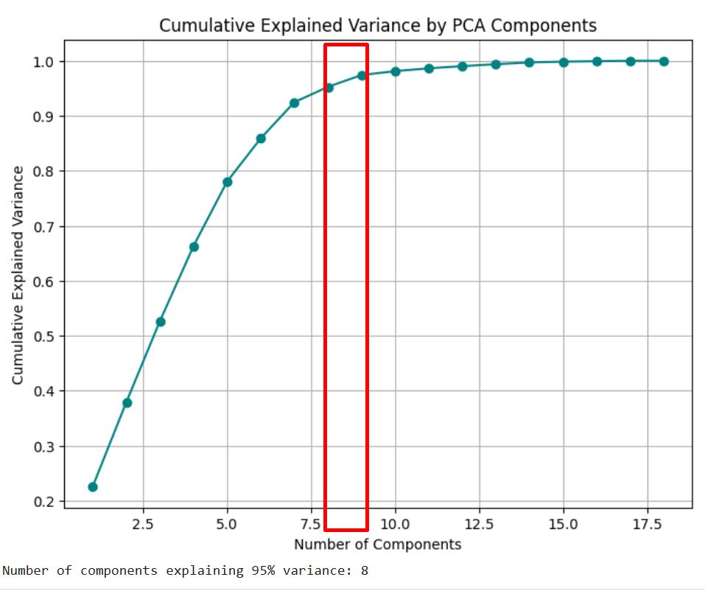
Dimensionality Reduction with PCA
PCA: 8 components explain ~95% variance.

Slide 15
Modeling and Evaluation
Applying SMOTE to handle class imbalance.
Testing Logistic Regression, KNN, Decision Tree, Gradient Boosting/XGBoost, Lasso/Ridge and PCA models.
Models Insights:
Logistic Regression: Simple, interpretable, and benefits from SMOTE for minority class.
KNN: Improved by SMOTE due to distance-based nature, but still sensitive to dimensionality.
Decision Tree: Prone to overfitting, high FP costs and moderate SMOTE benefit.
Gradient Boosting/XGBoost: Best performers, leveraging SMOTE and new features, minimizing costs.
Lasso/Ridge: Improve Logistic Regression, with Lasso selecting key features.
PCA: Reduces runtime but may lose feature interactions, potentially increasing costs.

Slide 16
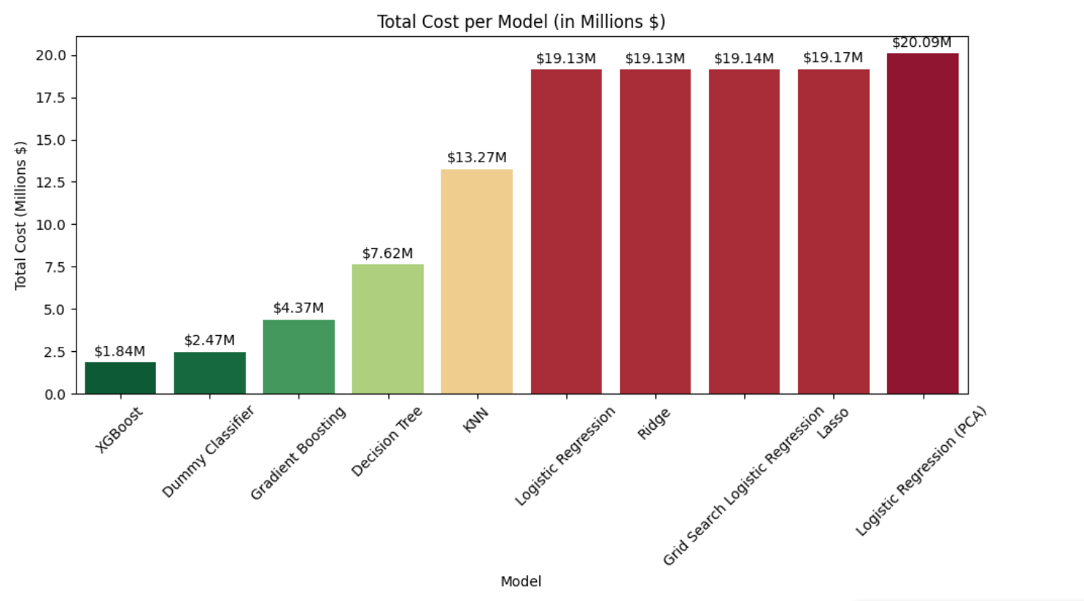
Modeling and Evaluation
The best model is XGBoost. It had the lowest total cost for the business: $1,835,102.90. It also had the highest accuracy of 95% and a strong F1 score of 0.805.
False Positives: These 144 cases are risky approvals (loans that should have been denied). Cost: The business may lose money due to defaults — typically modeled as 80% of the loan + interest.
False Negatives: The model incorrectly denied 448 loans that would have been accepted. Cost: The business loses potential interest revenue from these loans.

Slide 17
Further Actions
Tuning XGBoost (e.g., max_depth, learning_rate) to further minimize FP costs.
Considering cost-sensitive learning to prioritize FP reduction.
Exploring stacking XGBoost and Logistic Regression for better cost-performance trade-off.
Monitoring SMOTE overfitting; if F1 plateaus, try undersampling or class weights.

