Slide 2
w
w
w
Evaluating
What
Works

Slide 3
w
w
w

Slide 4


Slide 5
Evaluating
What
Works

Slide 7
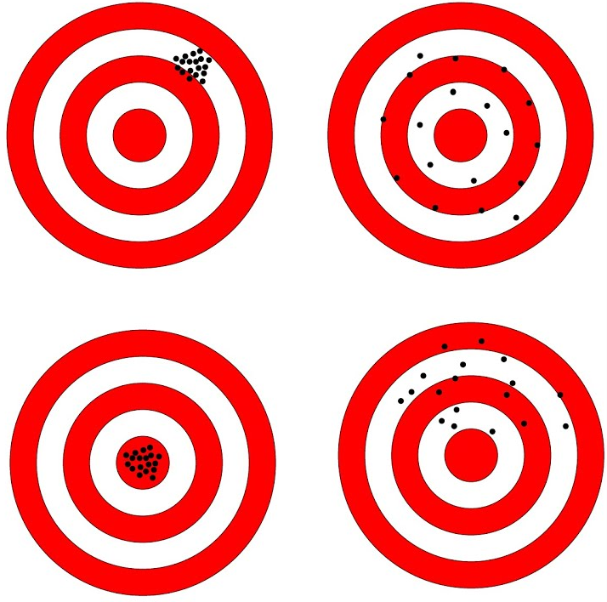
Reliable
but not valid
Valid
but not reliable
Reliable
and valid
Neither reliable
nor valid

