Slide 1
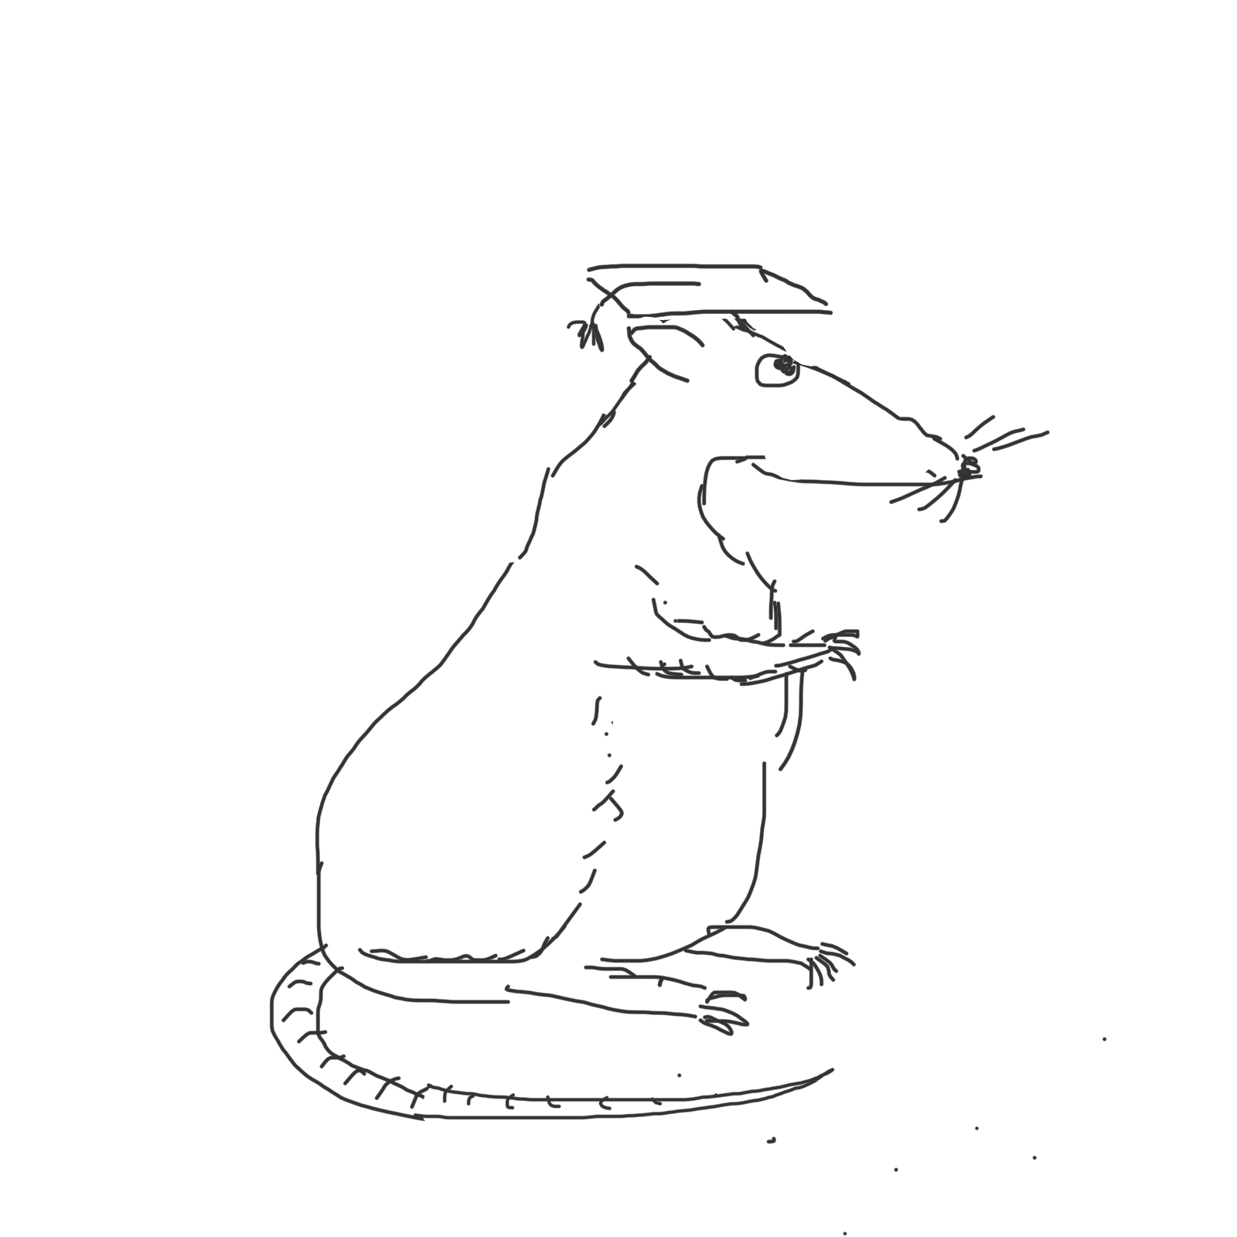
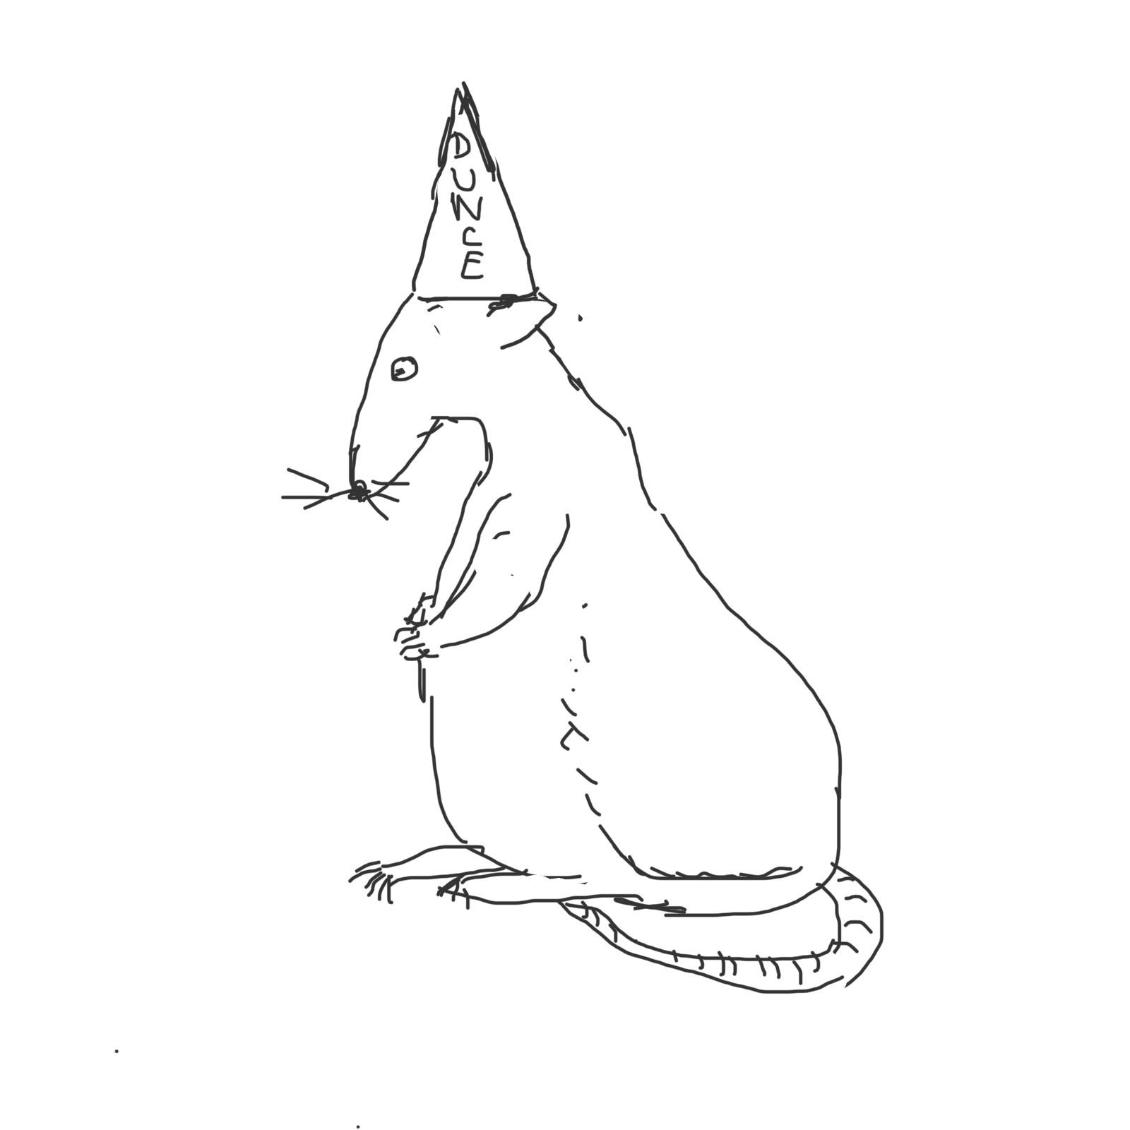
Maze-bright
Maze-dull

Slide 2
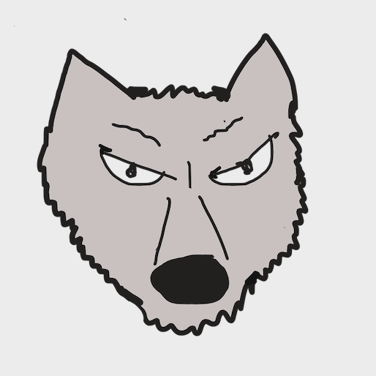
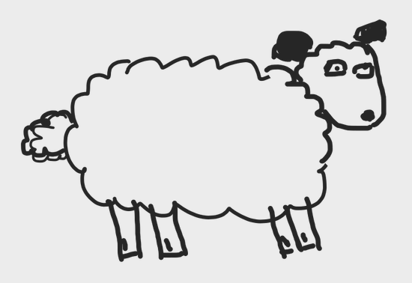
Ground truth
True positive False positive
(type 1 error
False negative True negative
(type II error)
What
villagers
think

