Slide 1
D-STAR

Slide 2

How D-Star is different
• D-Star radios convert your voice to digital before
transmission.
• Additional information is included in the "digital stream"
that is transmi@ed (and displayed on the receiving radio):
• Your call sign ("MyCall") is included
• You can set a short (4 character) "call sign tag", & a short
(20 character) "identification string" that is included with
each transmission.
• You can also include low-speed digital data or GPS
positioning information.
D-Star Basics
2

Slide 3

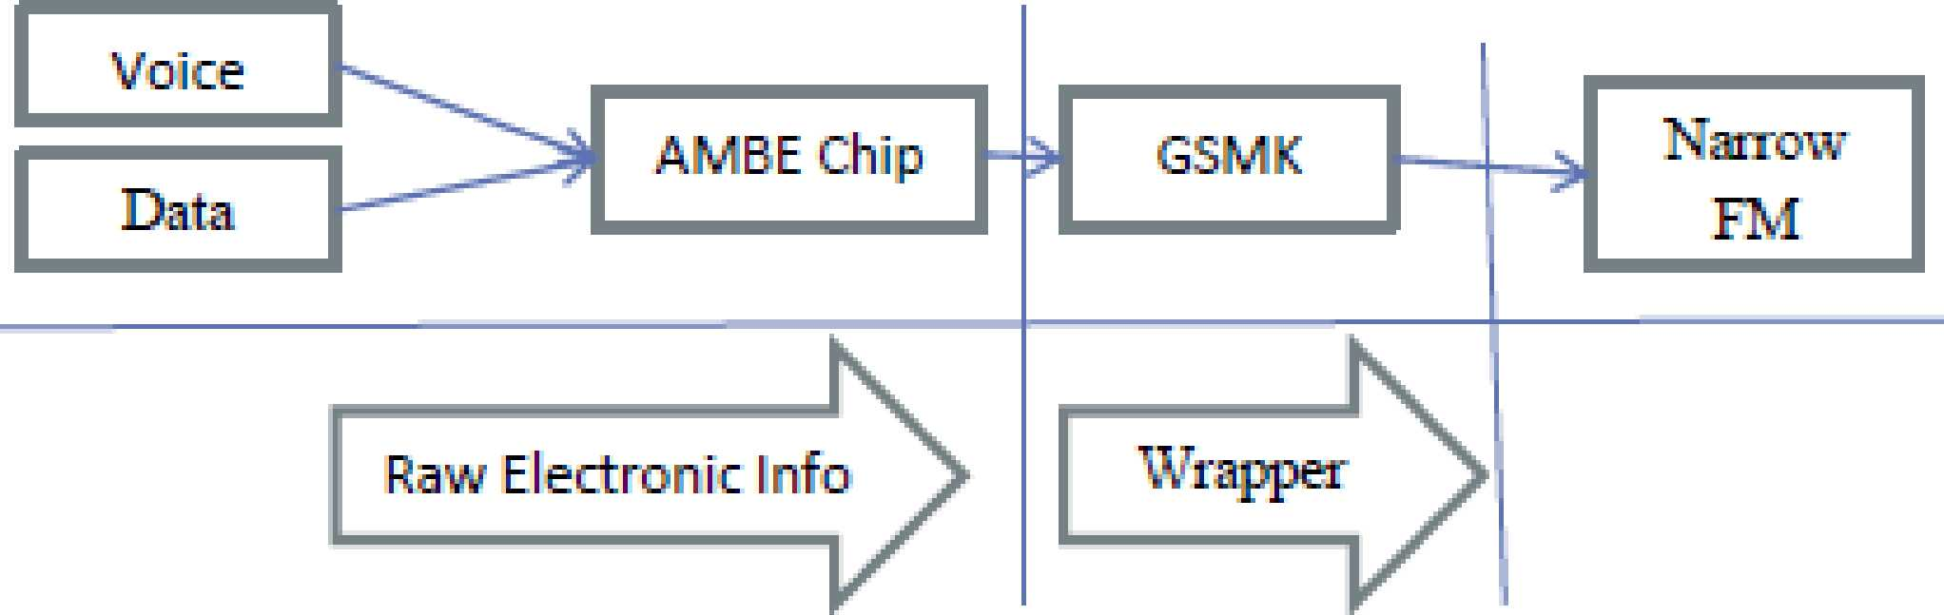
Basic Principles
• AMBE - Advanced Multi-Band Excitation (3,600 bps). A proprietary
Codec/Chip made by Digital Voice Systems Inc.
• GMSK - Gaussian (filtered) Minimum Shift Keying, the form of
modulation with no phase discontinuities used to provide data
transmission with efficient spectrum usage. [ http://www.radio-
electronics.com/info/rf-technology-design/pm-phase-modulation/what-
is-gmsk-gaussian-minimum-shift-keying-tutorial.php ]
D-Star Basics
3

Slide 4

It's Packet Radio, but not as we know it
• 4.8K b/s mixed voice/data stream (2m/70cm)
• 1200 b/s reserved for data
• 2400 b/s digitized audio
• 1200 b/s error correction
• 128 Kb/s data only stream (23cm)
• Occupies 6.25 KHz bandwidth
D-Star Basics
5

Slide 5
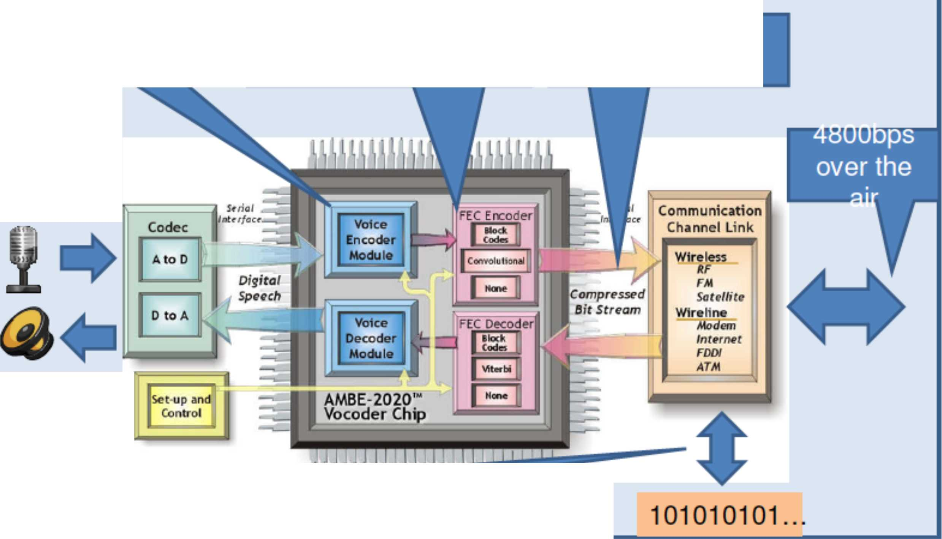
How it all adds up
2400bps audio
1200bps error
correction overhead
3600bps digital
audio channel
Microphone
Speaker
1200bps data or GPS
message
D-Star Basics
6

Slide 6
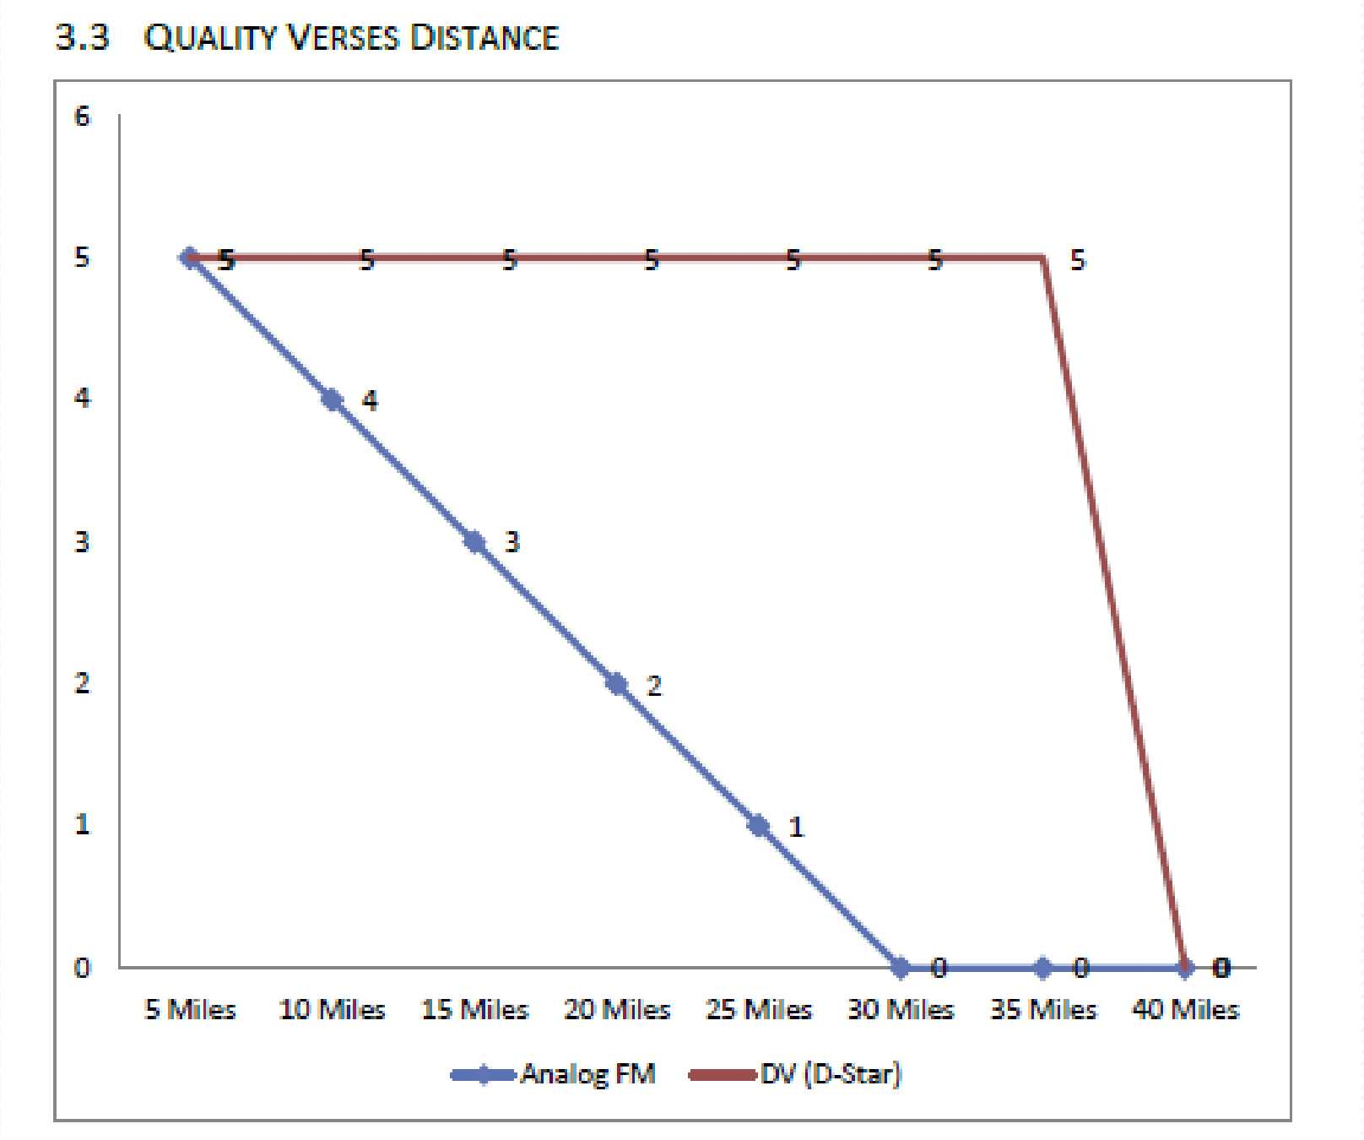
The digital difference
D-Star Basics
7

Slide 7
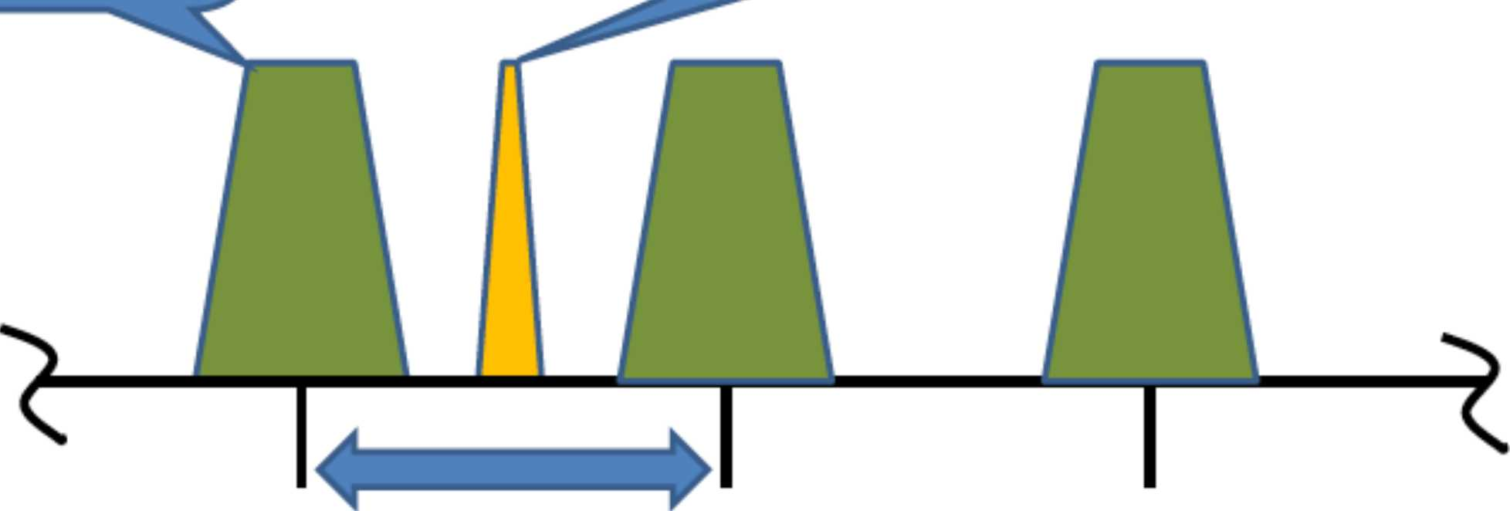
Bandwidth
Analog FM
(15kHz)
D-STAR
(6.25kHz)
D-STAR relieves
spectrum crowding!
25kHz Spacing
D-STAR
>6.25kHz occupied bandwidth
^ 12.5kHz channel spacing
Analog FM
> 15kHz occupied bandwidth
- 25kHz spacing
D-Star Basics
8

Slide 8
D-Star Repeater Structure
A D-Star repeater comprise (up to) 5 connections, grouped
as follows:
• RF voice ports used to receive and transmit voice
communications with transceivers
• RF data ports used to receive and transmit data with
transceivers
• network gateways that connect a repeater to the rest of
the D-Star network
Not all repeaters have all ports but most repeaters have at
least one RF port and a network gateway.
D-Star Basics 29

Slide 9
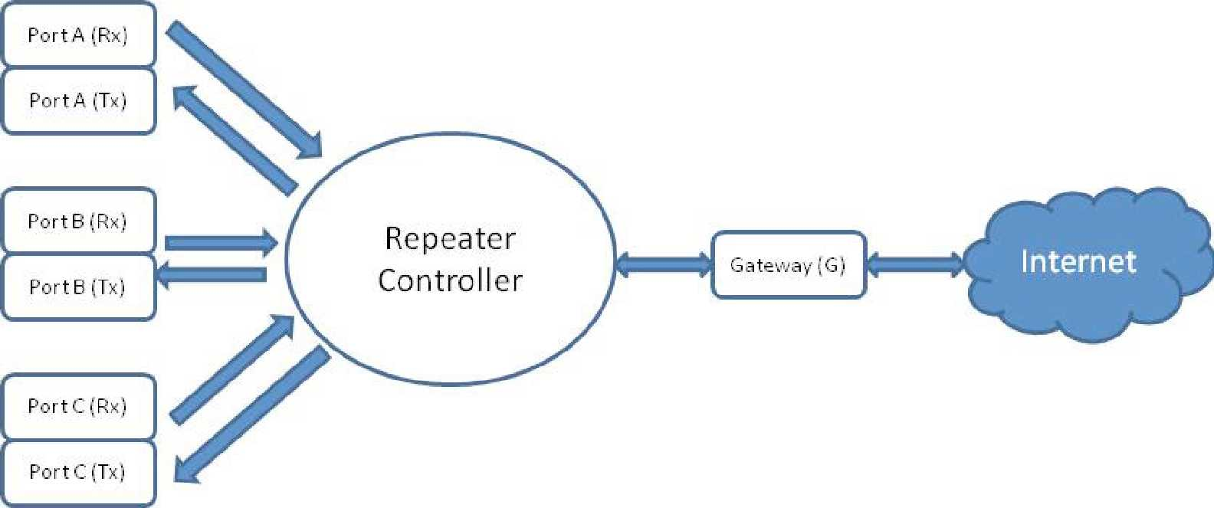
This figure shows 3 RF voice ports (labeled A, B and C) and the gateway connecting the repeater controller (which connects all of the repeater ports together) to the Internet which is used to carry the D-Star network.
The figure does not show a data port

Slide 10
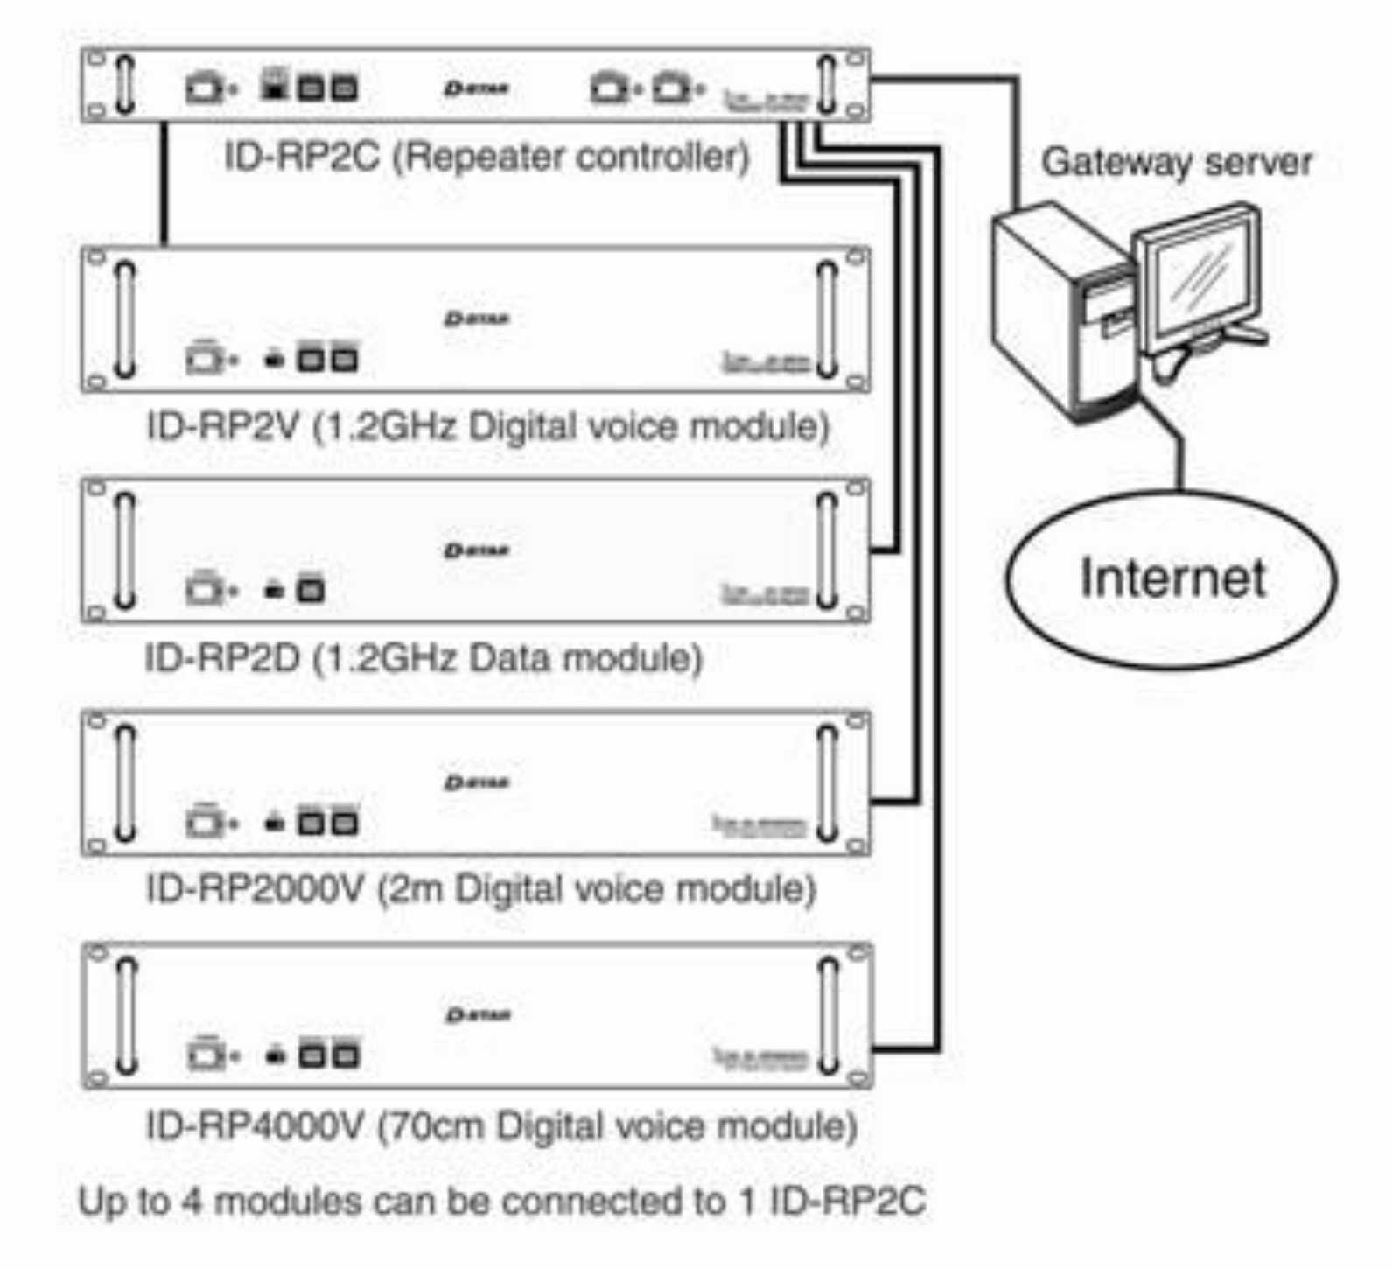
A D-Star Repeater Stack
D-Star Basics
31

Slide 11
Hardware - ICOM
• Handhelds:
• ID-51A and ID-51A Plus
• ID-31A
• IC-80AD
• IC-92AD
• Mobiles
• ID-880H
• ID-5100A
• ID-1
• Desk
• IC-7100
• IC-9100
D-Star Basics 30

Slide 12
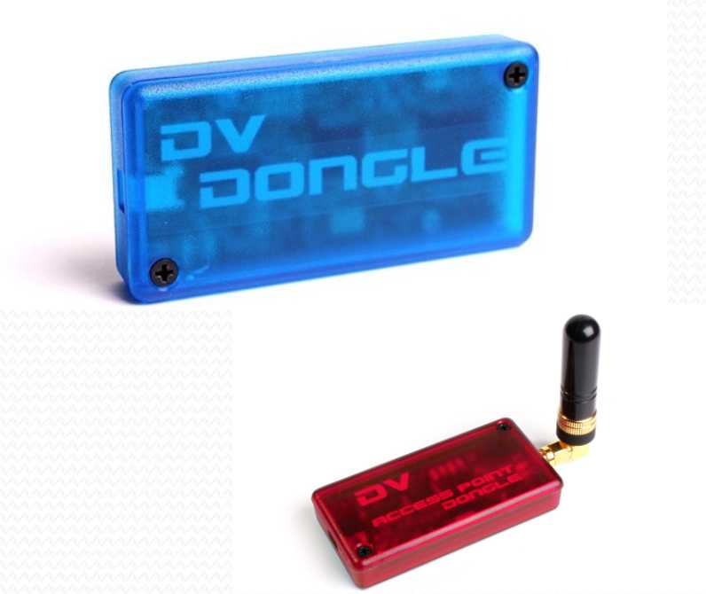
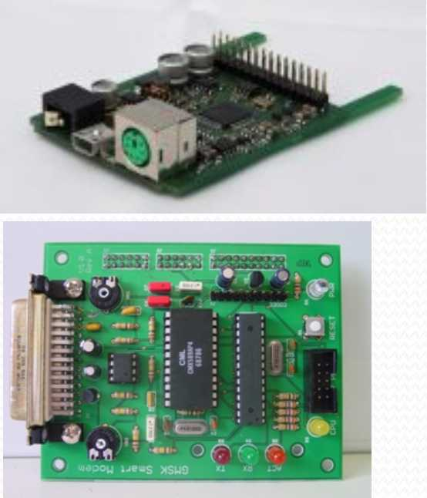
Hardware - Non-ICOM
Hot Spots, Dongles and D-I-Y Radios
• DV Dongle http://www.dvdongle.com
• DVAP http://www.dvapdongle.com
• DVRPTR http://shop.dvrptr.de/ and
http://www.dvrptr.net/
• HOTSPOTS http://www.dutch-star.eu/ and
http://www.portableuniversalpower.com/DHAP.htm
D-Star Basics
32

Slide 13
D-Star call sign terminology
• The terminology is from the viewpoint of the
communication link!
• "MyCall" is really YOUR call sign; that is, you, the person
holding the radio or microphone.
• "YourCall" (also called "UrCall") is really the call sign of the
OTHER person, that is, the person you want to talk to (you
only set this when you use the D-Star gateway system).
• "RptlCall" and "Rpt2Call" (also called "R1" & "R2") are
also used, and will be discussed shortly.
D-Star Basics
9

Slide 14
D-Star radio setup
• D-Star radios have two operating modes:
• Analog (FM -Frequency Modulation)
• You just set the frequency and talk.
• Digital (DV - Digital Voice)
• You also set the frequency.
• You must also (one time) enter your call sign.
• Your call sign goes into the "MyCall" field.
D-Star Basics 10

Slide 15
Using the local analog repeater
Some analog repeaters look for a special tone or code, in order to know that you want to use that repeater, rather than another on the same frequency.
  This tone is sometimes called “PL” or “CTCSS”.
  You must find out what the tone or code is, to use that repeater.
D-Star Basics

Slide 16
Talking around the world (FM)
With some analog repeaters, there are systems (eg, “EchoLink” & “IRLP” that allow you to use the Internet to connect two or more repeaters together:
  A local computer connected to the repeater digitizes the voice and sends it to a remote computer, which converts the audio back to analog and sends it to the remote repeater for transmission over the air.
D-Star Basics

Slide 17
Getting Started
• Gateway Registration
• Enables users to connect from a local D-Star repeater,
equipped with a D-Star Gateway, to any other Gateway
equipped D-Star repeater. Where?
• https://w4hpt.dstargateway.org/Dstar;do
• What? Your call sign (e.g. KK4ABC) (Use all CAPS)
• Program your radio
• Make a call
D-Star Basics
22

Slide 18
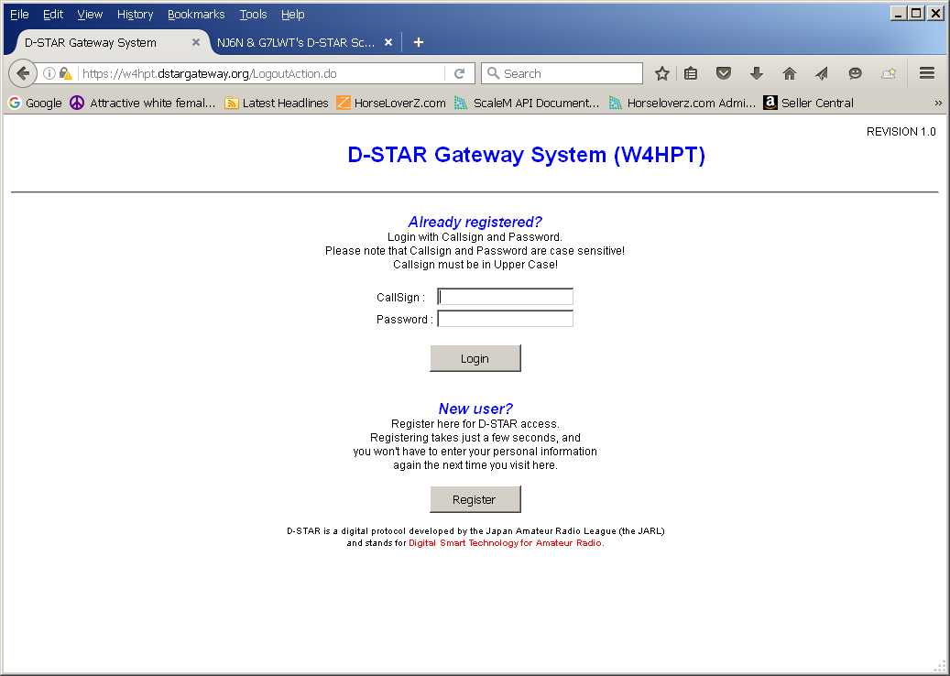
Registration Page

Slide 19
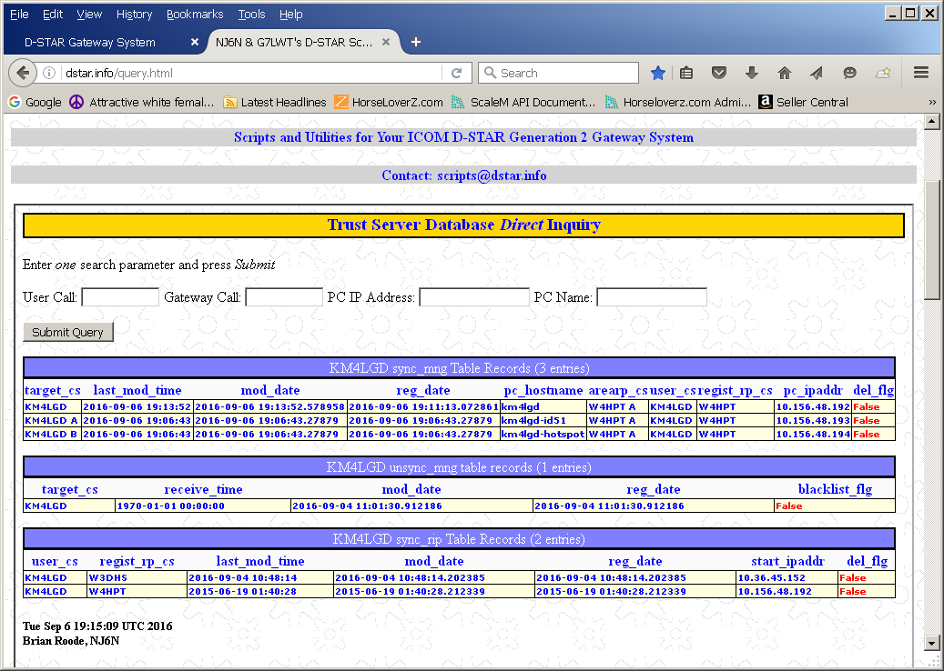
Do not register twice!!!

Slide 20
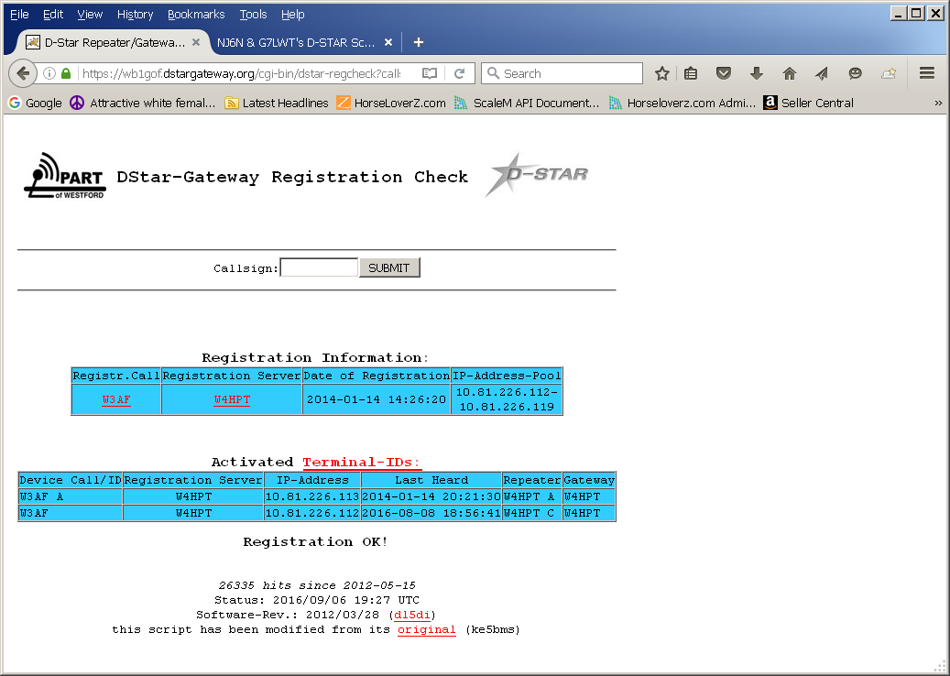
https://wb1gof.dstargateway.org/cgi-bin/dstar-regcheck

Slide 21
Local Frequencies
Simplex:
Also used for HotSpot and Dongle use
• 70 cm 438.9000, 438.9125, 438.9250, 438.9500
• 2m 145.1250, 145.1125, 145.1375
Repeaters:
http://www.dstarusers.org/repeaters.php
• KG4EOC B 444.100 (+5.0MHz)
• KN4DCI B 443.325 (+5.0MHz)
• W4AES B 443.325 (+5.0MHz)
• K1XC C 146.820 (-600KHZ)
• WD4WDW B 442.000 (+5.0MHZ)
• N4ARJ C 147.210 (+600KHz)
D-Star Basics
23

Slide 22
Using the local D-Star repeater
On D-Star repeaters, it’s a bit easier; the “code” is just the repeater’s callsign, and …
The repeater module (“A”, “B”, or “C”).
Most D-Star repeater installations have more than one repeater. Each repeater is on a different amateur radio band. By convention:
  The “C” module is on the “2m” band (144-148 MHz).
  The “B” module is on the “70cm” band (440-450 MHz).
  The “A” module is on the “23cm” band (1.2 GHz).
D-Star Basics

Slide 23
Local D-Star repeater setup
To set up your radio:
  You must set (one time) your call sign into the “MyCall” field.
  You should set the “URCall” field to “CQCQCQ” or “/” (these are specially recognized values).
  You must set the repeater call sign & module into the “Rpt1” field. The module (“A”, “B”, or “C”) must be set in the 8th character position of the “Rpt1Call” field.
  (KG4EOC B or KN4DCI B)
  You can leave the “Rpt2Call” field blank for local usage.
  BUT… usually better to set to gateway (KN4DCI G)
D-Star Basics

Slide 24
Other D-Star settings
Do NOT set any of the “Auto RX” settings in the radio to “ON”, until you have become more familiar with D-Star operation.
These “Auto RX=ON” settings will get in your way, without any warning.
You have been warned!
D-Star Basics

Slide 25
Talking around the world (D-Star)
With most D-Star repeater installations, there is a local computer that also connects the repeater to the Internet.
  This repeater is called the “gateway”.
  However, it is the user’s radio, not the gateway, that converts the audio to a digital signal before transmission, and decodes it upon reception.
  The gateway does a lot more than just connect two remote repeater systems.
D-Star Basics

Slide 26
The D-Star network
There are four ways to communicate with other users on other D-Star repeaters, using the D-Star network:
  “Repeater routing” – this is part of the original D-Star design.
  “Call sign routing” – this is part of the original D-Star design.
  Using “repeater linking” – this capability was added by “D-Plus”, a gateway software add-on.
  Using “reflector linking” – this capability was added by “D-Plus”, a gateway software add-on.
# 1 & 2 are slightly complex, and if both you & the other user don’t “get it right”, you will not be able to talk.
# 3 & 4 are much simpler to setup & use, and often the repeater is already set in that mode.
D-Star Basics

Slide 27
D-Star “network routing” overview
Advantages of call sign routing:
  You can call another user without knowing which repeater that user is currently on.
Limitations of repeater or call sign routing :
  You can’t hear what is happening on the remote repeater.
  You usually need to initially announce that you are remote, so that the remote user(s) know to set up their radios for repeater or call sign routing.
  If the remote user doesn’t setup his/her radio correctly, you will be unable to have a successful two-way conversation.
D-Star Basics

Slide 28
D-Star “network linking” overview
Advantages of repeater or reflector linking:
  You can hear what is happening on the remote repeater(s).
  The remote user does not need to configure his/her radio in order to respond.
  A repeater can be left in this configuration for new users.
Limitations of repeater or reflector linking :
  You can’t call another user without knowing which repeater that user is currently on.
D-Star Basics

Slide 29
What's a Reflector?
• Reflectors are basically a conference bridge for D-Star.
• A reflector is similar to a repeater, but with no RF
capabilities.
• Reflectors receive transmissions from connected
gateways (via the Internet) and send it out to all other
connected gateways for retransmission.
• They allow multiple D-Star repeaters and Dongle users,
from around the world, to be joined together and
whatever information is transmitted across one of the
repeaters is repeated across all of the connected
repeaters.
D-Star Basics
25

Slide 30
D-Star network basic setup (1)
To use any of these D-Star network modes, you must specify the “Rpt2” field:
  The “Rpt2” field designates the gateway computer, which is considered the “G” D-Star module.
  In the USA, the “Rpt2” field also contains the local repeater call sign (never the remote repeater or gateway).
  You must set the gateway call sign & module into the “Rpt2l” field. The module (“G”) must be set in the 8th character position of the “Rpt2” field. (W4HPT G)
D-Star Basics

Slide 31
D-Star network basic setup (2)
“MyCall” is set to your call sign.
“YourCall” is initially set to “CQCQCQ” or “/” (the latter is recommended on newer Icom D-Star radios).
Example: /W4NRT B (only 1 space) (WHY?)
“Rpt1” is set to the local repeater call sign, with the module (“A”, “B”, or “C”) in the 8th character position of the “Rpt1” field.
Even for local repeater calls, it is best to always set “Rpt2” to the local gateway call sign, with the module (“G”) in the 8th character position of the “Rpt2” field.
D-Star Basics

Slide 32
D-Star network commands (1)
These commands only work if:
  You have set the “Rpt2Call” field to specify your local gateway (otherwise the gateway will never see them).
  Your local gateway must be running:
    “D-Plus”, the gateway software add-on (written by Robin Cutshaw / AA4RC) to Icom’s gateway software; or
    “D-Extra” software on systems running non-Icom gateway software. (W4AES runs DPLUS)
These commands are set into the “YourCall” field of the radio. You key your radio to send the command to the gateway.
D-Star Basics

Slide 33
“Can you hear me now?”
D-Star network commands (2)
(with apologies to Verizon’s advertising slogan).
Ever want a truly objective signal report? Use the “echo” command:
  Program a “URCall” value of seven (7) spaces, followed by an “E” in the 8th (module) position.(N4ZIQ E) (2 spaces)
  Key your radio & speak a short test message of your choice (I recommend using the words “echo test” in it).
  When you unkey your radio, the gateway will play back (“echo”) your transmission.
  Remember to change your “URCall” value back!
D-Star Basics

Slide 34
D-Star radio tips & tricks
Get computer software to program your radio’s memories & save your radio’s settings.
Learn how to at least save a new repeater or user call sign manually into the radio until you get home …
Use the “Func-F1” & “Func-F2” microphone button combinations to save two alternate radio configurations.
Become familiar with the “DR” mode on D-Star radios that have it (currently the Icom IC-80AD, ID-880H, ID-31A, ID-51A.IC-7100 & ID-5100A).
D-Star Basics

Slide 35
D-Star tip: The “DR” mode
Icom’s new “D-Star Repeater” mode (in the IC-80AD, ID-880H, ID-31A, ID-51A,IC-7100 & ID-5100) separates the “URCall” memories from the “Rpt1”/Rpt2” memories.
In “DR” mode, you can select the “URCall” value, and then scroll through the “Rpt1”/Rpt2” memories without changing the “URCall” value.
Tip: Enter the “DR” mode first, before selecting a “URCall” value.
Tip: Save & use “/” as a “URCall” value in place of “CQCQCQ”. When “YourCall” contains “CQCQCQ”, the “DR” mode will blank out the “Rpt2” field, and your transmissions will not be routed to the gateway (or a linked repeater or reflector).
Or better, enter a “use Repeater” or “DR_CQ” entry in “Your call list) which is actually a CQCQCQ that preserves Rpt2.

Slide 36
D-Star tip: The “DR” mode
When setting up the FROM: Field (Which is really which repeater you are going to use) you have 3 options:
  Repeater List (By area, Florida is in SE)
  Nearby Repeater (If you have GPS)
  TX History (Repeaters previously used)

Slide 37
D-Star network information
www.DstarDB.com (tracks D-Star usage)
www.dstarinfo.com (DSTAR Repeater downloads, etc)
www.dstarusers.org (D-Star repeater list)
wb1gof.dstargateway.org/cgi-bin/dstar-regcheck (Check your registration)
http://dstar.info/query.html (Database query)
www.jfindu.net (and other APRS stuff)
www.aprs-is.net/DPRSCalc.aspx (D-PRS calculator)
D-Star Basics
28

Slide 38
References
D-STAR for Beginners (M0ZZM)
http://m0zzm.wordpress.com/2013/08/21/d-star-user-guide-for-beginners/
Newbies Guide to D-Star (VK3ANZ)
http://www.emdrc.com.au/pics/DStar/Newbies%20Guide%20to%20D-Star.pdf
DSTAR for the non-DSTAR Ham (N4FWD)
http://wgars.com/files/DSTAR-For Non-DSTAR.pdf
D-STAR for Dummies V 4.0 (W8KWA)
http://www.w4hso-starc.org/pdf/D-StarforDummiesReferenceEdition4.0.pdf
D-Star Basics http://www.dstardb.net/Fmedia/D-Star_Basics.ppt
What is D-Star? http://www.dstar.org.au/what_is_dstar.htm
Into to D-Star http://www.tapr.org/pdf/DCC2011-Intro_to_D-Star-Mark_Braunstein_WA4KFZ.pdf
D-Star Basics
33

Slide 39
Add-ons
• DPRS D-Star position reporting System APRS: See
http://www .aprs-is. net/dprs.aspx
• D-RATS http://d-rats.com - Text communications tool -
Useful for EMCOMMS with structured forms
• D*Chat
• D-StarLet - web-based text messaging
• D-Star TV - using SSTV techniques
• D-Star in space!
D-Star Basics
34

Slide 40
D-Star and P25
D-STAR
> Uses AMBE vocoder
> Packet-based voice &
data
> "flat" architecture
>Any station can connect
to any station
> The way hams operate!
APCO-25 (P25)
> IMBE vocoder (similar to
AMBE vocoder)
> Packet-based voice &
data
> "tree" architecture
> Tightly structured
communications
hierarchy
> Developed specifically for
local, state and federal
public safety
communications
D-Star Basics
35

Slide 41
Programming Demonstration
Icom Software download page
http://www.icom.co.ip/world/support/download/firm/
D-Star Basics
36

