Slide 1
ANTENNAS

Slide 2
Safety First!
Don’t put antennas. where they could fall across power lines
Don’t climb towers without a safety belt.
Don’t do tower work without a ground crew.
If you’re working under the tower, wear a hard hat.

Slide 3
Radio Frequency Safety
Awareness of RF Exposure
Hazard Recognition
Non Ionizing Radiation
  Below X-Ray and Gamma Ray Frequencies
  Ionizing Radiation can damage DNA

Slide 4
Terminology
ANTENNA - conductive object that radiates RF energy at
certain frequencies
• DUTY FACTOR - Ratio of average on time to total period of
transmissions. i.e., continuous=1.0, 40% on 60% off during a
specified period=0.4
• EFFECTIVE RADIATED POWER - ERP, Power supplied
to the antenna and the effects of gain
• GAIN - Characteristic of an antenna, expressed in dB, that
results in an increase of field strength at a given distance
when compared to a reference antenna.
• HERTZ - Hz, Unit of frequency, 1 Hz = One cycle per
second

Slide 5
RF Safety
FIELD STRENGTH - The strength of the magnetic and electric
fields at a given distance from source. The near field is 1/2
wavelength or less from the antenna. The far field is greater than ½ wavelength.
• SPECIFIC ABSORPTION RATE - SAR, The rate at which
energy is absorbed in biological tissues. Safety guidelines are based on SAR threshold where tissue heating occurs.
• MAXIMUM PERMISSIBLE EXPOSURE LIMITS (MPE) -
Established by the FCC based on ANSI/IEEE C95.1-1999, “Safety Levels with Respect to Human Exposure to Radio Frequency Electromagnetic Fields 3 kHz to 300 GHz. Two categories of limits are established. Controlled exposure limits apply to an employee who is fully aware of the potential for RF exposure and can exercise control over their exposure. Uncontrolled exposure limits apply for the general public or when there is no awareness for the potential for
exposure. (see next slide)

Slide 6
RF Safety Effect of Exposure
Tissue Heating (effects vary with exposed body area)
• Skin Sensation - Extremely High Exposure
• RF Burns From Touching an Energized Source
• Electric Shock From Induced Currents
• Cataracts - UHF and Microwave Frequencies
• Some Anecdotal Reports of Physiological Effects
• No Confirmed Studies as a Carcinogen or Cancer
Promoter (Energy levels are too low to cause ionization)

Slide 7
Symptoms of Exposure
Commonly reported effects of extended exposure to high levels of RF radiation
Include: headaches, dizziness, fatigue, and buzzing in the ears.
At UHF and microwave frequencies heating of the lens of the eye from high intensity fields can result in the formation of cataracts.

Slide 8
RF Regulations
OSHA 29 CFR 1910.97 Nonionizing Radiation
• ANSI/IEEE C95.1-1999, “Safety Levels with Respect to
Human Exposure to Radio Frequency Electromagnetic
Fields 3 kHz to 300 GHz”
• FCC Office of Engineering and Technology Bulletin 65,
97-01 (see ANSI/IEEE)

Slide 9
Exposure Considerations
Transmitter Power
• Frequency
• Duty Cycle
• Exposure Duration (Controlled MPE based on 6 minutes)
• Antenna Gain and Directionality
• Distance of Individual from the Antenna
• Other Transmitting Antennas at the Site

Slide 10
Basic Guidelins
Whenever possible, a distance of 6 feet or more should be maintained from all energized antennas. Avoid standing in one spot if near antennas or working in front of directional or dish antennas.
Two most sensitive areas to RF Exposure:
  Eyes
  Genitals

Slide 11
Physics and Newton
Sir Isaac Newton created the law of conservation of energy.
Energy can neither be created or destroyed
Energy can change form
  Wood burns to create heat
  Your RF Amplifier takes 120V AC from your wall outlet and converts it to RF energy at a specific frequency.

Slide 12
Definitions
dBd – Gain measured in relation to a dipole,
dBd = dBi + 2.15.
■ Azimuth Pattern – Radiation pattern of the
antenna when viewed from above. Directional
or omni directional.
■ Elevation Pattern – Angle of maximum
radiation in relation to the ground. Lower is
better for DX.
■ Balun – Short for BALanced/UNbalanced. A
device to force equal currents in coax.

Slide 13
Wavelength
Wavelength in m = c / f where c = speed of light = 3x10^8 m/s
Or 468/f in Mhz = Length in feet
Or 234/f in Mhz = Half wavelength in feet
Lower Frequency = Longer Antenna
Higher Frequency = Shorter Antenna

Slide 14
Free Space Loss
You lose half of your power every wavelength from the antenna.
  This is why shortwave travels so far compared to VHF/UHF.
    Not including propagation via the ionosphere
Signal never disappears it gets too low to measure.
A good antenna is better than an amplifier!
  Amplifier only works on transmit
  An antenna works on both TX and RX!
  Antenna gain does more for your signal than any active devices.

Slide 15
Feed lines
Feed line connects your radio to the antenna.
Feed lines are either balanced (neither side grounded) like ladder-line or unbalanced (one side grounded) like coaxial cable.
Either type can be used in your station.
Coax is more popular and easier to work with.
Coax has loss! Longer coax = more signal loss!
  Different coax type have different loss characteristics.
  Bigger diameter usually mean less loss and higher power capacity

Slide 16
Antenna Types
Isotropic Radiator – A theoretical antenna in
free space that radiates equally well in all
directions.
■ Gain – Increase in amplitude of a signal,
measured in dB
■ Decibel (dB) – Logarithmic measurement of
gain.
■ dBi – Gain measured in relation to an isotropic
radiator

Slide 17
Common Coax Types
RG-58
■ RG-8/U
■ RG-8/x (Mini 8)
■ RG-213
■ LMR400
■ RG-59
■ RG-6
■ Ladder Line

Slide 18
How much gain is a dB
0 dB = 1
■ 1 dB = 1.26
■ 2 dB = 1.58
■ 3 dB = 1.99
■ 4 dB = 2.51
■ 5 dB = 3.16
■ 6 dB = 3.98 = 1 S unit
■ 7 dB = 5.01
■ 8 dB = 6.31
■ 9 dB = 7.94
■ 10 dB = 10

Slide 19
Amp vs Antenna
To increase your TX signal from 100W to 1000W = 10dB of gain.
Or you can use an antenna like a TH-11 and get 9.2dB of gain on BOTH TX and RX!
Example:
  100 feet of RG-213 @ 400Mhz = 5dB
    More than half your power on TX/RX is lost through this coax.
  You have a 10dB gain beam.
  You have a 100W transmitter
  Let’s calculate ERP (Estimated Radiated Power)
  100W = 50dBm (Putting everything in the same units)
  ERP = +50dBm – 5dB (Coax loss) + 10dB (antenna gain) = 55dBm
  55dBm = 316 Watts ERP for TX

Slide 20
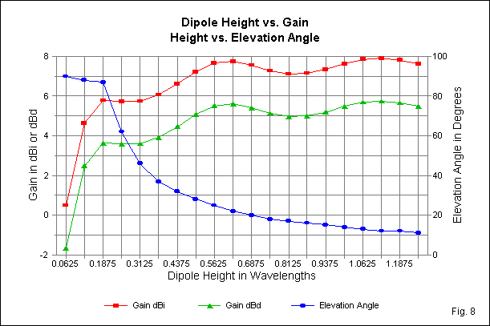
Dipole Height vs Gain and Elevation Angle

Slide 21
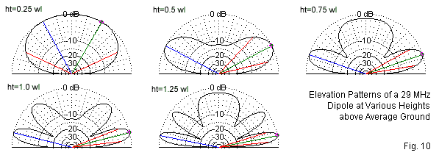

Slide 22
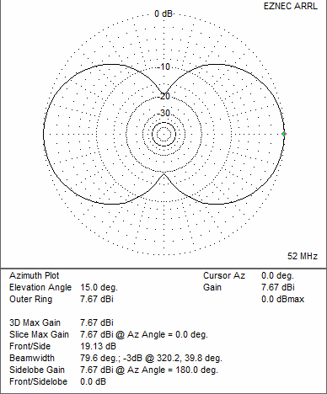

Slide 23
Inverted V – Only needs one support. 5%
shorter than a dipole. Takes up less space.
■ Off Center Fed Dipole – Feed point is 20-33%
from one end. Feed point impedance is high
and requires a 4-1 balun.
■ Windom – Similar to the OCFD. Fed at 34%
from the end, it uses a single feed wire and can
be resonant on more than one band.
■ Double Bazooka – Broad banded dipole made
out of coax.

Slide 24
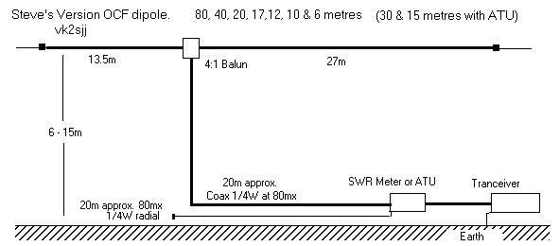
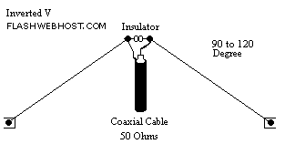
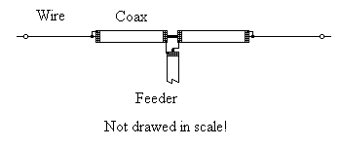

Slide 25
Doublets
Doublet – Multi-band antenna that is not
resonant on a particular band. 88 ft and 44 ft
are popular lengths. Requires antenna tuner.
■ G5RV – 102 ft. (3/2 λ) doublet with 31 (1/4 λ)
ft of ladder line, then fed with coax. Designed
as a 20m antenna. Multi-band with antenna
tuner.
■ Extended Double Zepp – Longer than a dipole
(5/8 wave or longer). 3 dB gain over a dipole.
Fed by ¼ λ ladder line into a balanced tuner

Slide 26
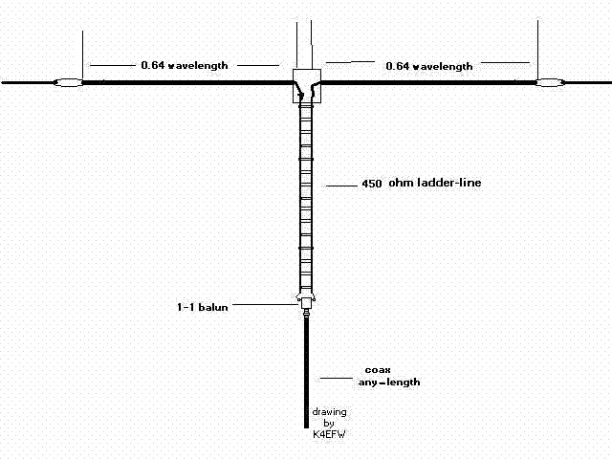

Slide 27
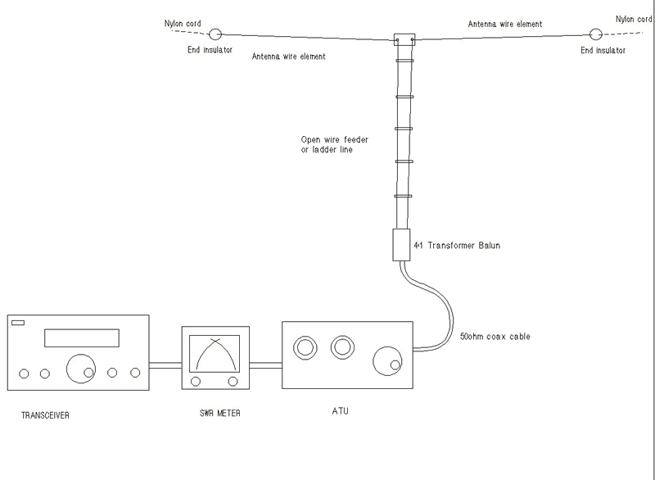

Slide 28
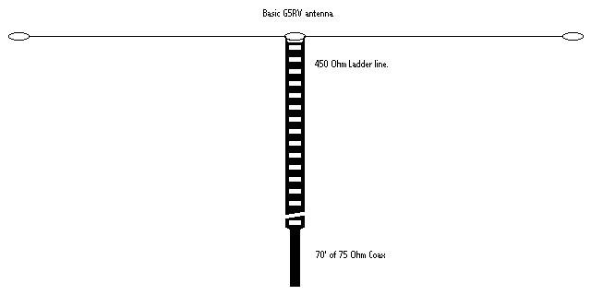

Slide 29
Rhombics
Four long wires forming two V’s connected with
a terminating resistor, making a large rhombic
shape.
■ Very large, each leg at least 1 – 2 wavelengths
long.
■ Very directional
■ High gain
■ Broad banded – consistent gain and impedance
over a 2 - 1 bandwidth.

Slide 30
Verticals
Mono band ¼ wavelength with ¼ wave counter
poise or radials or
■ Vertical Dipole that does not require radials.
■ Can be multiband with traps. Requires ¼ wave
radials for each band or many (60+) short radials.
■ Noisier than horizontal antennas
■ Easier to hide in antenna restricted areas (can be
disguised as flagpole or be a single wire in a tree)
■ Gain is less than a dipole but the low angle of
radiation is good for DX

Slide 31
End Fed Half Wave
A dipole antenna that’s fed at one end instead of
the middle
■ Very high impedance, 1800 - 5000 Ω.
■ Requires a balun
■ Single wire feed line
■ Very light, popular for QRP and backpacking

Slide 32
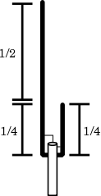
The J-Pole

Slide 33
144-148 J-Pole
Start with @54" of TV twin lead (flat, NOT foam core)
2. Strip 1/2" of insulation at bottom and solder wires together.
3. Measure 1 1/4" from soldered wires and strip insulation on both sides. This is the solder point for a coax feedline.
4. Measure 16 3/4" from coax shield solder point and cut out 1/4" notch.
5. Measure 50 1/3" from coax center conductor solder point and trim off twin lead at that point.
6. Feed with a length of RG58U coax. Tape coax at feedpoint to the twin lead for strength and seal coax for weather protection.
To get the best possible match, in step three above simply MARK the "solder points" and measure from the mark for step 4 and 5. Now solder straight pins to your conductor and your shield. Insert the pins at the marked point and test for VSWR at the design frequency (146MHz).
If necessary, probe up or down till you reach 1:1 (close as possible).
Solder at the best points. To try this, you may want to start with the twin lead a little long and trim down to resonant length - note: you'll need to trim in a 3:1 ratio to maintain the 3/4 to 1/4 wave.
It has been noted that this design can lead to rf coupling onto the feedline. To avoid, put ferrite beads on the coax at the feedpoint, or use 3-5 turns of coax (1"-2") taped together at the feedpoint.
You may attach an alligator clip to the plastic on the top of the antenna in order to easily hang it. Alternately, punch a hole near the top and use a length of fishing line to hang.

Slide 34
